Slide 1
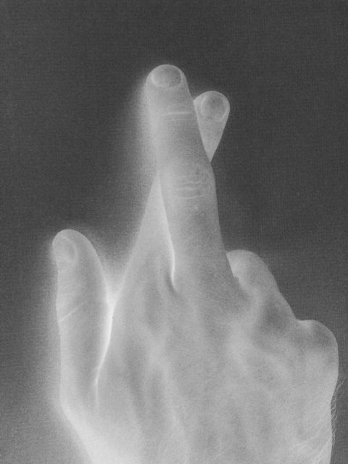
Ten Lies We Tell Ourselves
Understanding lies for what they really do to us

Slide 2
Lie #1 – “I don’t have time”
Eccl. 12:13-14
Let us hear the conclusion of the whole matter: Fear God and keep His commandments, for this is man’s all. 14 For God will bring every work into judgment, including every secret thing, whether good or evil.
Matt. 6:33
But seek first the kingdom of God and His righteousness, and all these things shall be added to you.
Matt. 16:26
For what profit is it to a man if he gains the whole world, and loses his own soul? Or what will a man give in exchange for his soul?

Slide 3
Lie #2 – “I have Plenty of Time”
Prov. 6:6, 9
6 Go to the ant, you sluggard! Consider her ways and be wise,
9 How long will you slumber, O sluggard? When will you rise from your sleep?
Prov. 10:26
As vinegar to the teeth and smoke to the eyes, So is the lazy man to those who send him.

Slide 4
Lie #2 – “I have Plenty of Time”
1 Peter 1:24
“ All flesh is as grass, And all the glory of man as the flower of the grass. The grass withers, And its flower falls away”
James 4:14
whereas you do not know what will happen tomorrow. For what is your life? It is even a vapor that appears for a little time and then vanishes away
1 John 2:17
And the world is passing away, and the lust of it; but he who does the will of God abides forever.

Slide 5
Lie #3 – “No one will see me”
Num. 32:23
But if you do not do so, then take note, you have sinned against the LORD; and be sure your sin will find you out.
2 Sam. 12:7
Then Nathan said to David, “You are the man! Thus says the LORD God of Israel: ‘I anointed you king over Israel, and I delivered you from the hand of Saul.
Acts 5 – Ananias and Sapphira

Slide 6
Lie #4 – “God understands that’s the way I am” “He made me that way”
Ezek. 28:15
You were perfect in your ways from the day you were created, Till iniquity was found in you.
James 1:17
Every good gift and every perfect gift is from above, and comes down from the Father of lights, with whom there is no variation or shadow of turning.

Slide 7
Lie #4 – “God understands that’s the way I am” “He made me that way”
Acts 17:30
Truly, these times of ignorance God overlooked, but now commands all men everywhere to repent,
Luke 13:3
…but unless you repent you will all likewise perish.

Slide 8
Lie #5 – “I can ask for forgiveness later”
Rom. 6:17
But God be thanked that though you were slaves of sin, yet you obeyed from the heart that form of doctrine to which you were delivered.
Matt. 24:36
“But of that day and hour no one knows, not even the angels of heaven, but My Father only.”

Slide 9
Lie #6 - “It’s ok if my intentions are good”
Uzzah – 2 Samuel 6:6-7
Uzzah put out his hand to the ark of God and took hold of it, for the oxen stumbled. 7 Then the anger of the LORD was aroused against Uzzah, and God struck him there for his error; and he died there by the ark of God.

Slide 10
Lie #7 – “I’m sure God is pleased with it”
1 Samuel 15:10-23 (read)
Col. 3:17
And whatever you do in word or deed, do all in the name of the Lord Jesus, giving thanks to God the Father through Him.

Slide 11
Lie #7 – “I’m sure God is pleased with it”
1 Cor. 4:6
Now these things, brethren, I have figuratively transferred to myself and Apollos for your sakes, that you may learn in us not to think beyond what is written, that none of you may be puffed up on behalf of one against the other.
2 John 9-11
Whoever transgresses and does not abide in the doctrine of Christ does not have God. He who abides in the doctrine of Christ has both the Father and the Son. 10 If anyone comes to you and does not bring this doctrine, do not receive him into your house nor greet him; 11 for he who greets him shares in his evil deeds.

Slide 12
Lie #8 – “I’m too young”
1 Tim. 4:12
Let no one despise your youth, but be an example to the believers in word, in conduct, in love, in spirit, in faith, in purity.
Titus 2:6-8
Likewise, exhort the young men to be sober-minded, 7 in all things showing yourself to be a pattern of good works; in doctrine showing integrity, reverence, incorruptibility, 8 sound speech that cannot be condemned, that one who is an opponent may be ashamed, having nothing evil to say of you.

Slide 13
Lie #8 – “I’m too young”
1 John 2:13
I write to you, fathers, Because you have known Him who is from the beginning. I write to you, young men, Because you have overcome the wicked one. I write to you, little children, Because you have known the Father.

Slide 14
Lie #9 – “I’m too old” “I’ve done my part”
Titus 2:3-4
the older women likewise, that they be reverent in behavior, not slanderers, not given to much wine, teachers of good things— 4 that they admonish the young women to love their husbands, to love their children,
Acts 15:22
Then it pleased the apostles and elders, with the whole church, to send chosen men of their own company to Antioch with Paul and Barnabas, namely, Judas who was also named Barsabas, and Silas, leading men among the brethren.

Slide 15
Lie #10 – “He’ll never convert”
Romans 1:16
For I am not ashamed of the gospel of Christ, for it is the power of God to salvation for everyone who believes, for the Jew first and also for the Greek.
1 Sam. 14:6
Then Jonathan said to the young man who bore his armor, “Come, let us go over to the garrison of these uncircumcised; it may be that the LORD will work for us. For nothing restrains the LORD from saving by many or by few.”
Luke 1:37
For with God nothing will be impossible.”

Slide 16
Lie #10 – “He’ll never convert”
Acts 9:1, 20
Then Saul, still breathing threats and murder against the disciples of the Lord, went to the high priest
20 Immediately he preached the Christ in the synagogues, that He is the Son of God.
1 Cor. 6:9-11
Do you not know that the unrighteous will not inherit the kingdom of God? Do not be deceived. Neither fornicators, nor idolaters, nor adulterers, nor homosexuals, nor sodomites, ¹⁰ nor thieves, nor covetous, nor drunkards, nor revilers, nor extortioners will inherit the kingdom of God. ¹¹ And such were some of you. But you were washed, but you were sanctified, but you were justified in the name of the Lord Jesus and by the Spirit of our God.

Slide 17
What’s it to me?
If we want to be faithful children of God we MUST STOP LYING TO OURSELVES ABOUT SIN!

