Slide 1
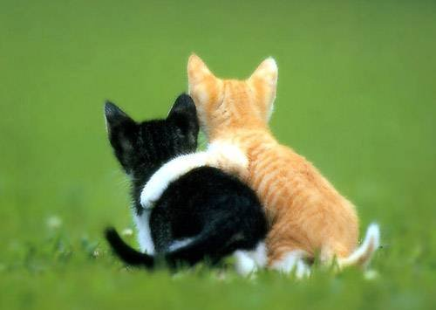
An Attractive Couple
Prayer and Praise
Notes:
1. Prayer and Praise are an important aspect of daily Christian Life.
2. And in worship to God, they make An Attractive Couple

Slide 2
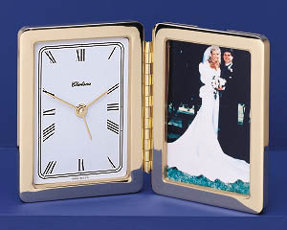
Times for Prayer and Praise (Jas. 5:13-18)
Times of Suffering (13)
Times of Cheer (13)
Times of Sickness (14-18)
A Difficult Text
Notes:
1. There are Times for Prayer and Praise (Jas. 5:13-18) all of us will be able to recognize these moments in our daily lives.
>>>>>>>>>>>>>>>>>>>>>>
2. There are Times of Suffering (13)
Is anyone among you suffering? Let him pray. Is anyone cheerful? Let him sing psalms. (James 5:13)
>>>>>>>>>>>>>>>>>>>>>>
3. This also applies to Times of Cheerfulness in which we can give praise. (13)
>>>>>>>>>>>>>>>>>>>>>>
4. Not only our Times of Sickness but also the times of sickness for others. (14-18)
5. Many people and preachers look at this as A Difficult Text from the book of James, so lets look at this book.

Slide 3
The Book of James: A Break Down
Essentials of Pure Religion (1)
Faith and love (2:1-13), Faith and works (2:14-26)
The tongue (3:1-12), Heavenly Wisdom (3:13-18)
Carnality and its cure (4:1-12), Proper view of life (4:13-17)
Perseverance (5:1-12), Praise and Prayer (5:13-18), Prodigal restoration (5:19-20)
Notes:
1. The Book of James: A Break Down
>>>>>>>>>>>>>>>>>
2. James provides us with the Essentials of Pure Religion in Chapter (1)
>>>>>>>>>>>>>>>>
3. He leads with Faith and love in (2:1-13),
a. He follows that with Faith and works (2:14-26)
>>>>>>>>>>>>>>>>
4. James then talks about the (mouth dragon), The tongue (3:1-12),
a. He uses the tongue as a Segway into a treatise on Heavenly Wisdom (3:13-18)
>>>>>>>>>>>>>>>>
5. James urges us to war against Carnality of this world and utilize its Biblical cure (4:1-12),
a. if we do these things, we will have a Proper view of life (4:13-17)
>>>>>>>>>>>>>>>>
6. James tells us to look forward with
a. Perseverance (5:1-12),
b. Praise and Prayer (5:13-18), Praise and Prayer is our topic today.
c. Prodigal restoration (5:19-20)

Slide 4
In Times of Suffering, Let Us “Pray” (13)
“Is anyone among you suffering? Let him pray” (13).
What kind of suffering? “Various Trials” (1:2)
1. Bereavement
2. Disappointment
3. Persecution
4. Financial loss
5. Sickness
Notes:
1. In Times of Suffering, Let Us “Pray” (13)
>>>>>>>>>>>>>>>>>
“Is anyone among you suffering? Let him pray” (13)
>>>>>>>>>>>>>>>>>
2. What kind of suffering?
a. James refers to them as “Various Trials” of this life. (1:2)
My brethren, count it all joy when you fall into various trials, (James 1:2)
b. What could he have been talking about?
1.) Bereavement
2.) Disappointment
3.) Persecution
4.) Financial loss
5.) Sickness

Slide 5
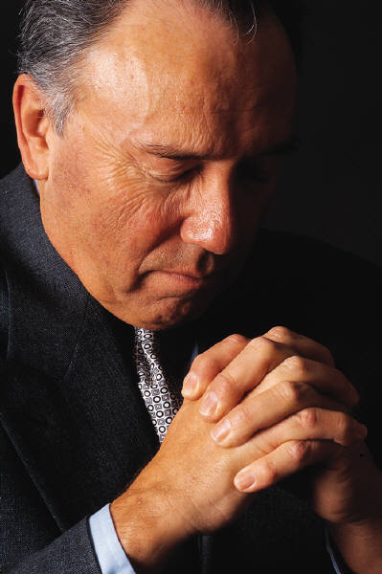
For What Should We Pray?
The Removal of Suffering (2 Cor. 12:8)
Strength to Endure Suffering (1 Cor. 10:13)
Notes:
1. For What Should We Pray?
>>>>>>>>>>>>>>>>>
2. Like the Apostle Paul, we can pray for the Removal of Suffering (2 Cor. 12:8)
Concerning this thing I pleaded with the Lord three times that it might depart from me. (2 Corinthians 12:8)
>>>>>>>>>>>>>>>>>
3. Strength to Endure Suffering (1 Cor. 10:13)
No temptation has overtaken you except such as is common to man; but God is faithful, who will not allow you to be tempted beyond what you are able, but with the temptation will also make the way of escape, that you may be able to bear it. (1 Corinthians 10:13)

Slide 6
God Answers According To His Will (1 John 5:14)
He may not remove the source of our suffering
Before I was afflicted I went astray, But now I keep Your word (Psalm 119:67)
It is good for me that I have been afflicted, That I may learn Your statutes (Psalm 119:71)
He will provide the strength necessary to endure it (Phi. 4:13)
Notes:
1. God Answers Our Prayers According To His Will and in His Own Time. (1 John 5:14)
Now this is the confidence that we have in Him, that if we ask anything according to His will, He hears us. (1 John 5:14)
>>>>>>>>>>>>>>>>
2. He may not remove the source of our suffering, as we probably asked, but as His children He will answer us!
>>>>>>>>>>>>>>>>
Before I was afflicted I went astray, But now I keep Your word (Psalm 119:67)
>>>>>>>>>>>>>>>>
It is good for me that I have been afflicted, That I may learn Your statutes (Psalm 119:71)
>>>>>>>>>>>>>>>
3. He will provide all of the strength necessary to endure our suffering. (Phi. 4:13)
I can do all things through Christ who strengthens me. (Philippians 4:13)

Slide 7
For Whom Should We Pray?
We should pray for ourselves (John 17:1-5; Mat. 26:39)
We should pray for those who may be the cause of our suffering.
"But I say to you who hear: Love your enemies, do good to those who hate you, bless those who curse you, and pray for those who spitefully use you” (Luke 6:27-28).
Notes:
1. For Whom Should We Pray?
>>>>>>>>>>>>>>>
2. We should pray for ourselves, as we see that did Jesus in (John 17:1-5; Mat. 26:39)
Jesus spoke these words, lifted up His eyes to heaven, and said: "Father, the hour has come. Glorify Your Son, that Your Son also may glorify You, (John 17)
>>>>>>>>>>>>>>>
3. We should pray for those who may be the cause of our personal suffering.
"But I say to you who hear: Love your enemies, do good to those who hate you, bless those who curse you, and pray for those who spitefully use you” (Luke 6:27-28).

Slide 8
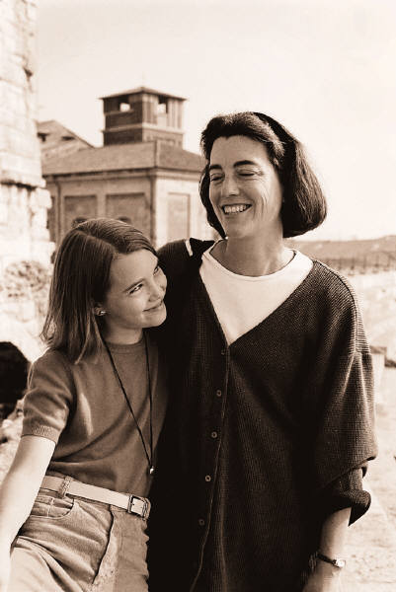
In Times of Cheer, Let us “Sing Praises” (13)
“Cheerful”- pleasantness, agreeableness
A state of mind free from trouble, the opposite of affliction, happiness
Notes:
1. In Times of Cheer, Let us “Sing Praises” (13)
>>>>>>>>>>>>>>>
2. As people of Christ, we can be “Cheerful”- we can have a state of pleasantness, and agreeableness with things that are in line with righteousness.
>>>>>>>>>>>>>>>
3. As a Christian, we can have a state of mind that is free from trouble, the opposite of worldly affliction, happiness

Slide 9
David: A Man After God’s Own Heart
“It is good to give thanks to the Lord, And to sing praises to Your name, O Most High; To declare Your lovingkindness in the morning, And Your faithfulness every night” (Psalms 92:1-2)
“I will sing of mercy and justice; To You, O Lord, I will sing praises” (Psalm 101:1)
“Praise the Lord! Praise the Lord, O my soul! While I live I will praise the Lord; I will sing praises to my God while I have my being” (Psalm 146:1-2)
Notes:
1. David: A Man After God’s Own Heart
>>>>>>>>>>>>>>>>>>>>
“It is good to give thanks to the Lord, And to sing praises to Your name, O Most High; To declare Your lovingkindness in the morning, And Your faithfulness every night” (Psalms 92:1-2)
a. At least twice a day, David gave thanks to the Lord for His listening.
>>>>>>>>>>>>>>>>>>>>>
“I will sing of mercy and justice; To You, O Lord, I will sing praises” (Psalm 101:1)
b. David was a man of prayer and praise for the Lord.
>>>>>>>>>>>>>>>>>>>>>
“Praise the Lord! Praise the Lord, O my soul! While I live I will praise the Lord; I will sing praises to my God while I have my being” (Psalm 146:1-2)

Slide 10
Why Some Don’t Sing
Some forget there are always reasons to be joyful (1 Thes. 5:16; Phi. 4:4)
Some think God is concerned with the aesthetic quality (Eph. 5:19; Col. 3:16)
Some simply haven’t begun the habit (Jas. 5:13)
Notes:
1. Why is it that Some Don’t Sing
>>>>>>>>>>>>>>>>
2. Is it possible that some forget there are always reasons to be joyful (1 Thes. 5:16; Phi. 4:4)
Rejoice always, (1 Thessalonians 5:16)
Rejoice in the Lord always. Again I will say, rejoice! (Philippians 4:4)
>>>>>>>>>>>>>>>>
3. “I just don’t sing well as all.” It could be that some think God is concerned with the aesthetic quality (Eph. 5:19; Col. 3:16)
speaking to one another in psalms and hymns and spiritual songs, singing and making melody in your heart to the Lord, (Ephesians 5:19)
---------------------------
Let the word of Christ dwell in you richly in all wisdom, teaching and admonishing one another in psalms and hymns and spiritual songs, singing with grace in your hearts to the Lord. (Colossians 3:16)
>>>>>>>>>>>>>>>>
4. Some simply haven’t begun the habit and don’t know just restful and joyful it can be. (Jas. 5:13)
Is anyone among you suffering? Let him pray. Is anyone cheerful? Let him sing psalms. (James 5:13)

Slide 11
In Times Of Sickness, Let Us “Pray” (14-18)
A Difficult Passage:
1. Is the Sickness physical or spiritual?
2. Is the anointing with oil medicinal or symbolic?
3. Is the healing through providential or miraculous means?
4. Is the healing spiritual or physical?
Notes:
A. In Times of Sickness, Let us “Pray” (14-18)
B. Some say that this is a Difficult Passage without proper guidelines.
1. Is the Sickness physical or spiritual?
2. Is the anointing with oil medicinal or is it just symbolic?
3. Is the healing through medical, providential, or miraculous means?
4. Is the healing spiritual or physical?

Slide 12
James 5:14-18
14. Is anyone among you sick? Let him call for the elders of the church, and let them pray over him, anointing him with oil in the name of the Lord.
15. And the prayer of faith will save the sick, and the Lord will raise him up. And if he has committed sins, he will be forgiven.
16. Confess your trespasses to one another, and pray for one another, that you may be healed. The effective, fervent prayer of a righteous man avails much.
17. Elijah was a man with a nature like ours, and he prayed earnestly that it would not rain; and it did not rain on the land for three years and six months.
18. And he prayed again, and the heaven gave rain, and the earth produced its fruit.
Notes:
James 5:14-18
14. Is anyone among you sick? Let him call for the elders of the church, and let them pray over him, anointing him with oil in the name of the Lord.
15. And the prayer of faith will save the sick, and the Lord will raise him up. And if he has committed sins, he will be forgiven.
16. Confess your trespasses to one another, and pray for one another, that you may be healed. The effective, fervent prayer of a righteous man avails much.
17. Elijah was a man with a nature like ours, and he prayed earnestly that it would not rain; and it did not rain on the land for three years and six months.
18. And he prayed again, and the heaven gave rain, and the earth produced its fruit.

Slide 13
Is The Sickness Physical Or Spiritual?
Physical: “And the prayer of faith will save the sick, and the Lord will raise Him up. And if he has committed sins, he will be forgiven” (15)
Notice: “…if he has committed sins…”
Implication: The sickness may or may not have a spiritual source (cf. 1 Cor. 11:30)
Notes:
1. Is the sickness physical or spiritual?
>>>>>>>>>>>>>>>
2. Physical: “And the prayer of faith will save the sick, and the Lord will raise Him up. And if he has committed sins, he will be forgiven” (James 5:15)
>>>>>>>>>>>>>>>>
3. Notice: “…if he has committed sins…”
>>>>>>>>>>>>>>>>
4. Implication: The sickness may or may not have a spiritual source (cf. 1 Cor. 11:30)
For this reason many are weak and sick among you, and many sleep. (1 Corinthians 11:30)

Slide 14
Is Anointing With Oil Medicinal Or Symbolic?
Medicinal: In Ancient times, certain oils were used for particular ailments (Isa. 1:6: Luke 10:34). However, if medicinal, why call for “the elders” and not “a physician” (cf. Mark 2:17). If medicinal, then the anointing of oil was used as a common aid in hope of providential healing.
Symbolic: In Bible times the anointing of oil was frequently representative of God’s approval (1 Sam. 10:1; Psalm 89:20). Therefore, many have concluded that this was a symbolic act to be done in conjunction with supernatural healing.
Notes:
1. Is the anointing with oil medicinal or symbolic?
>>>>>>>>>>>>>>>>>>>
2. Medicinal: In Ancient times, certain oils were used for particular ailments (Isa. 1:6: Luke 10:34).
From the sole of the foot even to the head, There is no soundness in it, But wounds and bruises and putrefying sores; They have not been closed or bound up, Or soothed with ointment. (Isaiah 1:6)
--------------------------------
So he went to him and bandaged his wounds, pouring on oil and wine; and he set him on his own animal, brought him to an inn, and took care of him. (Luke 10:34)
a. However, if medicinal, why call for “the elders” and not “a physician” (cf. Mark 2:17).
When Jesus heard it, He said to them, "Those who are well have no need of a physician, but those who are sick. I did not come to call the righteous, but sinners, to repentance." (Mark 2:17)
b. If medicinal, then the anointing of oil was used as a common aid in hope of providential healing.
>>>>>>>>>>>>>>>>>>>
3. Symbolic: In Bible times the anointing of oil was frequently representative of God’s approval (1 Sam. 10:1; Psalm 89:20).
Then Samuel took a flask of oil and poured it on his head, and kissed him and said: "Is it not because the LORD has anointed you commander over His inheritance? (1 Samuel 10:1)
----------------------
I have found My servant David; With My holy oil I have anointed him, (Psalms 89:20)
a. Therefore, many have concluded that this was a symbolic act to be done in conjunction with supernatural healing.

Slide 15
Evidence For The Miraculous
Miraculous healing was at times associated with the anointing of oil
“And they cast out many demons, and anointed with oil many who were sick, and healed them” (Mark 6:13)
Some did possess the gift of miraculous healing (1 Cor. 12:28-30).
Elders would be natural candidates (Eph. 4:8-11).
Notes:
1. Evidence for the Miraculous
2. Miraculous healing was at times associated with the anointing of oil.
>>>>>>>>>>>>>>>>>
“And they cast out many demons, and anointed with oil many who were sick, and healed them” (Mark 6:13)
>>>>>>>>>>>>>>>>>
3. Some did possess the gift of miraculous healing (1 Cor. 12:28-30).
And God has appointed these in the church: first apostles, second prophets, third teachers, after that miracles, then gifts of healings, helps, administrations, varieties of tongues. (1 Corinthians 12:28)
>>>>>>>>>>>>>>>>>
4. Elders would be natural candidates (Eph. 4:8-11).
Therefore He says: "WHEN HE ASCENDED ON HIGH, HE LED CAPTIVITY CAPTIVE, AND GAVE GIFTS TO MEN." (Ephesians 4:8)

Slide 16
Wayne Jackson
“Not all Christians in the 1st Century possessed the gift of healing…
It would be most natural… that the elders of local churches would be those who were granted the gift in their respected congregations…
If this view is correct… then the act of anointing with oil would not be appropriate for today for the simple reason that miraculous gifts are not available to the church in this age (1 Cor. 13:8).”
Notes:
1. Commentator Wayne Jackson says:
>>>>>>>>>>>>>>>>
2. “Not all Christians in the 1st Century possessed the gift of healing…
>>>>>>>>>>>>>>>>
3. It would be most natural… that the elders of local churches would be those who were granted the gift in their respected congregations…
>>>>>>>>>>>>>>>>
4. If this view is correct… then the act of anointing with oil would not be appropriate for today for the simple reason that miraculous gifts are not available to the church in this age (1 Cor. 13:8).”

Slide 17
What If Providential Healing Is In Mind?
Elijah’s prayer was answered providentially (17-18; 1 Kings 17:1; 18:1, 44).
Therefore, when medical treatment is taken, and righteous people pray, much good can be accomplished ( 5:16).
We would also conclude that the practice of anointing with oil has become unnecessary with the advancement of medical science.
Notes:
1. What if Providential Healing is in Mind?
>>>>>>>>>>>>>
2. Elijah’s prayer was answered providentially (17-18; 1 Kings 17:1; 18:1,42).
Elijah was a man with a nature like ours, and he prayed earnestly that it would not rain; and it did not rain on the land for three years and six months. And he prayed again, and the heaven gave rain, and the earth produced its fruit. (James 5:17-18)
------------------------
And Elijah the Tishbite, of the inhabitants of Gilead, said to Ahab, "As the LORD God of Israel lives, before whom I stand, there shall not be dew nor rain these years, except at my word." (1 Kings 17:1)
-------------------------
And it came to pass after many days that the word of the LORD came to Elijah, in the third year, saying, "Go, present yourself to Ahab, and I will send rain on the earth." (1 Kings 18:1)
-------------------------
Then it came to pass the seventh time, that he said, "There is a cloud, as small as a man's hand, rising out of the sea!" So he said, "Go up, say to Ahab, 'Prepare your chariot, and go down before the rain stops you.' " (1 Kings 18:44)
>>>>>>>>>>>>>
3. Therefore, when medical treatment is taken, and righteous people pray, much good can be accomplished (see 5:16).
Confess your trespasses to one another, and pray for one another, that you may be healed. The effective, fervent prayer of a righteous man avails much. (James 5:16)
4. We would also conclude; that the practice of anointing with oil has become unnecessary, because of the advancement in medical science.

Slide 18
Lessons From The Text
Shepherds should be involved when people are experiencing sickness– either physical or spiritual
Prayer is still powerful in all of life’s circumstances.
Notes:
1. So what are our Lessons from the text?
>>>>>>>>>>>>
2. Shepherds should be involved when people are experiencing sickness– either physical or spiritual
>>>>>>>>>>>>
3. Prayer is still powerful in all of life’s circumstances.

Slide 19
Invitation:
1. Hearing and faith, Mark 16:16
2. Repentance, Acts 2:38
3. Professing Christ, Rom. 10:9-10
4. Immersion in water, Acts 22:16
5. Faithfulness, Rev. 2:10
6. Prayerful penitence for the erring child of God, Acts 8:22
Repent therefore of this your wickedness, and pray God if perhaps the thought of your heart may be forgiven you. (Acts 8:22)
Invitation Song | 348 | Jesus Is Tenderly Calling
Closing Song | 247 | Tell It Today
Closing Prayer
Notes:
Invitation:
1. Hearing and faith, Mark 16:16
He who believes and is baptized will be saved; but he who does not believe will be condemned. (Mark 16:16)
2. Repentance, Acts 2:38
3. Professing Christ, Rom. 10:9-10
4. Immersion in water, Acts 22:16
5. Faithfulness, Rev. 2:10
6. Prayerful penitence for the erring child of God, Acts 8:22
Repent therefore of this your wickedness, and pray God if perhaps the thought of your heart may be forgiven you. (Acts 8:22)

