Slide 1
The Power of Focus
Lessons Learned From the Lord Jesus (Luke 2:40-52)
Notes:
1. Wednesday evening we spoke about “Focusing on Jesus”.
2. But, do we understand the power of Focusing?
3. There are many lessons to be learned from Jesus himself about focusing.

Slide 2
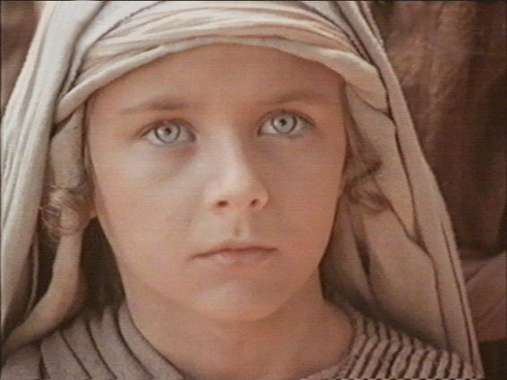
The Boy Jesus (Luke 2:40-52)
Notes:
And the Child grew and became strong in spirit, filled with wisdom; and the grace of God was upon Him. (Luke 2:40-52)
>>>>>>>>>>>>>>>>>>>
His parents went to Jerusalem every year at the Feast of the Passover.
And when He was twelve years old, they went up to Jerusalem according to the custom of the feast.
When they had finished the days, as they returned, the Boy Jesus lingered behind in Jerusalem. And Joseph and His mother did not know it;
but supposing Him to have been in the company, they went a day's journey, and sought Him among their relatives and acquaintances.
So when they did not find Him, they returned to Jerusalem, seeking Him. (Luke 2:41-45)

Slide 3
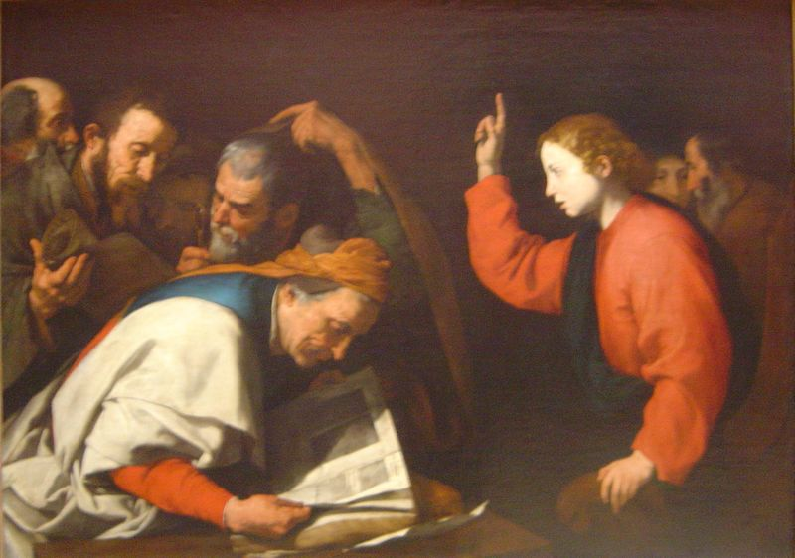
The Boy Jesus (Luke 2:40-52)
Notes:
Now so it was that after three days they found Him in the temple, sitting in the midst of the teachers, both listening to them and asking them questions.
And all who heard Him were astonished at His understanding and answers.
So when they saw Him, they were amazed; and His mother said to Him, "Son, why have You done this to us? Look, Your father and I have sought You anxiously."
And He said to them, "Why did you seek Me? Did you not know that I must be about My Father's business?"
But they did not understand the statement which He spoke to them.
Then He went down with them and came to Nazareth, and was subject to them, but His mother kept all these things in her heart.
And Jesus increased in wisdom and stature, and in favor with God and men. (Luke 2:46-52)

Slide 4
Focus
A center of activity, attraction, or attention…
a point of concentration
Notes:
1. What does it mean to FOCUS on something?
>>>>>>>>>>>>>>>>
2. When you focus in something, it becomes the center of activity, attraction, or attention…
3. What does that mean?
>>>>>>>>>>>>>>>>
4. That means we make it the point of concentration.
5. The concentration here, in this picture, is on the hand rather than on the face.

Slide 5
But seek first the kingdom of God and his righteousness and all these things shall be added to you.
Matthew 6:33
Notes:
1. Jesus gave us something to concentrate on when He said:
>>>>>>>>>>>>>>>>>>
But seek first the kingdom of God and his righteousness and all these things shall be added to you. Matthew 6:33

Slide 6
The former account I made, O Theophilus, of all that Jesus began both to do and teach.
(Acts 1:1)
Notes:
1. At about the age of 30, Jesus began His teaching career.
2. Not only did He teach, He practiced what He taught.
>>>>>>>>>>>>>>>>>>
The former account I made, O Theophilus, of all that Jesus began both to do and teach. (Acts 1:1)

Slide 7
The Power of Focus
Lessons Learned From the Lord Jesus (Luke 2:40-52)
Notes:
1. Looking at the power of focus
>>>>>>>>>>>>>>>>>>>
2. There Are Many Lessons That Can Be Learned From The Lord Jesus (Luke 2:40-52)

Slide 8
The Power of Focus
Decision
Notes:
1. In our first lesson, Jesus show us that a decision must be made.
>>>>>>>>>>>>>>>>>>>>
2. There is no beginning without a decision to start.
3. You cannot be involved in things of this life, unless you decide to be involved, otherwise you are drug along by this life like a helpless child.

Slide 9
And when He was twelve years old, they went up to Jerusalem according to the custom of the feast.
Luke 2:42
Notes:
And when He was twelve years old, they went up to Jerusalem according to the custom of the feast. Luke 2:42
>>>>>>>>>>>>>>>>>>>>>>>>
1. His parents went - every year - This was their constant custom, because it was positively enjoined by the law, Exo 23:17.
2. But it does not appear that infants were obliged to be present; and yet all the male-children are positively ordered to make their appearance at Jerusalem thrice in the year, Exo 34:23.
3. And our Lord, being now twelve years old, Luk 2:42, accompanies his parents to the feast.
4. Probably this was the very age at which the male children were obliged to appear before the Lord at the three public festivals - the feast of unleavened bread, feast of weeks, and the feast of tabernacles.
5. According to the Jewish canons, it was the age at which they were obliged to begin to learn a trade.

Slide 10
Decision
Deuteronomy 30:19
Joshua 24:15
1 Kings 18:21
Matthew 6:24
Notes:
1. From the beginning, by the nature of our God given free will, we have been required to make choices, life and death choices.
>>>>>>>>>>>>>>>>>>>>>>
I call heaven and earth as witnesses today against you, that I have set before you, life and death, blessing and cursing; therefore choose life, that both you and your descendants may live; (Deuteronomy 30:19)
And if it seems evil to you to serve the LORD, choose for yourselves this day whom you will serve, whether the gods which your fathers served that were on the other side of the River, or the gods of the Amorites, in whose land you dwell. But as for me and my house, we will serve the LORD." (Joshua 24:15)
And Elijah came to all the people, and said, "How long will you falter between two opinions? If the LORD is God, follow Him; but if Baal, follow him." But the people answered him not a word. (1 Kings 18:21)
"No one can serve two masters; for either he will hate the one and love the other, or else he will be loyal to the one and despise the other. You cannot serve God and mammon. (Matthew 6:24)

Slide 11
Decisions also have creative power.
Decide to make small, even painful steps towards that…
Whatever You have dreamed you can be, in time the dream will become reality.
That is God’s will for you.
He places dreams in us, so we are forced to walk outside our comfort zone.
Notes:
1. Decisions also have a personal creative power.
>>>>>>>>>>>>>>
2. Decide to make small, even painful steps towards that… you may reach life goal.
>>>>>>>>>>>>>>
3. Whatever You have dreamed you can be; in time the dream will become reality.
>>>>>>>>>>>>>>
4. That is God’s will for you.
>>>>>>>>>>>>>>
5. He places dreams in us, so we are forced to walk outside our comfort zone.
Quote from Foundation to all Freedom, http://www.freedomyou.com/mil/making/20powerful/20decisions.htm

Slide 12
Remember now your Creator in the days of your youth, before the difficult days come, and the years draw near when you say, "I have no pleasure in them”.
Ecclesiastes 12:1
Notes:
Remember now your Creator in the days of your youth, before the difficult days come, and the years draw near when you say, "I have no pleasure in them”. Ecclesiastes 12:1
1. Make a decision to look ahead toward not only your old age, but to your eternal life.

Slide 13
The Power of Focus
Diligence

Slide 14
When they had finished the days, as they returned, the Boy Jesus lingered behind in Jerusalem. And Joseph and His mother did not know it…
Luke 2:43
Notes:
When they had finished the days, as they returned, the Boy Jesus lingered behind in Jerusalem. And Joseph and His mother did not know it…
Luke 2:43
--------------------------
1. Had fulfilled the days - The days of the Passover.
2. These were eight days in all - one day for killing the paschal lamb, and seven days for the observance of the feast of unleavened bread, Exo 12:15; Lev 23:5-6.
3. Jesus made the decision to remain in Jerusalem, without permission from or telling His parents.

Slide 15
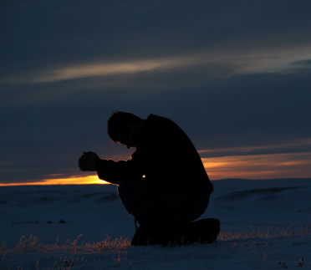
Jesus: His Spiritual Hunger
Matthew 4:4
Mark 1:35
Mark 6:46
Luke 4:16
Luke 6:12
Notes:
1. Jesus: His Spiritual Hunger was constant, and it was satisficed by both study and prayer.
2. It was through diligence that Jesus talked with His father.
>>>>>>>>>>>>>>>>>>>>>>>>
But He answered and said, "It is written, 'MAN SHALL NOT LIVE BY BREAD ALONE, BUT BY EVERY WORD THAT PROCEEDS FROM THE MOUTH OF GOD.' " (Matthew 4:4)
>>>>>>>>>>>>>>>>>>>>>>>>
Now in the morning, having risen a long while before daylight, He went out and departed to a solitary place; and there He prayed. (Mark 1:35)
>>>>>>>>>>>>>>>>>>>>>>>>
And when He had sent them away, He departed to the mountain to pray. (Mark 6:46)
>>>>>>>>>>>>>>>>>>>>>>>>
So He came to Nazareth, where He had been brought up. And as His custom was, He went into the synagogue on the Sabbath day, and stood up to read. (Luke 4:16)
>>>>>>>>>>>>>>>>>>>>>>>>>
Now it came to pass in those days that He went out to the mountain to pray and continued all night in prayer to God. (Luke 6:12)

Slide 16
The Power of Focus
Dedication
Notes:
1. Dedication is desired by God from each one of us.
2. Dedication requires the power of Focus.

Slide 17
Now so it was that after three days they found Him in the temple, sitting in the midst of the teachers, both listening to them and asking them questions.
Luke 2:46
Notes:
Now so it was that after three days they found Him in the temple, sitting in the midst of the teachers, both listening to them and asking them questions. Luke 2:46
1. Jesus was proposing questions to them respecting the law and the prophets.
2. There is no reason to suppose that this was for the purpose of perplexing or confounding them because Jesus was dedicated to the word of His Father.
3. The questions were doubtless proposed in a respectful manner, and the answers listened to with proper deference to their age and rank.
4. Jesus had no fear for His life, nor did He fear talking with strangers.

Slide 18
Do not be deceived: "Evil company corrupts good habits.''
1 Corinthians 15:33
Notes:
Do not be deceived: "Evil company corrupts good habits.'' 1 Corinthians 15:33
1. Paul made it very clear.
2. Dedicated men and women do not fellowship the world; but are dedicated to the word of God.

Slide 19
Godly Friends
(1 Sam. 23:16)
Notes:
1. As followers of Christ we must maintain Godly Friends.
>>>>>>>>>>>>>>>>>>>
Then Jonathan, Saul's son, arose and went to David in the woods and strengthened his hand in God. (1 Samuel 23:16)
a. This is what friends do for each other.
2. It was Jonathan that encouraged David to remain hidden from His ungodly father Saul.
3. Jonathan knew that David would be king of Israel and they became godly friends.

Slide 20
The Power of Focus
Determination
Notes:
1. The power of Focus will set our level of determination in our heart.
>>>>>>>>>>>>>>>>>>>>>
2.. Determination is not found in cowards, but it is a product of Focus.

Slide 21
And He said to them, "Why is it that you sought Me? Did you not know that I must be about My Father's business?''
Luke 2:49
Notes:
And He said to them, "Why is it that you sought Me? Did you not know that I must be about My Father's business?''
Luke 2:49
1. Jesus, with great determination, was intent on teaching His Father’s word.
2. He indicated to His parents: They ought to have come there at once.
3. These words are the first in which He reveals His consciousness of His supernatural birth.
4. Joseph and Mary knew His true Father and should have known where to find Him.

Slide 22
-- John 3:7
-- John 4:24
-- Acts 4:12
-- 2 Corinthians 5:10
-- Hebrews 11:6
Notes:
1. Determination means that urgent things must be accomplished “as soon as possible”.
2. What is your level of determination for each of these five verses.
>>>>>>>>>>>>>>>>>>>>>
Do not marvel that I said to you, 'You must be born again.' (John 3:7)
>>>>>>>>>>>>>>>>>>>>>>
God is Spirit, and those who worship Him must worship in spirit and truth." (John 4:24)
>>>>>>>>>>>>>>>>>>>>>>
Nor is there salvation in any other, for there is no other name under heaven given among men by which we must be saved." (Acts 4:12)
>>>>>>>>>>>>>>>>>>>>>>
For we must all appear before the judgment seat of Christ, that each one may receive the things done in the body, according to what he has done, whether good or bad. (2 Corinthians 5:10)
>>>>>>>>>>>>>>>>>>>>>
But without faith it is impossible to please Him, for he who comes to God must believe that He is, and that He is a rewarder of those who diligently seek Him.
(Hebrews 11:6)

Slide 23
The Power of Focus
Destination
Notes:
1. The Power Of Focus Must Be On Your Destination, your end goal for this life.
>>>>>>>>>>>>>>>>>>>>>>
2. Your focus must be on God’s Plan to Reconcile you to Himself, through the death of His Son Jesus.

Slide 24
And Jesus increased in wisdom and stature, and in favor with God and men.
(Luke 2:52)
Notes:
And Jesus increased in wisdom and stature, and in favor with God and men. (Luke 2:52)

Slide 25
Having a vision of your destination focuses you on your journey.
It gives you the basis for making difficult choices for learning from your actions and for allocating your resources.
Notes:
1. Having a vision of your destination focuses you on your journey and your goal.
>>>>>>>>>>>>>>>>>>>
2. It gives you the basis for making difficult choices, for learning from your actions, and for allocating your resources.
http://www.selfgrowth.com/articles/NinaHam1.html

Slide 26
Which way are you headed?
But Grow in the grace and knowledge…
(2 Peter 3:18)
Notes:
but grow in the grace and knowledge of our Lord and Savior Jesus Christ. To Him be the glory both now and forever. Amen. (2 Peter 3:18)

Slide 27
The Power of Focus
Decisions
Diligence
Dedication
Determination
Destination
Lessons Learned From the Lord Jesus (Luke 2:40-52)
Notes:
Through the Power of Focus,
>>>>>>>>>>>>>>>>>>
We have many Lessons Learned From the Lord Jesus (Luke 2:40-52)
>>>>>>>>>>>>>>>>>>
1. Decisions
2. Diligence
3. Dedication
4. Determination
5. Destination

Slide 28
Invitation:
1. Hearing and faith, Rom. 10:17
2. Repentance, Acts 2:38
3. Professing Christ, Rom. 10:9-10
4. Immersion in water, Acts 22:16
5. Faithfulness, Rev. 2:10
Invitation Song | 261 | Will Jesus Find Us Watching
Closing Song | 550 | Won’t it Be Wonderful There
Closing Prayer
Notes:
Invitation:
>>>>>>>>>>>>
1. Hearing and faith, Rom. 10:17
>>>>>>>>>>>>
2. Repentance, Acts 2:38
>>>>>>>>>>>>
3. Professing Christ, Rom. 10:9-10
>>>>>>>>>>>>
4. Immersion in water, Acts 22:16
>>>>>>>>>>>>
5. Faithfulness, Rev. 2:10

