Slide 2
Simple Talk About Sin 1 Peter 4:8

Slide 3
So Many Sins, So Little Time
Proverbs 6: 17-19
A proud look
A lying tongue
Hands that shed innocent blood
A heart that devises wicked plans
Feet that are swift running to evil
A false witness who speaks lies
One who sows discord among brethren
Galatians 5: 19-21
Adultery
Fornication
Uncleanness
Lewdness
Idolatry
Sorcery
Hatred
Contentions
Jealousies
Outbursts of Wrath
Selfish Ambitions
Dissensions
Heresies
Envy
Murders
Drunkenness
Revelries
And the like
2 Timothy 3: 2-4
Lovers of themselves
Lovers of money
Boasters
Proud
Blasphemers
Disobedient to Parents
Unthankful
Unholy
Unloving
Unforgiving
Slanderers
Without self-control
Brutal
Despisers of good
Traitors
Headstrong
Haughty
Lovers of pleasure rather than lovers of God
1 Corinthians 6: 9-10
Fornicators
Idolaters
Adulterers
Homosexuals
Sodomites
Thieves
Covetous
Drunkards
Revilers
Extortioners

Slide 4
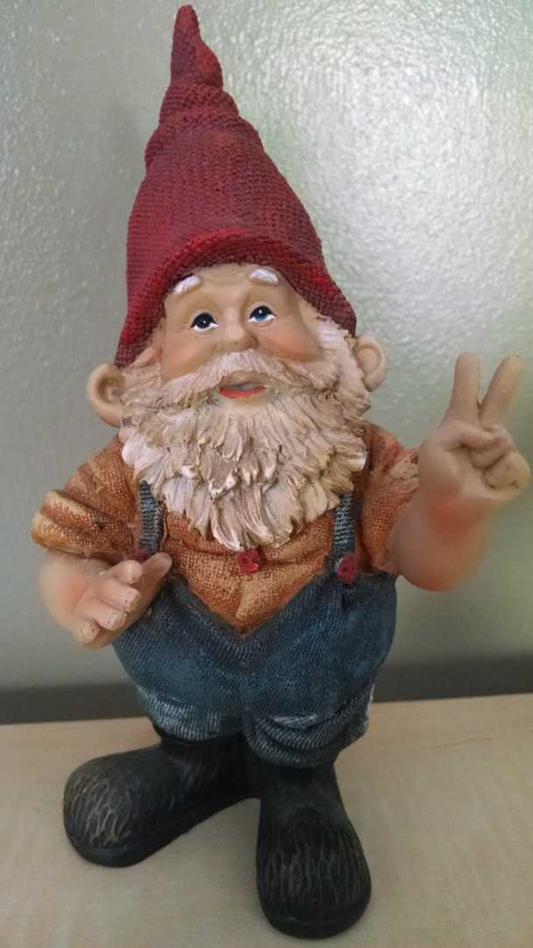
Idolatry
Defined as “Worship of idols” and “Extreme admiration, love, or reverence for something or someone
The desire for something that replaces God in our lives comes from within (James 1:12-14)

Slide 5
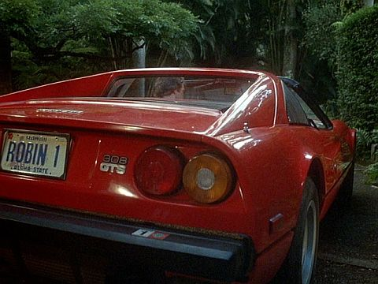
Selfish Ambitions
This is NOT the occasional need to work
This is when what YOU want becomes more important than what God wants for you
People begin to think they are solely responsible for their own success (1 Samuel 2:7)
The end of this life is out of sight, out of mind (1 Timothy 6: 9-10)
Bonus scripture: Proverbs 30: 7-9

Slide 6
So Many Sins, So Little Time
Proverbs 6: 17-19
A proud look
A lying tongue
Hands that shed innocent blood
A heart that devises wicked plans
Feet that are swift running to evil
A false witness who speaks lies
One who sows discord among brethren
Galatians 5: 19-21
Adultery
Fornication
Uncleanness
Lewdness
Idolatry
Sorcery
Hatred
Contentions
Jealousies
Outbursts of Wrath
Selfish Ambitions
Dissensions
Heresies
Envy
Murders
Drunkenness
Revelries
And the like
2 Timothy 3: 2-4
Lovers of themselves
Lovers of money
Boasters
Proud
Blasphemers
Disobedient to Parents
Unthankful
Unholy
Unloving
Unforgiving
Slanderers
Without self-control
Brutal
Despisers of good
Traitors
Headstrong
Haughty
Lovers of pleasure rather than lovers of God
1 Corinthians 6: 9-10
Fornicators
Idolaters
Adulterers
Homosexuals
Sodomites
Thieves
Covetous
Drunkards
Revilers
Extortioners

Slide 7
Simple Talk About Sin
A sin is something God doesn’t want you to do because it is bad for you
Sin is not identified in the Bible because God wants to take away your pleasure or happiness
Sin is defined by God, in the word of God, in order for us to identify and avoid things that cause us and those around us pain and suffering.
The devil is the opposite of God. Sin is the opposite of what God wants for us. (1 John 3:8)

Slide 8
The purpose and the practice of sin
Sin is the tool the devil uses to separate us from a God that loves us
There is no salvation in sin, only loss (Galatians 5:21)
All have sinned (Romans 3:23)

Slide 9
So Many Sins, So Little Time
Proverbs 6: 17-19
A proud look
A lying tongue
Hands that shed innocent blood
A heart that devises wicked plans
Feet that are swift running to evil
A false witness who speaks lies
One who sows discord among brethren
Galatians 5: 19-21
Adultery
Fornication
Uncleanness
Lewdness
Idolatry
Sorcery
Hatred
Contentions
Jealousies
Outbursts of Wrath
Selfish Ambitions
Dissensions
Heresies
Envy
Murders
Drunkenness
Revelries
And the like
2 Timothy 3: 2-4
Lovers of themselves
Lovers of money
Boasters
Proud
Blasphemers
Disobedient to Parents
Unthankful
Unholy
Unloving
Unforgiving
Slanderers
Without self-control
Brutal
Despisers of good
Traitors
Headstrong
Haughty
Lovers of pleasure rather than lovers of God
1 Corinthians 6: 9-10
Fornicators
Idolaters
Adulterers
Homosexuals
Sodomites
Thieves
Covetous
Drunkards
Revilers
Extortioners

Slide 10
The purpose and the practice of sin
Sin is the tool the devil uses to separate us from a God that loves us
There is no salvation in sin, only loss (Galatians 5:21)
All have sinned (Romans 3:23)
If we have sinned, how can we be saved? (Romans 5: 1-2)

Slide 15
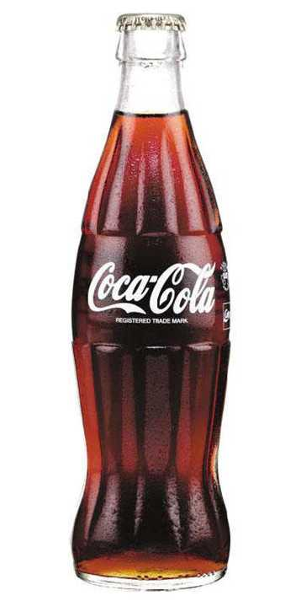
Characteristics of Sin
Sin has to appeal to us in some way
Sin has consequences (Romans 6:23)
Sin is advertised
Sin comes in many varieties (Matthew 4:1-11)
Sin reinvents itself (James 1:14; John 12: 5-6; Matthew 26: 14-16)

Slide 16
Closing Thoughts
We discuss sin because of its danger to our spiritual lives
We must admit sin
To recognize it and then fight it
To serve as an example to others (1 Timothy 1: 15-16)
Are we living lives that are a pattern worthy of others to observe and learn from?

