Slide 1
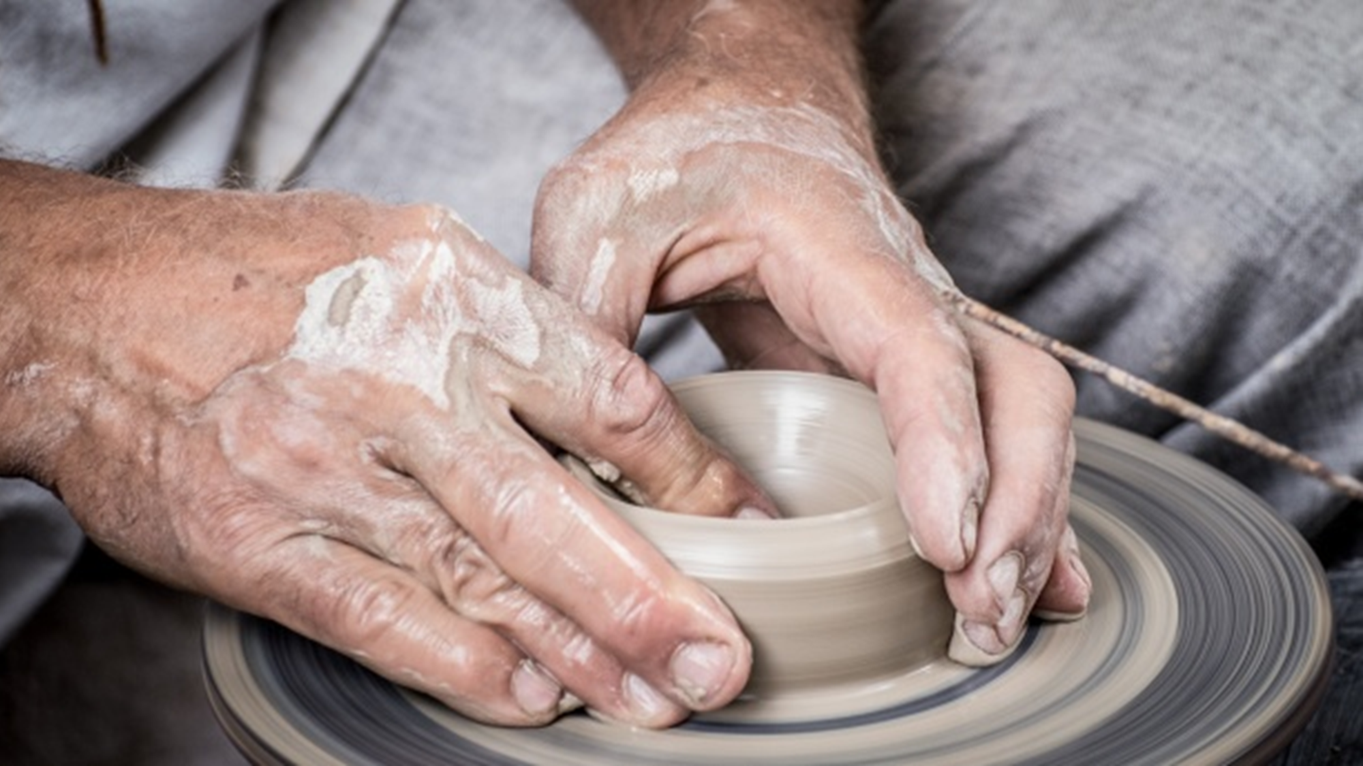
Welcome To The House of The Lord!

Slide 2
The Potter And The Clay
Jer. 18:1-6
Notes:
1. The Potter And The Clay
>>>>>>>>>>>>>
2. Our Text for this lesson starts at Jer. 18:1-6

Slide 3
Introduction
Jeremiah - “Weeping Prophet”
Jeremiah’s Work - Final Effort To Turn People Back To God
Jeremiah – O. T. Illustrative Preacher
Jer. 18:1-6
Notes:
1. Jeremiah – Is known as “Weeping Prophet” in most schools and commentaries.
a. However, Jeremiah is an extremely strong and God fearing prophet
>>>>>>>>>>>>>>>
2. Jeremiah’s Work – Was God’s Final Effort To Turn People Back To God
>>>>>>>>>>>>>>>
3. Jeremiah – O. T. Illustrative Preacher
a. God used many illustrations in Jeremiah to explain His decision to allow Nebuchadnezzar to besiege Jerusalem, destroy the temple, and burn the city to the ground.
b. On one occasion Jeremiah wore a linen loincloth, buried it in a cleft of the rock of the Euphrates River, and exhumed it. It was “spoiled… good for nothing” (Jer. 13:1-7).
c. God explains the meaning of this illustration, saying, “as the loincloth clings to the waist of a man, so I made the whole house of Israel and the whole house of Judah cling to me… that they might be for me a people, a name, a praise, and a glory…”(Jer. 13:11).
d. Yet, by their stubborn streak and rebellious spirit they developed a heart that would not hear God.
e. They became as useless as the spoiled linen loincloth (13:10).
>>>>>>>>>>>>>>>
4. Jer. 18:1-6
The word which came to Jeremiah from the LORD, saying: "Arise and go down to the potter's house, and there I will cause you to hear My words."
Then I went down to the potter's house, and there he was, making something at the wheel.
And the vessel that he made of clay was marred in the hand of the potter; so he made it again into another vessel, as it seemed good to the potter to make. Then the word of the LORD came to me, saying: "O house of Israel, can I not do with you as this potter?" says the LORD. "Look, as the clay is in the potter's hand, so are you in My hand, O house of Israel! (Jeremiah 18:1-6)

Slide 4
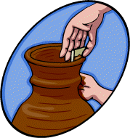
Potter = God
Clay = People of Judah
God Was Willing To Reshape Wicked Judah
Notes:
1. Potter = God – He created Judah to be His people and protect the seed line for Christ.
>>>>>>>>>>>>>
2. Clay = People of Judah, those who were given the law so that they might remain a pure and undefiled people.
>>>>>>>>>>>>>
3. God Was Willing To Reshape Wicked Judah, even after their great fall to false gods.

Slide 5
The Potter
Almighty God
God Is A Worker
Created Man In His Image, For His Glory (Isa. 43:7)
Continues To Have Abiding Interest In Man (Acts 17:24-28; Job 12:10; Rom. 11:36)
Notes:
The Potter
>>>>>>>>>>>>>>
1. Almighty God
>>>>>>>>>>>>>>
2. God Is A Worker
>>>>>>>>>>>>>>
3. God Created Man In His Image, For His Glory (Isa. 43:7)
Everyone who is called by My name, Whom I have created for My glory; I have formed him, yes, I have made him." (Isaiah 43:7)
>>>>>>>>>>>>>>
4. As sinful as we are, God Continues To Have Abiding Interest In Man (Acts 17:24-28; Job 12:10; Rom. 11:36)
-------------------------------
God, who made the world and everything in it, since He is Lord of heaven and earth, does not dwell in temples made with hands. Nor is He worshiped with men's hands, as though He needed anything, since He gives to all life, breath, and all things.
And He has made from one blood every nation of men to dwell on all the face of the earth, and has determined their preappointed times and the boundaries of their dwellings, so that they should seek the Lord, in the hope that they might grope for Him and find Him, though He is not far from each one of us; for in Him we live and move and have our being, as also some of your own poets have said, 'For we are also His offspring.' (Acts 17:24-28)
------------------------------------------
In whose hand is the life of every living thing, And the breath of all mankind? (Job 12:10)
-----------------------------------------
For of Him and through Him and to Him are all things, to whom be glory forever. Amen. (Romans 11:36)

Slide 6
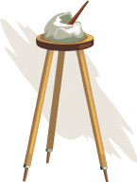
The Potter’s Clay
Isa. 64:8
Like Clay, Man Is Pliable
Freedom To Be Formed By God Or The Spirit Of This World (Rom. 12:2; 1 John 2:15-17)
God Desires To Make Us A Vessel Of Honor (1 Pt. 2:9-10)
Notes:
The Potter’s Clay
>>>>>>>>>>>>>>>>>>
1. Isa. 64:8
But now, O LORD, You are our Father; We are the clay, and You our potter; And all we are the work of Your hand. (Isaiah 64:8)
>>>>>>>>>>>>>>>>>>
2. Like Clay, Man Is Pliable and he can bent by the forces of light or of darkness.
>>>>>>>>>>>>>>>>>>
3. We have the Freedom To Be Formed By God Or The Spirit Of This World (Rom. 12:2; 1 John 2:15-17)
And do not be conformed to this world, but be transformed by the renewing of your mind, that you may prove what is that good and acceptable and perfect will of God. (Romans 12:2)
-----------------------------
Do not love the world or the things in the world. If anyone loves the world, the love of the Father is not in him. For all that is in the world—the lust of the flesh, the lust of the eyes, and the pride of life—is not of the Father but is of the world. And the world is passing away, and the lust of it; but he who does the will of God abides forever. (1 John 2:15-17)
>>>>>>>>>>>>>>>>>>
4. God Desires To Make Us A Vessel Of Honor, Not Vessels of Dishonor. (1 Pt. 2:9-10)
then the Lord knows how to deliver the godly out of temptations and to reserve the unjust under punishment for the day of judgment, and especially those who walk according to the flesh in the lust of uncleanness and despise authority. They are presumptuous, self-willed. They are not afraid to speak evil of dignitaries, (2 Peter 2:9-10)

Slide 7
The Potter’s Pattern
Shapes Clay Into Likeness Of A Pattern
God’s Patter For Man Is Christ
Notes:
1. The Potter’s Pattern For Us, What Does It Look Like?
>>>>>>>>>>>>>>>>>>>>
2. God Shapes His Precious Clay Into The Likeness Of A Pattern That Is Useful, and Serves His Purpose.
>>>>>>>>>>>>>>>>>>>>
3. God’s Pattern For Mankind Is His Son Jesus Christ

Slide 8
Forgiveness Is Only One Aspect Of Becoming A Christian
Another Is Being Transformed Into Image Of Christ (1 Cor. 11:1; Phil. 2:5; 1 Pt. 2:21-22; Col. 3:8-10; 2 Pt. 1:3-4)
Are You Allowing God To Shape You After Christ?
Notes:
1. In molding mankind, Forgiveness Is Only One Aspect Of Becoming A Christian.
>>>>>>>>>>>>>>>>
2. Another Is Being Transformed Into Image Of Christ (1 Cor. 11:1; Phil. 2:5; 1 Pt. 2:21-22; Col. 3:8-10; 2 Pt. 1:3-7)
Imitate me, just as I also imitate Christ. (1 Corinthians 11:1)
---------------------------
Let this mind be in you which was also in Christ Jesus, (Philippians 2:5)
---------------------------
For to this you were called, because Christ also suffered for us, leaving us an example, that you should follow His steps: "WHO COMMITTED NO SIN, NOR WAS DECEIT FOUND IN HIS MOUTH"; (1 Peter 2:21-22)
---------------------------
But now you yourselves are to put off all these: anger, wrath, malice, blasphemy, filthy language out of your mouth. Do not lie to one another, since you have put off the old man with his deeds, and have put on the new man who is renewed in knowledge according to the image of Him who created him, (Colossians 3:8-10)
----------------------------
as His divine power has given to us all things that pertain to life and godliness, through the knowledge of Him who called us by glory and virtue, by which have been given to us exceedingly great and precious promises, that through these you may be partakers of the divine nature, having escaped the corruption that is in the world through lust. (2 Peter 1:3-4)
>>>>>>>>>>>>>>>>
3. The Main Question of this Sermon is “Are You Allowing God To Shape You After Christ?”.

Slide 9
Potter’s Patience
Vessel Marred, He Made it Again (Jer. 18:4)
Other Material Available
Potter Continued To Work
Examples: Israel, Peter (Lk. 22:61-62)
God Seeks Our Repentance (2 Pt. 3:9; Rom. 2:4)
Notes:
1. Vessel Marred, He Made it Again (Jer. 18:4)
And the vessel that he made of clay was marred in the hand of the potter; so he made it again into another vessel, as it seemed good to the potter to make. (Jeremiah 18:4)
>>>>>>>>>>>>>>>>
2. A Whole Lot of Other Material Available Was Available To the Potter.
>>>>>>>>>>>>>>>>
3. The Potter Did Not Give Up On The Clay In His Hand, He Continued To Work The Clay For The Best Possible Vessel.
>>>>>>>>>>>>>>>>
4. Examples: Israel, Peter (Lk. 22:61-62)
And the Lord turned and looked at Peter. Then Peter remembered the word of the Lord, how He had said to him, "Before the rooster crows, you will deny Me three times." So Peter went out and wept bitterly. (Luke 22:61-62)
>>>>>>>>>>>>>>>>
5. God Seeks Our Repentance (2 Pt. 3:9; Rom. 2:4)
The Lord is not slack concerning His promise, as some count slackness, but is longsuffering toward us, not willing that any should perish but that all should come to repentance. (2 Peter 3:9)
Or do you despise the riches of His goodness, forbearance, and longsuffering, not knowing that the goodness of God leads you to repentance? (Romans 2:4)

Slide 10
Potter’s Product
Depends On The Way The Material Responds To Touch
Impenitent And Disobedient Hearts Mars The Vessel (2 Tim. 2:20-21)
Judas, Example Of How Sin Mars
Matt. 26:24
Notes:
1. The Potter’s Finished Product Depends On The Way The Material Responds To His Touch
>>>>>>>>>>>>>>>>>>>>
2. As In Mankind, An Impenitent And Disobedient Heart; Mars The Vessel (2 Tim. 2:20-21)
But in a great house there are not only vessels of gold and silver, but also of wood and clay, some for honor and some for dishonor. Therefore if anyone cleanses himself from the latter, he will be a vessel for honor, sanctified and useful for the Master, prepared for every good work. (2 Timothy 2:20-21)
>>>>>>>>>>>>>>>>>>>>
3. Judas, Is An Example Of How Sin Mars The Vessel and How Un-Repented Sin Mars Our Nation.
>>>>>>>>>>>>>>>>>>>>
4. Matt. 26:24
The Son of Man indeed goes just as it is written of Him, but woe to that man by whom the Son of Man is betrayed! It would have been good for that man if he had not been born." (Matthew 26:24)

Slide 11
When Marred By Sin, If One Will Repent And Return To The Lord, He Will Grow
God Will Make Him A Vessel Of Honor
Example: Manasseh
Example: Peter (John 1:42)
Notes:
1. When One Is Marred By Sin, If One Will Repent And Return To The Lord, He Will Grow In The Grace of God.
>>>>>>>>>>>>>>>>
2. God Will Make Him A Vessel Of Honor, He Will Not Give Up On A Penitent Individual.
>>>>>>>>>>>>>>>>
3. Example: Look at Old Wicked King of Judah, Manasseh!
a. The Potter Did Not Give UP On Him!
So Manasseh seduced Judah and the inhabitants of Jerusalem to do more evil than the nations whom the LORD had destroyed before the children of Israel. (2 Chronicles 33:9)
---------------------------------------
Therefore the LORD brought upon them the captains of the army of the king of Assyria, who took Manasseh with hooks, bound him with bronze fetters, and carried him off to Babylon. (2 Chronicles 33:11)
-------------------------------------
and prayed to Him; and He received his entreaty, heard his supplication, and brought him back to Jerusalem into his kingdom. Then Manasseh knew that the LORD was God. (2 Chronicles 33:13)
>>>>>>>>>>>>>>>>
4. Another Vessel made over is Peter (John 1:42) a fisherman made over by Jesus.
And he brought him to Jesus. Now when Jesus looked at him, He said, "You are Simon the son of Jonah. You shall be called Cephas" (which is translated, A Stone). (John 1:42)

Slide 12
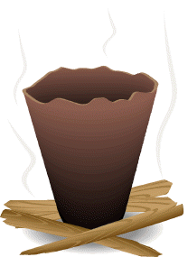
Jer. 19 – Back To Potter’s House For Earthen Vessel
Broken To Pieces (Jer. 19:11)
Symbol Of Israel’s Irrevocable Destruction
Opportunities Have Limitations
Notes:
1. Jer. 19 – We have An Opportunity to Go Back To Potter’s House For Renewal As Earthen Vessels.
>>>>>>>>>>>>>>>>>
2. Unrepentant Sinners Will be Broken To Pieces (Jer. 19:11)
and say to them, 'Thus says the LORD of hosts: "Even so I will break this people and this city, as one breaks a potter's vessel, which cannot be made whole again; and they shall bury them in Tophet till there is no place to bury. (Jeremiah 19:11)
>>>>>>>>>>>>>>>>>
3. This Symbol Of the Potter is a Symbol Of Israel’s Irrevocable Destruction, And of Ours As Degenerate Sinners.
>>>>>>>>>>>>>>>>>
4. Opportunities Have Limitations, There Is a Best By Due Date on Every Vessel the Potter Makes.

Slide 13
The Potter’s Requirements for A Marred Vessel
1. Hear the word – Romans 10: 17
2. Believe it – John 8:24
3. Repent of Sins – Acts 17:30
4. Confess Jesus – Romans 10: 9,10
5. Baptized for Forgiveness of sins – Acts 22:16
Notes:
The Potter’s Requirements for a Marred Vessel
1. Hear the word – Romans 10: 17
So then faith comes by hearing, and hearing by the word of God. (Romans 10:17)
>>>>>>>>>>>>>>
2. Believe it – John 8:24
Therefore I said to you that you will die in your sins; for if you do not believe that I am He, you will die in your sins." (John 8:24)
>>>>>>>>>>>>>>
3. Repent of Sins – Acts 17:30
Truly, these times of ignorance God overlooked, but now commands all men everywhere to repent, (Acts 17:30)
>>>>>>>>>>>>>>
4. Confess Jesus – Romans 10: 9,10
that if you confess with your mouth the Lord Jesus and believe in your heart that God has raised Him from the dead, you will be saved.. (Romans 10:9)
>>>>>>>>>>>>>>
5. Baptized for Forgiveness of sins – Acts 2:38 & Acts 22:16
And now why are you waiting? Arise and be baptized, and wash away your sins, calling on the name of the Lord.' (Acts 22:16)

