Slide 1
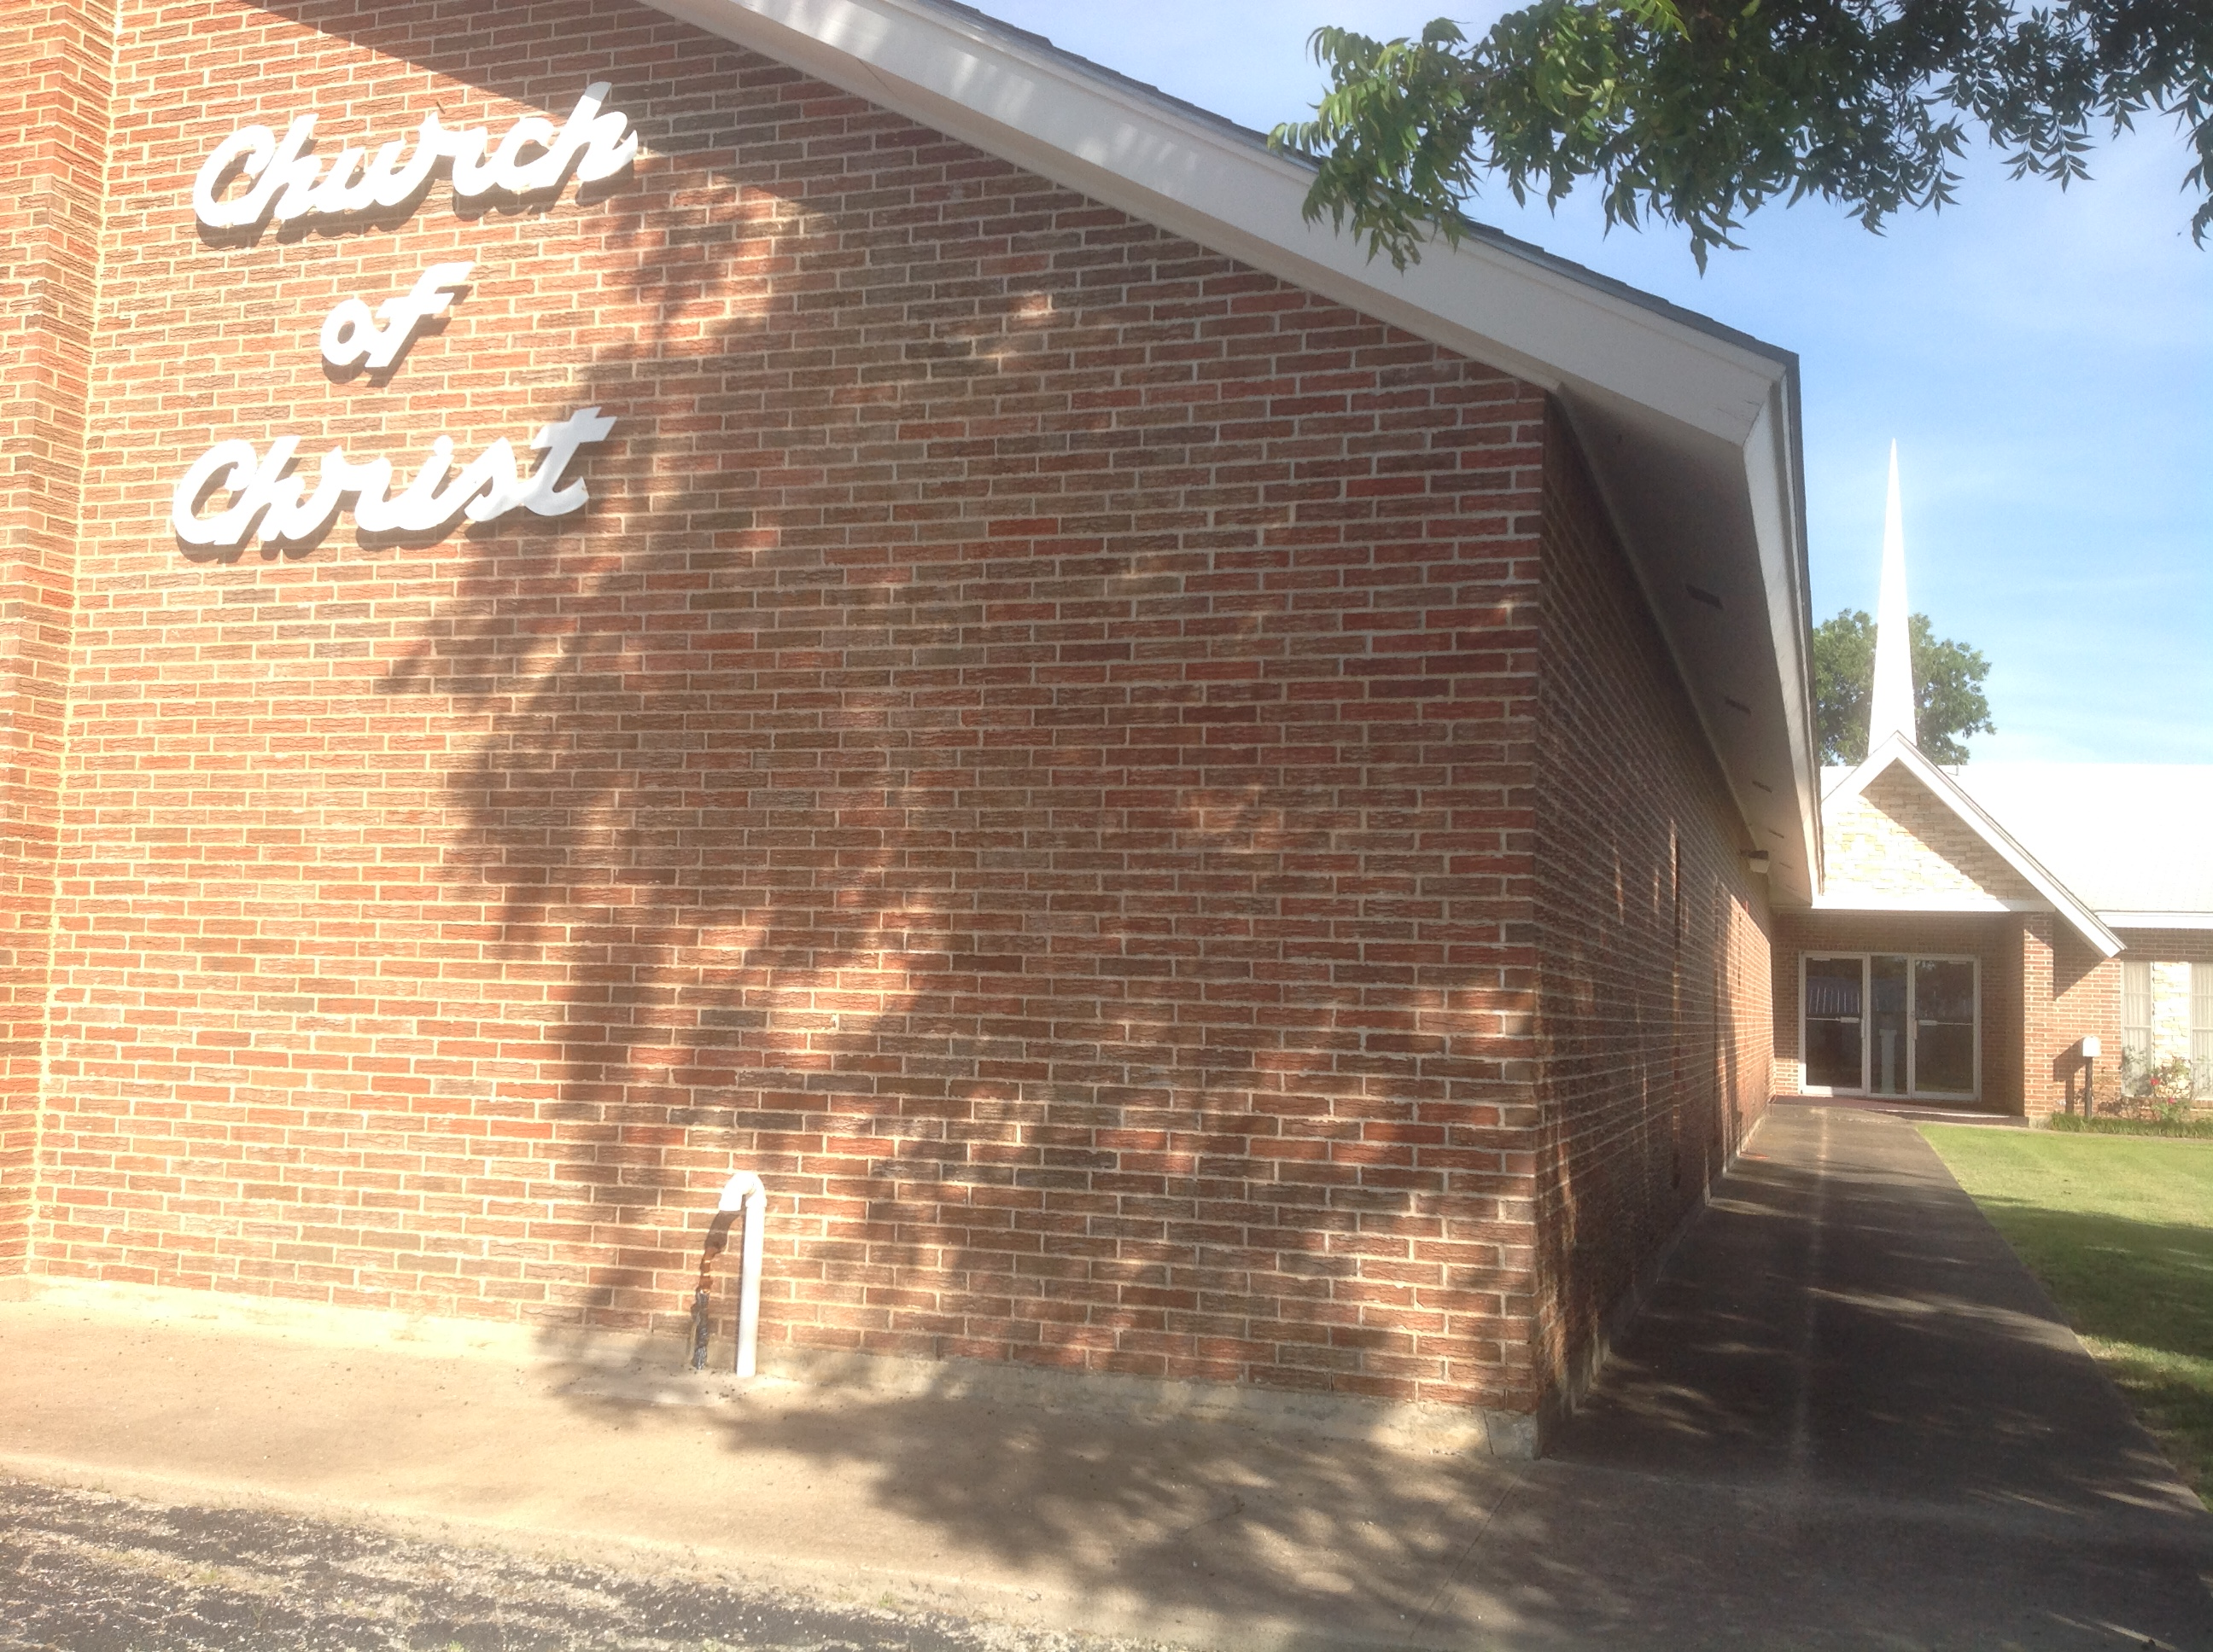
Everyone Is Welcome
Ranger Church of Christ
Mesquite and Rusk St.

Slide 2
Announcements | Songs | Title
1st Song | 70 | Hallelujah, Praise Jehovah
2nd Song | 272 | We Saw Thee Not
Opening Prayer
3rd Song | 288 | Abide With Me
4th Song | 257 | When I Survey the Wondrous Cross
Lords Supper
Offering
5th Song | 283 | Revive Us Again
Sermon
Invitation Song | 58 | God is Calling the Prodigal
Closing Song | 516 | To Christ Be True
Closing Prayer

Slide 4
Then Jesus entered and passed through Jericho. Now behold, there was a man named Zacchaeus who was a chief tax collector, and he was rich.
And he sought to see who Jesus was, but could not because of the crowd, for he was of short stature.
So he ran ahead and climbed up into a sycamore tree to see Him, for He was going to pass that way.
And when Jesus came to the place, He looked up and saw him, and said to him, "Zacchaeus, make haste and come down, for today I must stay at your house."
So he made haste and came down and received Him joyfully.
Notes:
1. Then Jesus entered and passed through Jericho. Now behold, there was a man named Zacchaeus who was a chief tax collector, and he was rich.
And he sought to see who Jesus was, but could not because of the crowd, for he was of short stature.
>>>>>>>>>>>>>>>>>>>>
2. So he ran ahead and climbed up into a sycamore tree to see Him, for He was going to pass that way.
>>>>>>>>>>>>>>>>>>>>
3. And when Jesus came to the place, He looked up and saw him, and said to him, "Zacchaeus, make haste and come down, for today I must stay at your house."
>>>>>>>>>>>>>>>>>>>>
4. So he made haste and came down and received Him joyfully.

Slide 5
But when they saw it, they all complained, saying, So he made haste and came down, and received Him joyfully. But when they saw it, they all complained, saying, "He has gone to be a guest with a man who is a sinner." Then Zacchaeus stood and said to the Lord, "Look, Lord, I give half of my goods to the poor; and if I have taken anything from anyone by false accusation, I restore fourfold." And Jesus said to him, "Today salvation has come to this house, because he also is a son of Abraham; for the Son of Man has come to seek and to save that which was lost." (Luke 19:1-10)
Notes:
1. But when they saw it, they all complained, saying, So he made haste and came down, and received Him joyfully. >>>>>>>>>>>>>>>>>>>>>>
2. But when they saw it, they all complained, saying, "He has gone to be a guest with a man who is a sinner." >>>>>>>>>>>>>>>>>>>>>>
3. Then Zacchaeus stood and said to the Lord, "Look, Lord, I give half of my goods to the poor; and if I have taken anything from anyone by false accusation, I restore fourfold." >>>>>>>>>>>>>>>>>>>>>>
4. And Jesus said to him, "Today salvation has come to this house, because he also is a son of Abraham; for the Son of Man has come to seek and to save that which was lost." (Luke 19:1-10)
a. Does this mean that we not be the only ones in Heaven?
b. You bet it does!

Slide 6
Zacchaeus was a wee little man, and a wee little man was he. He climbed up in the sycamore tree, for the Savior he wanted to see. And as the Savior came walking by, He looked up in the tree. And he said, Zacchaeus, you come down from there, for I’m going to your house today. For I’m going to your house today.
Notes:
Zacchaeus was a wee little man, and a wee little man was he. He climbed up in the sycamore tree, for the Savior he wanted to see. And as the Savior came walking by, He looked up in the tree. And he said, Zacchaeus, you come down from there, for I’m going to your house today. For I’m going to your house today.

Slide 7
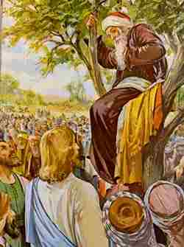
Z
A
C
C
H
A
E
U
S
ealous
gile
ourageous
alled
umble
ffluent
rror
-turn
aved

Slide 8
INTRODUCTION
(1 Sam 9:1-2) Saul, from his shoulders upward he was taller than any of the people.
(1 Sam 16:7) But the LORD said to Samuel, "Do not look at his appearance or at the height of his stature, because I have refused him. For the Lord does not see as man sees; for man looks at the outward appearance, but the LORD looks at the heart.“
(John 7:24) "Do not judge according to appearance, but judge with righteous judgment.“
How do you think God saw Zacchaeus?
Notes:
1. (1 Sam 9:1-2) Saul, from his shoulders upward he was taller than any of the people.
>>>>>>>>>>>>>>>>
2. (1 Sam 16:7) But the LORD said to Samuel, "Do not look at his appearance or at the height of his stature, because I have refused him. For the Lord does not see as man sees; for man looks at the outward appearance, but the LORD looks at the heart.“
>>>>>>>>>>>>>>>>
3. (John 7:24) "Do not judge according to appearance, but judge with righteous judgment.“
>>>>>>>>>>>>>>>>
4. How do you think God saw Zacchaeus?

Slide 9
Zacchaeus Was A Big Man In Many Ways
Notes:
Zacchaeus Was A Big Man In Many Ways

Slide 10
I. It Takes A Big Man To Reach Upward (climb) (1-4)
How humbling it must have been for Zacchaeus to climb up in that tree to be able to get a glimpse of Jesus
We all have an upward call from God (Philippians 3:13-15)
We all have an upward call to heaven (Hebrews 3:1)
We all have an upward call to be like Jesus (Romans 8:28-29)
We all have an upward call to be like God (1 Peter 1:15)
We all have an upward call to serve others (Matthew 23:11-12)
Notes:
1. It Takes A Big Man To Reach Upward (to climb) (1-4)
>>>>>>>>>>>>>>>>>>
2. How humbling it must have been for Zacchaeus to climb up in that tree to be able to get a glimpse of Jesus.
>>>>>>>>>>>>>>>>>>
3. We all have an upward call from God (Philippians 3:13-15)
I press toward the goal for the prize of the upward call of God in Christ Jesus. (Philippians 3:14)
>>>>>>>>>>>>>>>>>>
4. We all have an upward call to heaven (Hebrews 3:1)
Therefore, holy brethren, partakers of the heavenly calling, consider the Apostle and High Priest of our confession, Christ Jesus, (Hebrews 3:1)
>>>>>>>>>>>>>>>>>>
5. We all have an upward call to be like Jesus (Romans 8:28-29)
For whom He foreknew, He also predestined to be conformed to the image of His Son, that He might be the firstborn among many brethren. (Romans 8:29)
>>>>>>>>>>>>>>>>>>
6. We all have an upward call to be like God (1 Peter 1:15)
but as He who called you is holy, you also be holy in all your conduct, (1 Peter 1:15)
>>>>>>>>>>>>>>>>>>
7. We all have an upward call to serve others (Matthew 23:11-12)
But he who is greatest among you shall be your servant. And whoever exalts himself will be humbled, and he who humbles himself will be exalted. (Matthew 23:11-12)

Slide 11
II. It Takes A Big Man To Recognize A Need For Jesus (5-7)
Zacchaeus needed Jesus because he is a sinner – Luke 19:5-7
The Pharisees did not recognize their need for Jesus - (John 9:39-41)
The rich tend to trust in their riches - (1 Tim 6:17-19)
We must trust in God not in self - (Prov 3:5-8)
Jesus is the only source of eternal life
1. (John 6:67-69) He has the words of life
2. (Acts 4:12) Salvation in no other
Notes:
II. It Takes A Big Man To Recognize A Need For Jesus (5-7)
>>>>>>>>>>>>>>>>>>
1. Zacchaeus needed Jesus because he was a sinner – Luke 19:5-7
But when they saw it, they all complained, saying, "He has gone to be a guest with a man who is a sinner." (Luke 19:7)
>>>>>>>>>>>>>>>>>>
2. The Pharisees did not recognize their need for Jesus - (John 9:39-41)
Jesus said to them, "If you were blind, you would have no sin; but now you say, 'We see.' Therefore your sin remains. (John 9:41)
>>>>>>>>>>>>>>>>>>>
3. The rich tend to trust in their riches - (1 Tim 6:17-19)
Command those who are rich in this present age not to be haughty, nor to trust in uncertain riches but in the living God, who gives us richly all things to enjoy. (1 Timothy 6:17)
>>>>>>>>>>>>>>>>>>>
4. We must trust in God not self - (Prov 3:5-8)
Trust in the LORD with all your heart, And lean not on your own understanding; (Proverbs 3:5)
>>>>>>>>>>>>>>>>>>>
5. Jesus is the only source of eternal life
>>>>>>>>>>>>>>
1. (John 6:67-69) He has the words of life
But Simon Peter answered Him, "Lord, to whom shall we go? You have the words of eternal life. (John 6:68)
>>>>>>>>>>>>>>>>>>>>>>
2. (Acts 4:12) Salvation in no other
Nor is there salvation in any other, for there is no other name under heaven given among men by which we must be saved." (Acts 4:12)

Slide 12
III. It Takes A Big Man To Restore Ill Gotten Gains
Zacchaeus was willing to restore anything he didn’t get honestly – Luke 19:8
Zacchaeus was chief tax collector and rich. (Vs 2)
1. It’s difficult for the rich to give up their money
2. Most charitable giving is by the poor
The O.T. demanded restitution
(Exo 22:1-7)
(Prov 6:30-31)
The N.T. implies the need for restitution
John the Baptist - (Luke 3:7-13)
Paul (Acts 26:19-20)
Notes:
III. It Takes A Big Man To Restore Ill Gotten Gains
>>>>>>>>>>>>>>>>>
1. Zacchaeus was willing to restore anything he didn’t get honestly – Luke 19:8
Then Zacchaeus stood and said to the Lord, "Look, Lord, I give half of my goods to the poor; and if I have taken anything from anyone by false accusation, I restore fourfold." (Luke 19:8)
>>>>>>>>>>>>>>>>>
2. Zacchaeus was chief tax collector and rich. (Vs 2)
Now behold, there was a man named Zacchaeus who was a chief tax collector, and he was rich. (Luke 19:2)
a. It’s difficult for the rich to give up their money, especially in todays society.
b. Did you know that most charitable giving is by the poor
>>>>>>>>>>>>>>>>
3. The O.T. demanded restitution
a. (Exo 22:1-7)
"If a man steals an ox or a sheep, and slaughters it or sells it, he shall restore five oxen for an ox and four sheep for a sheep. (Exodus 22:1)
b. (Prov 6:30-31)
People do not despise a thief If he steals to satisfy himself when he is starving. Yet when he is found, he must restore sevenfold; He may have to give up all the substance of his house. (Proverbs 6:30-31)
>>>>>>>>>>>>>>>>
4. The N.T. implies the need for restitution
a. John the Baptist - (Luke 3:7-13)
Therefore bear fruits worthy of repentance, and do not begin to say to yourselves, 'We have Abraham as our father.' For I say to you that God is able to raise up children to Abraham from these stones. (Luke 3:8)
b. Paul (Acts 26:19-20)
"Therefore, King Agrippa, I was not disobedient to the heavenly vision, but declared first to those in Damascus and in Jerusalem, and throughout all the region of Judea, and then to the Gentiles, that they should repent, turn to God, and do works befitting repentance. (Acts 26:19-20)

Slide 13
III. It Takes A Big Man To Restore Ill Gotten Gains
E. Alexander Campbell: …without repentance, and restitution when possible, there can be no remission… The Millennial Harbinger Extra 4 (August 1833): 345-348
Notes:
III. It Takes A Big Man To Restore Ill Gotten Gains
>>>>>>>>>>>>>>>>>>>>>>>>
E. Alexander Campbell: …without repentance, and restitution when possible, there can be no remission… The Millennial Harbinger Extra 4 (August 1833): 345-348

Slide 14
IV. It Takes A Big Man To Repent Of Their Sin (9-10)
Zacchaeus showed by his willingness to make restitution that he recognized and repented of his sin.
Jesus’ statement shows Zacchaeus had repented of his sin
1. Salvation came to Zacchaeus that day-{9}
2. Zacchaeus was lost before - {10}
C. Repentance was not easy for Esau - (Heb 12:14-17) …he found no place for repentance, though he sought it diligently with tears.
D. Many of the Romans were impenitent and hardened in heart - (Rom 2:4-10)
Notes:
IV. It Takes A Big Man To Repent Of Their Sin (9-10)
1. Zacchaeus showed by his willingness to make restitution that he recognized and repented of his sin.
>>>>>>>>>>>>>
2. Jesus’ statement shows Zacchaeus had repented of his sin
a. Salvation came to Zacchaeus that day-{9}
b. Zacchaeus was lost before he repented - {10}
for the Son of Man has come to seek and to save that which was lost." (Luke 19:10)
>>>>>>>>>>>>>>>>>>
3. Repentance was not easy for Esau - (Heb 12:14-17) …he found no place for repentance, though he sought it diligently with tears. (Heb 12:17b)
>>>>>>>>>>>>>>>>>>
4. Many of the Romans were impenitent and hardened in heart - (Rom 2:4-10)
But in accordance with your hardness and your impenitent heart you are treasuring up for yourself wrath in the day of wrath and revelation of the righteous judgment of God, (Romans 2:5)

Slide 15
CONCLUSION
Be a big enough person not to judge by appearance
Be a big enough person to reach upward
Be a big enough person to recognize your need for Jesus
Be a big enough person to restore ill-gotten gain
Be a big enough person to repent of your sins
Notes:
CONCLUSION:
>>>>>>>>>>>>>>>>
1. Be a big enough person not to judge by appearance
>>>>>>>>>>>>>>>>
2. Be a big enough person to reach upward
>>>>>>>>>>>>>>>>
3. Be a big enough person to recognize your need for Jesus
>>>>>>>>>>>>>>>>
4. Be a big enough person to restore ill-gotten gain
>>>>>>>>>>>>>>>>
5. Be a big enough person to repent of your sins

Slide 16
Zacchaeus hear the Plan of Salvation and repented
Hear the word – Romans 10: 17
Believe it – John 8:24
Repent of Sins –Acts 17:30
Confess Jesus – Romans 10: 9,10
Baptized for Forgiveness of sins –Acts 22:16
Notes:
1. Zacchaeus heard the Lord’s plan of Salvation and Salvation came to him that day!
>>>>>>>>>>>>>>
2. It is the same plan that Zacchaeus heard; Hear the word – Romans 10: 17
So then faith comes by hearing, and hearing by the word of God. (Romans 10:17)
>>>>>>>>>>>>>>
3. Believe it – John 8:24
Therefore I said to you that you will die in your sins; for if you do not believe that I am He, you will die in your sins." (John 8:24)
>>>>>>>>>>>>>>
4. Repent of Sins – Acts 2:38 & Acts 17:30
Truly, these times of ignorance God overlooked, but now commands all men everywhere to repent, (Acts 17:30)
>>>>>>>>>>>>>>
5. Confess Jesus – Romans 10: 9,10
that if you confess with your mouth the Lord Jesus and believe in your heart that God has raised Him from the dead, you will be saved. For with the heart one believes unto righteousness, and with the mouth confession is made unto salvation. (Romans 10:9-10)
>>>>>>>>>>>>>>
6. Baptized for Forgiveness of sins – Acts 2:38 & Acts 22:16
And now why are you waiting? Arise and be baptized, and wash away your sins, calling on the name of the Lord.' (Acts 22:16)
>>>>>>>>>>>>>>
7. THERE IS NO OTHER WAY!

Slide 17
Invitation Song | 58 | God is Calling the Prodigal
Closing Song | 516 | To Christ Be True
Closing Prayer

