Slide 1
My Will
VS
Thy Will
"There are two kinds of people: those who say to God, 'Thy will be done,' and those to whom God says, 'All right, then, have it your way.'“ – C.S Lewis

Slide 2
Man Has Free Will
1 Corinthians 10:13
Notes:
I. Man has free will.
1 Cor. 10:13
Phil. 2:12-13
2 Peter 3:9; Matt. 7:13-14
(Choose only between two things, life/death) Deut. 30:19-20; Joshua 24:14-15
Wouldn’t tell us not to if we couldn’t. Or tell us to do if we couldn’t not do.
10 Commandments (Exodus 20) “You Shall Not”

Slide 3
1 Corinthians 10:13
No temptation has overtaken you except such as is common to man; but God is faithful, who will not allow you to be tempted beyond what you are able, but with the temptation will also make the way of escape, that you may be able to bear it.

Slide 4
Man Has Free Will
1 Corinthians 10:13
Philippians 2:12-13
Notes:
I. Man has free will.
1 Cor. 10:13
Phil. 2:12-13
2 Peter 3:9; Matt. 7:13-14
(Choose only between two things, life/death) Deut. 30:19-20; Joshua 24:14-15
Wouldn’t tell us not to if we couldn’t. Or tell us to do if we couldn’t not do.
10 Commandments (Exodus 20) “You Shall Not”

Slide 5
Philippians 2:12-13
Therefore, my beloved, as you have always obeyed, not as in my presence only, but now much more in my absence, work out your own salvation with fear and trembling; ¹³ for it is God who works in you both to will and to do for His good pleasure.

Slide 6
Man Has Free Will
1 Corinthians 10:13
Philippians 2:12-13
2 Peter 3:9; Matthew 7:13-14
Notes:
I. Man has free will.
1 Cor. 10:13
Phil. 2:12-13
2 Peter 3:9; Matt. 7:13-14
(Choose only between two things, life/death) Deut. 30:19-20; Joshua 24:14-15
Wouldn’t tell us not to if we couldn’t. Or tell us to do if we couldn’t not do.
10 Commandments (Exodus 20) “You Shall Not”

Slide 7
2 Peter 3:9
The Lord is not slack concerning His promise, as some count slackness, but is longsuffering toward us, not willing that any should perish but that all should come to repentance.

Slide 8
Matthew 7:13-14
Enter by the narrow gate; for wide is the gate and broad is the way that leads to destruction, and there are many who go in by it. ¹⁴ Because narrow is the gate and difficult is the way which leads to life, and there are few who find it.

Slide 9
Man Has Free Will
1 Corinthians 10:13
Philippians 2:12-13
2 Peter 3:9; Matthew 7:13-14
Deuteronomy 30:19-20; Joshua 24:14-15
Notes:
I. Man has free will.
1 Cor. 10:13
Phil. 2:12-13
2 Peter 3:9; Matt. 7:13-14
(Choose only between two things, life/death) Deut. 30:19-20; Joshua 24:14-15
Wouldn’t tell us not to if we couldn’t. Or tell us to do if we couldn’t not do.
10 Commandments (Exodus 20) “You Shall Not”

Slide 10
Deuteronomy 30:19-20
I call heaven and earth as witnesses today against you, that I have set before you life and death, blessing and cursing; therefore choose life, that both you and your descendants may live; ²⁰ that you may love the LORD your God, that you may obey His voice, and that you may cling to Him, for He is your life and the length of your days; and that you may dwell in the land which the LORD swore to your fathers, to Abraham, Isaac, and Jacob, to give them.

Slide 11
Joshua 24:14-15
Now therefore, fear the LORD, serve Him in sincerity and in truth, and put away the gods which your fathers served on the other side of the River and in Egypt. Serve the LORD! ¹⁵ And if it seems evil to you to serve the LORD, choose for yourselves this day whom you will serve, whether the gods which your fathers served that were on the other side of the River, or the gods of the Amorites, in whose land you dwell. But as for me and my house, we will serve the LORD.

Slide 12
Man Has Free Will
1 Corinthians 10:13
Philippians 2:12-13
2 Peter 3:9; Matthew 7:13-14
Deuteronomy 30:19-20; Joshua 24:14-15
Exodus 20 (10 commandments)
Notes:
I. Man has free will.
1 Cor. 10:13
Phil. 2:12-13
2 Peter 3:9; Matt. 7:13-14
(Choose only between two things, life/death) Deut. 30:19-20; Joshua 24:14-15
Wouldn’t tell us not to if we couldn’t. Or tell us to do if we couldn’t not do.
10 Commandments (Exodus 20) “You Shall Not”

Slide 13
Two Choices
A. Light or Darkness.
John 8:12; John 3:19
Notes:
II. There is an obvious distinction between two choices (Always two; no other choice).
A. Light or Darkness.
John 8:12
John 3:19
B. Spirit or Flesh.
John 6:63
Rom. 8:1-11
C. Rock (Thy will) or Sand (My will)
Matt. 7:24-27

Slide 14
John 8:12
Then Jesus spoke to them again, saying, "I am the light of the world. He who follows Me shall not walk in darkness, but have the light of life."

Slide 15
John 3:19
And this is the condemnation, that the light has come into the world, and men loved darkness rather than light, because their deeds were evil.

Slide 16
Two Choices
A. Light or Darkness.
John 8:12; John 3:19
B. Spirit or Flesh.
John 6:63; Romans 8:1-11
Notes:
II. There is an obvious distinction between two choices (Always two; no other choice).
A. Light or Darkness.
John 8:12
John 3:19
B. Spirit or Flesh.
John 6:63
Rom. 8:1-11
C. Rock (Thy will) or Sand (My will)
Matt. 7:24-27

Slide 17
John 6:63
It is the Spirit who gives life; the flesh profits nothing. The words that I speak to you are spirit, and they are life.

Slide 18
Two Choices
A. Light or Darkness.
John 8:12; John 3:19
B. Spirit or Flesh.
John 6:63; Romans 8:1-11
C. Rock or Sand.
Matthew 7:24-27
Notes:
II. There is an obvious distinction between two choices (Always two; no other choice).
A. Light or Darkness.
John 8:12
John 3:19
B. Spirit or Flesh.
John 6:63
Rom. 8:1-11
C. Rock (Thy will) or Sand (My will)
Matt. 7:24-27

Slide 19
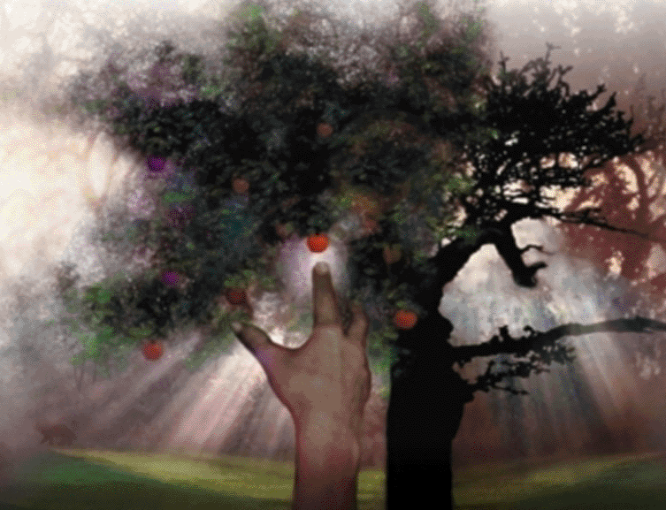
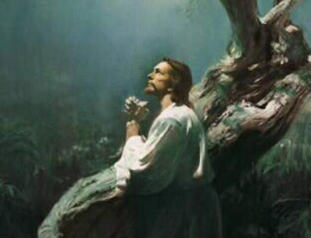
My Will or Thy Will
Garden of Eden
(Genesis 2:8-3:24)
Garden of Gethsemane
(Mark 14:32-39; John 18:1-11)
Notes:
D. Thy Will or My Will.
Two Gardens
Garden of Eden (Genesis 2:8-3:24)
(2:8-9, 15-17) immediately two choices (two trees).
(3:1-5) Serpent makes “My Will” seem appealing.
(3:6-7) Adam and Eve choose their will over God’s.
Garden of Gethsemane (Matt. 26:36-46; Mark 14:32-42; Luke 22:39-46; John 18:1-11)
(Mark 14:32-39) Jesus recognized two choices (I will or You will).
(John 18:1-11) Jesus chose God’s will.

Slide 20
Consequences
A. Garden Scenes.
Romans 5:12-21
B. General choice of God’s will or Our will.
My Will
Temporal Pleasure – Matthew 6:19
Notes:
III. There are consequences for both choices.
A. Specific consequences of Garden scenes.
Romans 5:12-21
B. General choice of God’s will or our will.
My Will
Temporal Pleasure – Matt. 6:19
Eternal Agony – Luke 12:20-21 (Rich Fool)
Thy Will
Temporal Suffering – Matt. 6:20; Luke 16:20-22
Eternal Salvation – Luke 16:25 (Lazarus and Rich Man)

Slide 21
Matthew 6:19
Do not lay up for yourselves treasures on earth, where moth and rust destroy and where thieves break in and steal.

Slide 22
Consequences
A. Garden Scenes.
Romans 5:12-21
B. General choice of God’s will or Our will.
My Will
Temporal Pleasure – Matthew 6:19
Eternal Agony – Luke 12:20-21
Thy Will
Temporal Suffering – Matthew 6:20; Luke 16:20-22
Notes:
III. There are consequences for both choices.
A. Specific consequences of Garden scenes.
Romans 5:12-21
B. General choice of God’s will or our will.
My Will
Temporal Pleasure – Matt. 6:19
Eternal Agony – Luke 12:20-21 (Rich Fool)
Thy Will
Temporal Suffering – Matt. 6:20; Luke 16:20-22
Eternal Salvation – Luke 16:25 (Lazarus and Rich Man)

Slide 23
Matthew 6:20
But lay up for yourselves treasures in heaven, where neither moth nor rust destroys and where thieves do not break in and steal.

Slide 24
Consequences
A. Garden Scenes.
Romans 5:12-21
B. General choice of God’s will or Our will.
My Will
Temporal Pleasure – Matthew 6:19
Eternal Agony – Luke 12:20-21
Thy Will
Temporal Suffering – Matthew 6:20; Luke 16:20-22
Eternal Salvation – Luke 16:25
Notes:
III. There are consequences for both choices.
A. Specific consequences of Garden scenes.
Romans 5:12-21
B. General choice of God’s will or our will.
My Will
Temporal Pleasure – Matt. 6:19
Eternal Agony – Luke 12:20-21 (Rich Fool)
Thy Will
Temporal Suffering – Matt. 6:20; Luke 16:20-22
Eternal Salvation – Luke 16:25 (Lazarus and Rich Man)

