Slide 1
Hope: A Great Treasure

Slide 2
What Is Hope?
The expectation of something promised.
The reality of something becoming real.
Acquiring what we want.
Hope becomes stronger the closer we get to the reality of it actually coming to be.
There is certainness with hope.

Slide 3
What Do We Hope For?
Heaven, Being with Deity eternally, Jesus appearing with His mighty angels, Justice of God realized
To see in reality what we have only believed to be.
Wasted or false hope would be:
More money in my bank, more possessions, more pleasure, whatever I want.

Slide 4
Hope Makes A Difference
Romans 5:1-6
Notice that hope does several things for us.
We exult in trials and tribulations as well as the glory of God
Hope does not disappoint.

Slide 5
Hope Makes A Difference
Romans 8:18-25
The redemption of our bodies
Suffering in this life will not matter in the life to come.
To be set free from the corruption that the whole creation faces.
Just imagine, no pain or sickness, no growing old, just perfect bodies to go along with our perfect voices and vision.
2 Corinthians 4:16-5:5
Philippians 3:20-21

Slide 6
Hope Makes A Difference
Titus 2:11-14
2 Thessalonians 1:6-10
Hope calls for us to seek the appearance of Jesus bringing His justice to all mankind.

Slide 7
Hope Makes A Difference
1 John 3:1-3
The faith to be replaced by sight.
If we have this hope, we purify ourselves.
Revelation 21:1-4
What we hope for will be worth it.

Slide 8
What Does Hope Do For Us?
It gives us a purpose.
Luke 24:13-35
Their hope was GONE, then realized. Then they got busy sharing the good news.

Slide 9
What Does Hope Do For Us?
Hope brings joy to us.
Philippians 1:18-26
Not only knowing what it does for us, but what it does for others that we care about.

Slide 10
What Does Hope Do For Us?
Hope develops patience.
Romans 8:24-25
James 1:2-4

Slide 11
What Does Hope Do For Us?
We wait for the hope of righteousness
Galatians 5:5
Know the hope of His calling
Ephesians 1:18
Gives us the hope of glory
Colossians 1:27

Slide 12
What Does Hope Do For Us?
Eternal life is offered to us.
Titus 3:4-7
Eternal life is described as thriving and living.
1 Peter 1:3

Slide 13
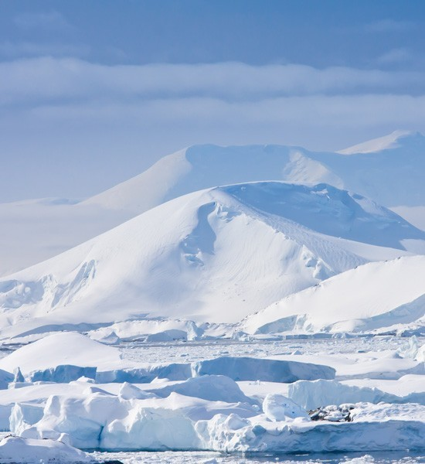
What Does Hope Do For Us?
It abides beyond the spiritual gifts
1 Corinthians 13:13
It strengthens our faith
Hebrews 11:1

Slide 14
Conclusion
We are a people of hope
Only true Christians can claim this hope.
Those outside of Christ have no hope for this world or the one to come.

