Slide 1
Ranger Church of Christ
Mesquite and Rusk St.
Welcome to the Ranger
Mesquite & Rusk St.
church of Christ
This Photo by Unknown Author is licensed under CC BY-NC-ND

Slide 2
Announcements | Songs | Title
1st Song | 258 | When We All Get to Heaven
2nd Song | 111 | My Jesus I Love Thee
Opening Prayer
3rd Song | 286 | Where He Leads I’ll Follow
4th Song | 257 | When I Survey the Wondrous Cross
Lords Supper
Offering
5th Song | 2 | A Wonderful Savior
Sermon
Invitation Song | 8 | Are You Washed In The Blood
Closing Song | 136 | My Faith Looks up to Thee
Closing Prayer

Slide 3
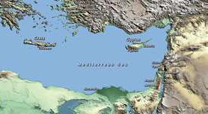
Overview of Biblical World Geography
Notes:
1. Overview of Biblical World Geography

Slide 4
Notes:
1. The Bible world extends from the Persia Gulf in the southeast to the city of Rome in the northwest,
>>>>>>>>>>>>>>>>>>>>>>>>>>>>>
2. And from Mt. Sinai in the south to Mt. Ararat in the north.
>>>>>>>>>>>>>>>>>>>>>
a. The Bible world, then, is about 2,200 miles from east to west and about 900 miles from north to south.
1.) Just shy of 2 million square miles.
b. The width of the Bible world, including the vast Mediterranean Sea, comprises about 2/3 the width of the continental United States.
>>>>>>>>>>>>>>>>>>>>>
c. The height of the Bible lands is about 2/3 the distance between the Mexican and Canadian borders.

Slide 5
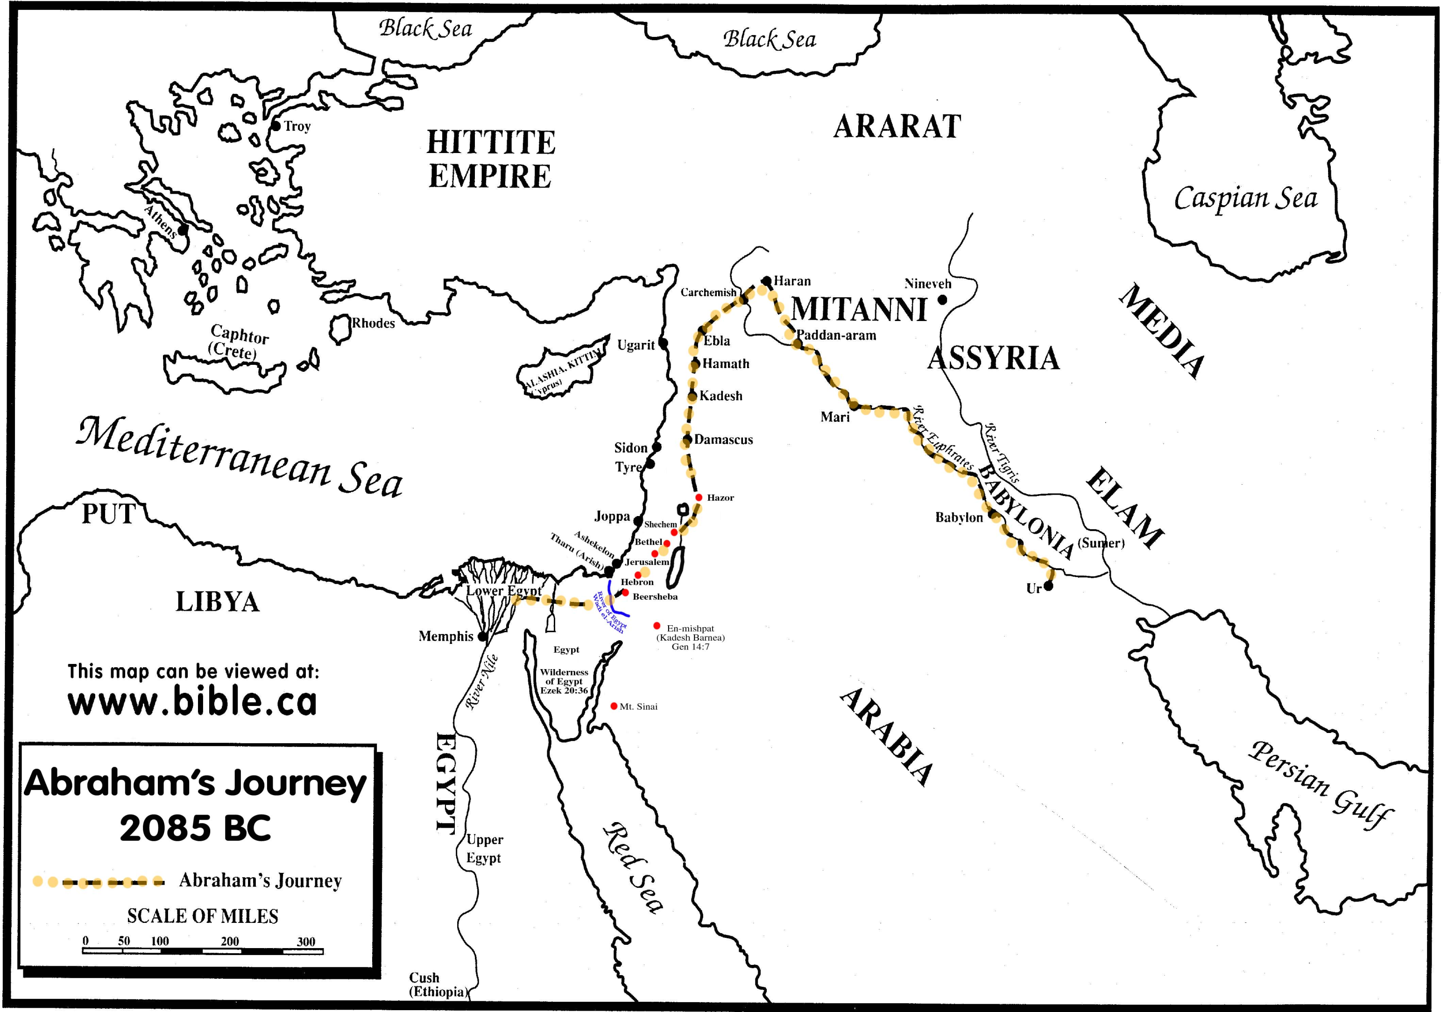
^
Mt.
^
Notes:
1. Bible world map: include important points such as,
a. Fertile Crescent,
>>>>>>>>>>>>>>>>
b. plus Tigris and Euphrates rivers
>>>>>>>>>>>>>>>>
c. vast desert,
>>>>>>>>>>>>>>>>
d. vast mountains
>>>>>>>>>>>>>>>>
e. large islands
>>>>>>>>>>>>>>>>
f. Nile River
>>>>>>>>>>>>>>>>
g. Red Sea and the Persian Gulf.
2. And we have the Eastern most point of the known Biblical world.
3. When we mention the Bible world, we are including areas of the world that correspond to events that appear in both testaments of the Bible.
a. If one were to include references to places besides places where events mentioned in the Bible occurred, the geographical area under consideration would be much larger, e.g. “Spain” Rom. 15:24, 28.
whenever I journey to Spain, I shall come to you. For I hope to see you on my journey, and to be helped on my way there by you, if first I may enjoy your company for a while. (Romans 15:24)
Therefore, when I have performed this and have sealed to them this fruit, I shall go by way of you to Spain. (Romans 15:28)
b. Most of the events recorded in the Bible took place in relatively small geographical areas that are comparable in size to regions of our country, states or counties.
c. Especially modern means of travel make the width and breadth of the Bible world appear small.
4. The topography or “lay of land” and geography in the Bible world is interwoven into the fabric of Bible events.
a. For instance, Noah’s ark came to rest on Mt. Ararat, Moses received the Ten Commandments on Mt. Sinai and Jerusalem is a mountain city.
b. On the other hand, the Jordan River drops an average of 22 feet per mile and empties into the lowest surface body of water on the planet the Dead Sea.

Slide 6
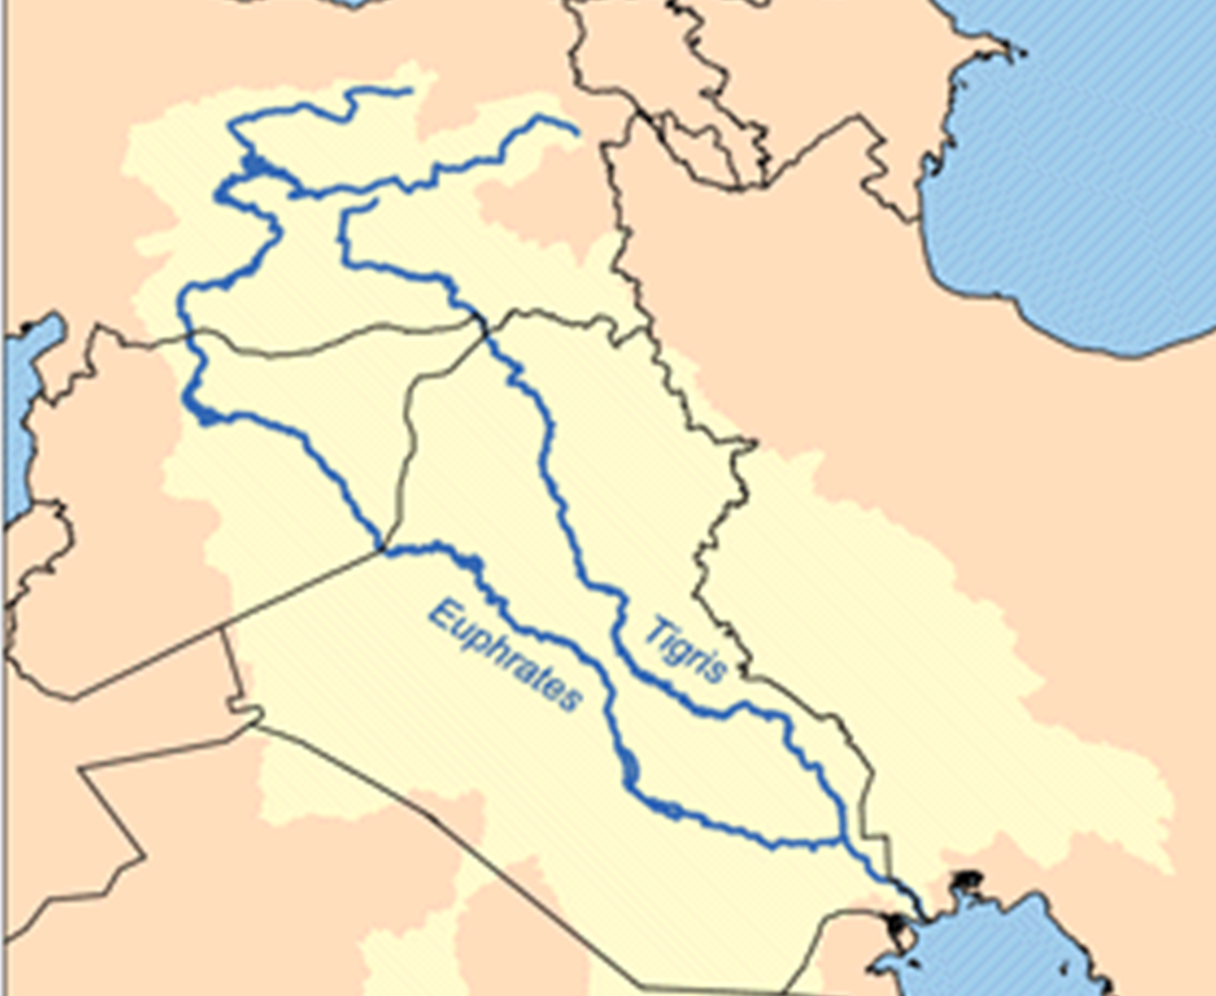
The Garden of Eden
Notes:
I. The Garden of Eden
A. In the persons of Adam and Eve, humanity made its debut on planet earth, in the Garden of Eden, Gen. 1-3.
>>>>>>>>>>>>>>>>>
1. The Garden of Eden was located in the eastern part of what is now Iraq.
2. Two of the four rivers that ran through the Garden of Eden still bear their ancient names, Euphrates and Tigris, Gen. 2:10-14.
>>>>>>>>>>>>>>>>>
3. Iraq also is the land in which lie the ruins of the ancient Sumerians, Babylonians, Assyrians as well as the cities of Ur, Babylon and Nineveh.
B. Archaeological discoveries provide secular and historical validation of the biblical account of creation.
1. One of the earliest known civilizations, the Sumerians, had a king list that refers to the universal flood and long lifespans.
2. Another ancient civilization, the Babylonians also had an account (seven Creation Tablets) of a universal flood, though there are similarities and dissimilarities to the biblical account (because of man’s waywardness, especially regarding monotheism versus polytheism.)
3. Two Temptation Seals each picturing a man, a woman and a serpent, dating to about 3,000 B.C., were discovered at Nineveh (in Iraq).
C. Nations that occupied the land now known as Iraq were once great world powers.
1. Just beyond Iraq and still bordering the Persian Gulf, the ancient Mede and Persian kingdoms occupied what is now known as Iran.
2. The combined kingdom of the Medes and Persians conquered Babylon, after which the Jews in captivity there were freed to return to Palestine.
3. Hence, the Persian Gulf marks the eastern-most compass point of the Bible world.

Slide 7
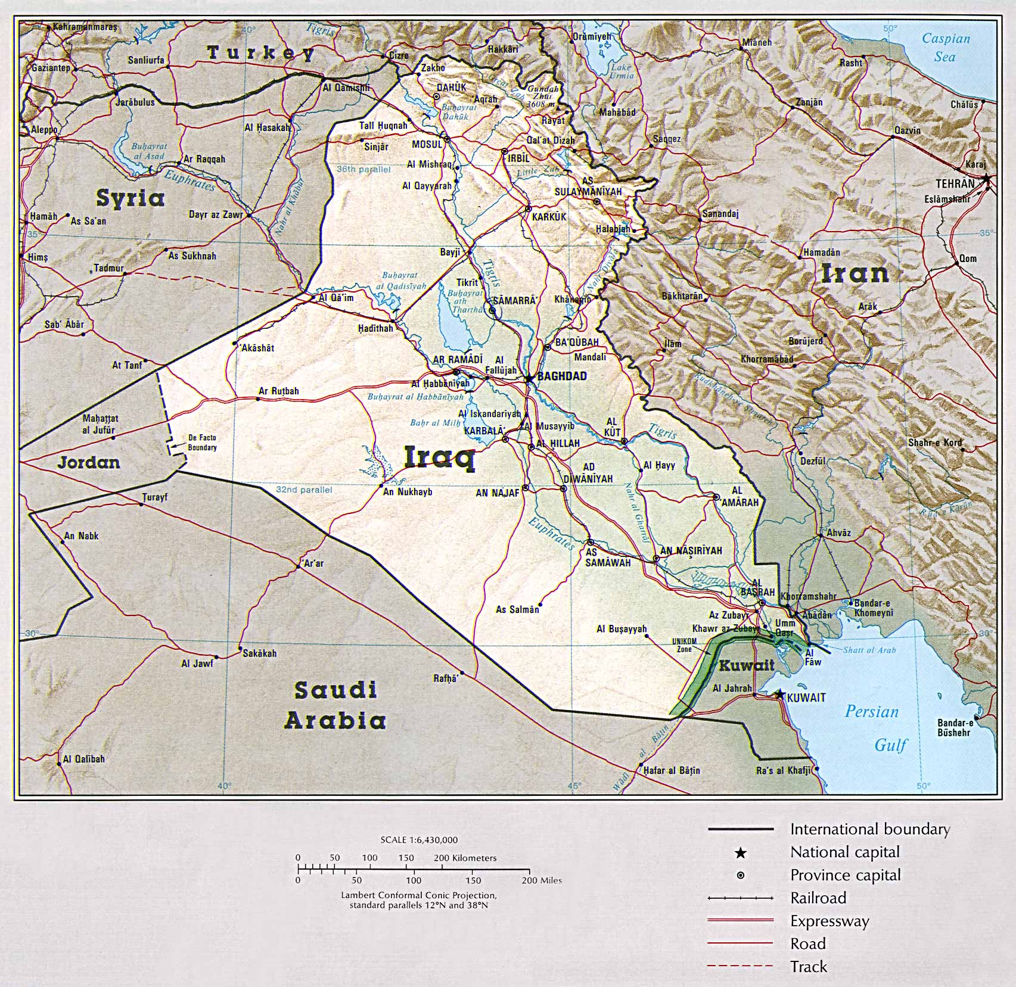
Notes:
1. This is a view of how we know the countries look today!
2. Notice the central location of Iraq, it is surrounded by Iran on the east, and Turkey, Syria, Jordan and Saudi Arabia on the east.

Slide 8
MAN
Woman
Tree of knowledge of Good and Evil
Serpent
Temptation Seal
Assur-banipal, king of Babylon (c. 1364-1368 BC), recorded that he "loved to read the writings of the age before the Flood." He referred to "inscriptions of the time before the Flood.".... Each person had their own seal. Seals were carved by delicate saws or drills on small pieces of stone or metal. seals and writings have been found under the Flood layer in Ur (modern Kuwait) ie., the "Temptation Seal" was found near Babylon, portraying in pictures exactly what Genesis says in words. It shows a tree, on the left side a man, the right side a woman plucking fruit, and behind her a serpent. Source: Halley's Bible Handbook, by H.H.Halley; Zondervan Publishing Co.; Copyright 1965; p. 44
Notes:
A. Two Temptation Seals, each picturing a man, a woman and a serpent, dating to about 3,000 B.C., were discovered at Nineveh (in Iraq).
1. Nations that occupied the land now known as Iraq were once world powers.
2. Just beyond Iraq and still bordering the Persian Gulf, the ancient Mede and Persian kingdoms occupied what is now known as Iran.
3. The combined kingdom of the Medes and Persians conquered Babylon, after which the Jews in captivity there were freed to return to Palestine.
4. Hence, the Persian Gulf marks the eastern-most compass point of the Bible world.
B. Assur-banipal, king of Babylon (1364-1368 BC), recorded that he "loved to read the writings of the age before the Flood."
1. He referred to "inscriptions of the time before the Flood.".... Each person had their own seal.
2. Seals were carved by delicate saws or drills on small pieces of stone or metal. seals and writings have been found under the Flood layer in Ur (modern Kuwait) ie.,
3. This seal, the "Temptation Seal" was found near Babylon, portraying in pictures exactly what Genesis says in words.
>>>>>>>>>>>>>>
a. It shows a tree, on the left side
>>>>>>>>>>>>>>
b. a man,
>>>>>>>>>>>>>>
c. the right side a woman plucking fruit, and
>>>>>>>>>>>>>>
d. behind her a serpent.

Slide 9
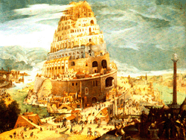
Then they said to one another, "Come, let us make bricks and bake them thoroughly." They had brick for stone, and they had asphalt for mortar. (Genesis 11:3)
Notes:
A. The ancient city of Babylon was situated in a flat, mud plain.
Then they said to one another, "Come, let us make bricks and bake them thoroughly." They had brick for stone, and they had asphalt for mortar. (Genesis 11:3)
1. It was the site of the Tower of Babel, (Gen. 11:1-9)
>>>>>>>>>>>>>>>>>>>
B. The Word "Babylon"
1. Babylon is Akkadian "babilani" which means "the Gate of God" and it became the capital of the land of Babylonia.
2. The etymology of the name Babel in the Bible means "confused" (Gen 11:9) and throughout the Bible, Babylon was a symbol of the confusion caused by godlessness.
3. The name Babylon is the Greek form of the Hebrew name Babel.

Slide 10
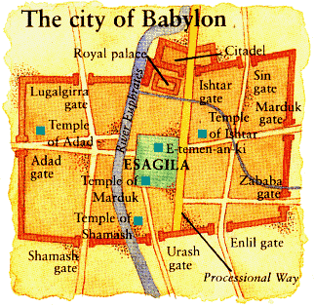
Notes:
1. Much later, the great, fortified city of Babylon was constructed in the plain, with massive outer walls besides inner walls and a moat plus numerous towers.

Slide 11
People
Notes:
1. Its outer walls were 350 feet tall, 87 feet thick and had 100 gates; no battering ram could break through the walls and no catapult could heave anything heavy over the walls; the main street in Babylon was one half mile wide.
2. Notice the size of the man inside the walls.

Slide 12
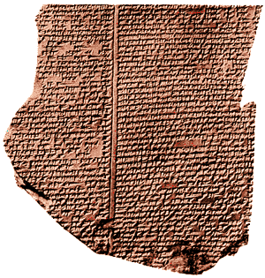
Code of Hammurabi
Notes:
1. One of the main aspects of Babylonian culture was that it had a codified system of law.
2. Hammurabi's famous code was the successor of earlier collections of laws going back to about 2050 BC.
3. The Babylonians used their art for the national celebration of great events and glorification of their gods.
4. It was marked by stylized and symbolic representations, but it expressed realism and spontaneity in the depiction of animals.
5. Hammurabi, was an early king of Babylon, he gave the world a complex law system called the Code of Hammurabi (1700 B.C.) that predates the Law of Moses by hundreds of years, but compares in it’s complexity to it.
6. Abraham practiced the Code of Hammurabi when he elected to have a second wife, by which to have children, since Sarah was barren.
7. Archaeological discoveries, provide secular and historical validation of the biblical account of God being the source of human laws.
8. The king of the ancient city of Ur (from which Abraham began his journey to Palestine) is depicted in archaeological discoveries as receiving laws from his god.
a. (correct in the assessment of law originating with God, but they were incorrect in attributing the origin of law to an idolatrous god).

Slide 13
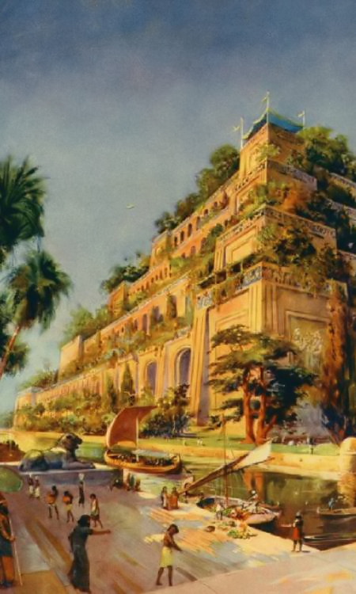
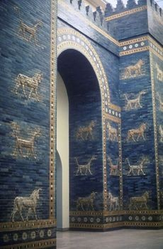
Notes:
1. During the second time Babylon enjoyed dominance in the Fertile Crescent, it vanquished (among other nations) the nation of Judah.
2. The prophesied 70 years of captivity began in 606 B.C.; a second carrying away from Judah to captivity occurred in 597 B.C.
3. Under the leadership of Nebuchadnezzar, - Babylon defeated Judah in 587 B.C.; the Jews were freed from captivity in 536 B.C., two years after the Medes & Persians conquered Babylon.

Slide 14
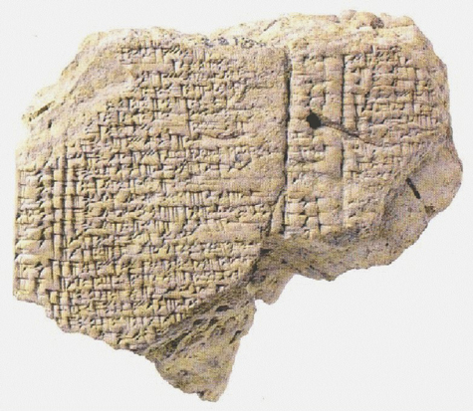
Ration record from Babylon mentioning Jehoiachin. During Robert Koldeway’s excavations at Babylon at the turn of the 20th century, he discovered what archaeologists call the “Northern Palace,” most likely the royal residence of King Nebuchadnezzar.
One of Jehoiachin Ration Tablets
Notes:
1. Ration record from Babylon mentioning Jehoiachin.
2. During Robert Koldeway’s excavations at Babylon at the turn of the 20th century, he discovered what archaeologists call the “Northern Palace,” most likely the royal residence of King Nebuchadnezzar.
3. Koldeway found there a number of cuneiform-inscribed clay tablets dating to the years 594–569 BC.
4. Four of the tablets list rations for “Jehoiachin, king of Judah” and his family.
5. These tablets are today in the Pergamum Museum, Berlin.

Slide 15
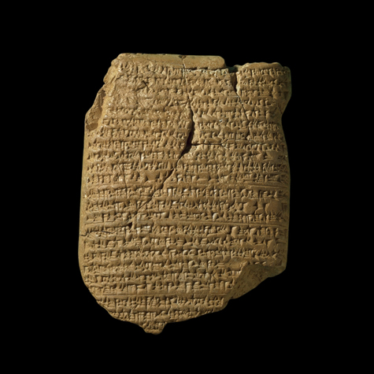
Notes:
1. Archaeological discoveries validate the biblical accounts associated with ancient Babylon.
a. Archaeology - records various kings of the divided kingdoms of Israel and Judah, and events associated with them, including: Omri, Ahab, Jehu, Pekah, Hosea, Ahaz, Hezekiah, Manasseh and Uzziah.
b. Jehoiachin, king of Judah, was taken prisoner to Babylon. Jehoiachin’s name appears on two seals impressed on jar handles; the seal reads: “Belonging to Eliakim steward of Jehoiachin.”
c. Also, Jehoiachin’s “ration receipts” in captivity were found in Babylon on the previous slide.
2. Babylon was twice a world power.

Slide 16
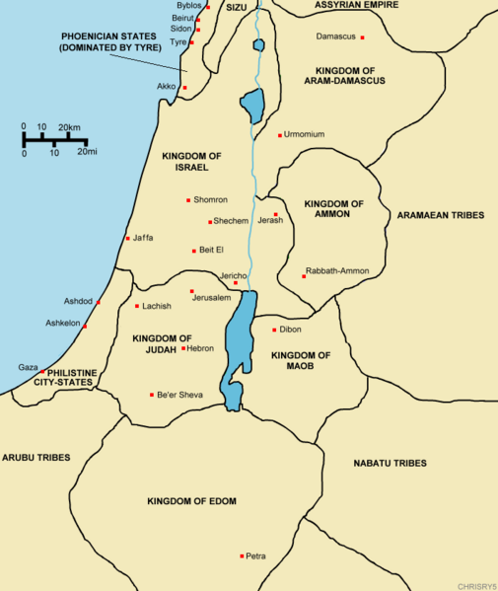
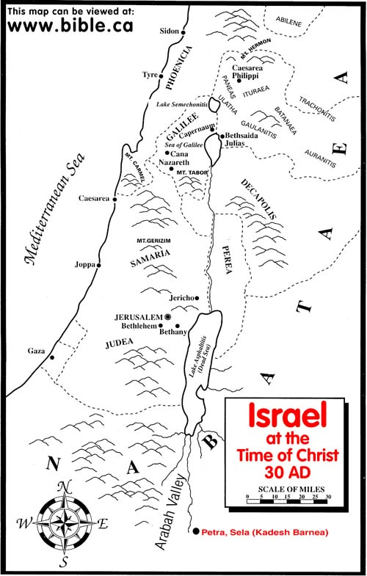
Notes:
1. A. Palestine served as a land bridge between the continents and subcontinents.
a. Until the rise of air travel in recent history, Palestine was the geographical center of the world.
b. It links Europe, Asia Minor, Africa, Saudi Arabia and Asia.
c. Consequently, whoever controlled Palestine controlled politics and commerce in most of the known world.
d. Therefore, Palestine has always been a battleground for and between nations!
2. We have a map demonstration of Canaan in this slide:
3. Palestine and Canaan do not represent exactly the same amount of land.
a. Technically, Canaan was the land on the west side of the Jordan River and amounted to 6,600 square miles.
b. Palestine included land on either side of the Jordan River and was about 12,000 square miles (the land over which David was King).

Slide 17
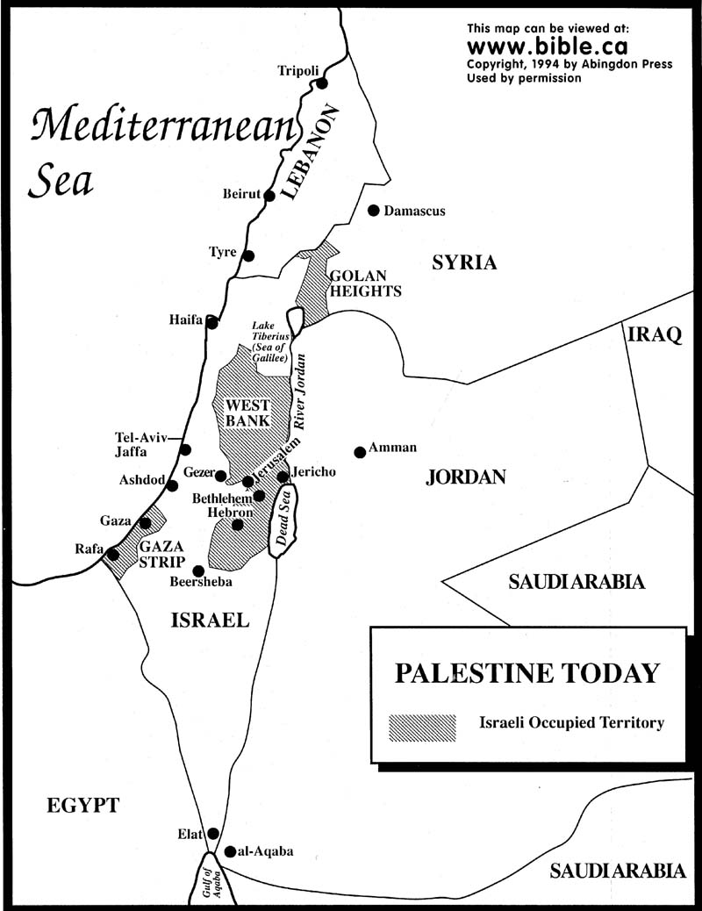
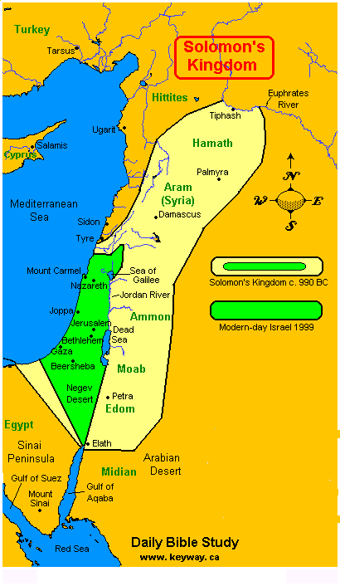
Notes:
1. By contrast, King Solomon ruled over 60,000 square miles from Canaan to the Euphrates River.

Slide 18
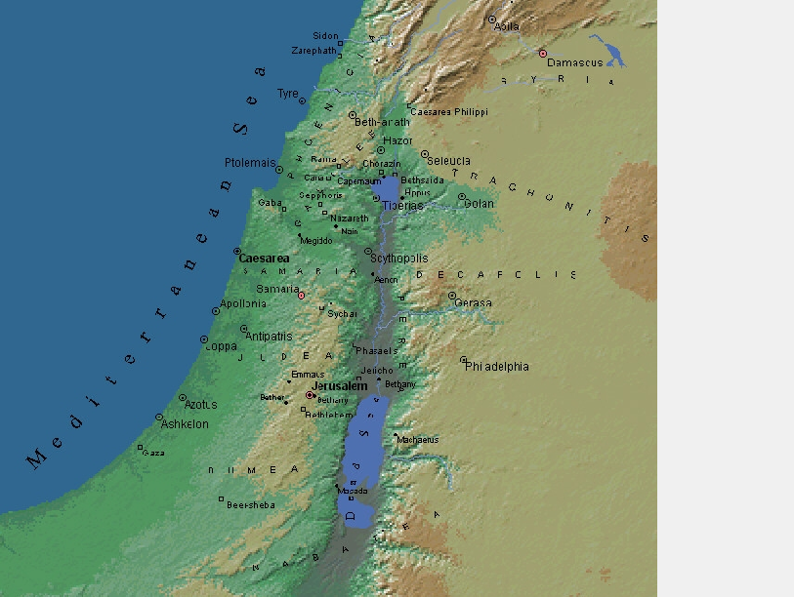
Notes:
1. Canaan is a land with many geographical contrasts in a relatively small space.
2. A coastal plain which runs north to south, except for where Mt. Carmel juts into the sea, comprises the Mediterranean coast.
3. Low rolling hills run parallel just east of the southern half of Canaan’s coastal plain.
4. The Central Mountain Range runs parallel north to south east
>>>>>>>>>>>>>>>
5. Of the low rolling hills in the south, and the coastal plain in the north, it is bounded by the Jordan River Valley on the east;
>>>>>>>>>>>>>>>
6. mountains on either side of the Jordan River range from 2,500 feet to over 3,000 feet above sea level.
7. Jerusalem, with Bethlehem (five miles to the south of Jerusalem), and Hebron still further south are mountain cities;
>>>>>>>>>>>>>>>
8. Jericho (800 feet below sea level), 16 miles east of Jerusalem (2,500 feet above sea level) is 3,300 feet below the elevation of Jerusalem.
>>>>>>>>>>>>>>>
9. The Dead Sea’s surface is 1,300 feet below sea level.
>>>>>>>>>>>>>>>
10. Canaan, then, has the Mediterranean Sea to the west and a great desert beyond the Jordan River and to its south, plus coastal plains, hills, mountains and deep valleys; the twin Lebanon Mountain chains at the north end of Palestine rise to 10,200 feet
>>>>>>>>>>>>>>>
11. We can add to this Mount Hermon an elevation of 9,200 feet.

Slide 19
Notes:
1. Mountain passes were critical to the history of Palestine.
2. A mountain pass just east of Mt. Carmel
>>>>>>>>>>>>>
3. Near the seacoast, provided the only means of conveniently traveling with commerce or armies north or south through Canaan, as well as east or west at that point between the coast and the Jordan River Valley.
>>>>>>>>>>>>>>
2. The various names of the vicinity are Valley of Megiddo, Valley of Jezreel and Plain of Esdraelon; this is the very spot where premillennialists believe that the Battle of Armageddon is supposed to occur.

Slide 20
Notes:
1. Palestine is an archaeological wonderland, besides the surrounding regions of Egypt, Saudi Arabia, Turkey and Iraq.
>>>>>>>>>>>>>>>
2. One can hardly press a shovel into the soil without striking something that corresponds to that countries ancient history.
3. Every major construction project from roads to buildings is often hampered while archaeologists rescue artifacts or ancient human remains.
4. Israel under the leadership of King Solomon was once a world power.
We have covered everything from the Garden of Eden, to Babylon and Palestine this morning; so we will stop and resume this afternoon with Egypt, Turkey, Greece, and Rome.

Slide 21
The Invitation is Yours!
He who believes and is baptized will be saved; but he who does not believe will be condemned. (Mark 16:16)
If we confess our sins, He is faithful and just to forgive us our sins and to cleanse us from all unrighteousness. (1 John 1:9)
Invitation Song | 8 | Are You Washed In The Blood
Closing Song | 136 | My Faith Looks up to Thee
Closing Prayer
Notes:
He who believes and is baptized will be saved; but he who does not believe will be condemned. (Mark 16:16)
If we confess our sins, He is faithful and just to forgive us our sins and to cleanse us from all unrighteousness. (1 John 1:9)

Slide 22
Ranger Church of Christ
Mesquite and Rusk St.
Welcome to the Ranger
Mesquite & Rusk St.
church of Christ
Evening Worship

Slide 23
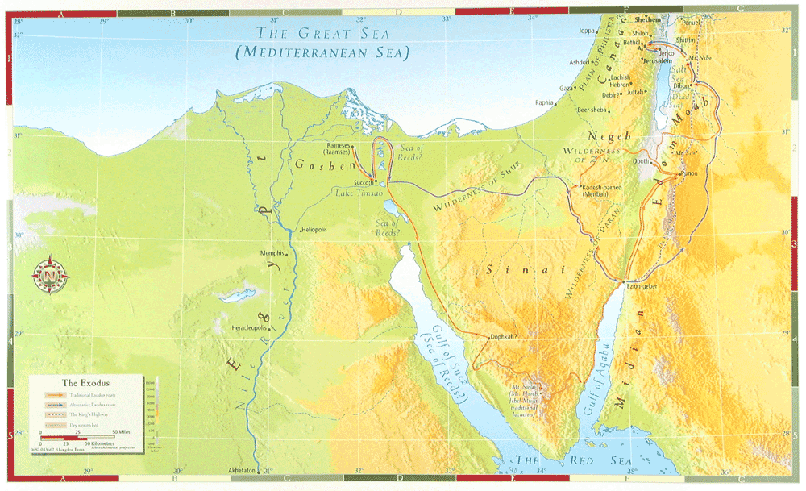
Notes:
A. Egypt is a vast desert, the only redemption which it has is from the fertility and water of the Nile River Valley.
1. Consequently, Egypt is sometimes referred to as “the gift of the Nile.”
>>>>>>>>>>>>>>>>>>
2. The Nile River is the longest river system in the world and among a handful of rivers in the world that flow north; it is over 4,000 miles long.
3. Besides the Nile River itself, irrigation drawn from the Nile River is just as essential to the habitability of Egypt as it would by a population of any size.
B. Egypt has long been known for its archaeological treasures.
1. Egypt is nearly as old as the earliest traces of humanity found near the Persian Gulf.
2. Due to the great expanse of time inhabited and because of both the extensive use of stone and a climate friendly to the preservation of other materials, Egypt is unsurpassed in its archaeological contributions.
3. The great, still unexplained pyramids best symbolize Egypt’s ancient past.
>>>>>>>>>>>>>>>>>>>>>>>
C. Mt. Sinai, east of Egypt and at the southern extremity of the Sinai Peninsula, this is where Moses received the Ten Commandments and inaugurated Judaism;
1. Mt. Sinai is the southern-most compass point of the Bible world known at that time.
D. It may be difficult to imagine, but once Egypt was a vibrant dominating Biblical world power.

Slide 24
Hittusa
Notes:
A. In Assyria, note the towns of Nineveh on the Tigris River and it’s relationship to Babylon on the Euphrates River.
1. Anciently, the Hittites marshaled a kingdom from the lofty mountains of Turkey, the capital of which was Hittusa.
>>>>>>>>>>>>>>>>
2. The Hittites were hearty warriors who themselves migrated from the Black Sea and Caspian Sea area to Turkey.
>>>>>>>>>>>>>>>
3. from which they fought with Babylon (and sacked it)
>>>>>>>>>>>>>>>
4. The Hittites fought to a standstill with the Egyptians before they took Canaan for themselves..
B. Much of the Book of Acts chronicles the missionary journeys of the apostle Paul; largely through what today is Turkey.

Slide 25
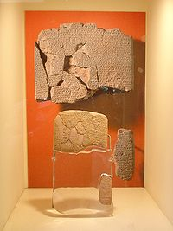
Egypto-Hittite Peace Treaty (c. 1258 BC) between Hattusili III and Ramesses II is the best known early written peace treaty. Istanbul Archaeology Museum
Notes:
A. The Hittiet empire lasted from 1600 – 1200 B.C.
1. The Hittites are thought to have had the first constitutional monarchy.
2. This consisted of a king, royal family, the pankush (who monitored the king's activities), and an often rebellious aristocracy.
3. The Hittites also made huge advances in legislation and justice.
4. They produced the Hittite laws.
5. These laws rarely used death as a punishment. For example, the punishment for theft was to pay back the amount stolen.
B. During the 15th century BC, Hittite power fell into obscurity, re-emerging with the reign of Tudhaliya I from ca. 1400 BC.
1. Under Suppiluliuma I and Mursili II, the Empire was extended to most of Anatolia and parts of Syria and Canaan,
2. By 1300 BC the Hittites were bordering on the Egyptian sphere of influence, leading to the inconclusive Battle of Kadesh in 1274 BC.

Slide 26
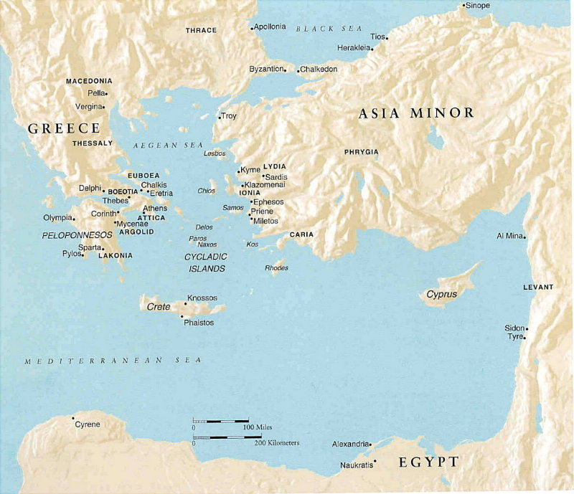
Notes:
A. The Hittites are usually depicted as a people living among the Israelites –
1. Abraham purchases the Patriarchal burial-plot of Machpelah from "Ephron HaChiti", Ephron the Hittite.
2. Hittites served as high military officers in David's army.
3. In 2 Kings 7:6, however, they are a people with their own kingdoms (the passage refers to "kings" in the plural), apparently located outside geographic Canaan, and sufficiently powerful to put a Syrian army to flight. B. The ruggedness of Turkey, which still has not been tamed by the modern world, concealed in plain sight the mountain city capital of the Hittites; archaeologists only discovered it in the early 20th century.
C. On the border between Turkey and the old Soviet Union, Mt. Ararat where Noah’s Ark came to rest.
1. It is the northern-most compass point of the known Bible world.
E. It may be hard to believe, but Turkey was once a strong world power.

Slide 27
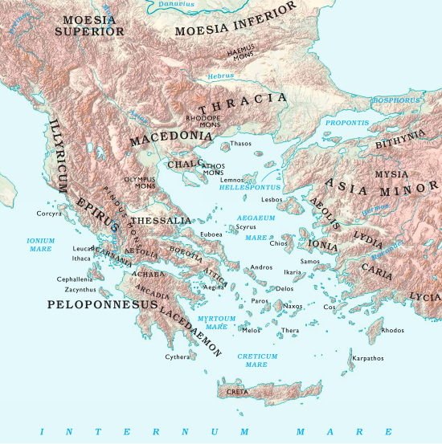
Notes:
VI. Greece
A. The Greeks unseated the Persians as rulers of the Bible world in 333 B.C.
1. Under the leadership of a young man named Alexander the Great, - Greece graduated from numerous warring city-states to a Mega superpower status.
2. Against overwhelming numbers, Alexander the Great conquered the known world in 11 years.
3. Stopping his advance in India - only because his army was reluctant to go further.
4. Alexander the Great died of a disease and a broken heart at the age of 33 with no more worlds to conquer.

Slide 28
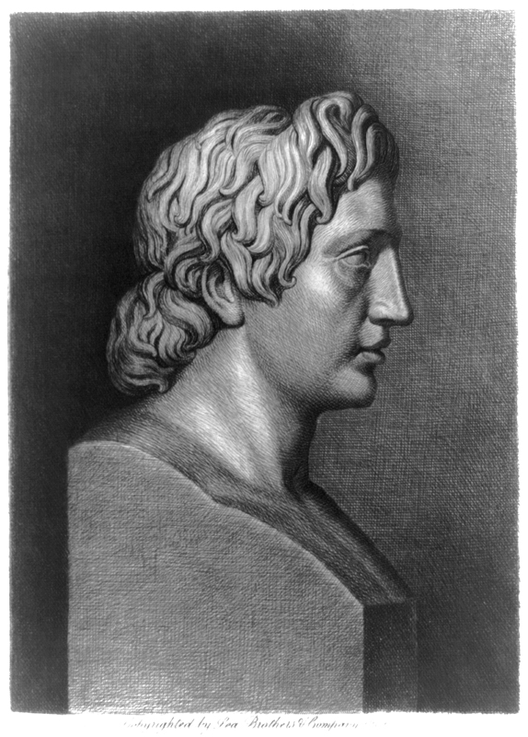
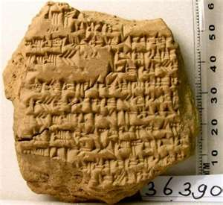
363go The archaeology of Alexander the Great: Babylonian Diary
Notes:
A. The quote here is:
I am not afraid of an army of lions - led by a sheep; I am afraid of an army of sheep led by a lion. Alexander the Great

Slide 29
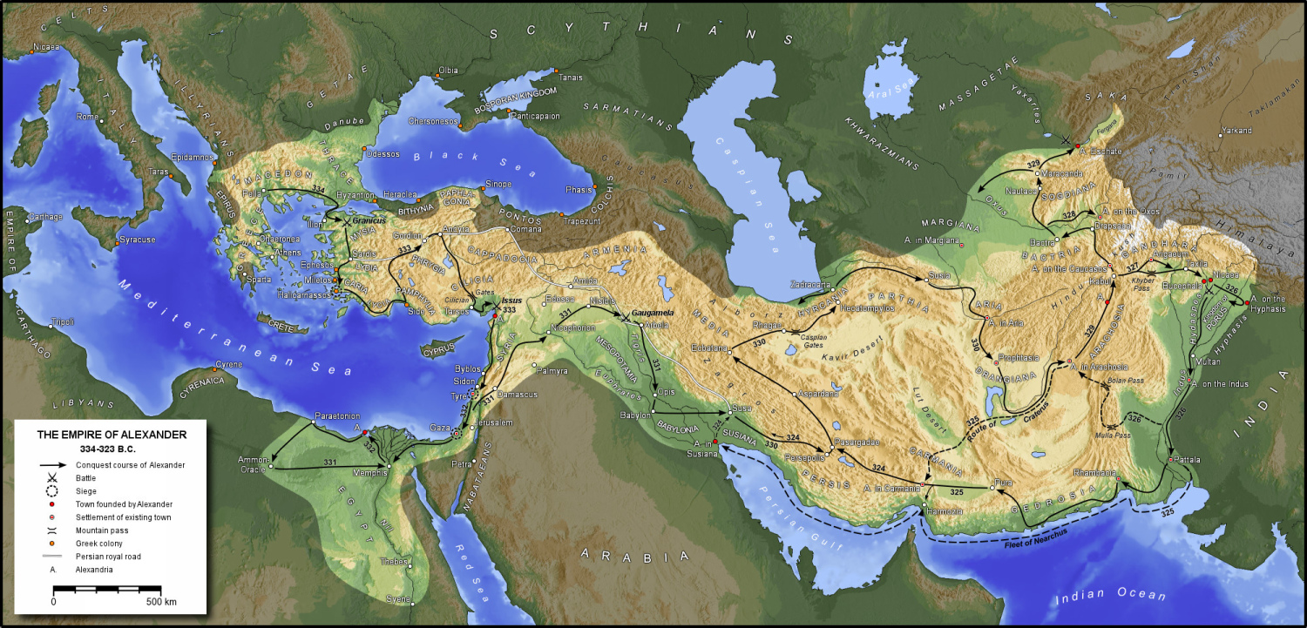
Notes:
A. The rise of Greece was foretold in Bible prophecy, Dan.2:31-45; 8:21; 10:20; 11:2.
And the male goat is the kingdom of Greece. The large horn that is between its eyes is the first king. (Daniel 8:21)
-------------------------
Then he said, "Do you know why I have come to you? And now I must return to fight with the prince of Persia; and when I have gone forth, indeed the prince of Greece will come. (Daniel 10:20)
-------------------------
And now I will tell you the truth: Behold, three more kings will arise in Persia, and the fourth shall be far richer than them all; by his strength, through his riches, he shall stir up all against the realm of Greece. (Daniel 11:2)
1. Cambyses, the son of Cyrus.
2. Smerdis, the Magian, who was an impostor, who pretended to be another son of Cyrus.
3. And Darius, the son of Hystaspes, who married Mandane, the daughter of Cyrus.
B. Cambyses reigned seven years and five months; and Smerdis reigned only seven months after that; and Darius Hystaspes reigned thirty-six years later.
1. The fourth shall be far richer than they all - This was Xerxes, the son of Darius, of whom Justin says. “He had so great an abundance of riches in his kingdom, that although rivers were dried up by his numerous armies, yet his wealth remained unexhausted.”

Slide 30
Notes:
1. Greece gave the world its Greek culture, including a universal language, in which later the New Testament was written.
2. Archaeological sites pepper Greece today and many of its ruins remain above ground as they do in Athens and Corinth; they are still impressive.
3. Greece was once a world superpower and brought in one language used in all nations.
4. As we later learned was required by God for the Biblical understanding of the world.

Slide 31
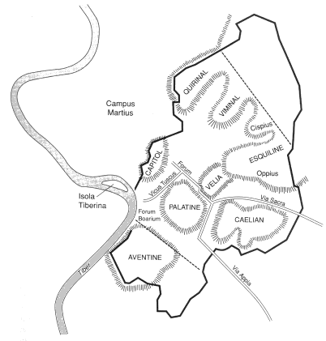
The Seven Hills of Rome
753 B.C. – 476 A.D. = 1,229 years
Notes:
VII. Rome
A. Rome was built on seven hills in Italy, it rose to dominate the known world at it’s time,
1. And it has survived longer than any other superpower the world has known (753 B.C.476 A.D. – 1,229 years).

Slide 32
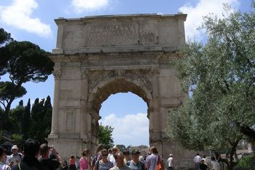
Notes:
1. Consequently, because of its long history as well as what remains above ground, Rome is obviously a town of archaeological significance.
2. The Arch of Titus that commemorates the destruction of Jerusalem, the Coliseum, and the catacombs remain as prominent items of archaeological interest.

Slide 33
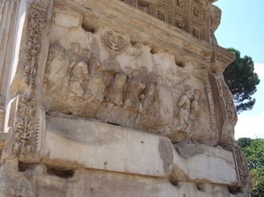
Notes:
1. Inside the Arch of Titus, is the relief of the Sacking of Jerusalem.
2. Notice the size of the Temple Candlestick.

Slide 34
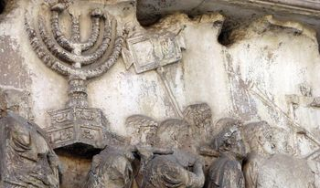
Notes:
1. Relief showing the sacking of Jerusalem on the arch of Titus.

Slide 35
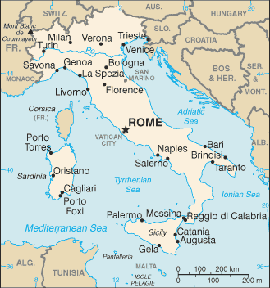
Notes:
1. Rome provided the most reliable transportation system of highways throughout its empire, granting rapid access to all parts of the know provinces.
2. Jesus was born, lived, and died during the reign of the Roman Empire.
a. The early church began and functioned while Rome ruled the Mediterranean world and beyond.
3 There was a church of Christ in Rome to which the apostle Paul penned an epistle.
4. Italy was once the worlds greatest and longest lasting power.

Slide 36
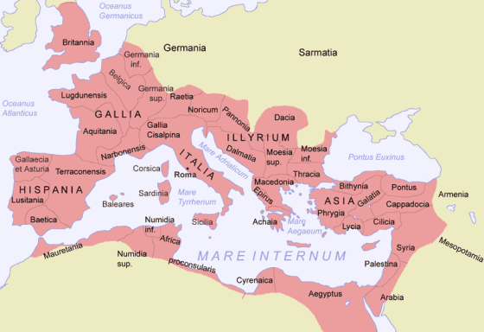
Notes:
B. Rome marks the western-most compass point of the Bible world.
1. Rome is of primary biblical importance because it pertains to the establishment of Christianity and the Lord’s church, Dan. 2:31-45; Acts 2:1-47.

Slide 37
Head of Gold – Babylon - Nebuchadnezzar
Chest of Silver – Medo-Persian –
Cyrus II the Great and Darius the Mede
Belly and thighs of Brass – Greece
Alexander the Great
Legs of Iron - Rome
Feet of Iron and Clay – 10 Caesars
The Stone Not Cut With Hands Jesus Christ.
Notes:
A. Dan 2:32-45
1. So we can now see the fulfillment of the prophecy of Daniel from the dream of Nebuchadnezzer.
a. Kingdom of iron with feet of clay and iron.
b. Crushed by the stone not carved out by human hands
c. Stone is the corner stone of the kingdom.
d. Acts 2 that kingdom is established by Jesus Christ as prophesied in the Book of Daniel.

Slide 38
ROME
Notes:
Conclusion:
1. The Bible world was sufficiently small enough that when any part of it was inflamed by war, the entire Bible world was affected; 200,000 or more troops in anyone’s backyard would be hard to overlook.
2. The Bible world is awash in tens of thousands of archaeologically valuable sites, the vast majority of which have not been examined yet.
3. The Bible is accurate geographically and topographically.
a. This is suggestive of its reliability on whatever it addresses in its pages.
b. Therefore, it is reasonable to accept the credibility of the Bible in areas that do not lend themselves to inspection, e.g. religious doctrine.
4. A fundamental understanding of the geography of the biblical world is essential to comprehension of Bible information and Bible truths.

Slide 39
"Therefore thus will I do to you, O Israel; Because I will do this to you, Prepare to meet your God, O Israel!" (Amos 4:12)
Then Peter said to them, "Repent, and let every one of you be baptized in the name of Jesus Christ for the remission of sins; and you shall receive the gift of the Holy Spirit. (Acts 2:38)
Repent therefore of this your wickedness, and pray God if perhaps the thought of your heart may be forgiven you. (Acts 8:22)
Notes:
Invitation:
1. More important than the geography of the Bible world is knowledge of the Bible whereby one can prepare to meet God in eternity, Amos 4:12.
"Therefore thus will I do to you, O Israel; Because I will do this to you, Prepare to meet your God, O Israel!" (Amos 4:12)
2. Believers need to repent and be baptized for the remission of their sins, Acts 2:38.
Then Peter said to them, "Repent, and let every one of you be baptized in the name of Jesus Christ for the remission of sins; and you shall receive the gift of the Holy Spirit. (Acts 2:38)
3. Erring Christians need to repent and pray, Acts 8:22.
Repent therefore of this your wickedness, and pray God if perhaps the thought of your heart may be forgiven you. (Acts 8:22)

