Slide 1
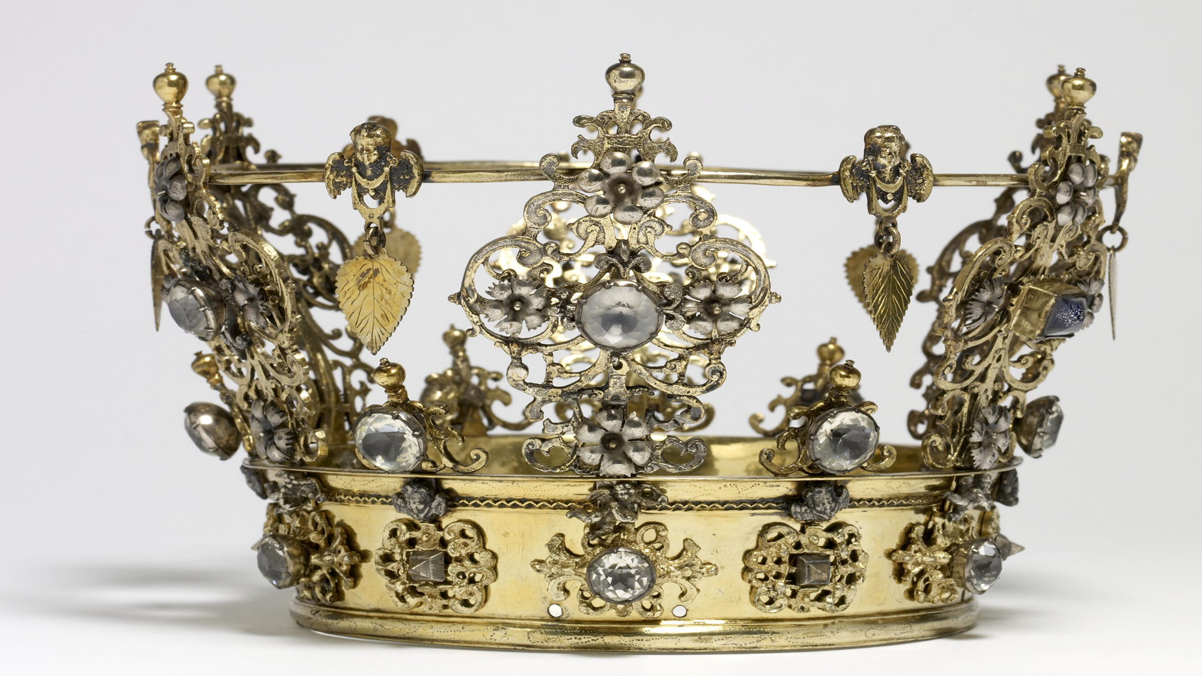
Live With the King
Ranger Church of Christ
Mesquite and Rusk St.

Slide 2
Announcements | Songs | Title
1st Song | 273 | Wonderful Love
2nd Song | 144 | More Love to Thee
Opening Prayer
3rd Song | 96 | He Is Able to Deliver Thee
4th Song | 229 | The Lord’s Supper
Lords Supper
Offering
5th Song | 185 | Stepping in the Light
Sermon
Invitation Song | 58 | God is Calling the Prodigal
Closing Song | 220 | Take the Name of Jesus with You
Closing Prayer

Slide 3
The Winner’s Circle
Notes:
1. Can I achieve the rewards of being in the “Winners Circle” and Live with The King?
>>>>>>>>>>>>>>>>>>>
2. God always wins! That is the theme of the Bible.
3. Satan’s best efforts to overthrow Divine Authority, to thwart the will of God, and drag down all humanity with him, fails miserably.
4. Jesus came to “destroy the works of the devil” (1 John 3:8).
He who sins is of the devil, for the devil has sinned from the beginning. For this purpose the Son of God was manifested, that He might destroy the works of the devil. (1 John 3:8)

Slide 4
Recall if you will Jesus at the Jordan River
Jesus was led by the Holy Spirit into the wilderness
Jesus refused to be swayed by the devil’s deceptive appeal
This truth is best summarized by the last words of Jesus
Notes:
Recall if you will Jesus at the Jordan River:
>>>>>>>>>>>>>>
A. Jesus was led by the Holy Spirit into the wilderness
1. To be tempted by the Devil,
2. This was right after His baptism by John the Baptist.
Then Jesus, being filled with the Holy Spirit, returned from the Jordan and was led by the Spirit into the wilderness, (Luke 4:1)
1. Just as Job was allowed to be tempted by Satan,
2. Just as Peter was allowed to be sifted by the Devil
3. So Jesus was led by the Holy Spirit Himself, into the wilderness for the sole purpose of being tempted by Satan.
>>>>>>>>>>>>>>>
B. In the Desert Jesus refused to be swayed by the devil’s deceptive appeals to vanity.
1. The Devil used flattering words in his temptation:
2. “If you are the Son of God...”.
3. Instead, Jesus rebuffed the devil by being focused on the written word, and the truth contained therein about His Father (Matt 4 & Luke 4).
>>>>>>>>>>>>>>>>>>
C. This truth is best summarized by the last words of Jesus on that subject that day, saying,
"Away with you, Satan! For it is written, 'YOU SHALL WORSHIP THE LORD YOUR GOD, AND HIM ONLY YOU SHALL SERVE” (Matthew 4:10).

Slide 5
In the Garden before His betrayal
Our Lord faced the moment of death.
As He faced His own mortality
Notes:
II. In the Garden before His betrayal;
A. Our Lord faced the moment of death.
1. He was desiring; that is seeking a way out.
2. Without compromising the purpose of His mission.
3. His mission we can find and read in (Luke 19:10; Matthew 20:28).
for the Son of Man has come to seek and to save that which was lost." (Luke 19:10)
just as the Son of Man did not come to be served, but to serve, and to give His life a ransom for many." (Matthew 20:28)
B. As He faced His own mortality:
1. Jesus said:
"O My Father, if it is possible, let this cup pass from Me; nevertheless, not as I will, but as You will…” (Matthew 26:39)
2. And, “Again, a second time, He went away and prayed, saying:
‘O My Father, if this cup cannot pass away from Me unless I drink it, Your will be done." (Matthew 26:42)

Slide 6
What was sandwiched between these major moments and the trial and temptation
There were other times Satan sought to lead Christ into sin, but failed (Heb 4:15).
God wins!
And He invites us to join Him in the winner’s circle.
Notes:
III. What was sandwiched in between these major moments of trial and temptation:
>>>>>>>>>>>>>>>>>>
A. There were other times Satan sought to lead Christ into sin, but failed (Heb 4:15).
For we do not have a High Priest who cannot sympathize with our weaknesses, but was in all points tempted as we are, yet without sin. (Hebrews 4:15)
1. In the hours leading up to the crucifixion Jesus said in (John 12:31).
Now is the judgment of this world; now the ruler of this world will be cast out. (John 12:31)
2. Jesus destroyed the works of the devil, as we read that was what He came to do, in (1 John 3:8)
>>>>>>>>>>>>>>>>>>>
B. God wins!
>>>>>>>>>>>>>>>>>>>
C. And He invites us to join Him in the winner’s circle.

Slide 7
For us to enter the Winner’s Circle we must:
Qualify for the Race:
Hear the bride and the Spirit say, "Come!” (Rev 22:17)
We are called by the gospel (2 Thess 2:11),
We are to obey it and be purified by it (1 Pet 1:22).
We must believe (Rom 10:9-10) and confess Jesus Christ (Acts 8:37)
repent (Acts 2:38) of sin, and be baptized (Acts 22:16)
Jesus then records our name in His Book of Life
Notes:
IV. In order for us to enter the Winner’s Circle we must:
>>>>>>>>>>>>>>>>>>>>>
A. Qualify for the Race:
1. We enter the race only by invitation, which God in His grace and mercy has extended to all men (Eph 2:4-9; Titus 2:11).
For the grace of God that brings salvation has appeared to all men, (Titus 2:11)
2. Hear the bride and the Spirit say, "Come!” (Rev 22:17).
And the Spirit and the bride say, "Come!" And let him who hears say, "Come!" And let him who thirsts come. Whoever desires, let him take the water of life freely. (Revelation 22:17)
>>>>>>>>>>>>>>>>>>>>
3. We are called by the gospel (2 Thess 2:11) otherwise, we believe Satan’s and man’s lies.
And for this reason God will send them strong delusion, that they should believe the lie, (2 Thessalonians 2:11)
>>>>>>>>>>>>>>>>>>>>
a. We are to obey it and be purified by it (1 Pet 1:22; 1 Pet 4:17).
Since you have purified your souls in obeying the truth through the Spirit in sincere love of the brethren, love one another fervently with a pure heart, (1 Peter 1:22)
For the time has come for judgment to begin at the house of God; and if it begins with us first, what will be the end of those who do not obey the gospel of God? (1 Peter 4:17)
>>>>>>>>>>>>>>>>>>>>>
4. To qualify for the race we must believe in and confess Jesus Christ as the Son of God (Romans 10:9-10; Acts 8:37),
Then Philip said, "If you believe with all your heart, you may." And he answered and said, "I believe that Jesus Christ is the Son of God." (Acts 8:37)
>>>>>>>>>>>>>>>>>>>>>>
repent of sin, and be baptized for the remission of sins (Read: Rom 10:13; Acts 22:16; Acts 2:38-39; Romans 6:3-4).
a. These are the required “Rules of Qualification” for the race.
b. We call them the “Plan of Salvation”
>>>>>>>>>>>>>>>>>>
For "WHOEVER CALLS ON THE NAME OF THE LORD SHALL BE SAVED." (Romans 10:13)
--------------------
And now why are you waiting? Arise and be baptized, and wash away your sins, calling on the name of the Lord.' (Acts 22:16)
--------------------
Then Peter said to them, "Repent, and let every one of you be baptized in the name of Jesus Christ for the remission of sins; and you shall receive the gift of the Holy Spirit. (Acts 2:38)
--------------------
Or do you not know that as many of us as were baptized into Christ Jesus were baptized into His death? Therefore we were buried with Him through baptism into death, that just as Christ was raised from the dead by the glory of the Father, even so we also should walk in newness of life. (Romans 6:3-4)
------------------------
>>>>>>>>>>>>>>>>>>>>>>>
5. Jesus then records our name in His Book of Life where it remains on record until the end of time, unless we are disqualified and scratched from the Book of Life (1 Cor 9:27; 2 Peter 2:20-21; Rev 3:5).
>>>>>>>>>>>>>>>>>>>>>>>
But I discipline my body and bring it into subjection, lest, when I have preached to others, I myself should become disqualified. (1 Corinthians 9:27)
For if, after they have escaped the pollutions of the world through the knowledge of the Lord and Savior Jesus Christ, they are again entangled in them and overcome, the latter end is worse for them than the beginning. For it would have been better for them not to have known the way of righteousness, than having known it, to turn from the holy commandment delivered to them. (2 Peter 2:20-21)
--------------------------
He who overcomes shall be clothed in white garments, and I will not blot out his name from the Book of Life; but I will confess his name before My Father and before His angels. (Revelation 3:5)
And the LORD said to Moses, "Whoever has sinned against Me, I will blot him out of My book. (Exodus 32:33)

Slide 8
Prepare for the Race:
Run in such a way that you may obtain it.
Everyone who competes is to be temperate in all things
Exercise self-control in all things
Training regimen is not a waste of time and energy
Body in subjection through discipline
Notes:
B. Prepare for the Race:
1. In 1 Cor 9:24 Paul exhorts us to
>>>>>>>>>>>>>>>>>>
Do you not know that those who run in a race all run, but one receives the prize? Run in such a way that you may obtain it. (1 Cor 9:24)
2. He reminds us that our prize for which we are striving is imperishable (vs. 25), and requires that we compete with integrity:
>>>>>>>>>>>>>>>>>>
And everyone who competes for the prize is temperate in all things. Now they do it to obtain a perishable crown, but we for an imperishable crown. (1 Cor 9:25)
>>>>>>>>>>>>>>>>>
a) exercise self-control in all things
>>>>>>>>>>>>>>>>>
b) be sure that our training regimen is not a waste of time and energy (like a boxer beating the air),
>>>>>>>>>>>>>>>>>>
c) bring our body in subjection through discipline (Vs. 27), otherwise we could be disqualified.

Slide 9
Race According to the Rules:
Playing by the rules is the only way to win
So also the race for the imperishable crown.
Our race has a morality clause in it
And it regulates our speech
The Rules forbids prejudice
Notes:
C. Race According to the Rules:
1. In 2 Tim 2:5 we read,
“And also if anyone competes in athletics, he is not crowned unless he competes according to the rules.”
>>>>>>>>>>>>>>>>>>>>>>>>>>>>
2. Regardless how it may appear with the current athletes and their use of PED (Performance Enhancement Drugs) there use being revealed in sports, playing by the rules is the only way to win.
>>>>>>>>>>>>>>>>>>>>>>>>>>>>
3. So also the race for the imperishable crown.
>>>>>>>>>>>>>>>>>>>>>>>>>>>>
4. Our race has a morality clause in it (1 Thess 4:3-8),
that no one should take advantage of and defraud his brother in this matter, because the Lord is the avenger of all such, as we also forewarned you and testified. For God did not call us to uncleanness, but in holiness. Therefore he who rejects this does not reject man, but God, who has also given us His Holy Spirit. (1 Thessalonians 4:6-8)
>>>>>>>>>>>>>>>>>>>>>>>>>>>>
5. and it regulates our speech (James. 3:1-10).
And the tongue is a fire, a world of iniquity. The tongue is so set among our members that it defiles the whole body, and sets on fire the course of nature; and it is set on fire by hell. (James 3:6)
>>>>>>>>>>>>>>>>>>>>>>>>>>>>
6. The Rules forbids prejudice,
a. The Rules demands Biblical authority for all matters of faith and practice
b. And teaches proper conduct in the church (James 2:1-4; Col 3:16-17; 1 Tim 3:15; 4:12-16).
I write so that you may know how you ought to conduct yourself in the house of God, which is the church of the living God, the pillar and ground of the truth. (1 Timothy 3:15)

Slide 10
Train Others For The Race
In the Great Commission Jesus gave Us instructions
We have no less responsibility today
Notes:
D. Train Others For The Race:
>>>>>>>>>>>>>>>
1. In the Great Commission Jesus gave us instructions to invite others onto our team, the church, so they can run the race with us.
"Go into all the world and preach the gospel to every creature” (Mark 16:15).
>>>>>>>>>>>>>>>
3. We have no less responsibility today, than they did back then, to fulfill God’s plan to take this message of salvation to “the uttermost parts of the earth” and “make disciples of all the nations” (Acts 1:8; Matt 28:19).
--------------------------------
Go therefore and make disciples of all the nations, baptizing them in the name of the Father and of the Son and of the Holy Spirit, (Matthew 28:19)

Slide 11
Finish The Race
All is for naught if we do not finish the race
run with endurance the race set before us
“finish the course” to gain the crown of righteousness
Notes:
E. Finish The Race:
>>>>>>>>>>>>>>>>>
1. All is for naught if we do not finish the race.
>>>>>>>>>>>>>>>>>
2. We must “run with endurance the race set before us” & “finish the course” to gain the crown of righteousness. (Heb 12:1-2; 2 Tim 4:7-8).
>>>>>>>>>>>>>>>>>
Therefore we also, since we are surrounded by so great a cloud of witnesses, let us lay aside every weight, and the sin which so easily ensnares us, and let us run with endurance the race that is set before us, looking unto Jesus, the author and finisher of our faith, who for the joy that was set before Him endured the cross, despising the shame, and has sat down at the right hand of the throne of God. (Hebrews 12:1-2)
I have fought the good fight, I have finished the race, I have kept the faith. Finally, there is laid up for me the crown of righteousness, which the Lord, the righteous Judge, will give to me on that Day, and not to me only but also to all who have loved His appearing. (2 Timothy 4:7-8)

Slide 12
To maintain a place in the “Winners Circle”, you must play by the rules.
There are no shortcuts; no manmade rules will get you into the eternal “Winners Circle”
As we have noted from the life of Jesus, Satan will give us a daily struggle against our race for the crown.
How much are you willing to endure for a “Crown of Righteousness”?
Notes:
Conclusion:
1. To maintain a place in the “Winners Circle”, you must play by the rules.
>>>>>>>>>>>>>>>
2. There are no shortcuts; no manmade rules will get you into the eternal “Winners Circle”
>>>>>>>>>>>>>>>
3. As we have noted from the life of Jesus, Satan will give us a daily struggle against our race for the crown.
>>>>>>>>>>>>>>>
4. How much are you willing to endure for a “Crown of Righteousness”?

Slide 13
1. We have just read the Plan of Salvation, It is directly from the Rule Book that governs our daily lives,
2. Without which you cannot not achieve the crown of righteousness that you may be seeking.
3. Whatever part of that plan that you maybe struggling with, why don’t you let us help you with it.
4. If it be baptism, or prayers of forgiveness, let us help you while we sing the invitation song.
Notes:
Invitation:
1. We have just read the Plan of Salvation, It is directly from the Rule Book that governs our daily lives,
>>>>>>>>>>>>>>>>>
2. Without which you cannot not achieve the crown of righteousness that you may be seeking.
>>>>>>>>>>>>>>>>>
3. Whatever part of that plan that you maybe struggling with, why don’t you let us help you with it.
>>>>>>>>>>>>>>>>>
4. If it be baptism, or prayers of forgiveness, let us help you while we sing the invitation song.

Slide 14
Invitation Song | 58 | God is Calling the Prodigal
Closing Song | 220 | Take the Name of Jesus with You
Closing Prayer

