Slide 1
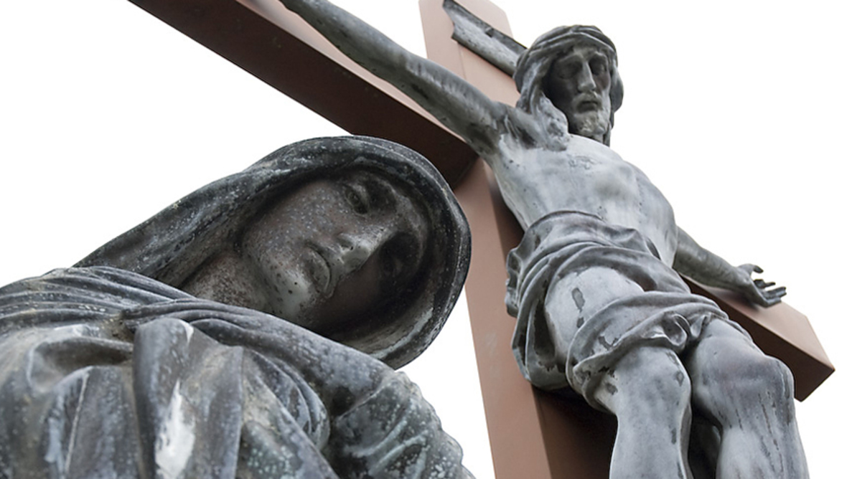
The Gospel
Ranger Church of Christ
Mesquite and Rusk St.

Slide 2

What Is the Gospel?
Notes:
1. Can Everyone Here answer this simple question?
2. The most common answer is “the Bible.”
3. But the Bible is just the container for the Gospel.

Slide 3
Introduction
“Gospel” is a common word – recognized religious term, associated with Christianity
Familiarity does not mean understanding
“Gospel” = good news, glad tidings
Do you associate joy and happiness with the Gospel?
Notes:
1. “Gospel” as we know it, is a common word – It is recognized as religious term, associated with Christianity.
2. Many people say that they have a Familiarity with the Gospel, but that does not mean they have true understanding of the Gospel
3. In the scripture the “Gospel” = is described as the good news, glad tidings for all mankind.
4. Do you associate joy and happiness with what you hear when you hear the Gospel preached or taught?

Slide 4
Introduction
This lesson: study the biblical use of the word “gospel”
The study will involve noticing the phrases in which the word “gospel” appears

Slide 5
What Is the Gospel?
The Gospel of Christ (Mark 1:1)
Notes:
1. What Is the Gospel?
2. Not only is it a good question, it is a very important question.
The beginning of the gospel of Jesus Christ, the Son of God. (Mark 1:1)

Slide 6
Gospel of Christ
Phrase comes into use after Jesus death and resurrection
Christ’s earthly work was necessary before for there to be a Gospel (Lk. 24:44-49)
Without Jesus, there is no Gospel (John 6:67-68; Acts 4:12)
Notes:
1. Did you think about the fact that the phrase “The Gospel of Christ” did not come into use until after Jesus’ death and resurrection.
2. Christ’s earthly work was necessary before for there to be anything called the Gospel (Lk. 24:44-49)
Then He said to them, "These are the words which I spoke to you while I was still with you, that all things must be fulfilled which were written in the Law of Moses and the Prophets and the Psalms concerning Me."
And He opened their understanding, that they might comprehend the Scriptures.
Then He said to them, "Thus it is written, and thus it was necessary for the Christ to suffer and to rise from the dead the third day,
and that repentance and remission of sins should be preached in His name to all nations, beginning at Jerusalem. And you are witnesses of these things. Behold, I send the Promise of My Father upon you; but tarry in the city of Jerusalem until you are endued with power from on high." (Luke 24:44-49)
>>>>>>>>>>>>>>>>>>>>>>>>
3. Without Jesus, there would be no Gospel, no good news! (John 6:67-68; Acts 4:12)
Then Jesus said to the twelve, "Do you also want to go away?"
But Simon Peter answered Him, "Lord, to whom shall we go? You have the words of eternal life. (John 6:67-68)
Nor is there salvation in any other, for there is no other name under heaven given among men by which we must be saved." (Acts 4:12)

Slide 7
Gospel of Christ
Called “Gospel of Christ” because Jesus is the author and subject of this message
Good news because the story of Hs life and death are true, not myth nor fiction
God entering world to live and die for us (Matt. 1:20-23)
Notes:
1. Called “Gospel of Christ” because Jesus is the author and He is the subject of this message.
>>>>>>>>>>>>>>>>>>
2. It is “Good news” because it is the story of Hs life and death, there is no doubt that they are true, and not myth nor mere fiction.
>>>>>>>>>>>>>>>>>>
3. God Himself, entering world to live and die for us (Matt. 1:20-23)
But while he thought about these things, behold, an angel of the Lord appeared to him in a dream, saying, "Joseph, son of David, do not be afraid to take to you Mary your wife, for that which is conceived in her is of the Holy Spirit.
And she will bring forth a Son, and you shall call His name JESUS, for He will save His people from their sins."
So all this was done that it might be fulfilled which was spoken by the Lord through the prophet, saying:
"BEHOLD, THE VIRGIN SHALL BE WITH CHILD, AND BEAR A SON, AND THEY SHALL CALL HIS NAME IMMANUEL," which is translated, "God with us."
(Matthew 1:20-23)

Slide 8
Gospel of Christ
True needs of the world are fulfilled in the Gospel
Peace and gladness of the soul (Col. 3:15)
Understanding of life and eternity (John 1:4)
Cleansing of the conscience (Isa. 53:4-6; 1 Pet. 3:21)
Notes:
1. True needs of the world are fulfilled in the Gospel
a. Peace and gladness of the soul (Col. 3:15)
And let the peace of God rule in your hearts, to which also you were called in one body; and be thankful. (Colossians 3:15)
b. Understanding of life and eternity (John 1:4)
In Him was life, and the life was the light of men.
c. Cleansing of the conscience (Isa. 53:4-6; 1 Pet. 3:21)
Surely He has borne our griefs And carried our sorrows; Yet we esteemed Him stricken, Smitten by God, and afflicted.
But He was wounded for our transgressions, He was bruised for our iniquities; The chastisement for our peace was upon Him, And by His stripes we are healed. All we like sheep have gone astray; We have turned, every one, to his own way; And the LORD has laid on Him the iniquity of us all. (Isaiah 53:4-6)
-----------------------
There is also an antitype which now saves us-baptism (not the removal of the filth of the flesh, but the answer of a good conscience toward God), through the resurrection of Jesus Christ, (1 Peter 3:21)

Slide 9
Gospel of Christ
True needs of the world are fulfilled in the Gospel
Hope for life after death (1 Pet. 1:3; 1 Thess. 4:13-14)
Strength to persevere in times of difficulty (Phil. 4:13)
Comfort in times of trials (2 Cor. 1:3-5)
Notes:
1. Mankind needs to understand that all the true needs of the world are fulfilled in the Gospel of Christ.
2. We have true “Hope for life after death” because of Jesus Christ. (1 Pet. 1:3; 1 Thess. 4:13-14)
Blessed be the God and Father of our Lord Jesus Christ, who according to His abundant mercy has begotten us again to a living hope through the resurrection of Jesus Christ from the dead, (1 Peter 1:3)
------------------------
But I do not want you to be ignorant, brethren, concerning those who have fallen asleep, lest you sorrow as others who have no hope.
For if we believe that Jesus died and rose again, even so God will bring with Him those who sleep in Jesus. (1 Thessalonians 4:13-14)
>>>>>>>>>>>>>>>>>>
3. We have the necessary strength to persevere in times of difficulty on the Earth. (Phil. 4:13)
I can do all things through Christ who strengthens me. (Philippians 4:13)
>>>>>>>>>>>>>>>>>>
4. It is unbelievable the amount of Comfort we can have in our times of trials (2 Cor. 1:3-5)
Blessed be the God and Father of our Lord Jesus Christ, the Father of mercies and God of all comfort,
who comforts us in all our tribulation, that we may be able to comfort those who are in any trouble, with the comfort with which we ourselves are comforted by God.
For as the sufferings of Christ abound in us, so our consolation also abounds through Christ. (2 Corinthians 1:3-5)

Slide 10
Gospel of Christ
True needs of the world are fulfilled in the Gospel
Starting place for the higher goals of life (Phil. 3:7-14; 1 Pet. 1:5-8)
The good news to the world is the story of Jesus Christ’s life, death, and resurrection
Notes:
1. True needs of the world are fulfilled in the Gospel
>>>>>>>>>>>>>>>>>>>>>
2. Starting place for the higher goals of life (Phil. 3:7-14; 1 Pet. 1:5-8)
Not that I have already attained, or am already perfected; but I press on, that I may lay hold of that for which Christ Jesus has also laid hold of me.
Brethren, I do not count myself to have apprehended; but one thing I do, forgetting those things which are behind and reaching forward to those things which are ahead,
I press toward the goal for the prize of the upward call of God in Christ Jesus. (Philippians 3:12-14)
------------------------
who are kept by the power of God through faith for salvation ready to be revealed in the last time. In this you greatly rejoice, though now for a little while, if need be, you have been grieved by various trials, that the genuineness of your faith, being much more precious than gold that perishes, though it is tested by fire, may be found to praise, honor, and glory at the revelation of Jesus Christ, whom having not seen you love. Though now you do not see Him, yet believing, you rejoice with joy inexpressible and full of glory, (1 Peter 1:5-8)
>>>>>>>>>>>>>>>>>>>>>
3. The good news to the world is the real unblimished, untwisted, story of Jesus Christ’s life, death, and resurrection.

Slide 11
Gospel of Christ
The historical fact of Jesus life, death, and resurrection is not, by itself, the Gospel
Note:
“According to the Scriptures”
“For our sins”
“By which we are saved”
The Gospel, good news, is that these historical events have purpose and meaning for us (1 Cor. 15:1-4)
Notes:
1. Just these historical fact of Jesus life, death, and resurrection is not, by itself, the full Gospel.
>>>>>>>>>>>>>>>>>>>>>>>>>
2. The Gospel, good news, is that these historical events have purpose and meaning for us (1 Cor. 15:1-4)
Moreover, brethren, I declare to you the gospel which I preached to you, which also you received and in which you stand,
by which also you are saved, if you hold fast that word which I preached to you-unless you believed in vain.
For I delivered to you first of all that which I also received: that Christ died for our sins according to the Scriptures,
and that He was buried, and that He rose again the third day according to the Scriptures, (1 Corinthians 15:1-4)
>>>>>>>>>>>>>>>>>>>>>>>>>
Note:
“According to the Scriptures”
“For our sins”
“By which we are saved”

Slide 12
What Is the Gospel?
The Gospel of Christ (Mark 1:1)
Notes:
1. The Gospel of Christ (Mark 1:1)
The beginning of the gospel of Jesus Christ, the Son of God. (Mark 1:1)

Slide 13
What Is the Gospel?
The Gospel of Christ (Mark 1:1)
The Gospel of God (1 Thes. 2:8)
Notes:
1. The Gospel of God (1 Thes. 2:8)
So, affectionately longing for you, we were well pleased to impart to you not only the gospel of God, but also our own lives, because you had become dear to us. (1 Thessalonians 2:8)

Slide 14
What Is the Gospel?
The Gospel of Christ (Mark 1:1)
The Gospel of God (1 Thes. 2:8)
The Gospel of Salvation (Eph. 1:13)
Notes:
1. The Gospel of Salvation (Eph. 1:13)
In Him you also trusted, after you heard the word of truth, the gospel of your salvation; in whom also, having believed, you were sealed with the Holy Spirit of promise, (Ephesians 1:13)

Slide 15
What Is the Gospel?
The Gospel of Christ (Mark 1:1)
The Gospel of God (1 Thes. 2:8)
The Gospel of Salvation (Eph. 1:13)
My Gospel (Rom. 2:16)
Notes:
1. My Gospel (Rom. 2:16)
in the day when God will judge the secrets of men by Jesus Christ, according to my gospel. (Romans 2:16)
2. Not only is it Paul’s Good News, it can be your Good News through your obedience to the will of Jesus Christ.

Slide 16
This is the Good News!
Hear the Word – Romans 10: 17
Believe the Word – John 8:24
Repent of Your Sins – Acts 17:30
Confess Jesus – Romans 10: 9-10
Baptized for Forgiveness of sins – Acts 22:16
Invitation Song | 8 | Are You Washed in the Blood
Closing Song | 641 | Where No One Stands Alone
Closing Prayer
Notes:
Invitation:
1. The Bible’s way to Salvation!
>>>>>>>>>>>>>>
2. Hear the word – Romans 10: 17
So then faith comes by hearing, and hearing by the word of God. (Romans 10:17)
>>>>>>>>>>>>>>
3. Believe it – John 8:24
Therefore I said to you that you will die in your sins; for if you do not believe that I am He, you will die in your sins." (John 8:24)
>>>>>>>>>>>>>>
4. Repent of Sins –Acts 17:30
Truly, these times of ignorance God overlooked, but now commands all men everywhere to repent, (Acts 17:30)
>>>>>>>>>>>>>>
5. Confess Jesus – Romans 10: 9-10
that if you confess with your mouth the Lord Jesus and believe in your heart that God has raised Him from the dead, you will be saved. For with the heart one believes unto righteousness, and with the mouth confession is made unto salvation. (Romans 10:9-10)
>>>>>>>>>>>>>>
6. Baptized for Forgiveness of sins – Acts 22:16
And now why are you waiting? Arise and be baptized, and wash away your sins, calling on the name of the Lord.' (Acts 22:16)
>>>>>>>>>>>>>>

