Slide 1

Humble yourselves in the sight of the Lord, and He will lift you up. (James 4:10)
Ranger Church of Christ

Slide 2
Announcements | Songs | Title
1st Song | 393 | True Worship
2nd Song | 150 | Near To The Heart of God
Opening Prayer
3rd Song | 111 | My Jesus, I Love Thee
4th Song | 279 | Why Did My Savior Come to Earth?
Lords Supper
Offering
5th Song | 231 | “Tis So Sweet to Trust in Jesus
Sermon
Invitation Song | 36 | Christ Receiveth Sinful Men
Closing Song | 177 | Purer in Heart, O God
Closing Prayer

Slide 3
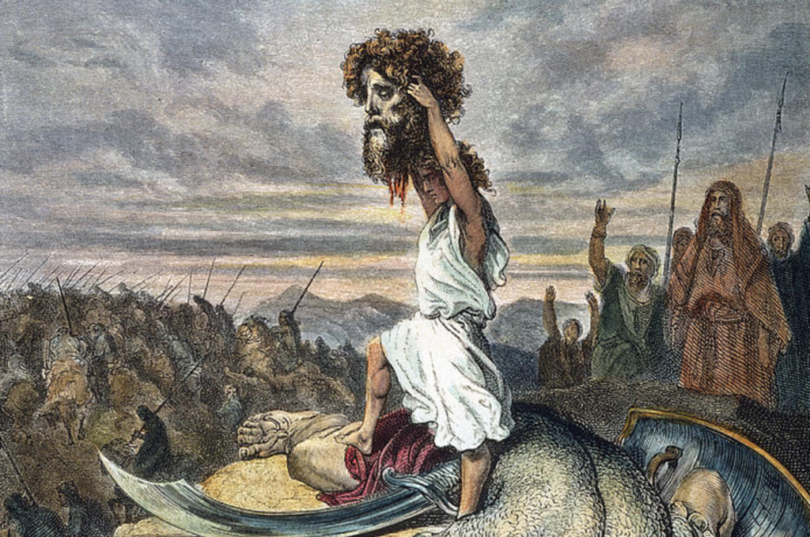

Slide 4
Producing the Fruit of Virtue
2 Pet. 1:5
Notes:
1. Producing the Fruit of Virtue
>>>>>>>>>>>>>>>>
2. 2 Pet. 1:5
But also for this very reason, giving all diligence, add to your faith virtue, to virtue knowledge, (2 Peter 1:5)

Slide 5
Introduction
Bearing the Fruit of the Spirit
Producing the Fruit of Virtue
Virtue is one of the graces of character we are to develop (2 Pet. 1:5-8)
  “Diligence” – designates importance
  Necessary to be fruitful
  Negligence is to be shortsighted
Notes:
1. As Christians we are to be seen in the community bearing the Fruit of the Spirit on a daily basis.
2. One of the fruits we are to Produce is the fruit of Virtue
3. Virtue is one of the graces of character we are to possess. (2 Pet. 1:5-8)
But also for this very reason, giving all diligence, add to your faith virtue, to virtue knowledge, to knowledge self-control, to self-control perseverance, to perseverance godliness, to godliness brotherly kindness, and to brotherly kindness love. For if these things are yours and abound, you will be neither barren nor unfruitful in the knowledge of our Lord Jesus Christ. (2 Peter 1:5-8)
4. It says give all “Diligence” – this word “Diligence designates the importance of virtue in our character.
5. Peter understood that it is necessary in order for us to be fruitful and not barren before the Lord.
6. Lack of diligence will leave us negligent and that leaves us in a state of shortsightedness.

Slide 6
Virtue Defined
Thayer – presents two meanings:
  Broad sense, moral excellence or goodness
  Limited sense – courage, valor
Peter is listing seven forms of moral excellence – thus, courage
McKnight – commonly used by poets to denote military courage
Guy Wood – depicts courage…and determination to do right
Notes:
1. When was the last time you looked up Virtue; so that you made yourself aware of it’s meaning?
>>>>>>>>>>>>>>>>>>
2. Thayer – presents two meanings fir our usage:
>>>>>>>>>>>>>>>>>>
a. In a broad sense, It is the value of moral excellence or goodness in a person and his life.
>>>>>>>>>>>>>>>>>>
b. In a limited sense – it is talking about “courage, valor” possessed by an individual in times of danger.
>>>>>>>>>>>>>>>>>>
3. Peter is listing seven forms of moral excellence to be added to your faith– thus, courage is necessary for moral excellence.
>>>>>>>>>>>>>>>>>>
4. McKnight – the dictionary commonly used by poets says virtue is to denote military courage.
>>>>>>>>>>>>>>>>>>
5. Guy N. Wood – depicts courage…and determination to do right, as virtue, which is the definition of moral excellence,

Slide 7
Virtue Defined
Thus, Peter says we must develop lion-hearted courage and bravery
Like a soldier will stand his ground in the thick of battle
Two kinds of courage:
  Military (cf. Matt. 26:41)
  Moral: do that which is morally right – regardless of difficulty, opposition, or sacrifice required
Notes:
1. Thus, Peter says we must develop a lion-hearted courage and stance of bravery in the face of evil.
>>>>>>>>>>>>>>>>>>>>>>
a. Like a soldier ordered to stand his ground in the thick of battle.
>>>>>>>>>>>>>>>>>>>>>>
2. Two kinds of courage:
>>>>>>>>>>>>>>>>>>>>>>
a. Military or Militant type of courage, a stand your ground type of attitude in the face of fear. (cf. Matt. 26:41)
Watch and pray, lest you enter into temptation. The spirit indeed is willing, but the flesh is weak." (Matthew 26:41)
>>>>>>>>>>>>>>>>>>>>>>>
b. Moral virtue: means that you will do that which is morally right – regardless of personal difficulty, opposition, or sacrifice required

Slide 8
Virtue Defined
Peter was brave with a sword, but turned fearful in moral struggle, denied Lord 3 times (Matt. 26:69-75)
  Takes more courage to fight without a sword
Joshua 1:1-9 – exhorts to have courage that is beyond military courage
  Faithful to God and His word, each and every day
Notes:
1. Peter was brave with a sword, but later he turned fearful when he was confronted in moral struggle, he lost his virtue and denied Lord 3 times (Matt. 26:69-75)
Then he began to curse and swear, saying, "I do not know the Man!" Immediately a rooster crowed. And Peter remembered the word of Jesus who had said to him, "Before the rooster crows, you will deny Me three times." So he went out and wept bitterly. (Matthew 26:74-75)
>>>>>>>>>>>>>>>>>>>>>
2. It takes much, much, more courage. to fight a battle without a sword, than it does with one.
>>>>>>>>>>>>>>>>>>>>>
3. Joshua 1:1-9 – exhorts us to have courage that is beyond and above military courage.
Only be strong and very courageous, that you may observe to do according to all the law which Moses My servant commanded you; do not turn from it to the right hand or to the left, that you may prosper wherever you go. (Joshua 1:7)
Have I not commanded you? Be strong and of good courage; do not be afraid, nor be dismayed, for the LORD your God is with you wherever you go." (Joshua 1:9)
>>>>>>>>>>>>>>>>>>>>>
4. Virtue means that you will remain faithful to God and to His word, each and every day that you live following your baptism.

Slide 9
Virtue of Faith
“Add to your faith virtue”
  Faith insufficient without courage
    E.g., rich young man (Matt. 19:16-22)
    E.g., believing rulers (John 12:42-43)
    E.g., Peter (Gal. 2:11-13)
Notes:
1. “Add to your faith virtue” means faith needs courage to be effective in you.
>>>>>>>>>>>>>>>>
2. Faith by itself is insufficient without courage
>>>>>>>>>>>>>>>>
3. Look at the example Jesus gave us of the rich young man (Matt. 19:16-22)
Jesus said to him, "If you want to be perfect, go, sell what you have and give to the poor, and you will have treasure in heaven; and come, follow Me." (Matthew 19:21)
a. It would take courage and virtue to fully rely, and fully trust in Jesus, by selling all you have and start following Him.
b. The weakness of his courage and lack of virtue was expressed in what Matthew wrote about the incident.
But when the young man heard that saying, he went away sorrowful, for he had great possessions. (Matthew 19:22)
>>>>>>>>>>>>>>>>
4. Another example is the believing rulers (John 12:42-43)
Nevertheless even among the rulers many believed in Him, but because of the Pharisees they did not confess Him, lest they should be put out of the synagogue; for they loved the praise of men more than the praise of God. (John 12:42-43)
a. In this Scripture, we see the lack of virtue and the lack of courage necessary to stand up to the rulers of the synagogue.
>>>>>>>>>>>>>>>>
5. Peter was caught playing the hypocrite instead of holding on to his virtue. (Gal. 2:11-13)
Now when Peter had come to Antioch, I withstood him to his face, because he was to be blamed; for before certain men came from James, he would eat with the Gentiles; but when they came, he withdrew and separated himself, fearing those who were of the circumcision. And the rest of the Jews also played the hypocrite with him, so that even Barnabas was carried away with their hypocrisy. (Galatians 2:11-13)
a. Here we see Peter as the ring leader of the Jews, including Barnabas, letting go of their virtue and strength in the Lord, there by becoming hypocrites.

Slide 10
Virtue of Faith
Courage needed that we may act upon our faith, regardless of the opposition or demands
  In times of temptation
    E.g., Joseph (Gen. 39:7-12)
  To live life of self-denial and cross-bearing (Matt. 16:24-26)
VIRTUE
Notes:
1. Our courage is needed so that we may act upon our faith, holding on to virtue and courage, regardless of the opposition or their demands.
>>>>>>>>>>>>>>>>
2. We need it most In times of temptation, but also in times of casual living.
>>>>>>>>>>>>>>>>
3. We have the Biblical example of virtue exhibited by Joseph (Gen. 39:7-12)
There is no one greater in this house than I, nor has he kept back anything from me but you, because you are his wife. How then can I do this great wickedness, and sin against God?" (Genesis 39:9)
>>>>>>>>>>>>>>>>
4. The virtue of Faith will cause us to live life of self-denial and cross-bearing in this world. (Matt. 16:24-26)
Then Jesus said to His disciples, "If anyone desires to come after Me, let him deny himself, and take up his cross, and follow Me. (Matthew 16:24)

Slide 11
Renounce friendship of world (James. 4:4;
1 John. 2:15-17)
Shun evil companions (1 Cor. 15:33)
Change habits (Rom. 12:2)
Sow to the Spirit (Rom. 6:17-18)
Notes:
1. It is necessary that we renounce friendship of world (Ja. 4:4; 1 Jn. 2:15-17)
Adulterers and adulteresses! Do you not know that friendship with the world is enmity with God? Whoever therefore wants to be a friend of the world makes himself an enemy of God. (James 4:4)
Do not love the world or the things in the world. If anyone loves the world, the love of the Father is not in him. For all that is in the world—the lust of the flesh, the lust of the eyes, and the pride of life—is not of the Father but is of the world. And the world is passing away, and the lust of it; but he who does the will of God abides forever. (1 John 2:15-17)
>>>>>>>>>>>>>>>>>>>>>>>>
2. We must shun evil companions and embrace fellow Christians. (1 Cor. 15:33)
Do not be deceived: "Evil company corrupts good habits." (1 Corinthians 15:33)
>>>>>>>>>>>>>>>>>>>>>>>>
3. Change habits (Rom. 12:2)
And do not be conformed to this world, but be transformed by the renewing of your mind, that you may prove what is that good and acceptable and perfect will of God. (Romans 12:2)
>>>>>>>>>>>>>>>>>>>>>>>>
4. We must sow to the Spirit, not to the world. (Rom. 6:17-18)
But God be thanked that though you were slaves of sin, yet you obeyed from the heart that form of doctrine to which you were delivered. And having been set free from sin, you became slaves of righteousness. (Romans 6:17-18)

Slide 12
Virtue of Faith
Courage needed that we may act upon our faith, regardless of opposition or demands
To teach the gospel to others when we have opportunity
  Eccl. 3:7 – time to speak
  Easy to talk about gospel to other Christian, courage is needed to talk to unbelievers (1 Pet 3:15-17; Rom. 1:16)
Notes:
1. Courage is needed and necessary so that we may act upon our faith, regardless of opposition, or demands, place upon us.
>>>>>>>>>>>>>>>>>>>>>
2. Virtue is also needed to teach the gospel to others when we have opportunity to teach.
>>>>>>>>>>>>>>>>>>>>>
3. Eccl. 3:7 – time to speak
A time to tear, And a time to sew; A time to keep silence, And a time to speak; (Ecclesiastes 3:7)
>>>>>>>>>>>>>>>>>>>>>>
Easy to talk about gospel to other Christian, but courage is needed to, knock on doors, initiate conversations, and just talk to unbelievers (1 Pet 3:15-17; Rom. 1:16)
For I am not ashamed of the gospel of Christ, for it is the power of God to salvation for everyone who believes, for the Jew first and also for the Greek. (Romans 1:16)
But sanctify the Lord God in your hearts, and always be ready to give a defense to everyone who asks you a reason for the hope that is in you, with meekness and fear; having a good conscience, that when they defame you as evildoers, those who revile your good conduct in Christ may be ashamed. For it is better, if it is the will of God, to suffer for doing good than for doing evil. (1 Peter 3:15-17)

Slide 13
How Do We Develop Virtue?
Recognize need for courage
  Satan mighty foe – he uses fear and intimidation
  Luke 14:28-33
  If we anticipate difficulties and challenges, with determination to overcome, we will be prepared to muster up courage
Notes:
1. How Do We Develop Virtue?
2. First of all, we need to recognize need for courage and self defense.
3. Satan is a mighty, mighty foe – he loves to use fear and intimidation as well as temptation.
4. Remember the tower builder and the king that was unable to make war in Jesus’s parable? Luke 14:28-33.
lest, after he has laid the foundation, and is not able to finish, all who see it begin to mock him, (Luke 14:29)
a. Satan delights in using intimidation to discourage his followers.
5. If we anticipate the difficulties and the challenges in life, with determination to overcome all obstacles, we will be prepared to muster up courage to follow Christ.

Slide 14
How Do We Develop Virtue?
Determine to be courageous
  It is a matter of will, making up our mind that we will confront the threat or challenge
  Courage is not absence of fear, but acting in face of fear
  Focus on blessings of overcoming, not the loss or discomfort (Ps 31:24)
Notes:
1. How Do We Develop Virtue?
>>>>>>>>>>>>>>>>
2. To be courageous, you must determine to be courageous.
a. Do not confuse being determined with being stubborn.
b. Determination is an intelligent conclusion, stubbornness is hard headed resistance without reason.
>>>>>>>>>>>>>>>>
3. It is a matter of personal will, the decision we come to in making up our mind that “we will confront the threat or challenge”.
>>>>>>>>>>>>>>>>
4. Courage is not absence of fear, but it is acting in face of fear knowing the possible deadly outcome.
>>>>>>>>>>>>>>>>
5. Courage will focus on blessings of overcoming the power of Satan, while not counting the personal loss or discomforts of your stand with the Lord. (Ps 31:24)
Be of good courage, And He shall strengthen your heart, All you who hope in the LORD. (Psalms 31:24)

Slide 15
How Do We Develop Virtue?
Remember you are a child of God
  1 John 4:4 – greater is He that is in you
  1 Cor. 10:13 – not tempted beyond what you are able
  Eph. 6:10-17 – God equips us to be victorious
  Rev. 2 – 3 – they that overcome
Notes:
1. How Do We Develop Virtue?
>>>>>>>>>>>>>>>>
2. Always remember the fact that you are a child of God. and God will strengthen you. (Psa 31:24)
>>>>>>>>>>>>>>>>
3. 1 John 4:4 – Know the fact that He that is greater is “He that is in you”.
You are of God, little children, and have overcome them, because He who is in you is greater than he who is in the world. (1 John 4:4)
>>>>>>>>>>>>>>>>
4. 1 Cor. 10:13 – No matter how strong the temptation appears, we will not be tempted beyond what we are able to withstand.
No temptation has overtaken you except such as is common to man; but God is faithful, who will not allow you to be tempted beyond what you are able, but with the temptation will also make the way of escape, that you may be able to bear it. (1 Corinthians 10:13)
>>>>>>>>>>>>>>>>
5. Eph. 6:10-17 – Tells us that God equips us to be victorious, it is up to us to use the equipment supplied for His glory, by withstanding Satan in this earthly battle.
Put on the whole armor of God, that you may be able to stand against the wiles of the devil. (Ephesians 6:11)
>>>>>>>>>>>>>>>>
6. Rev. 2 – 3 – “they that overcome” is the lesson we learn in Revelation chapters 2 & 3; will that be you?

Slide 16
How Do We Develop Virtue?
Walk by faith, not by sight (2 Cor. 5:7)
  Heb. 11:1 – assurance of things hoped for
  Rom. 8:28 – know by faith all things work together for good
Be encouraged by the courage of past saints (Heb. 12:1)
Notes:
How Do We Develop Virtue?
1. In our walk with God, we walk by faith, not by sight (2 Cor. 5:7)
For we walk by faith, not by sight. (2 Corinthians 5:7)
>>>>>>>>>>>>>>>>>>
2.. As part of our faith, we have His assurance of things we have hoped for (Heb. 11:1)
Now faith is the substance of things hoped for, the evidence of things not seen. (Hebrews 11:1)
>>>>>>>>>>>>>>>>>>
3. Without doubt, we know by our faith in Christ, all things work together for good (Rom. 8:28)
And we know that all things work together for good to those who love God, to those who are the called according to His purpose. (Romans 8:28)
>>>>>>>>>>>>>>>>>>
4. Without wavering, we can be encouraged by the courage of past saints (Heb. 12:1)
Therefore we also, since we are surrounded by so great a cloud of witnesses, let us lay aside every weight, and the sin which so easily ensnares us, and let us run with endurance the race that is set before us, (Hebrews 12:1)

Slide 17
How Do We Develop Virtue?
Remember we increase courage by facing the things we fear and by conquering them (2 Tim. 4:7)
  The harder he fought, the stronger his courage became
Notes:
How Do We Develop Virtue?
>>>>>>>>>>>>>>
1. Remember; we increase our courage by facing the things we fear, and by conquering them, just as the Apostle Paul did. (2 Tim. 4:7)
I have fought the good fight, I have finished the race, I have kept the faith. (2 Timothy 4:7)
>>>>>>>>>>>>>>
2. The harder Paul fought, the stronger his courage became.

Slide 18
Conclusion
1 Cor. 16:13 – be brave, be strong
Virtue [courage] is needed in our walk with God
Do you have the courage to become a Christian?
Do you have the courage to be a faithful Christian?
Notes:
1. 1 Cor. 16:13 – Virtue means that we must be brave, be strong in the face of our adversaries.
Watch, stand fast in the faith, be brave, be strong. (1 Corinthians 16:13)
>>>>>>>>>>>>>>>>>>>
2. Virtue [that is courage] is needed in our walk with God; and our stand against the world of Satan.
>>>>>>>>>>>>>>>>>>>
3. Do you have the courage to become a Christian?
a. The plan of salvation is simple, believe what you hear and know is from the word of God.
b. Know that as a sinner your must repent to the one you have sinned against, all sins are against Almighty God.
c. You, in believing, must confess Him as the Son of God, and be baptized for the remission of your sins, and walk with Him until you leave the face of this earth,
>>>>>>>>>>>>>>>>>>>
4. As a Christian; have you maintained the courage to be a faithful Christian?
a. If your courage has been found to be weak, God still loves you and He requires you to repent and return to Him.
Repent therefore of this your wickedness, and pray God if perhaps the thought of your heart may be forgiven you. (Acts 8:22)

Slide 19

Invitation Song | 36 | Christ Receiveth Sinful Men
Closing Song | 177 | Purer in Heart, O God
Closing Prayer

