Slide 1
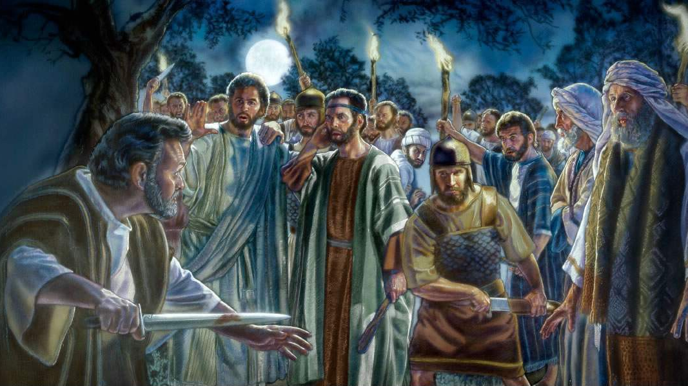
Ranger Church of Christ
Mesquite and Rusk St.
Soldiers of Christ Arise!

Slide 2
The Sanctity of Human Life
Abortion
Euthanasia
Suicide
Capital Punishment
Serving in Military, Police
Human Engineering
Serving in Military, Police
Notes:
1. There are many subjects under the heading of “The Sanctity of Human Life”
>>>>>>>>>>>>>>>>>>>>>>>>
2. Today. Lets look at the subject of “Serving in Military, or as a Police Officer”

Slide 3
If sinful for a Christian to be a soldier or police officer, then it is sinful for anyone to do so
Yet, God commands governments to punish evil doers (1 Pet. 2:14)
Individual has no right to execute personal vengeance (Rom. 12:19)
God delegated “vengeance to civil government (Rom. 13:4)
Notes:
1. If it is sinful for a Christian to be a soldier or police officer, then it is also sinful for anyone to do so.
>>>>>>>>>>>>>>>>>
2. Yet, God commands governments to punish evil doers (1 Pet. 2:14)
or to governors, as to those who are sent by him for the punishment of evildoers and for the praise of those who do good. (1 Peter 2:14)
>>>>>>>>>>>>>>>>>
3. As an Individual, we have no right to execute personal vengeance (Rom. 12:19)
Beloved, do not avenge yourselves, but rather give place to wrath; for it is written, "VENGEANCE IS MINE, I WILL REPAY," says the Lord.
(Romans 12:19)
>>>>>>>>>>>>>>>>>
4. God delegated “vengeance to civil government (Rom. 13:4)
For he is God's minister to you for good. But if you do evil, be afraid; for he does not bear the sword in vain; for he is God's minister, an avenger to execute wrath on him who practices evil. (Romans 13:4)

Slide 4
Difference between defensive and offense wars
Nations can act criminally or wickedly – must be
opposed
Christians cannot participate in murder or theft as
individual, small group or nation
Christians may participate in self-defense whether
individually, small group or nation
Notes:
1. There is a major difference between defensive and offense wars
>>>>>>>>>>>>>>>>>>>>>>>>>
2. Nations can act criminally or wickedly during war or peace times– these wicked acts must be opposed, as in the case of the American citizen that was a Saudi reporter for the Washington Post; he was killed last week in Tujrkey for disparaging remarks against the Saudi king .
>>>>>>>>>>>>>>>>>>>>>>>>>
3. Christians cannot participate in murder, or theft, as individuals, small groups or nations.
>>>>>>>>>>>>>>>>>>>>>>>>>
4. Christians may participate in self-defense when necessary, whether individually, in small group, or as a nation.

Slide 5
Self-Defense
Ex. 22:1-3
Luke 22:35-36
Personal Responsibility
Josh. 2:19
2 Sam. 1:16
Ezek. 33:2-4
Acts 18:6
Notes:
1. Self-Defense
>>>>>>>>>>>>>>>>>
2. Ex. 22:1-3 – Defend yourself, flee, the Lord is coming for Jerusalem’s destruction, both of wicked and righteous.
And the word of the LORD came to me, saying, "Son of man, set your face toward Jerusalem, preach against the holy places, and prophesy against the land of Israel; and say to the land of Israel, 'Thus says the LORD: "Behold, I am against you, and I will draw My sword out of its sheath and cut off both righteous and wicked from you. (Ezekiel 21:1-3)
>>>>>>>>>>>>>>>>>
3. Luke 22:35-36 – The Lord authorized self defense for the Apostles.
And He said to them, "When I sent you without money bag, knapsack, and sandals, did you lack anything?" So they said, "Nothing." Then He said to them, "But now, he who has a money bag, let him take it, and likewise a knapsack; and he who has no sword, let him sell his garment and buy one. (Luke 22:35-36)
a. The sword was not for opening letters from their fans, but it was for self defense.
>>>>>>>>>>>>>>>>>
4. Personal Responsibility is appointed to us in times of trials.
>>>>>>>>>>>>>>>>>
5. Josh. 2:19 – You have a responsibility to protect those of your household.
So it shall be that whoever goes outside the doors of your house into the street, his blood shall be on his own head, and we will be guiltless. And whoever is with you in the house, his blood shall be on our head if a hand is laid on him. (Joshua 2:19)
>>>>>>>>>>>>>>>>>
6. 2 Sam. 1:16 – Most criminals are caught by the testimony of their own mouths.
So David said to him, "Your blood is on your own head, for your own mouth has testified against you, saying, 'I have killed the LORD's anointed.’ “ (2 Samuel 1:16)
>>>>>>>>>>>>>>>>>
7. Ezek. 33:2-4 – You have a responsibility to listen for the warning of God.
"Son of man, speak to the children of your people, and say to them: 'When I bring the sword upon a land, and the people of the land take a man from their territory and make him their watchman, when he sees the sword coming upon the land, if he blows the trumpet and warns the people, then whoever hears the sound of the trumpet and does not take warning, if the sword comes and takes him away, his blood shall be on his own head. (Ezekiel 33:2-4)
>>>>>>>>>>>>>>>>>
8. Acts 18:6 – Paul in Corinth was opposed and shook the dust off his garments.
But when they opposed him and blasphemed, he shook his garments and said to them, "Your blood be upon your own heads; I am clean. From now on I will go to the Gentiles." (Acts 18:6)

Slide 6
New Testament Examples
John and the soldiers (Luke 3:14)
Soldiers ask if need to meet any special requirement before they could be baptized
Answer: do not intimidate, be content with wages
Not told to cease being soldiers
Notes:
1. Remember the lesson from John the Baptist and the soldiers (Luke 3:14)
Likewise the soldiers asked him, saying, "And what shall we do?" So he said to them, "Do not intimidate anyone or accuse falsely, and be content with your wages." (Luke 3:14)
>>>>>>>>>>>>>>>>>>>>>>>>>
2. The Soldiers ask if they needed to meet any special requirement before they could be baptized
>>>>>>>>>>>>>>>>>>>>>>>>>
3. Answer: do not intimidate, be content with wages
>>>>>>>>>>>>>>>>>>>>>>>>>
4. They were not told to cease being soldiers in order to be a Christian.

Slide 7
New Testament Examples
Saints in Caesar’s household (Phil. 4:22)
“Caesar’s household” = Imperial Civil Service – included soldiers
Evidently there were faithful Christians in “Caesar’s household”
Notes:
1. Saints in Caesar’s household (Phil. 4:22)
All the saints greet you, but especially those who are of Caesar's household. (Philippians 4:22)
>>>>>>>>>>>>>>>>>>>>
2. There were saints in “Caesar’s household” = They were his Imperial Civil Service – this included soldiers who were guarding Paul.
>>>>>>>>>>>>>>>>>>>>>
3. Evidently there were faithful Christians in “Caesar’s household” probably converted by the apostle Paul.

Slide 8
New Testament Examples
Cornelius (Acts 10:1–11:14)
First Gentile to obey Gospel
Peter sent to speak words he need to hear to be saved (Acts 10:6, 22; 11:14)
Not told to resign from military
Evidently being a soldier was not sinful
Notes:
1. Cornelius (Acts 10:1–11:14)
There was a certain man in Caesarea called Cornelius, a centurion of what was called the Italian Regiment, a devout man and one who feared God with all his household, who gave alms generously to the people, and prayed to God always. (Acts 10:1-2)
>>>>>>>>>>>>>>>>>>
2. He was the First Gentile to obey Gospel.
>>>>>>>>>>>>>>>>>>
3. Peter sent to speak words he need to hear to be saved (Acts 10:6, 22; 11:14)
He is lodging with Simon, a tanner, whose house is by the sea. He will tell you what you must do." (Acts 10:6)
And they said, "Cornelius the centurion, a just man, one who fears God and has a good reputation among all the nation of the Jews, was divinely instructed by a holy angel to summon you to his house, and to hear words from you." (Acts 10:22)
who will tell you words by which you and all your household will be saved.’ (Acts 11:14)
>>>>>>>>>>>>>>>>>>
4. At no time did Peter command him to resign from military.
>>>>>>>>>>>>>>>>>>
5. Evidently being a soldier was not sinful

Slide 9
New Testament Examples
The Philippian Jailer (Acts 16:31-36)
One of first in Europe to obey the Gospel
Though he served Roman government, and carried a sword, not commanded to leave his occupation
Continued as jailer (vv. 35-36)
Notes:
1. The Philippian Jailer (Acts 16:31-36)
And he brought them out and said, "Sirs, what must I do to be saved?" So they said, "Believe on the Lord Jesus Christ, and you will be saved, you and your household." Then they spoke the word of the Lord to him and to all who were in his house. And he took them the same hour of the night and washed their stripes. And immediately he and all his family were baptized. Now when he had brought them into his house, he set food before them; and he rejoiced, having believed in God with all his household. (Acts 16:30-34)
>>>>>>>>>>>>>>>>>>
2. He was one of first in Europe to obey the Gospel
>>>>>>>>>>>>>>>>>>
3. Though he served Roman government, and carried a sword, not commanded to leave his occupation
>>>>>>>>>>>>>>>>>>
4. He continued as the jailer for the Roman Government. (vv. 35-36)
And when it was day, the magistrates sent the officers, saying, "Let those men go." So the keeper of the prison reported these words to Paul, saying, "The magistrates have sent to let you go. Now therefore depart, and go in peace." (Acts 16:35-36)

Slide 10
New Testament Examples
Paul used Roman soldier (Acts 23:12-23)
Paul used 470 soldiers as body guards to protect against 40 Jews who sought to kill him
He knew the soldiers would kill or imprison those who attack
If it is wrong to be a soldier, it is wrong to use one (1 Tim. 5:22)
Notes:
1. Paul used Roman soldier (Acts 23:12-23)
And when it was day, some of the Jews banded together and bound themselves under an oath, saying that they would neither eat nor drink till they had killed Paul. Now there were more than forty who had formed this conspiracy. (Acts 23:12-13)
>>>>>>>>>>>>>>>>>>>>>>>>
2. Paul used 470 soldiers as personal body guards to protect himself against 40 Jews who had planned and sought to kill him.
And he called for two centurions, saying, "Prepare two hundred soldiers, seventy horsemen, and two hundred spearmen to go to Caesarea at the third hour of the night; and provide mounts to set Paul on, and bring him safely to Felix the governor." (Acts 23:23-24)
>>>>>>>>>>>>>>>>>>>>>>>>
3. He knew and his orders implied that the soldiers would kill or imprison those who attack them for any reason.
>>>>>>>>>>>>>>>>>>>>>>>>
4. If it is wrong to be a soldier, it is wrong to use one (1 Tim. 5:22)
Do not lay hands on anyone hastily, nor share in other people's sins; keep yourself pure. (1 Timothy 5:22)

Slide 11
Conclusion
Not sinful to be a soldier or police officer
If one’s conscience will not allow him to serve in either of these ways, then stay out (Rom. 14:23)
If serving, then be honest in your dealings with others and “be content with your wages” (Luke 3:14)
Notes:
1. It is not sinful to be a soldier or police officer
>>>>>>>>>>>>>>>>>>>>>
2. If one’s conscience will not allow him to serve in either of these ways, then stay out (Rom. 14:23)
But he who doubts is condemned if he eats, because he does not eat from faith; for whatever is not from faith is sin. (Romans 14:23)
>>>>>>>>>>>>>>>>>>>>>
3. If serving, then be honest in your dealings with others and “be content with your wages” (Luke 3:14)
Likewise the soldiers asked him, saying, "And what shall we do?" So he said to them, "Do not intimidate anyone or accuse falsely, and be content with your wages." (Luke 3:14)

Slide 12
The Bible’s way to Salvation!
Hear the word – Romans 10: 17
Believe it – John 8:24
Repent of Sins –Acts 17:30
Confess Jesus – Romans 10: 9,10
Baptized for Remission of sins – Acts 22:16
There is no other way!
GRACE
God’s
Redemption
At
Christ
Expense
Notes:
1. The Bible’s way to Salvation!
For by grace you have been saved through faith, and that not of yourselves; it is the gift of God, (Ephesians 2:8)
a. What is Grace?
>>>>>>>>>>>>>>>>>
a. GRACE
b. God’s
c. Redemption
d. At
e. Christ
f. Expense
>>>>>>>>>>>>>>>
2. Hear the word – Romans 10: 17
So then faith comes by hearing, and hearing by the word of God. (Romans 10:17)
>>>>>>>>>>>>>>
3. Believe it – John 8:24
Therefore I said to you that you will die in your sins; for if you do not believe that I am He, you will die in your sins." (John 8:24)
>>>>>>>>>>>>>>
4. Repent of Sins – Acts 2:38 & Acts 17:30
Truly, these times of ignorance God overlooked, but now commands all men everywhere to repent, (Acts 17:30)
>>>>>>>>>>>>>>
5. Confess Jesus – Romans 10: 9,10
that if you confess with your mouth the Lord Jesus and believe in your heart that God has raised Him from the dead, you will be saved. For with the heart one believes unto righteousness, and with the mouth confession is made unto salvation. (Romans 10:9-10)
>>>>>>>>>>>>>>
6. Baptized for Forgiveness of sins – Acts 2:38 & Acts 22:16
And now why are you waiting? Arise and be baptized, and wash away your sins, calling on the name of the Lord.' (Acts 22:16)
>>>>>>>>>>>>>>
7. THERE IS NO OTHER WAY!

