Slide 1
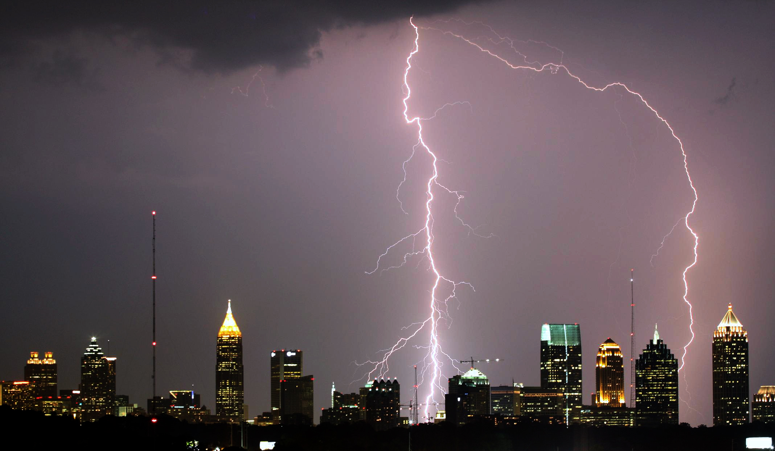
Reverence for God
Ranger Church of Christ

Slide 2
Reverence for God
Notes:
1. What is on your mind when you come to worship.
2. Do you have any clue why you are here, during worship services.

Slide 3
Introduction
1 Pet. 1:13-16
None would want to be irreverent, but there are ways we can fall short of true reverence
Not taking God with utmost seriousness
Wishing to serve on own terms
Lukewarm (Rev. 3:15-17)
Notes:
1. Introduction
>>>>>>>>>>>>>>>>>>>>
2. 1 Pet. 1:13-16
Therefore gird up the loins of your mind, be sober, and rest your hope fully upon the grace that is to be brought to you at the revelation of Jesus Christ; as obedient children, not conforming yourselves to the former lusts, as in your ignorance; but as He who called you is holy, you also be holy in all your conduct, because it is written, "BE HOLY, FOR I AM HOLY." (1 Peter 1:13-16)
>>>>>>>>>>>>>>>>>>>>
3. None would want to be irreverent, but there are ways we can fall short of true reverence
>>>>>>>>>>>>>>>>>>>>
4. Not taking God with utmost seriousness
>>>>>>>>>>>>>>>>>>>>
5. Wishing to serve on own terms
>>>>>>>>>>>>>>>>>>>>
6. Lukewarm (Rev. 3:15-17)
"I know your works, that you are neither cold nor hot. I could wish you were cold or hot. So then, because you are lukewarm, and neither cold nor hot, I will vomit you out of My mouth. Because you say, 'I am rich, have become wealthy, and have need of nothing'—and do not know that you are wretched, miserable, poor, blind, and naked— (Revelation 3:15-17)

Slide 4
Introduction
We often fail to act in such a way as to constantly manifest reverence for God in the minds of others
Example: Moses (Num. 20:12)
Are we doing the same by our dress and behavior in worship
Or, by willful disobedience to some command (Rom. 2:23-24)
Notes:
1. We often fail to act in such a way as to constantly manifest reverence for God in the minds of others
>>>>>>>>>>>>>>>>>>
2. Example: Moses (Num. 20:12)
Then the LORD spoke to Moses and Aaron, "Because you did not believe Me, to hallow Me in the eyes of the children of Israel, therefore you shall not bring this assembly into the land which I have given them." (Numbers 20:12)
>>>>>>>>>>>>>>>>>>
3. Are we doing the same by our dress and behavior in worship
>>>>>>>>>>>>>>>>>>
4. Or, by willful disobedience to some command (Rom. 2:23-24)
You who make your boast in the law, do you dishonor God through breaking the law? For "THE NAME OF GOD IS BLASPHEMED AMONG THE GENTILES BECAUSE OF YOU," as it is written. (Romans 2:23-24)

Slide 5
Introduction
We must have a deep reverence for God
God ought to be most serious concern for our entire life
Let’s notice some things we cannot do and have a true reverence for God
Notes:
1. We must have a deep reverence for God
>>>>>>>>>>>>>>>>>
2. God ought to be most serious concern for our entire life
>>>>>>>>>>>>>>>>>
3. Let’s notice some things we cannot do and have a true reverence for God

Slide 6
Reverence for God
We Cannot Be Indifferent to God
Notes:
1. In Our Reverence for God
>>>>>>>>>>>>>>>>>>>>>>>
2. We Cannot Be Indifferent to God

Slide 7
We Cannot Be Indifferent to God
In material minded society most feel religion does not matter
Even some Christians act as if other things are more important to them than God
Truth: God wills we be devoted to Him (Eccl. 12:13-14)
God consuming fire toward the irreverent (Heb. 12:29)
Notes:
1. We Cannot Be Indifferent to God
>>>>>>>>>>>>>>>>>>
2. In material minded society most feel religion does not matter
>>>>>>>>>>>>>>>>>>
3. Even some Christians act as if other things are more important to them than God
>>>>>>>>>>>>>>>>>>
4. Truth: God wills we be devoted to Him (Eccl. 12:13-14)
Let us hear the conclusion of the whole matter: Fear God and keep His commandments, For this is man's all. For God will bring every work into judgment, Including every secret thing, Whether good or evil. (Ecclesiastes 12:13-14)
>>>>>>>>>>>>>>>>>>
5. God is a consuming fire toward the irreverent people of this world. (Heb. 12:29)
For our God is a consuming fire. (Hebrews 12:29)

Slide 8
We Cannot Be Indifferent to God
God’s appearance to Israel upon Mt. Sinai was truly awe-inspiring (Ex. 19:16-19; 20:18-19)
Christians have come to “Mount Zion” (Heb. 12:18-29)
God’s awesomeness depicted
Moses and people had reverence and respect for God
Notes:
1. God’s appearance to Israel upon Mt. Sinai was truly awe-inspiring (Ex. 19:16-19; 20:18-19)
Now Mount Sinai was completely in smoke, because the LORD descended upon it in fire. Its smoke ascended like the smoke of a furnace, and the whole mountain quaked greatly. (Exodus 19:18)
Now all the people witnessed the thunderings, the lightning flashes, the sound of the trumpet, and the mountain smoking; and when the people saw it, they trembled and stood afar off. (Exodus 20:18)
>>>>>>>>>>>>>>>>>>
2. Christians have come to “Mount Zion” (Heb. 12:18-29)
But you have come to Mount Zion and to the city of the living God, the heavenly Jerusalem, to an innumerable company of angels, to the general assembly and church of the firstborn who are registered in heaven, to God the Judge of all, to the spirits of just men made perfect, (Hebrews 12:22-23)
>>>>>>>>>>>>>>>>>>
3. God’s awesomeness is depicted at Mt Zion.
>>>>>>>>>>>>>>>>>>
4. Moses and people had reverence and respect for God and His power.

Slide 9
We Cannot Be Indifferent to God
“Take heed how you hear” (Luke 8:18; Isa. 66:2; Heb. 2:1-4)
We cannot be indifferent to God and expect to show proper reverence for Him
Notes:
1. “Take heed how you hear” (Luke 8:18; cf. Isa. 66:2; Heb. 2:1-4)
Now a certain ruler asked Him, saying, "Good Teacher, what shall I do to inherit eternal life?" (Luke 18:18)
For all those things My hand has made, And all those things exist," Says the LORD. "But on this one will I look: On him who is poor and of a contrite spirit, And who trembles at My word. (Isaiah 66:2)
Therefore we must give the more earnest heed to the things we have heard, lest we drift away. (Hebrews 2:1)
>>>>>>>>>>>>>>>>>>>>>
2. We cannot be indifferent to God and expect to show proper reverence for Him

Slide 10
Reverence for God
We Cannot Be Indifferent to God
We Cannot Accommodate God to Ourselves
Notes:
1. We Cannot Accommodate God to Ourselves
>>>>>>>>>>>>>>>>>>

Slide 11
We Cannot Accommodate God to Ourselves
Many try to adjust God to their liking
If find God and His will intrusive on lifestyle or embarrassment before non-Christian friends
Mark 8:34, 38 – deny himself
Rom. 12:1-2 – living sacrifice
Notes:
1. Many try to adjust God to their liking rather than do His will.
>>>>>>>>>>>>>>>>>>
2. If you find God and His will intrusive on your lifestyle or an embarrassment before non-Christian friends, you need to take action now.
>>>>>>>>>>>>>>>>>>
3. Mark 8:34, 38 – deny himself
When He had called the people to Himself, with His disciples also, He said to them, "Whoever desires to come after Me, let him deny himself, and take up his cross, and follow Me. (Mark 8:34)
For whoever is ashamed of Me and My words in this adulterous and sinful generation, of him the Son of Man also will be ashamed when He comes in the glory of His Father with the holy angels." (Mark 8:38)
>>>>>>>>>>>>>>>>>>
4. Rom. 12:1-2 – living sacrifice
I beseech you therefore, brethren, by the mercies of God, that you present your bodies a living sacrifice, holy, acceptable to God, which is your reasonable service. And do not be conformed to this world, but be transformed by the renewing of your mind, that you may prove what is that good and acceptable and perfect will of God. (Romans 12:1-2)

Slide 12
We Cannot Accommodate God to Ourselves
Must let God be God and let ourselves be His creatures (Rom. 1:21, 25)
If any accommodation needs to be made, let it be our accommodation to God
Notes:
1. Must let God be God and let ourselves be His creatures (Rom. 1:21, 25)
because, although they knew God, they did not glorify Him as God, nor were thankful, but became futile in their thoughts, and their foolish hearts were darkened. (Romans 1:21)
who exchanged the truth of God for the lie, and worshiped and served the creature rather than the Creator, who is blessed forever. Amen. (Romans 1:25)
>>>>>>>>>>>>>>>>>>>>>>>>
2. If any accommodation needs to be made, let it be our accommodation to God

Slide 13
Reverence for God
We Cannot Be Indifferent to God
We Cannot Accommodate God to Ourselves
We Cannot Confine God to One Compartment of Life

Slide 14
We Cannot Confine God to One Compartment of Life
Many tempted to confine God to one compartment of life and keep the others to ourselves (business, entertainment, family, etc.
There is no area of life where God is irrelevant
We cannot put God in a box of our making (2 Cor. 8:5; Col. 3:17)
Notes:
1. Many tempted to confine God to one compartment of life and keep the others to ourselves (e.g., business, entertainment, family, etc.
>>>>>>>>>>>>>>>>>>>>>>>
2. We cannot put God in a box of our making (2 Cor. 8:5; Col. 3:17)
And not only as we had hoped, but they first gave themselves to the Lord, and then to us by the will of God. (2 Corinthians 8:5)
And whatever you do in word or deed, do all in the name of the Lord Jesus, giving thanks to God the Father through Him. (Colossians 3:17)
>>>>>>>>>>>>>>>>>>>>>>>
3. There is no area of life where God is irrelevant

Slide 15
Reverence for God
We Cannot Be Indifferent to God
We Cannot Accommodate God to Ourselves
We Cannot Confine God to One Compartment of Life
We Cannot Mock God
Notes:
1. We Cannot Mock God
>>>>>>>>>>>>>>>>>>>>>

Slide 16
We Cannot Mock God
“Mock”= “to treat with ridicule or contempt; deride”
Children who learn that their parents give empty threats, will do as they please with a rebellious attitude of mockery toward those parents
We cannot be this way with God (Gal. 6:7-8; Psalm 36:1; Heb. 10:26-29)
Notes:
1. “Mock”= “to treat with ridicule or contempt; deride”
>>>>>>>>>>>>>>>>>>>>>
2. Children who learn that their parents give empty threats, will do as they please with a rebellious attitude of mockery toward those parents
>>>>>>>>>>>>>>>>>>>>>
3. We cannot be this way with God (Gal. 6:7-8; Psalm 36:1; Heb. 10:26-29)
Do not be deceived, God is not mocked; for whatever a man sows, that he will also reap. For he who sows to his flesh will of the flesh reap corruption, but he who sows to the Spirit will of the Spirit reap everlasting life. (Galatians 6:7-8)
An oracle within my heart concerning the transgression of the wicked: There is no fear of God before his eyes. (Psalms 36:1)
Of how much worse punishment, do you suppose, will he be thought worthy who has trampled the Son of God underfoot, counted the blood of the covenant by which he was sanctified a common thing, and insulted the Spirit of grace? (Hebrews 10:29)

Slide 17
We Cannot Mock God
Some may treat God with less respect than any other human being (Mal. 1:6-8)
God will not be insulted or trifled with (Prov. 28:9)
Notes:
1. Some may treat God with less respect than any other human being (Mal. 1:6-8)
"A son honors his father, And a servant his master. If then I am the Father, Where is My honor? And if I am a Master, Where is My reverence? Says the LORD of hosts To you priests who despise My name. Yet you say, 'In what way have we despised Your name?’ (Malachi 1:6)
>>>>>>>>>>>>>>>>>
2. God will not be insulted or trifled with (Prov. 28:9)
One who turns away his ear from hearing the law, Even his prayer is an abomination. (Proverbs 28:9)

Slide 18
Conclusion
Jesus sifted those who wanted only a superficial attachment from those who wanted a serious involvement (Luke 9:57-62)
We must draw near to God with both actions and hearts (Matt. 15:8)
Notes:
1. Jesus sifted those who wanted only a superficial attachment from those who wanted a serious involvement (Luke 9:57-62)
Then He said to another, "Follow Me." But he said, "Lord, let me first go and bury my father." Jesus said to him, "Let the dead bury their own dead, but you go and preach the kingdom of God." And another also said, "Lord, I will follow You, but let me first go and bid them farewell who are at my house." But Jesus said to him, "No one, having put his hand to the plow, and looking back, is fit for the kingdom of God." (Luke 9:59-62)
>>>>>>>>>>>>>>>>>>>>>>
2. We must draw near to God with both actions and hearts (Matt. 15:8)
'THESE PEOPLE DRAW NEAR TO ME WITH THEIR MOUTH, AND HONOR ME WITH THEIR LIPS, BUT THEIR HEART IS FAR FROM ME. (Matthew 15:8)

Slide 19
Conclusion
We must seek to have reverence for God with all seriousness and diligence
2 Tim. 2:15 – be diligent
1 Pet. 1:13 – be sober
2 Pet. 1:10 – give diligence
Notes:
1. We must seek to have reverence for God with all seriousness and diligence
>>>>>>>>>>>>>>>>>>
2. 2 Tim. 2:15 – be diligent
Be diligent to present yourself approved to God, a worker who does not need to be ashamed, rightly dividing the word of truth. (2 Timothy 2:15)
>>>>>>>>>>>>>>>>>>
3. 1 Pet. 1:13 – be sober
Therefore gird up the loins of your mind, be sober, and rest your hope fully upon the grace that is to be brought to you at the revelation of Jesus Christ; (1 Peter 1:13)
>>>>>>>>>>>>>>>>>>
4. 2 Pet. 1:10 – give diligence
Therefore, brethren, be even more diligent to make your call and election sure, for if you do these things you will never stumble; (2 Peter 1:10)

Slide 20
Conclusion
It is imperative that we:
Think about God more seriously
Obey His commands more completely
Be more totally involved in His work
Give ourselves more sacrificially to Him
We must Reverence God!

Slide 21
Invitation:
1. The Bible’s way to Salvation!
2. Hear the word – Romans 10: 17
3. Believe it – John 8:24
4. Repent of Sins – Acts 2:38 & Acts 17:30
5. Confess Jesus – Romans 10: 9,10
6. Baptized for Forgiveness of sins –Acts 22:16
Notes:
Invitation:
1. The Bible’s way to Salvation!
>>>>>>>>>>>>>>
2. Hear the word – Romans 10: 17
So then faith comes by hearing, and hearing by the word of God. (Romans 10:17)
>>>>>>>>>>>>>>
3. Believe it – John 8:24
Therefore I said to you that you will die in your sins; for if you do not believe that I am He, you will die in your sins." (John 8:24)
>>>>>>>>>>>>>>
4. Repent of Sins – Acts 2:38 & Acts 17:30
Truly, these times of ignorance God overlooked, but now commands all men everywhere to repent, (Acts 17:30)
>>>>>>>>>>>>>>
5. Confess Jesus – Romans 10: 9,10
that if you confess with your mouth the Lord Jesus and believe in your heart that God has raised Him from the dead, you will be saved. For with the heart one believes unto righteousness, and with the mouth confession is made unto salvation. (Romans 10:9-10)
>>>>>>>>>>>>>>
6. Baptized for Forgiveness of sins – Acts 2:38 & Acts 22:16
And now why are you waiting? Arise and be baptized, and wash away your sins, calling on the name of the Lord.' (Acts 22:16)
>>>>>>>>>>>>>>
7. THERE IS NO OTHER WAY!

