Slide 1
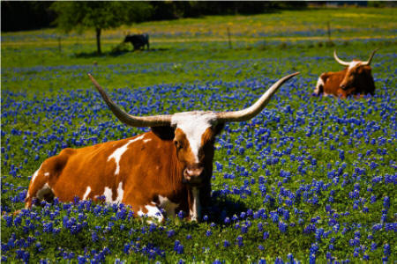
Join Us in Worship
Ranger Church of Christ
Mesquite and Rusk St.

Slide 2
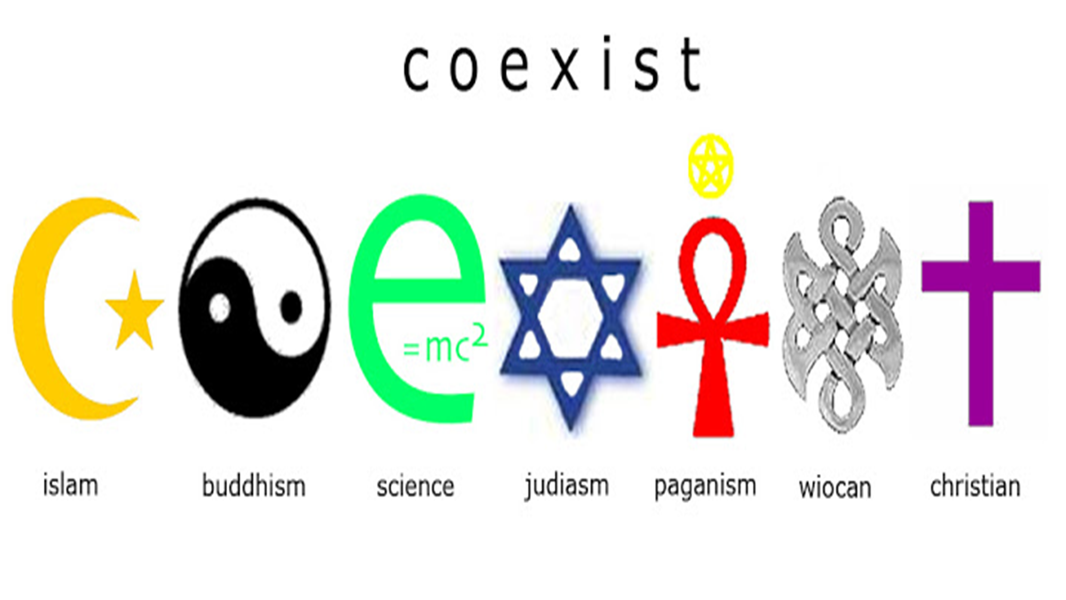
Notes:
1. We have a choice of Religious bases in todays world.
2. Many have been blended these basic religions and that lend to the confusion of what the true religion is.
3. With that in mind, is Your Religious Basis Really the True One?

Slide 3
Is Your Religious Basis Really True?
Notes:
1. The last Sunday, of the past month, March 24th, I preached a lesson on “Is Your Religion Really Yours”.
2. I developed a concern; as to whether or not everyone understood the basis I used, for that lesson on religion.
3. I probably should have preached this one first, but hind sight has no critics -- until the task is completed.
4. We must always be careful with our trust, after all, “salt looks just like sugar”.

Slide 4
Introduction
Religion: faith in God, love for God, obedience, moral living, hope of heaven
Religion has vast bearing on one‘s life
Religion is founded upon a certain basis
This lesson consider on what basis is your religion founded
Notes:
1. So, what it religion? Religion is faith in God, love for God, obedience to God, moral living, and a hope of heaven
>>>>>>>>>>>>>>>>>>>>>>>>
2. Religion, as such, has a vast bearing on one‘s earthly life, and the consequences are eternal for the soul.
>>>>>>>>>>>>>>>>>>>>>>>>
3. Religion is founded upon a certain basis beliefs
>>>>>>>>>>>>>>>>>>>>>>>>
4. In this lesson we shall consider “on what basis your religion has been founded.

Slide 5
Introduction
Two lessons which ask “Is Your Religious Basis Really True?”
First lesson: consider some negatives – wrong things upon which to base religion
Second lesson: consider the positive side – Bible passages that teach that our religion must be true and must be ours
Notes:
1. Two lessons which ask “Is Your Religion Really True?”
>>>>>>>>>>>>>>
2. First lesson: consider some negatives – wrong things upon which to base religion
>>>>>>>>>>>>>>
3. Second lesson: consider the positive side – Bible passages that teach that our religion must be ours

Slide 6
Is Your Religious Basis Really True?
Religion of Many Is Organizational
Religion of Many Is Founded on Family
Religion of Many Is Based on Social Relationships
Notes:
1. Is Your Religious Basis Really True, and what are the bases for religion?
2. The religion of many people is purely organizational in character.

Slide 7
Religion that Is Organizational
Act and believe as their “church” dictates
Moral standards
Doctrine
Worship attendance
Church Manual
The whole basis of their religion is organizational
If change to another “church,” then they would also change to that religion’s dogmas
Notes:
1. When religion that is organizational, there is a church manual written for the organization.
a. You must Act and believe as their “church” dictates
>>>>>>>>>>>>>>>>>>>>
2. Their Moral standards are set out in the manual and varies from church to church.
>>>>>>>>>>>>>>>>>>>>
3. The doctrine and creeds are determined by the counsel or governing body of the organization.
>>>>>>>>>>>>>>>>>>>>
4. Worship attendance in many organizations is required on most major religious holidays and is optional on a weekly basis.
>>>>>>>>>>>>>>>>>>>>
5. If you decide to change to another “church,” then you would also change to that religion’s dogmas and use their church manual.
>>>>>>>>>>>>>>>>>>>>
6. The whole basis of their religion is organizational

Slide 8

Religion that Is Organizational
Some seek to convert others to their organization – to their dogmas, not to Christ
The New Testament converts people to the Lord:
Notes:
1. Some seek to convert others to their organization – to their dogmas, numbers is the goal for worship, not the conversion to Christ.
>>>>>>>>>>>>>>>>>>>>
2. The New Testament converts people to the Lord God:
For the word of God is living and powerful, and sharper than any two-edged sword, piercing even to the division of soul and spirit, and of joints and marrow, and is a discerner of the thoughts and intents of the heart. (Hebrews 4:12)

Slide 9
Requires your personal belief in the your Savior (Jn. 20:30-31; 1 Jn. 1:1-4)
Requires your personal confession (Rm. 10:9-10)
Includes your personal acceptance of the atonement of Christ for your own sins (Acts 2:38; 3:26; cf. Mt. 3:7-9)
If religion is not personal, it is of no value (Rom. 12:1-2)
Notes:
Alien Sinners, Christ authored “Plan of Salvation” that must be taught, believed and obeyed for eternal life.
If you need to respond to the invitation, think on these things during this lesson.
>>>>>>>>>>>>>>>>>>>>>>>>>>>>
1. Salvation requires your personal belief in the your Savior (Jn. 20:30-31; 1 Jn. 1:1-4)
And truly Jesus did many other signs in the presence of His disciples, which are not written in this book; but these are written that you may believe that Jesus is the Christ, the Son of God, and that believing you may have life in His name. (John 20:30-31)
a. John gives us the Words of Life:
That which was from the beginning, which we have heard, which we have seen with our eyes, which we have looked upon, and our hands have handled, concerning the Word of life— the life was manifested, and we have seen, and bear witness, and declare to you that eternal life which was with the Father and was manifested to us— that which we have seen and heard we declare to you, that you also may have fellowship with us; and truly our fellowship is with the Father and with His Son Jesus Christ. And these things we write to you that your joy may be full. (1 John 1:1-4)
>>>>>>>>>>>>>>>>>>>>>>>>>>>>
2. Requires your personal confession (Rm. 10:9-10)
that if you confess with your mouth the Lord Jesus and believe in your heart that God has raised Him from the dead, you will be saved. For with the heart one believes unto righteousness, and with the mouth confession is made unto salvation. (Romans 10:9-10)
>>>>>>>>>>>>>>>>>>>>>>>>>>>>
3. Includes your personal acceptance of the atonement of Christ for your own sins (Acts 2:38; 3:26; cf. Mt. 3:7-9)
Then Peter said to them, "Repent, and let every one of you be baptized in the name of Jesus Christ for the remission of sins; and you shall receive the gift of the Holy Spirit. (Acts 2:38)
To you first, God, having raised up His Servant Jesus, sent Him to bless you, in turning away every one of you from your iniquities." (Acts 3:26)
But when he saw many of the Pharisees and Sadducees coming to his baptism, he said to them, "Brood of vipers! Who warned you to flee from the wrath to come? Therefore bear fruits worthy of repentance, and do not think to say to yourselves, 'We have Abraham as our father.' For I say to you that God is able to raise up children to Abraham from these stones. (Matthew 3:7-9)
>>>>>>>>>>>>>>>>>>>>>>>>>>>>
4. If religion is not personal, it is of no value to you or anyone else. (Rom. 12:1-2)
I beseech you therefore, brethren, by the mercies of God, that you present your bodies a living sacrifice, holy, acceptable to God, which is your reasonable service. And do not be conformed to this world, but be transformed by the renewing of your mind, that you may prove what is that good and acceptable and perfect will of God. (Romans 12:1-2)
a. The apostle Paul lays it squarely on the back of each individual, it is the responsibility of each individual to make religion personal.
Therefore, my beloved, as you have always obeyed, not as in my presence only, but now much more in my absence, work out your own salvation with fear and trembling; (Philippians 2:12)

Slide 10
Is Your Religious Basis Really True?
Religion of Many Is Organizational
Religion of Many Is Founded on Family
Religion of Many Is Based on Social Relationships
Notes:
1. Religion of many people in America is founded on what the family has always believed, it is sort of a “hand me down religion”.

Slide 11
Religion Founded on the Family
Religious belief and practice is built around family loyalty
Like politics in some places
Some in the church follow the religious tradition of the family
All is based on choice of some strong family member
This strong member does the studying for all the family
Notes:
1. Religious belief and practice is built around family loyalty to a specific organization; for the entire family.
>>>>>>>>>>>>>>>>>>>>>>>
a. You might look at it like politics, in many places around the country, like Silicon Valley is a liberal Democratic area of California.
>>>>>>>>>>>>>>>>>>>>>>>
2. Some in the church, follow the religious tradition of the family father, that have been handed down for ages and generations.
>>>>>>>>>>>>>>>>>>>>>>>
a. All of this is based on the personal choice of some strong family member from the past or near past.
>>>>>>>>>>>>>>>>>>>>>>
b. This strong family member does, and has done, all the studying that is done within the entire family, and he has become the family religious expert.

Slide 12
Religion Founded on the Family
Problem – some do not have their own religion
When youth leave home, many fall away – no root of faith and conviction (cf. Luke 8:13)
Easily swayed by false ways because religion not their own – only adopted religion
Family Religion
Notes:
1. Religion that has been founded on the family is not without problems and it may even be without truth.
>>>>>>>>>>>>>>>>>>>>>>>>>>>>>>>>>>>
2. One problem is that – some members do not have their own religion, that is, they disagrees with the family religion dogma.
a. As a consequence, when youth leave home, many fall away – because they have no deep and abiding root of faith and conviction in the family religion. (Luke 8:13)
But the ones on the rock are those who, when they hear, receive the word with joy; and these have no root, who believe for a while and in time of temptation fall away. (Luke 8:13)
>>>>>>>>>>>>>>>>>>>>>>>>>>>>>>>>>>>
b. These family religions are easily swayed by false religious ways; because the family religion not their own – they only adopted it for a home religion.

Slide 13
Religion Founded on the Family
Problem – some do not have their own religion
Some adopt the religion of their mate – it is not their own
Often 3rd generation Christians have only a hand-me-down faith
Notes:
1. Another Problem – classified as “some do not have their own religion”.
>>>>>>>>>>>>>>>>>>>>>>
a. Some people adopt the religion of their mate – it is not their own, never was and never will be, except for the marriage.
b. We all know some that have left the “faith of the family” after death or divorce.
>>>>>>>>>>>>>>>>>>>>>>
2. Often 3rd generation Christians have only a hand-me-down faith, based on what grandfather or grandmother said and taught…

Slide 14
Unlike their grandparents who had been converted out of error and withstood the persecution that comes with standing for truth
Simply had religion handed to them
If they had weak parents they likely will be even weaker (Judg. 2:10-12)
Notes:
1. Those who are weak in faith are unlike their grandparents, who had been converted out of error and withstood the persecution that comes with standing up for truth
>>>>>>>>>>>>>>>>>>>>
2. This family faith was simply a religion that was handed to them on a platter, to be rejected or accepted at their pleasure.
>>>>>>>>>>>>>>>>>>>>
3. If they had weak parents they, more than likely they themselves, will be even weaker (Judg. 2:10-12)
When all that generation had been gathered to their fathers, another generation arose after them who did not know the LORD nor the work which He had done for Israel. Then the children of Israel did evil in the sight of the LORD, and served the Baals; and they forsook the LORD God of their fathers, who had brought them out of the land of Egypt; and they followed other gods from among the gods of the people who were all around them, and they bowed down to them; and they provoked the LORD to anger. (Judges 2:8-12)

Slide 15
Religion Founded on the Family
In N. T. Christianity, one must follow the Lord himself, not follow the family
If religion based on family, it is worthless (Matt. 10:37-38)
By accepting truth, one may lose family, but be spiritually blessed (Mark 10:29-30)
Notes:
1. In N. T. Christianity, we must follow the Lord Himself, and not follow the family that is lost in un-Biblical doctrine.
>>>>>>>>>>>>>>>>>>>>>>>>>
a. If religion is based on family, it is worthless (Matt. 10:37-38)
He who loves father or mother more than Me is not worthy of Me. And he who loves son or daughter more than Me is not worthy of Me. And he who does not take his cross and follow after Me is not worthy of Me. (Matthew 10:37-38)
>>>>>>>>>>>>>>>>>>>>>>>>>
b. By accepting the one and only truth, one may lose his family, but be spiritually blessed in all he does. (Mark 10:29-30)
So Jesus answered and said, "Assuredly, I say to you, there is no one who has left house or brothers or sisters or father or mother or wife or children or lands, for My sake and the gospel's, who shall not receive a hundredfold now in this time—houses and brothers and sisters and mothers and children and lands, with persecutions—and in the age to come, eternal life. (Mark 10:29-30)

Slide 16
Is Your Religious Basis Really True?
Religion of Many Is Organizational
Religion of Many Is Founded on Family
Religion of Many Is Based on Social Relationships
Notes:
1. The religion of many is based on social relationships that they have develop while here on this earth.

Slide 17
Religion Based on Social Relationships
All based on personal loyalty – person they look up to
People build friendships and social ties in the religion of which they are members
Follow their trends because do not want to be thought of in an unfavorable way
Notes:
1. All of this religion is based on personal loyalty – to some person whom they look up to with respect and awe.
>>>>>>>>>>>>>>>>>>>>
2. People build friendships and social ties in the religion of which they are members, and feel betrayed if some leave the social group.
>>>>>>>>>>>>>>>>>>>>
3. They continue to follow their trends, because they do not want to be thought of in an unfavorable way.

Slide 18
Religion Based on Social Relationships
Some groups use these social ties to pressure people into submission – such as cults
Some, through social pressures, are half-converted
Notes:
1. Some of these social groups use these social ties to pressure people into submission – personal guilt trips, such as many of today’s cults do.
>>>>>>>>>>>>>>>>>>>>>>
2. Some, through aggressive social pressures, are half-converted to these doctrines and require more social pressure.

Slide 19
Holding to a few doctrinal points,
but not all the N. T.
Obey the Gospel, but not fully converted to all His teachings
Do all because expected by others, not out of devotion to the Lord (Matt. 23:5; John 12:42-43; John 5:44)
2 Tim. 2:19 – Lord knows those who are His
Notes:
1. Many of these social groups are holding to a few doctrinal points, but not all the N. T. as the Lord requires.
>>>>>>>>>>>>>>>>>>>>>
2. Some may even obey the Gospel, but they are not fully converted to all His teachings and will be therefore lost eternally.
>>>>>>>>>>>>>>>>>>>>>
3. The things they do they do because it is expected by others, it is not out of devotion to the Lord but devotion to the social group. (Matt. 23:5; John 12:42-43; John 5:44)
But all their works they do to be seen by men. They make their phylacteries broad and enlarge the borders of their garments. (Matthew 23:5)
Nevertheless even among the rulers many believed in Him, but because of the Pharisees they did not confess Him, lest they should be put out of the synagogue; for they loved the praise of men more than the praise of God. (John 12:42-43)
How can you believe, who receive honor from one another, and do not seek the honor that comes from the only God? (John 5:44)
>>>>>>>>>>>>>>>>>>>>>
4. 2 Tim. 2:19 – The Lord tells us that He knows those who are His.
Nevertheless the solid foundation of God stands, having this seal: "The Lord knows those who are His," and, "Let everyone who names the name of Christ depart from iniquity." (2 Timothy 2:19)

Slide 20
Conclusion
Is your religion really yours?
2 Cor. 13:5 – we should each examine ourselves
Do you have a personal faith?
Will your love for God see you through trials?
Are you living by His will out of personal conviction?
Notes:
1. Is your religious basis really true?
>>>>>>>>>>>>>>
2. 2 Cor. 13:5 – we should each examine ourselves each and everyday so that we may stand justified in the eyes of God and His Son Jesus Christ.
>>>>>>>>>>>>>>
a. Do you have a personal faith, I mean a real true personal faith?
>>>>>>>>>>>>>>
b. Will your love for God see you through trials and tribulations that are set before you by God?
>>>>>>>>>>>>>>
c. Are you living by His will, out of your personal conviction that Jesus Christ is the Son of God, and that God raised Him from the dead?
>>>>>>>>>>>>>>
If you are an erring sinner or an alien sinner, now is the time to rectify that condition by responding to the Gospel call.
>>>>>>>>>>>>>>

