Slide 1
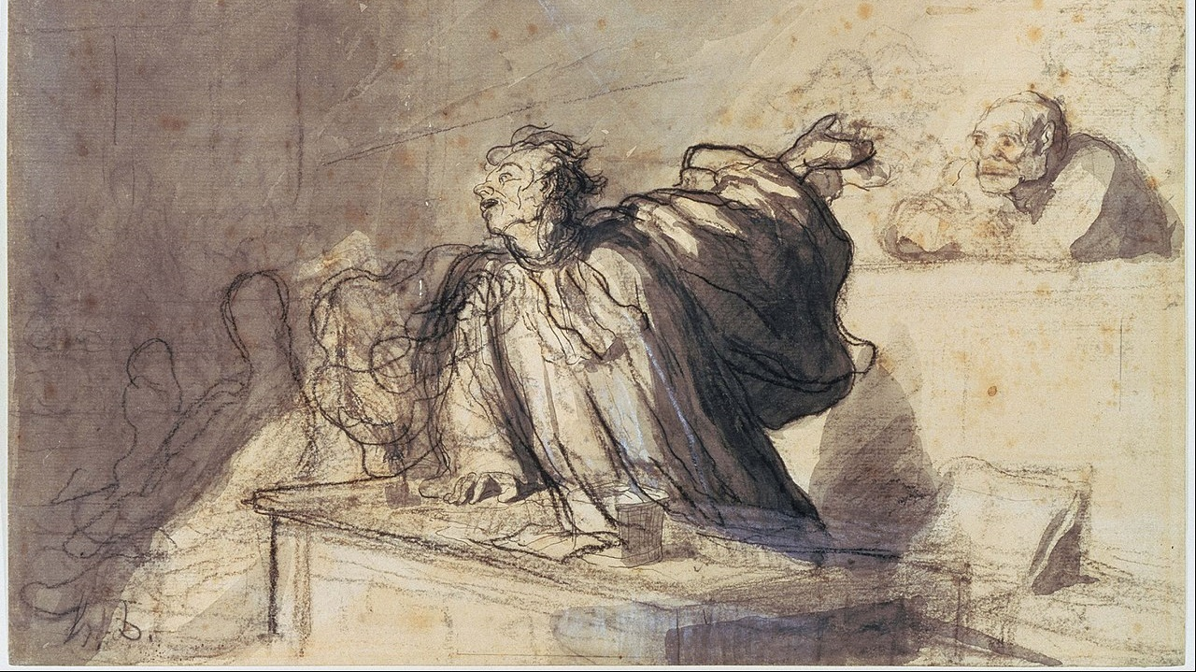
Welcome to Worship
The Accuser
Ranger Church of Christ

Slide 2
The Plea of the Church
What Do “Church of Christer’s” Want?
Notes:
1. The Plea of the Church is a universal plea directed at all mankind.
2. The world may very well ask “What Do “Church of Christer's” Want?
3. We want them to want what we know we have now, an eternal home in Jesus Christ.

Slide 3
Accept JESUS as LORD- Acts 2:36
Not the denominational concept of “accepting Jesus as your personal savior.”
Acts 2:22-24, 29-36
Matthew 7:21-23 -- many act presumptuously in Jesus’ name, but will be REJECTED.
Notes:
1. The plea of the church of Christ is that you Accept JESUS as the LORD- Acts 2:36
"Therefore let all the house of Israel know assuredly that God has made this Jesus, whom you crucified, both Lord and Christ." (Acts 2:36)
2. This is not the denominational concept of “accepting Jesus as your personal savior.”
a. Believing that Jesus is the Son of God; is not enough for your salvation, you must keep and obey His commands.
3. Acts 2:22-24, 29-36
"Men of Israel, hear these words: Jesus of Nazareth, a Man attested by God to you by miracles, wonders, and signs which God did through Him in your midst, as you yourselves also know-Him, being delivered by the determined purpose and foreknowledge of God, you have taken by lawless hands, have crucified, and put to death; whom God raised up, having loosed the pains of death, because it was not possible that He should be held by it. (Acts 2:22-24)
>>>>>>>>>>>>>>>>>>>>>>>>>
4. Matthew 7:21-23 – many denominations act presumptuously in Jesus’ name, but will be REJECTED by His judgment.
"Not everyone who says to Me, 'Lord, Lord,' shall enter the kingdom of heaven, but he who does the will of My Father in heaven. Many will say to Me in that day, 'Lord, Lord, have we not prophesied in Your name, cast out demons in Your name, and done many wonders in Your name?' And then I will declare to them, 'I never knew you; depart from Me, you who practice lawlessness!' (Matthew 7:21-23)

Slide 4
Accept JESUS as LORD- Acts 2:36
Accepting Jesus means we DO what He SAYS (Luke 6:46). (Accepting the authority of parents, teachers, employers, govt)
John 12:48; We will be judged by Jesus’ WORDS
2 Thes. 1:6-9 Failure to hear and obey Jesus’ words will result in our DESTRUCTION.
Notes:
1. Accepting Jesus means we DO what He SAYS for us to do, not what we want to do in His name. (Luke 6:46).
a. (Accepting the authority of Christ, is like accepting the authority of our parents, teachers, employers, govt)
"But why do you call Me 'Lord, Lord,' and not do the things which I say? (Luke 6:46)
>>>>>>>>>>>>>>>>>>>
2. John 12:48; We will be judged by Jesus’ WORDS, whether we know and do His word or not.
He who rejects Me, and does not receive My words, has that which judges him-the word that I have spoken will judge him in the last day. (John 12:48)
>>>>>>>>>>>>>>>>>>>
3. 2 Thes. 1:6-9 Failure to hear and obey Jesus’ words will result in our eternal DESTRUCTION. As Caden read:
since it is a righteous thing with God to repay with tribulation those who trouble you, and to give you who are troubled rest with us when the Lord Jesus is revealed from heaven with His mighty angels, in flaming fire taking vengeance on those who do not know God, and on those who do not obey the gospel of our Lord Jesus Christ. These shall be punished with everlasting destruction from the presence of the Lord and from the glory of His power, (2 Thessalonians 1:6-9)

Slide 5
Accept the BIBLE as the Only Rule of FAITH
No one can know anything of the mind of God except thru what He has revealed in the BIBLE.
Deut 4:2 -- do not add to or diminish ought from = keeping Rev 22:18-19
2 Tim 3:16-17 God’s Word makes the man of God COMPLETE & furnishes him unto EVERY GOOD WORK
2 Peter 1:3 God’s Word provides ALL THINGS that pertain to LIFE and GODLINESS.
Notes:
1. We must Accept the BIBLE as the Only Rule of FAITH for our lives
>>>>>>>>>>>>>>>>>>
2. No one can know anything of the mind of God except through what He has revealed to us in the BIBLE.
>>>>>>>>>>>>>>>>>>
3. Deut 4:2 -- do not add to or diminish ought from = keeping Rev 22:18-19
You shall not add to the word which I command you, nor take from it, that you may keep the commandments of the LORD your God which I command you. (Deuteronomy 4:2)
----------------------------------------------
For I testify to everyone who hears the words of the prophecy of this book: If anyone adds to these things, God will add to him the plagues that are written in this book; and if anyone takes away from the words of the book of this prophecy, God shall take away his part from the Book of Life, from the holy city, and from the things which are written in this book. (Revelation 22:18-19)
>>>>>>>>>>>>>>>>>>
4. 2 Tim 3:16-17 God’s Word makes the man of God COMPLETE & furnishes him unto EVERY GOOD WORK
All Scripture is given by inspiration of God, and is profitable for doctrine, for reproof, for correction, for instruction in righteousness, that the man of God may be complete, thoroughly equipped for every good work. (2 Timothy 3:16-17)
>>>>>>>>>>>>>>>>>>
5. 2 Peter 1:3 God’s Word provides ALL THINGS that pertain to LIFE and GODLINESS.
as His divine power has given to us all things that pertain to life and godliness, through the knowledge of Him who called us by glory and virtue, (2 Peter 1:3)

Slide 6
God’s Word is not the Source of Religious DIVISION!
John 17:17-23; 1 Corinthians 14:40
Can we all see the Bible alike?
Is the Creator of the universe incapable of producing an understandable book?
There are more than 600 distinct “Christian” religious bodies in Los Angeles.
1 Corinthians 1:10
Notes:
1. God’s Word is not the Source of Religious DIVISION, men are the source of Religious Division!
a. We are not allowed to interpret the word of God differently, we are required to understand it as He has given it to us.
>>>>>>>>>>>>>>>>>>
2. John 17:17-23; 1 Corinthians 14:40
Sanctify them by Your truth. Your word is truth. As You sent Me into the world, I also have sent them into the world. And for their sakes I sanctify Myself, that they also may be sanctified by the truth. "I do not pray for these alone, but also for those who will believe in Me through their word; that they all may be one, as You, Father, are in Me, and I in You; that they also may be one in Us, that the world may believe that You sent Me. And the glory which You gave Me I have given them, that they may be one just as We are one: I in them, and You in Me; that they may be made perfect in one, and that the world may know that You have sent Me, and have loved them as You have loved Me. (John 17:17-23)
-----------------------------
Let all things be done decently and in order. (1 Corinthians 14:40)
>>>>>>>>>>>>>>>>>>>
3. Can we all see the Bible alike?
a. Yes, we must see it alike, in order to be one with the Father and the Son.
>>>>>>>>>>>>>>>>>>>
4. Do you believe that the Creator of the universe is incapable of producing an understandable book?
a. He has produced His word in a fully understandable context, yet it is not understood by the hardhearted and those who do not love God.
b. You cannot serve God and yourself at the same time, it cannot bey “Your Way”, it must be God’s way.
>>>>>>>>>>>>>>>>>>>
5. There are more than 600 distinct “Christian” religious bodies just in the city of Los Angeles.
a. There are no less than 14 churches in the Ranger area, count them, you may come up with more than I have.
b. Which one of these, is the one that Christ built, the one that teaches what the Bible teaches, and nothing else?
>>>>>>>>>>>>>>>>>>>
6. 1 Corinthians 1:10
Now I plead with you, brethren, by the name of our Lord Jesus Christ, that you all speak the same thing, and that there be no divisions among you, but that you be perfectly joined together in the same mind and in the same judgment. (1 Corinthians 1:10)

Slide 7
There is ONE faith - Eph 4:5
Hank Aaron- the career home run king
Nolan Ryan- the career strikeout king
All these are one of a kind – e.g., John the immerser.
There are many verses in the New Testament pertaining to “THE FAITH.”
Notes:
1. There is ONE faith - Eph 4:5
one Lord, one faith, one baptism; (Ephesians 4:5)
>>>>>>>>>>>>>>>>>>
2. Hank Aaron- is the career home run king
>>>>>>>>>>>>>>>>>>
3. Nolan Ryan- the career strikeout king
>>>>>>>>>>>>>>>>>>
4. All these are “one of a kind” – for example, “John the immerser”.
>>>>>>>>>>>>>>>>>>
5. There are many verses in the New Testament pertaining to “THE FAITH.”

Slide 8
Our plea with all men everywhere is to set aside the doctrines and creeds of men, and embrace the one faith of the Bible.
Notes:
Our plea, with all men everywhere, is that they set aside the doctrines and creeds of men, and embrace the one faith of the Bible.

Slide 9
Accept the CHURCH Jesus built - Matthew 16:18
Acts 2:36-38, 41, 47
Acts 20:28
Ephesians 5:23-32
We do not plead for “our church” over yours, but for all men to be a member of the one church built by Christ.
Notes:
1. Accept the CHURCH Jesus built - Matthew 16:18
And I also say to you that you are Peter, and on this rock I will build My church, and the gates of Hades shall not prevail against it. (Matthew 16:18)
>>>>>>>>>>>>>>>>>>>>>
2. Acts 2:36-38, 41, 47
"Therefore let all the house of Israel know assuredly that God has made this Jesus, whom you crucified, both Lord and Christ." Now when they heard this, they were cut to the heart, and said to Peter and the rest of the apostles, "Men and brethren, what shall we do?" Then Peter said to them, "Repent, and let every one of you be baptized in the name of Jesus Christ for the remission of sins; and you shall receive the gift of the Holy Spirit. (Acts 2:36-38)
-----------------------------------
Then those who gladly received his word were baptized; and that day about three thousand souls were added to them. (Acts 2:41)
-----------------------------------
praising God and having favor with all the people. And the Lord added to the church daily those who were being saved. (Acts 2:47)
>>>>>>>>>>>>>>>>>>>>>
3. Acts 20:28 – tells us that it is “His blood bought church”.
Therefore take heed to yourselves and to all the flock, among which the Holy Spirit has made you overseers, to shepherd the church of God which He purchased with His own blood. (Acts 20:28)
>>>>>>>>>>>>>>>>>>>>>
4. Ephesians 5:23-32
that He might present her to Himself a glorious church, not having spot or wrinkle or any such thing, but that she should be holy and without blemish. (Ephesians 5:27)
>>>>>>>>>>>>>>>>>>>>>
5. We do not plead for “our church” over “yours”, but for all men to be a member of the one church built by Christ.

Slide 10
Accept God’s Conditions of SALVATION:
Mk 4: Parable of the soils All must HEAR God’s Word
Rom 10:17 HEARING God’s Word produces FAITH
Acts 17:30 God commands all men to REPENT
Rom 10:10 CONFESSION is made unto salvation
Mk 16:16 He who BELIEVES and is BAPTIZED
1 Pet 3:21 Baptism doth now also SAVE us.
Rev 2:10 We must be FAITHFUL until DEATH.
Notes:
1. As members of the Ranger church of Christ, we want everyone to Accept God’s Conditions for SALVATION:
>>>>>>>>>>>>>>>>>>>>>
2. We know from the Parable of the soils, All must HEAR God’s Word Mk chapter 4.
>>>>>>>>>>>>>>>>>>>>>
3. HEARING God’s Word produces FAITH Rom 10:17 – you cannot believe what you have not seen or heard.
>>>>>>>>>>>>>>>>>>>>>
4. God commands all men to REPENT Acts 17:30 – the Lord demands that we repent of our sins against Him and ask for forgiveness.
>>>>>>>>>>>>>>>>>>>>>
5. CONFESSION is made unto salvation Rom 10:10 – unto salvation means without confession, you do not truly believe.
>>>>>>>>>>>>>>>>>>>>>
6. He who BELIEVES and is BAPTIZED Mk 16:16 – The Lord tied belief and baptism together through His inspired word.
>>>>>>>>>>>>>>>>>>>>>
7. Baptism doth now also SAVE us. 1 Pet 3:21 – in spite of denominational teaching, there is no salvation without baptism.
>>>>>>>>>>>>>>>>>>>>>>
8. We must be FAITHFUL until DEATH. Rev 2:10 – if we want that crown of life.

Slide 11
2 Corinthians 13:5 Examine and Prove Yourself
Do I accept the Lordship of Jesus?
Am I willing to take the Bible as my only rule of faith and practice?
Am I a member of the church that Jesus built?
Have I accepted and obeyed God’s conditions of salvation?
Do I love the Lord enough to do what He says? John 14:15, 23
Do I have the courage to obey His commands? Matt 10:32-39
Notes:
1. 2 Corinthians 13:5 Examine and Prove Yourself
Examine yourselves as to whether you are in the faith. Test yourselves. Do you not know yourselves, that Jesus Christ is in you?&#151;unless indeed you are disqualified. (2 Corinthians 13:5)
>>>>>>>>>>>>>>>>>>>>>>
2. Do I accept the authority and Lordship of Jesus?
>>>>>>>>>>>>>>>>>>>>>>
3. Ask yourself “Am I willing to take the Bible as my only rule of faith and practice?”
>>>>>>>>>>>>>>>>>>>>>>
4. Am I a member of the one and only church that Jesus built?
>>>>>>>>>>>>>>>>>>>>>>
5. Have I accepted and obeyed God’s conditions of salvation?
>>>>>>>>>>>>>>>>>>>>>>
6. Do I love the Lord enough to do what He says? John 14:15, 23
"If you love Me, keep My commandments. (John 14:15)
Jesus answered and said to him, "If anyone loves Me, he will keep My word; and My Father will love him, and We will come to him and make Our home with him. (John 14:23)
>>>>>>>>>>>>>>>>>>>>>>
7. Do I have the courage to obey His commands? Matt 10:32-39

Slide 12
What do we want?
We want the same thing the LORD wants!
Invitation Song | 17 | Almost Persuaded
Closing Song | 36 | Christ Receiveth Sinful Men
Closing Prayer
Notes:
1. What do we want?
>>>>>>>>>>>>>>>>>>>
2. We want the same thing the LORD wants!
>>>>>>>>>>>>>>>>>>>
3. The invitation if offered for your response if you want what the Lord wants you to have.

