Slide 1
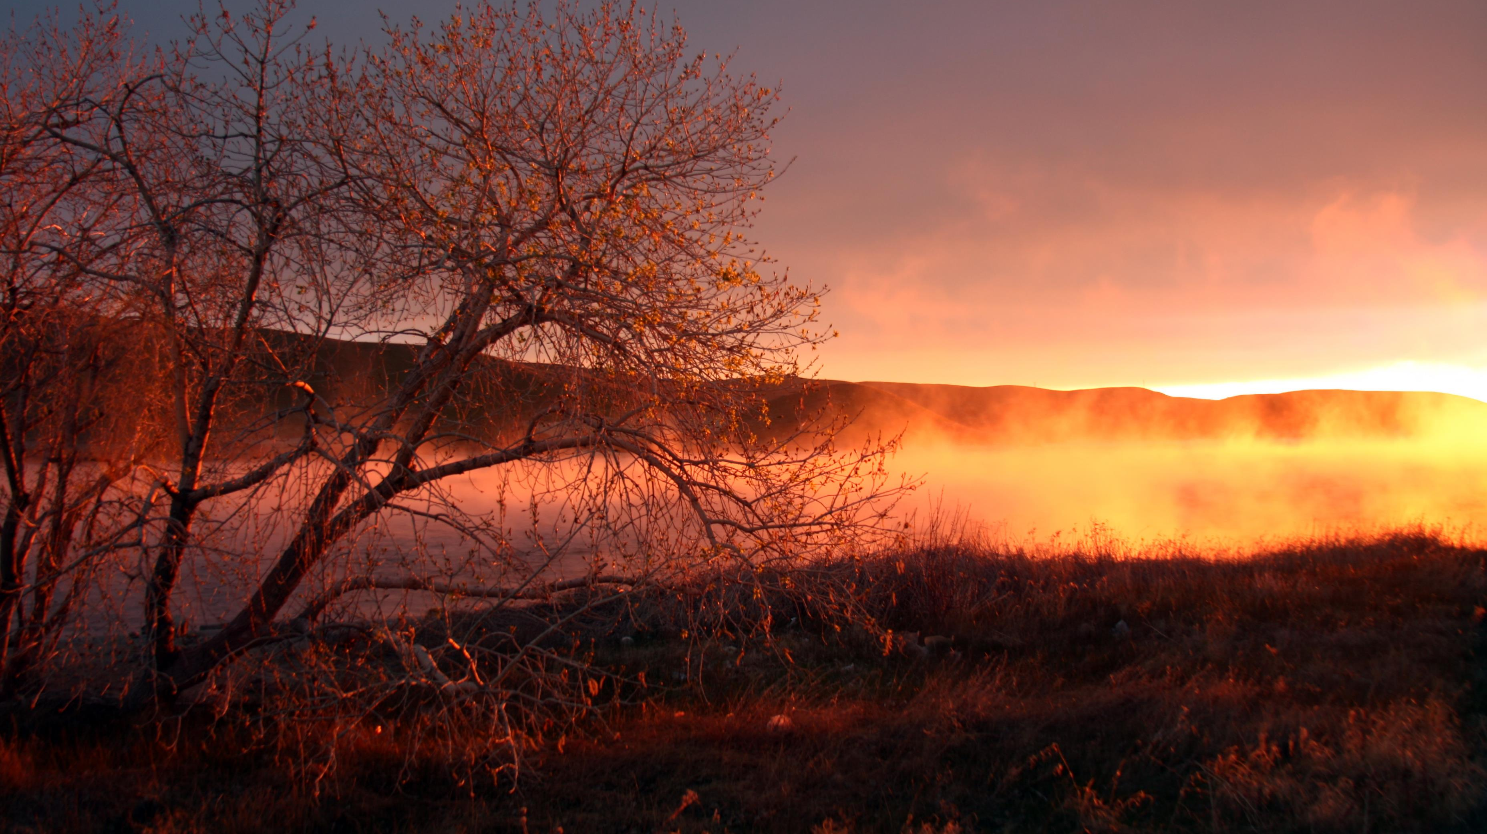
Your Invited To Worship
Ranger Church of Christ
Mesquite and Rusk St.

Slide 2
Announcements | Songs | Title
1st Song | 2 | A Wonderful Savior
2nd Song | 232 | The Lord’s My Shepherd
Opening Prayer
3rd Song | 245 | The Christian’s Welcome Home
4th Song | 504 | The Breaking of Bread
Lords Supper
Offering
5th Song | 186 | Standing on the Promises
Sermon
Invitation Song | 226 | There’s A Great Day Coming
Closing Song | 55 | Doxology
Closing Prayer

Slide 3
Lest Any Fall from the Grace of God
Hebrews 12:14-17
GRACE
LOST
Notes:
1. As we studied in Bible Class last week, the book of Revelation refutes the “Saved by Grace Only” doctrine of men.
2. The Grace of God is a gift from God, that gift is His Blood Covenant with mankind, completed in His Son’s blood, Only IF – we are obedient to His will and His plan of Salvation.
3. If you have not been obedient to His will, you will be lost!
4. Yes you can fall from the grace of God by leading a profane life.

Slide 4
Introduction
Heb. 12:14-17
Continues to exhort saints to be faithful to the Lord
Had urged saints to faithfully live for God throughout course of life (12:1-4)
Had given O.T. examples of those who did so (Heb. 11)
Notes:
1. Introduction
2. Heb. 12:14-17
Pursue peace with all people, and holiness, without which no one will see the Lord: looking carefully lest anyone fall short of the grace of God; lest any root of bitterness springing up cause trouble, and by this many become defiled; lest there be any fornicator or profane person like Esau, who for one morsel of food sold his birthright. For you know that afterward, when he wanted to inherit the blessing, he was rejected, for he found no place for repentance, though he sought it diligently with tears. (Hebrews 12:14-17)
>>>>>>>>>>>>>>>>>>>>
a. The Hebrew writer, continues to exhort saints to be faithful to the Lord, don’t lead a life that is worldly and profess to be a Christian, let the worldly life go!
>>>>>>>>>>>>>>>>>>>>
b. He had urged saints to faithfully live for God throughout course of life (12:1-4)
For consider Him who endured such hostility from sinners against Himself, lest you become weary and discouraged in your souls. You have not yet resisted to bloodshed, striving against sin. (Hebrews 12:3-4)
1.) You Have not yet been called to resist sinners, to the extreme point in which they will take your life.
>>>>>>>>>>>>>>>>>>>>
c. The Hebrew writer had already given O.T. examples of those who did so, in chapter eleven. (Heb. 11)
Therefore from one man, and him as good as dead, were born as many as the stars of the sky in multitude—innumerable as the sand which is by the seashore. (Hebrews 11:12)

Slide 5
Introduction
Heb. 12:14-17
Now in this our he exhorts saints to pursue a righteous relationship with God & man
Peace toward men and sanctification toward God
This is involved our faithfully running in the Christian race
Notes:
1. Heb. 12:14-17
>>>>>>>>>>>>>>>>>>
2. Now in our text, he exhorts saints to pursue a righteous relationship with God & man.
>>>>>>>>>>>>>>>>>>
3. Peace toward men and sanctification toward God
>>>>>>>>>>>>>>>>>>
4. This is involved our faithfully running in the Christian race, as the Apostle Paul stated he had completed. (2 Tim 4:8)

Slide 6
Mark 12:29-31
First commandment: love God
Second commandment: love neighbor
Let us now consider these two important guidelines of living the faithful Christian life
Notes:
1. Mark 12:29-31
Jesus answered him, "The first of all the commandments is: 'HEAR, O ISRAEL, THE LORD OUR GOD, THE LORD IS ONE. AND YOU SHALL LOVE THE LORD YOUR GOD WITH ALL YOUR HEART, WITH ALL YOUR SOUL, WITH ALL YOUR MIND, AND WITH ALL YOUR STRENGTH.' This is the first commandment. And the second, like it, is this: 'YOU SHALL LOVE YOUR NEIGHBOR AS YOURSELF.' There is no other commandment greater than these.“ (Mark 12:29-31)
>>>>>>>>>>>>>>>>>>>>
2. First commandment: love God
>>>>>>>>>>>>>>>>>>>>
3. Second commandment: love neighbor
>>>>>>>>>>>>>>>>>>>>
4. Let us now consider these two important guidelines of living the faithful Christian life

Slide 7
“Pursue peace with all people”
“Peace” – harmony with, not enemy, not out of sorts or at odds with
Especially in the church (Jn. 13:34-35; 14:23-24)
Eph. 2:14-17 – Reconciled
1 Pet 1:22 – Love Fervently
1 Cor. 3:3 – Carnal Minded
Pursue Peace: Phil 2:3; Col 3:8-9; Rom 14:19
Notes:
1. “Pursue peace with all people”
Pursue peace with all people, and holiness, without which no one will see the Lord: (Hebrews 12:14)
>>>>>>>>>>>>>>>>>>>>
2. “Peace” – means harmony with, not the enemy of, not out of sorts and at odds with.
>>>>>>>>>>>>>>>>>>>>
3. Especially in the church (Jn. 13:34-35; 14:23-24)
A new commandment I give to you, that you love one another; as I have loved you, that you also love one another. By this all will know that you are My disciples, if you have love for one another.“ (John 13:34-35)
>>>>>>>>>>>>>>>>>>>>>>
4. Eph. 2:14-17 – reconciled
For He Himself is our peace, who has made both one, and has broken down the middle wall of separation, having abolished in His flesh the enmity, that is, the law of commandments contained in ordinances, so as to create in Himself one new man from the two, thus making peace, and that He might reconcile them both to God in one body through the cross, thereby putting to death the enmity. (Ephesians 2:14-16)
>>>>>>>>>>>>>>>>>>>>>>
5. 1 Pet. 1:22 – love fervently
Since you have purified your souls in obeying the truth through the Spirit in sincere love of the brethren, love one another fervently with a pure heart, (1 Peter 1:22)
>>>>>>>>>>>>>>>>>>>>>>
6. 1 Cor. 3:3 – carnal minded
for you are still carnal. For where there are envy, strife, and divisions among you, are you not carnal and behaving like mere men? (1 Corinthians 3:3)
>>>>>>>>>>>>>>>>>>>>>>
7. Pursue peace: Phil. 2:3; Col. 3:8-9; Rom. 14:19)
Let nothing be done through selfish ambition or conceit, but in lowliness of mind let each esteem others better than himself. (Philippians 2:3)
-------------------------------
Therefore let us pursue the things which make for peace and the things by which one may edify another. (Romans 14:19)

Slide 8
“Pursue peace with all people”
0
Also pursue peace with those of the world
Readers were persecuted – tempted to be bitter, hateful
We are not of the world (Jn. 15:19; Rom. 12:19, 21)
Notes:
1. “Pursue peace with all people”
>>>>>>>>>>>>>>>>
2. Also pursue peace with those of the world
>>>>>>>>>>>>>>>>
3. Readers were persecuted – tempted to be bitter, hateful
>>>>>>>>>>>>>>>
4. We are not of the world (Jn. 15:19; Rom. 12:19, 21)
If you were of the world, the world would love its own. Yet because you are not of the world, but I chose you out of the world, therefore the world hates you. (John 15:19)

Slide 9
“Pursue peace with all people”
“Pursue” – earnest pursuit
Rom. 12:18 – as much as depends on you (1 Pt. 2:23)
Do everything that lies in our power, which is consistent with truth and godliness, to live in peace with all men
Notes:
1. “Pursue” – Make it an earnest pursuit, not just a casual passing glance.
>>>>>>>>>>>>>>>>>>>>>>>
2. Rom. 12:18 – as much as depends on you (1 Pt. 2:23)
If it is possible, as much as depends on you, live peaceably with all men. (Romans 12:18)
who, when He was reviled, did not revile in return; when He suffered, He did not threaten, but committed Himself to Him who judges righteously; (1 Peter 2:23)
>>>>>>>>>>>>>>>>>>>>>>>
3. Do everything that lies within our power, which is consistent with truth and godliness, to live in peace with all men

Slide 10
“Pursue…holiness, without which no one can see the Lord”
“Holiness” – sanctification, consecration unto God in heart and life
To continuously endeavor to live distinctively for God (Phil. 1:20-21; Rom. 12:1-2; Phil. 2:15)
Notes:
1. “Pursue…holiness, without which no one can see the Lord”
Pursue peace with all people, and holiness, without which no one will see the Lord: (Hebrews 12:14)
>>>>>>>>>>>>>>>>>>>>>
2. “Holiness” – sanctification, consecration unto God in heart and in our daily life.
>>>>>>>>>>>>>>>>>>>>>
3. We are to continuously endeavor to live distinctively for God (Phil. 1:20-21; Rom. 12:1-2; Phil. 2:15)
according to my earnest expectation and hope that in nothing I shall be ashamed, but with all boldness, as always, so now also Christ will be magnified in my body, whether by life or by death. For to me, to live is Christ, and to die is gain. (Philippians 1:20-21)
-------------------------------------
And do not be conformed to this world, but be transformed by the renewing of your mind, that you may prove what is that good and acceptable and perfect will of God. (Romans 12:2)
------------------------------------
that you may become blameless and harmless, children of God without fault in the midst of a crooked and perverse generation, among whom you shine as lights in the world, (Philippians 2:15)

Slide 11
“Pursue…holiness, without which no one can see the Lord”
Without holiness no one can see Christ in us
Christ cannot be see in our lukewarmness, materialism, or hypocrisy
Christ must be seen in all of our life, or He is seen in none
Notes:
1. Without holiness no one can see Christ in us
>>>>>>>>>>>>>>>>>>>>>
2. Christ cannot be see in our lukewarmness, materialism, or hypocrisy
>>>>>>>>>>>>>>>>>>>>>
3. Christ must be seen in all of our life, or He is seen in all of or He is seen none of it.

Slide 12
“Looking carefully lest anyone fall short of the grace of God”
Faithfulness involves a genuine concern for spiritual welfare of other saints
“looking carefully” - watching over one another (Gal. 6:1)
Any of us can fall from grace (Heb. 3:12-14)
Notes:
“Looking carefully lest anyone fall short of the grace of God”
>>>>>>>>>>>>>>>>>>>>>>
1. Faithfulness involves a genuine concern for spiritual welfare of other saints
>>>>>>>>>>>>>>>>>>>>>>
2. “looking carefully” - watching over one another (Gal. 6:1)
Brethren, if a man is overtaken in any trespass, you who are spiritual restore such a one in a spirit of gentleness, considering yourself lest you also be tempted. (Galatians 6:1)
>>>>>>>>>>>>>>>>>>>>>>
3. Any of us can fall from grace (Heb. 3:12-14)
Beware, brethren, lest there be in any of you an evil heart of unbelief in departing from the living God; but exhort one another daily, while it is called "TODAY," lest any of you be hardened through the deceitfulness of sin. For we have become partakers of Christ if we hold the beginning of our confidence steadfast to the end, (Hebrews 3:12-14)

Slide 13
“Lest any root of bitterness springing up cause trouble, and by this many become defiled”
“Root of bitterness” – root which was poisonous
Deut. 29:18 - emerging of idolatrous men, influencing people of Israel
Notes:
“Lest any root of bitterness springing up cause trouble, and by this many become defiled”
>>>>>>>>>>>>>>>>>
1. “Root of bitterness” – root which was poisonous
>>>>>>>>>>>>>>>>>
2. Deut. 29:18 - emerging of idolatrous men, influencing people of Israel
so that there may not be among you man or woman or family or tribe, whose heart turns away today from the LORD our God, to go and serve the gods of these nations, and that there may not be among you a root bearing bitterness or wormwood; (Deuteronomy 29:18)

Slide 14
“Lest any root of bitterness springing up cause trouble, and by this many become defiled”
Christians in sin must be disciplined for benefit of the church (1 Cor. 5:6-7)
Discipline begins when a saint goes to a brother in sin (James 5:19-20), then takes it to church
Notes:
“Lest any root of bitterness springing up cause trouble, and by this many become defiled”
>>>>>>>>>>>>>>>>>>>>>>
1. Christians in sin, and not repentant, must be disciplined for benefit of the church (1 Cor. 5:6-7; Matt 18:15-17)
Your glorying is not good. Do you not know that a little leaven leavens the whole lump? Therefore purge out the old leaven, that you may be a new lump, since you truly are unleavened. For indeed Christ, our Passover, was sacrificed for us. (1 Corinthians 5:6-7)
>>>>>>>>>>>>>>>>>>>>>>
2. Discipline begins when a saint goes to a brother in sin (James 5:19-20), then takes it to church
Brethren, if anyone among you wanders from the truth, and someone turns him back, let him know that he who turns a sinner from the error of his way will save a soul from death and cover a multitude of sins (James 5:19-20)

Slide 15
“Lest there be any fornicator or profane person like Esau, who for one morsel of food sold his birthright”
Diligent care for one another to prevent any becoming a profane person (Heb. 12:16)
“Profane” – lacking in spiritual discernment
1 Cor. 5:5
Notes:
1. “Lest there be any fornicator or profane person like Esau, who for one morsel of food sold his birthright” . (Hebrews 12:16)
>>>>>>>>>>>>>>>>>>>>>>>
2. Diligent care for one another will tend to prevent anyone from becoming a profane person (Heb. 12:16)
>>>>>>>>>>>>>>>>>>>>>>>
3. “Profane” – lacking in spiritual discernment, - he took a profane view of his birthright.
a. Webster - 1. Irreverent to any thing sacred; as applied to persons. A man is profane when he takes the name of God in vain, or treats sacred things with abuse and irreverence.
>>>>>>>>>>>>>>>>>>>>>>>
4. 1 Cor. 5:5
deliver such a one to Satan for the destruction of the flesh, that his spirit may be saved in the day of the Lord Jesus. (1 Corinthians 5:5)
a. It is better that he receives the trials of world and return to Christ than to fellowship as a false Christian and be lost on “That Day”.

Slide 16
“For you know that afterward, when he wanted to inherit the blessing, he was rejected, for he found no place for repentance, though he sought it diligently with tears”
Notes:
For you know that afterward, when he wanted to inherit the blessing, he was rejected, for he found no place for repentance, though he sought it diligently with tears” (Heb 12:17)

Slide 17
Esau sought with tears the blessing he had earlier forfeited – when it was too late!
That can happen to each of us in the matter of eternal salvation (Matt. 24:36-39)
Notes:
1. Esau sought with tears the blessing he had earlier forfeited – when it was too late!
>>>>>>>>>>>>>>>>>>>>>>
2. That can happen to each of us in the matter of eternal salvation (Matt. 24:36-39)
For as in the days before the flood, they were eating and drinking, marrying and giving in marriage, until the day that Noah entered the ark, and did not know until the flood came and took them all away, so also will the coming of the Son of Man be. (Matthew 24:38-39)

Slide 18
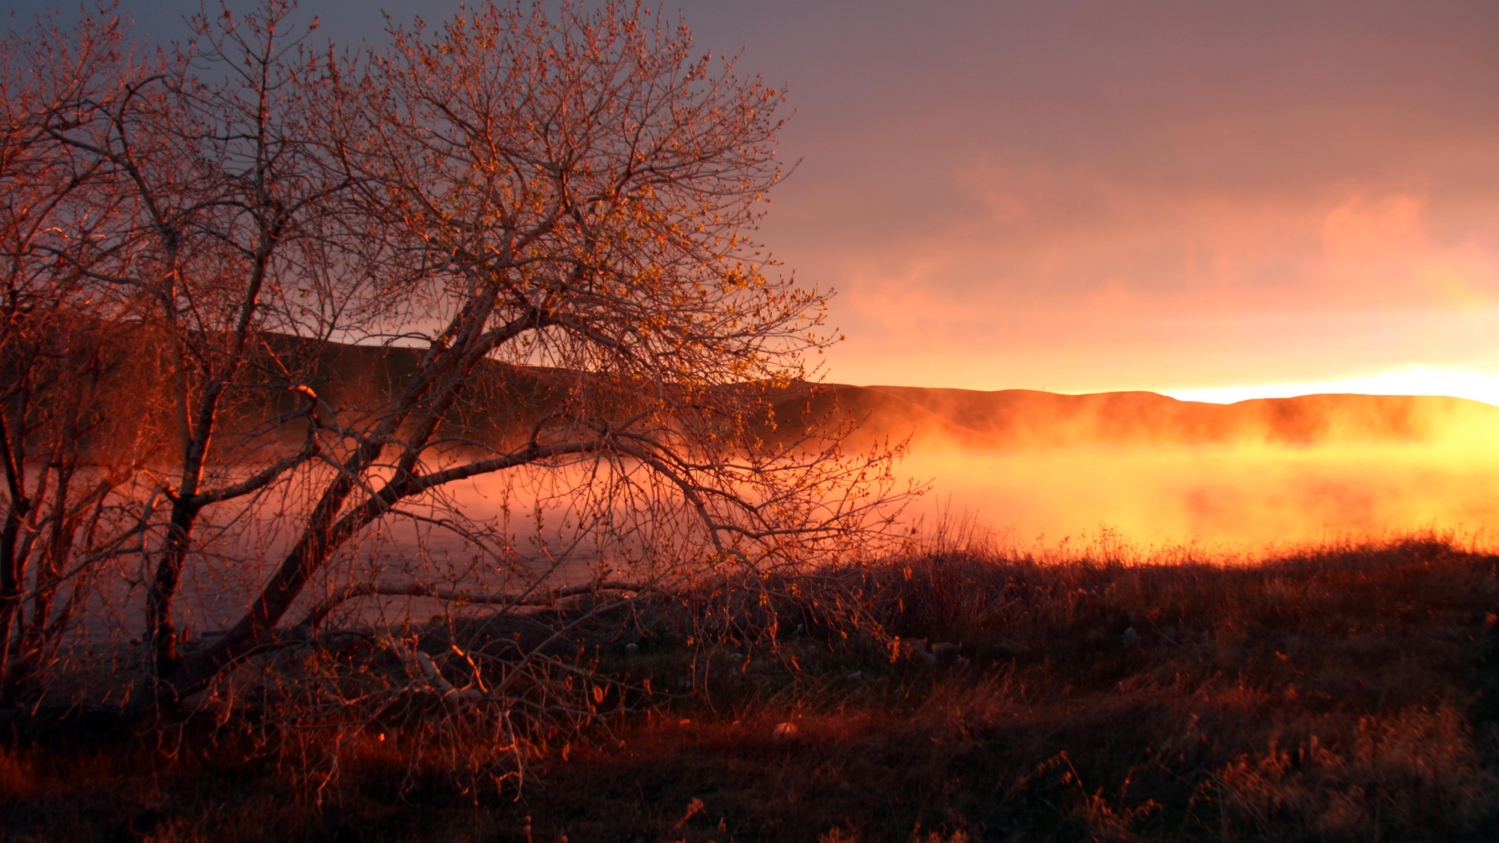
Invitation:
1. Hearing and faith, Rom. 10:17; Mark 16:16
2. Repentance, Acts 2:38
3. Professing Christ, Rom. 10:9-10
4. Immersion in water, Rom. 6:3-5; Acts 22:16
5. Faithfulness, Rev. 2:10
6. Prayerful penitence for the erring - Acts 8:22
Repent therefore of this your wickedness, and pray God if perhaps the thought of your heart may be forgiven you. (Acts 8:22)
Invitation Song | 226 | There’s A Great Day Coming
Closing Song | 55 | Doxology
Closing Prayer
Notes:
Invitation:
1. Hearing and faith, Rom. 10:17; Mark 16:16
2. Repentance, Acts 2:38
3. Professing Christ, Rom. 10:9-10
4. Immersion in water, Rom. 6:3-5; Acts 22:16
5. Faithfulness, Rev. 2:10
6. Prayerful penitence for the erring child of God, Acts 8:22
Repent therefore of this your wickedness, and pray God if perhaps the thought of your heart may be forgiven you. (Acts 8:22)

