Slide 1
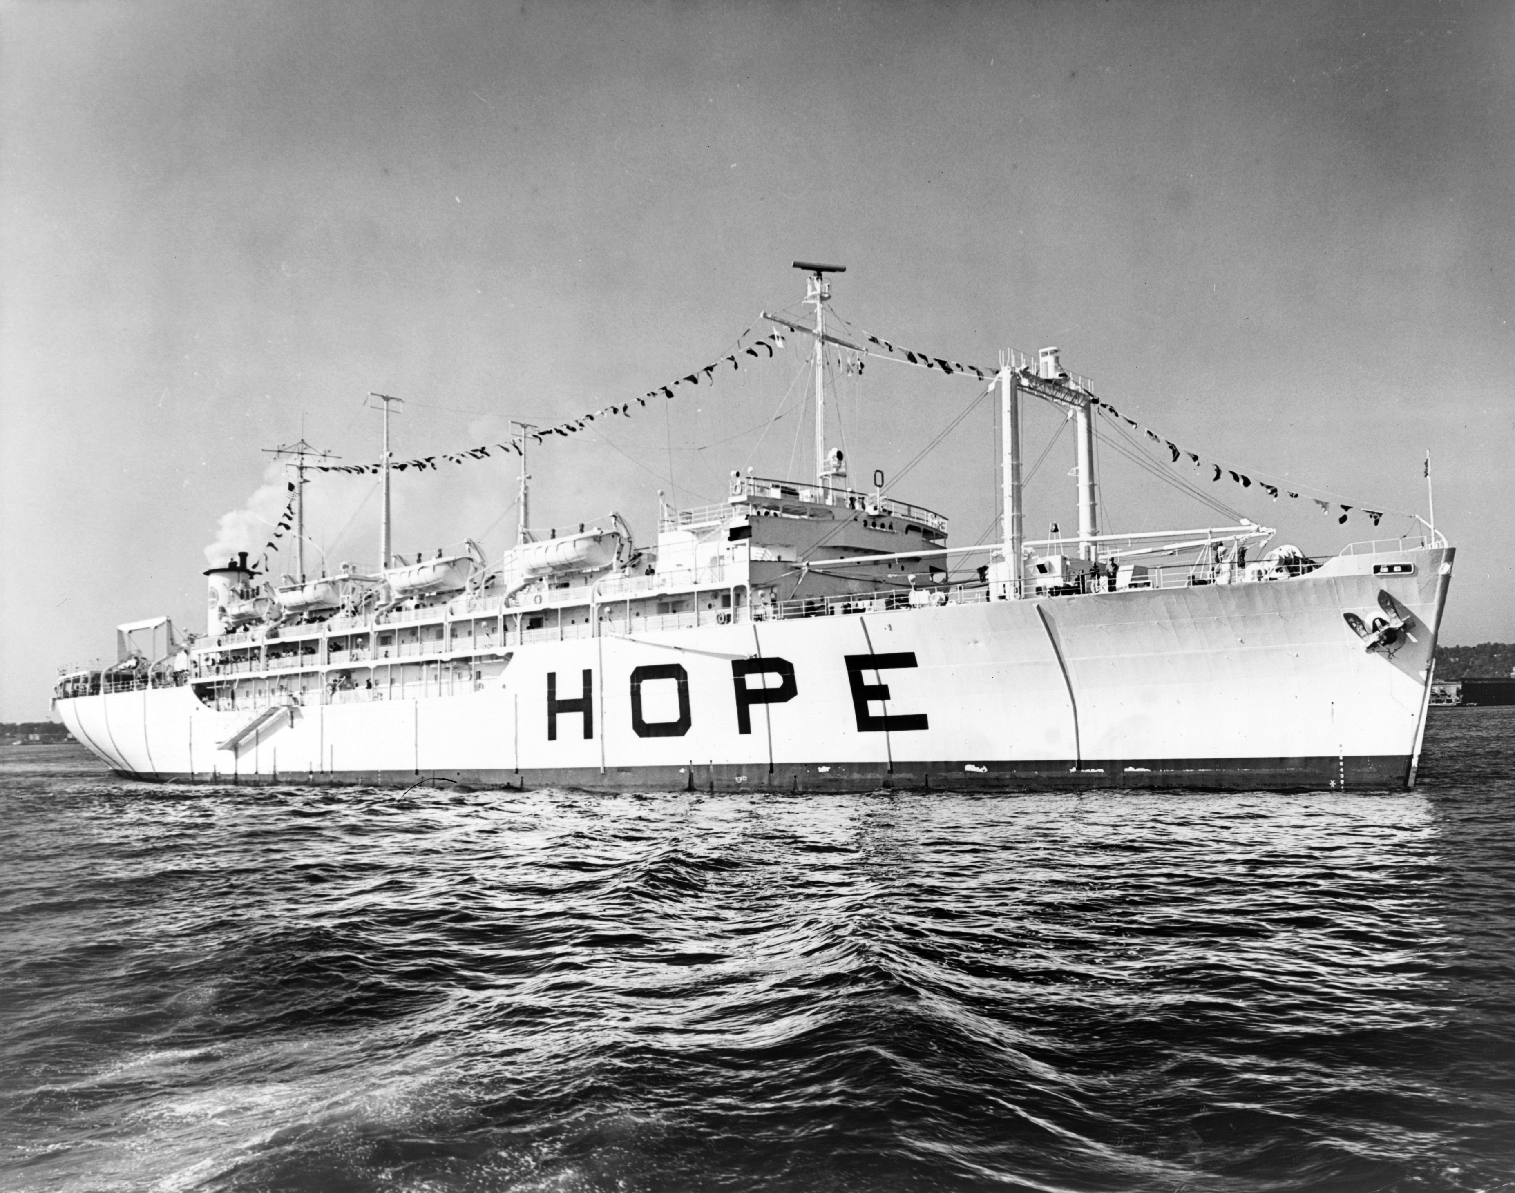
Ranger Church of Christ
Mesquite and Rusk St.
Worship With Us This Evening

Slide 2
We Can Have Hope – the Anchor of the Soul
HO PE
Hebrews 6
Notes:
1. We Can Have Hope – Hope has been described as the Anchor of the Soul
>>>>>>>>>>>>>>>>>>>>>
2. This evening, we will use Hebrews 6 as our text.

Slide 3
Introduction
HO PE
Heb. 6:1-8
Warns of impending peril to Christians with minimal interest in the Gospel (vs. 4-6)
Falling from grace is a threat (Gal. 5:4; 2 Pt. 2:20-22)
Defense against apostasy is intent interest in the word of God (Heb. 2:1-2)
Notes:
1. Heb. 6:1-8 warns us of the peril of not progressing.
>>>>>>>>>>>>>>>>>>>>>>>
2. The Hebrew writer warns us of the impending peril to Christians that maintain a minimal interest in the Gospel (vs. 4-6)
For it is impossible for those who were once enlightened, and have tasted the heavenly gift, and have become partakers of the Holy Spirit, and have tasted the good word of God and the powers of the age to come, if they fall away, to renew them again to repentance, since they crucify again for themselves the Son of God, and put Him to an open shame. (Hebrews 6:4-6)
>>>>>>>>>>>>>>>>>>>>>>>
3. Falling from grace is a real threat for lax and uninterested Christians. (Gal. 5:4; 2 Pt. 2:20-22)
You have become estranged from Christ, you who attempt to be justified by law; you have fallen from grace. (Galatians 5:4)
----------------------------------------
For if, after they have escaped the pollutions of the world through the knowledge of the Lord and Savior Jesus Christ, they are again entangled in them and overcome, the latter end is worse for them than the beginning. For it would have been better for them not to have known the way of righteousness, than having known it, to turn from the holy commandment delivered to them. (2 Peter 2:20-21)
>>>>>>>>>>>>>>>>>>>>>>>
4. Defense against apostasy is intent interest in the word of God (Heb. 2:1-2)
Therefore we must give the more earnest heed to the things we have heard, lest we drift away. For if the word spoken through angels proved steadfast, and every transgression and disobedience received a just reward, (Hebrews 2:1-2)

Slide 4
Introduction
HO PE
The stagnant Christian
Instead of being crucified with Christ (Gal. 2:20)…
Is crucifying Christ in his heart and before the world (Heb. 6:6)
Victory is the fruit of unrelenting effort (v. 11; 2 Pet. 1:10; Phil. 2:12)
Notes:
1. The stagnant Christian is the major subject of our text.
>>>>>>>>>>>>>>>>>>>>>>>>>
2. The stagnant Christian, Instead of being crucified with Christ as he should be (Gal. 2:20)…
I have been crucified with Christ; it is no longer I who live, but Christ lives in me; and the life which I now live in the flesh I live by faith in the Son of God, who loved me and gave Himself for me. (Galatians 2:20)
>>>>>>>>>>>>>>>>>>>>>>>>>
3. Is crucifying Christ in his heart and doing so before the world (Heb. 6:6)
if they fall away, to renew them again to repentance, since they crucify again for themselves the Son of God, and put Him to an open shame. (Hebrews 6:6)
4. Victory is the fruit of unrelenting labor and all of our efforts. (v. 11; 2 Pet. 1:10; Phil. 2:12)
And we desire that each one of you show the same diligence to the full assurance of hope until the end, (Hebrews 6:11)
--------------------------------------------
Therefore, brethren, be even more diligent to make your call and election sure, for if you do these things you will never stumble; (2 Peter 1:10)
--------------------------------------------
Therefore, my beloved, as you have always obeyed, not as in my presence only, but now much more in my absence, work out your own salvation with fear and trembling; (Philippians 2:12)

Slide 5
Introduction
HO PE
Heb. 6:9-20
Confident his readers will not fall away, but hold onto their hope
Hope is important – it is the anchor or security of the soul (Heb. 6:19)
In these verses we are told how we can have hope
Notes:
1. Heb. 6:9-20 – We have a better understanding of God’s infallible purpose in Christ.
>>>>>>>>>>>>>>>>>>>>>>>>
2. The Hebrew writer is confident in the fact that his readers will not fall away but hold onto their eternal hope.
>>>>>>>>>>>>>>>>>>>>>>>>
3. Hope is important – it is the anchor or security of the soul (Heb. 6:19)
This hope we have as an anchor of the soul, both sure and steadfast, and which enters the Presence behind the veil, (Hebrews 6:19)
>>>>>>>>>>>>>>>>>>>>>>>>
4. In these verses we are told how we can have hope and maintain that Hope.

Slide 6
We Can Have Hope
Because of the Nature of God
Because We Are Doing Our Best
Because God Has Blessed Those Who Have Done His Will, In the Past
Because God Cannot Lie
In Jesus Christ
Notes:
1. We Can Have Hope
>>>>>>>>>>>>>>>>>>>
2. Because of the Nature of God

Slide 7
Hope Because of the Nature of God
Heb. 6:10
God does not give up on us when we sin – He lovingly waits
Not a tyrant that sees only sins - He sees a prodigal (Luke 15:20-24)
Desires return (2 Pet. 3:9; 1 Tim. 2:3)
Invites return (Rev. 3:20)
Notes:
1. Hope Because of the Nature of God
>>>>>>>>>>>>>>>>>>>>>>>>>>
2. Heb. 6:10 God is not unjust!
For God is not unjust to forget your work and labor of love which you have shown toward His name, in that you have ministered to the saints, and do minister. (Hebrews 6:10)
>>>>>>>>>>>>>>>>>>>>>>>>>>
3. God does not give up on us when we sin – He lovingly waits for our repentance, but He is not without limits.
>>>>>>>>>>>>>>>>>>>>>>>>>>
4. Not a tyrant that sees only sins - He sees a prodigal son in all sinners. (Luke 15:20-24)
>>>>>>>>>>>>>>>>>>>>>>>>>>
5. He desires our repentance and return to Him. (2 Pet. 3:9; 1 Tim. 2:3)
The Lord is not slack concerning His promise, as some count slackness, but is longsuffering toward us, not willing that any should perish but that all should come to repentance. (2 Peter 3:9)
For this is good and acceptable in the sight of God our Savior, (1 Timothy 2:3)
>>>>>>>>>>>>>>>>>>>>>>>>>>
6. Invites return (Rev. 3:20)
Behold, I stand at the door and knock. If anyone hears My voice and opens the door, I will come in to him and dine with him, and he with Me. (Revelation 3:20)

Slide 8
We Can Have Hope
Because of the Nature of God
Because We Are Doing Our Best
Because God Has Blessed Those Who Have Done His Will, In the Past
Because God Cannot Lie
In Jesus Christ
Notes:
1. We Can Have Hope
>>>>>>>>>>>>>>>
2. Because We Are Doing Our Best

Slide 9
Heb. 6:11-12
If we continue to serve diligently, we have assurance of hope
Christianity demands commitment to living for Christ
Luke 9:23-24 – take up cross
Rev. 3:15-16 – lukewarm
Phil. 2:12 – work out
Notes:
1. Heb. 6:11-12
And we desire that each one of you show the same diligence to the full assurance of hope until the end, that you do not become sluggish, but imitate those who through faith and patience inherit the promises. (Hebrews 6:11-12)
>>>>>>>>>>>>>>>>>>>>>>>
2. If we continue to serve our Father diligently, we have assurance of that blessed hope “in Him”.
>>>>>>>>>>>>>>>>>>>>>>>
3. Christianity demands daily commitment to living a Christian life for Christ.
4. Luke 9:23-24 – take up cross
Then He said to them all, "If anyone desires to come after Me, let him deny himself, and take up his cross daily, and follow Me. For whoever desires to save his life will lose it, but whoever loses his life for My sake will save it. (Luke 9:23-24)
5. Rev. 3:15-16 – lukewarm
"I know your works, that you are neither cold nor hot. I could wish you were cold or hot. So then, because you are lukewarm, and neither cold nor hot, I will vomit you out of My mouth. (Revelation 3:15-16)
a. Jesus, said if you are lukewarm and “in Christ” He will vomit you out.
6. Phil. 2:12 – work out
Therefore, my beloved, as you have always obeyed, not as in my presence only, but now much more in my absence, work out your own salvation with fear and trembling; (Philippians 2:12)
a. Sluggish, lazy, uncommitted Christians will not work out their salvation and will thereby be lost,
b. Christian in thought only is not taking up your cross daily.

Slide 10
Notice: “show the same diligence to the full assurance of hope until the end” (v. 11)
Salvation is like a race:
Must enter the race
Must run the race
Must be the full course of the race
2 Tim. 4:7 – fought the fight, finished the race, kept the faith
Notes:
1. Notice: “show the same diligence to the full assurance of hope until the end” (v. 11)
>>>>>>>>>>>>>>>>>>>>>>
2. Salvation is like a race:
>>>>>>>>>>>>>>>>>>>>>>>
a. You must enter the race in order to obtain the goal.
>>>>>>>>>>>>>>>>>>>>>>>
b. You must physically run the race to reach the end.
>>>>>>>>>>>>>>>>>>>>>>>
c. You must run the full course of the race, there are no short cuts.
>>>>>>>>>>>>>>>>>>>>>>>
3. 2 Tim. 4:7 – Paul fought the fight, finished the race, kept the faith
a. So also, we must do, this is “working out your own salvation”.
b. No work. No Salvation!!

Slide 11
We Can Have Hope
Because of the Nature of God
Because We Are Doing Our Best
Because God Has Blessed Those Who Have Done His Will, In the Past
Because God Cannot Lie
In Jesus Christ
Notes:
1. We Can Have Hope
2. Because God Has Blessed Those Who Have Done His Will, In the Past

Slide 12
Heb. 6:13-15
In the past God blessed the faithful (Heb. 11; Rom. 15:4)
If we imitate these people of faith, we too will receive all that has been promised
Thus, instead of doubting benefit of faithfulness, give diligence to have full assurance
Notes:
1. Heb. 6:13-15 – Is the Certainty of God’s Promise to Us.
For when God made a promise to Abraham, because He could swear by no one greater, He swore by Himself, saying, "SURELY BLESSING I WILL BLESS YOU, AND MULTIPLYING I WILL MULTIPLY YOU." And so, after he had patiently endured, he obtained the promise. (Hebrews 6:13-15)
>>>>>>>>>>>>>>>>>>>>>>>>>
2. In the past God has blessed the faithful (Heb. 11; Rom. 15:4)
For whatever things were written before were written for our learning, that we through the patience and comfort of the Scriptures might have hope. (Romans 15:4)
>>>>>>>>>>>>>>>>>>>>>>>>>
3. If we imitate these people of faith, we too will receive all that has been promised to us.
>>>>>>>>>>>>>>>>>>>>>>>>>>
4. Thus, instead of our doubting benefit of faithfulness, we must give all diligence to have full assurance of these promises.

Slide 13
We Can Have Hope
Because of the Nature of God
Because We Are Doing Our Best
Because God Has Blessed Those Who Have Done His Will, In the Past
Because God Cannot Lie
In Jesus Christ
Notes:
1. We Can Have Hope
>>>>>>>>>>>>>>>>>>>
2. Because God Cannot Lie

Slide 14
Heb. 6:16-18
God promised it (Titus 1:2)
God backed His promise with an oath
Notes:
1. Heb. 6:16-18
For men indeed swear by the greater, and an oath for confirmation is for them an end of all dispute. Thus God, determining to show more abundantly to the heirs of promise the immutability of His counsel, confirmed it by an oath, that by two immutable things, in which it is impossible for God to lie, we might have strong consolation, who have fled for refuge to lay hold of the hope set before us. (Hebrews 6:16-18)
>>>>>>>>>>>>>>>>>>
2. God promised it (Titus 1:2)
in hope of eternal life which God, who cannot lie, promised before time began, (Titus 1:2)
>>>>>>>>>>>>>>>>>>
3. God backed His promise with an oath

Slide 15
We Can Have Hope
Because of the Nature of God
Because We Are Doing Our Best
Because God Has Blessed Those Who Have Done His Will, In the Past
Because God Cannot Lie
In Jesus Christ
Notes:
We Can Have Hope
>>>>>>>>>>>>>>>>>>>>
In Jesus Christ

Slide 16
Heb. 6:19-20
Jesus, our resurrected Savior, has secured our hope in heaven
1 Pet. 1:3-4
John 14:1-3
Notes:
1. Heb. 6:19-20
This hope we have as an anchor of the soul, both sure and steadfast, and which enters the Presence behind the veil, where the forerunner has entered for us, even Jesus, having become High Priest forever according to the order of Melchizedek. (Hebrews 6:19-20)
>>>>>>>>>>>>>>>>>>>>>>
2. Jesus, our resurrected Savior, He is our anchor, He has secured our hope in heaven with His own blood.
>>>>>>>>>>>>>>>>>>>>>>
3. 1 Pet. 1:3-4
Blessed be the God and Father of our Lord Jesus Christ, who according to His abundant mercy has begotten us again to a living hope through the resurrection of Jesus Christ from the dead, to an inheritance incorruptible and undefiled and that does not fade away, reserved in heaven for you, (1 Peter 1:3-4)
>>>>>>>>>>>>>>>>>>>>>>>
4. John 14:1-3
"Let not your heart be troubled; you believe in God, believe also in Me. In My Father's house are many mansions; if it were not so, I would have told you. I go to prepare a place for you. And if I go and prepare a place for you, I will come again and receive you to Myself; that where I am, there you may be also. (John 14:1-3)

Slide 17
Conclusion
Does your life have this anchor “sure and steadfast”?
Have you “laid hold” on it through faith and Obedience?
Are you continuing to hold to a full assurance of hope?
HOPE
Notes:
1. In Conclusion, three questions for you!
>>>>>>>>>>>>>>>>>>>>
2. Does your life have this anchor in Christ fixed “sure and steadfast”?
>>>>>>>>>>>>>>>>>>>>
3. Have you “laid hold” on it through your “efforts and labor of love” through your faith and Obedience?
>>>>>>>>>>>>>>>>>>>
4. Are you continuing to hold to a full assurance of hope?

Slide 18
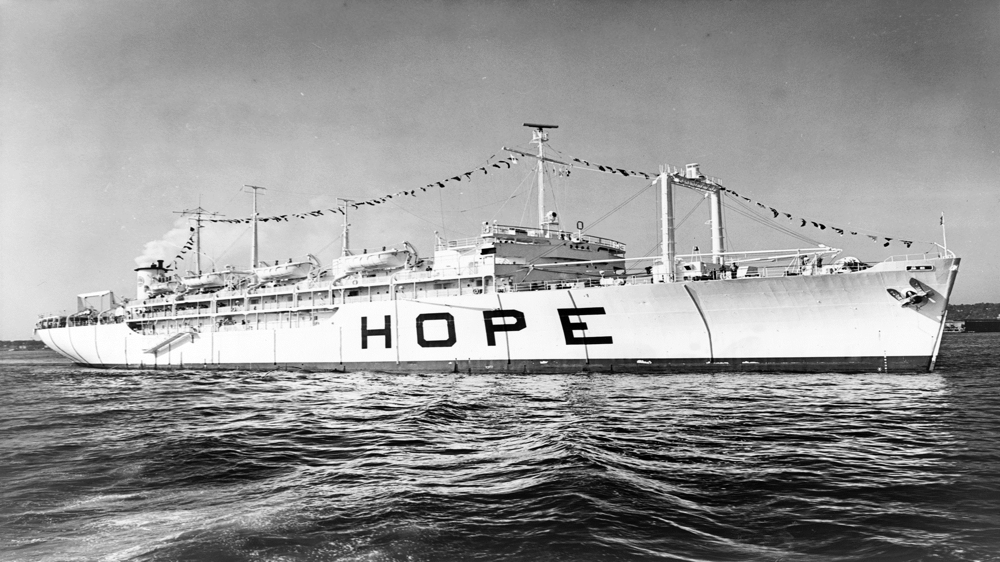
1. Hearing and faith, Rom. 10:17; Mark 16:16
2. Repentance, Acts 2:38
3. Professing Christ, Rom. 10:9-10
4. Immersion in water, Rom. 6:3-5; Acts 22:16
5. Faithfulness, Rev. 2:10
Notes:
1. Hearing and faith, Rom. 10:17; Mark 16:16
2. Repentance, Acts 2:38
3. Professing Christ, Rom. 10:9-10
4. Immersion in water, Rom. 6:3-5; Acts 22:16
5. Faithfulness, Rev. 2:10

