Slide 1

In Spirit and in Truth
Ranger Church of Christ
Mesquite and Rusk St.

Slide 2
Announcements | Songs | Title
1st Song | 542 | Worthy Art Thou
2nd Song | 338 | Dear Lord and Father of Mankind
Opening Prayer
3rd Song | 621 | Rise Up, O Men Of God!
4th Song | 23 | By Christ Redeemed
Lords Supper
Offering
5th Song | 41s | The Battle Belongs to the Lord
Sermon
Invitation Song | 6s | He Died For You And Me
Closing Song | 28s | He Paid A Debt
Closing Prayer

Slide 3
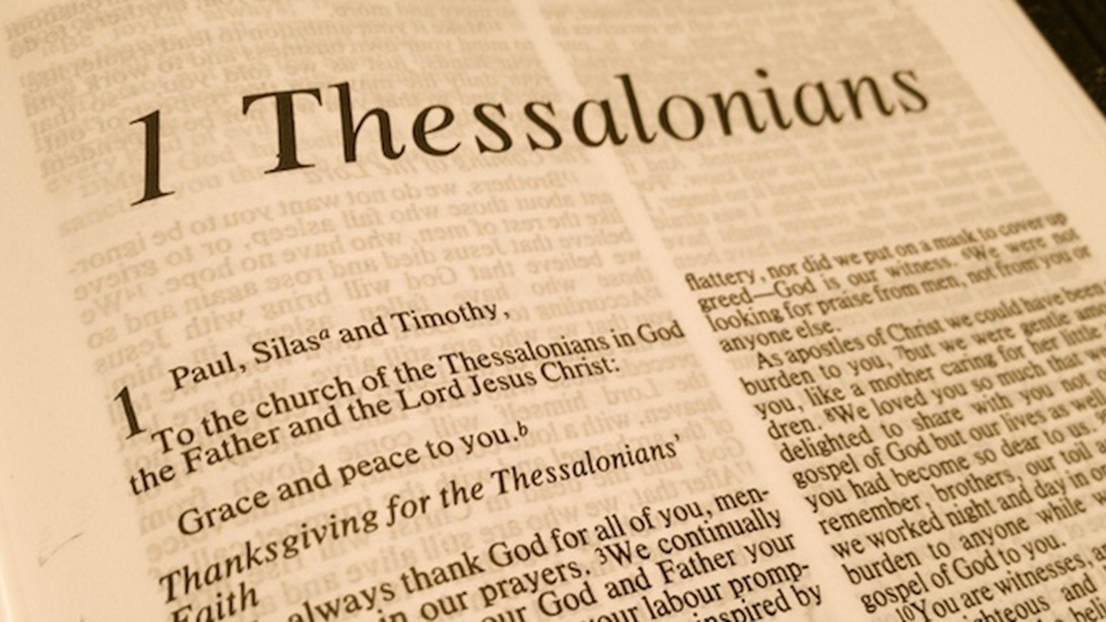

Slide 4
Their Faith, Love and Hope
(1 Thessalonians 1:1-3)
Notes:
Paul, Silvanus, and Timothy, To the church of the Thessalonians in God the Father and the Lord Jesus Christ: Grace to you and peace from God our Father and the Lord Jesus Christ.
We give thanks to God always for you all, making mention of you in our prayers,
remembering without ceasing your work of faith, labor of love, and patience of hope in our Lord Jesus Christ in the sight of our God and Father, (1 Thessalonians 1:1-3)

Slide 5
Introduction
The church at Thessalonica
  Began with preaching of Paul on his second missionary journey (Acts 17)
  Unbelieving Jews force Paul to leave the city
  Letter written at Corinth (50-52 A.D.) while Paul waited for Timothy and Silas to catch up to him
Notes:
1. The church at Thessalonica is not unique as a new church, but it was planted by evangelism.
>>>>>>>>>>>>>>>>>>>
2. It’s beginning was with the preaching of the Apostle Paul on his second missionary journey recorded in (Acts 17).
a. Paul began his teaching in the Jewish Synagogue in accordance with his instructions from Christ, to go to the Jews first and then to the Gentiles.
b. A few Jews and many Gentiles believed, but most Jews did not believe and started riots and dragging Jason into court.
>>>>>>>>>>>>>>>>>>>>
3. These unbelieving Jews forced the Christians to encourage Paul to leave the city and go to Berea.
a. The Jews at Thessalonica heard that Paul was preaching again in Berea and immediately went to Berea to stir up trouble for Paul hoping to end his evangelism.
b. But the Christians in Berea sent and accompanied Paul to Athens, for his own safety.
>>>>>>>>>>>>>>>>>>>
4. This Letter to the Thessalonians was written at Corinth (50-52 A.D.) while Paul waited for Timothy and Silas to catch up to him.

Slide 6
Introduction
Paul’s concern: how is this young congregation, under persecution, fairing?
  Timothy brought back news that was encouraging (1 Thes 3:1-6)
In opening remarks of this letter we learn about “their Faith, Love, and Hope”
Notes:
1. Paul’s concern: was “how is this young congregation, under Jewish persecution, was fairing?”
>>>>>>>>>>>>>>>>>>
2. Timothy brought back good news that was encouraging to Paul (1 Thes 3:1-6)
For our gospel did not come to you in word only, but also in power, and in the Holy Spirit and in much assurance, as you know what kind of men we were among you for your sake.
And you became followers of us and of the Lord, having received the word in much affliction, with joy of the Holy Spirit, (1 Thessalonians 1:5-6)
>>>>>>>>>>>>>>>>>>
3. In Paul’s opening remarks of this letter we learn about “their Faith, Love, and Hope”

Slide 7
Their Work of Faith
They had a working faith
  I.e., a faith that was alive (Jas 2:20, 26)
  Centered in the person of Jesus the Christ (Col. 1:4)
  Prompted by love
    Gal. 5:6 – faith working through love
    John 14:15 – If you love me
    2 Thes. 1:3 – faith growing with love
Notes:
1. Their Work of Faith
>>>>>>>>>>>>>>>>>>>>>>
2. No one could doubt that they had a working faith
>>>>>>>>>>>>>>>>>>>>>>
3. I.e., It was a faith that was alive (Jas 2:20, 26)
But do you want to know, O foolish man, that faith without works is dead? (James 2:20)
For as the body without the spirit is dead, so faith without works is dead also. (James 2:26)
>>>>>>>>>>>>>>>>>>>>>>
4. They were where they should be, that is centered in the person of Jesus the Christ (Col. 1:4)
since we heard of your faith in Christ Jesus and of your love for all the saints; (Colossians 1:4)
>>>>>>>>>>>>>>>>>>>>>>
5. Their work was prompted by love of the brethren and love for Christ.
>>>>>>>>>>>>>>>>>>>>>>
6. Gal. 5:6 – faith working through love
For in Christ Jesus neither circumcision nor uncircumcision avails anything, but faith working through love. (Galatians 5:6)
>>>>>>>>>>>>>>>>>>>>>>
7. John 14:15 – If you love me
"If you love Me, keep My commandments. (John 14:15)
>>>>>>>>>>>>>>>>>>>>>>
8. 2 Thes. 1:3 – faith growing with love
We are bound to thank God always for you, brethren, as it is fitting, because your faith grows exceedingly, and the love of every one of you all abounds toward each other, (2 Thessalonians 1:3)

Slide 8
Their Work of Faith
What about our faith?
  Is our faith a living faith?
    Manifesting itself in obedience?
    Or are we like some who believe, but do not obey Jesus?
      John 12:42-43 – Jewish rulers
      Jas. 2:19 – demons
Notes:
1. We can read about their Works of Faith, But….
>>>>>>>>>>>>>>>>
2. What about our faith?
>>>>>>>>>>>>>>>>
3. Is our faith a true and living faith?
>>>>>>>>>>>>>>>>
4. Do we see our faith manifesting itself in obedience to Christ and His commands?
>>>>>>>>>>>>>>>>
5. Or, could it be that we are we like some who believe, but do not obey Jesus?
>>>>>>>>>>>>>>>>
6. John 12:42-43 – Jewish rulers
Nevertheless even among the rulers many believed in Him, but because of the Pharisees they did not confess Him, lest they should be put out of the synagogue; for they loved the praise of men more than the praise of God. (John 12:42-43)
>>>>>>>>>>>>>>>>
7. Jas. 2:19 – Do we believe like the demons?
You believe that there is one God. You do well. Even the demons believe—and tremble! (James 2:19)

Slide 9
Their Work of Faith
What about our faith?
  Is our faith strongly centered in Christ Jesus?
    Faith produced by the Word (Rom. 10:17)
    Faith that leads to life in Christ? (John 20:30-31)
  If so, our faith will also “grow exceedingly”, evidenced by service
Notes:
1. What about our faith?
>>>>>>>>>>>>>>>>>>
2. Is our faith strongly centered in Christ Jesus?
>>>>>>>>>>>>>>>>>>
3. Our faith, true faith produced by the Word (Rom. 10:17)
So then faith comes by hearing, and hearing by the word of God. (Romans 10:17)
>>>>>>>>>>>>>>>>>>
4. It is our faith that leads us to desire a life in Christ? (John 20:30-31)
And truly Jesus did many other signs in the presence of His disciples, which are not written in this book; but these are written that you may believe that Jesus is the Christ, the Son of God, and that believing you may have life in His name. (John 20:30-31)
>>>>>>>>>>>>>>>>>>
5. If so, our faith will also “grow exceedingly” strong with reading and study, and it will be evidenced by service to Christ and others.

Slide 10
Their Labor of Love
They had a working love
  1 John 3:18 - not in word only
  Col. 1:4 – directed toward their brethren in Christ
  Later commanded by Paul (1 Thes. 4:9-10)
  Their love continued to abound (2 Thes. 1:3)
Notes:
1. Let’s look at “Their Labor of Love”.
>>>>>>>>>>>>>>>>>>>>>
2. They had a working love, not an idle faith, but a working faith and love.
>>>>>>>>>>>>>>>>>>>>>
3. 1 John 3:18 - John says ”not in word only”.
My little children, let us not love in word or in tongue, but in deed and in truth. (1 John 3:18)
>>>>>>>>>>>>>>>>>>>>>
4. Col. 1:4 – Where do you direct your love, it should be directed toward your brethren in Christ
since we heard of your faith in Christ Jesus and of your love for all the saints; (Colossians 1:4)
>>>>>>>>>>>>>>>>>>>>>
5. An increase in love toward fellow saints was commanded by Paul (1 Thes. 4:9-10)
But concerning brotherly love you have no need that I should write to you, for you yourselves are taught by God to love one another; and indeed you do so toward all the brethren who are in all Macedonia. But we urge you, brethren, that you increase more and more; (1 Thessalonians 4:9-10)
>>>>>>>>>>>>>>>>>>>>>
6. Their love continued to abound (2 Thes. 1:3)
We are bound to thank God always for you, brethren, as it is fitting, because your faith grows exceedingly, and the love of every one of you all abounds toward each other, (2 Thessalonians 1:3)

Slide 11
Their Labor of Love
What about our love?
  Is our labor and love in word only?
  Is our love directed toward our brethren?
    Mark of true discipleship (John 13:34-35)
    Indicative of a spiritual life (1 John 3:14, 18-19, 23; 1 Pet. 1:22)
  Is our love abounding, evidenced by serving one another (Gal. 5:13)
Notes:
1. What about our love?
>>>>>>>>>>>>>>>>>>>>>>>
2. Is our labor and love in word only?
>>>>>>>>>>>>>>>>>>>>>>>
3. Is our love directed toward our brethren and Christ?
>>>>>>>>>>>>>>>>>>>>>>>
4. This labor of love is the mark of true discipleship (John 13:34-35)
A new commandment I give to you, that you love one another; as I have loved you, that you also love one another. By this all will know that you are My disciples, if you have love for one another." (John 13:34-35)
>>>>>>>>>>>>>>>>>>>>>>>
5. It is our first marker and is Indicative of a spiritual life (1 John 3:14, 18-19, 23; 1 Pet. 1:22)
We know that we have passed from death to life, because we love the brethren. He who does not love his brother abides in death. (1 John 3:14)
-------------------------------------
And by this we know that we are of the truth, and shall assure our hearts before Him. For if our heart condemns us, God is greater than our heart, and knows all things. (1 John 3:19-20)
>>>>>>>>>>>>>>>>>>>>>>>
6. Is our love abounding, are we growing, as evidenced by serving one another and not our own bellies. (Gal. 5:13)
For you, brethren, have been called to liberty; only do not use liberty as an opportunity for the flesh, but through love serve one another. (Galatians 5:13)

Slide 12
Their Patience of Hope
They had a hope that gave them patience
  Strong hope gives patience (Rom. 8:25)
  Hope focused on what was laid up for them in heaven (Col. 1:5)
  1 Pet. 1:3-4 – incorruptible, undefiled, does not fade away…in heaven
  Encouraged to wear this hope as a helmet (1 Thes. 5:8)
Notes:
What about their patient Hope?
>>>>>>>>>>>>>>>>>>
1. It was not only Paul but others as well that recognized “Their Patience of Hope”.
>>>>>>>>>>>>>>>>>>
2. They had a hope that gave them patience to wait on the Lords will.
>>>>>>>>>>>>>>>>>>
3. Strong hope gives patience (Rom. 8:25)
But if we hope for what we do not see, we eagerly wait for it with perseverance. (Romans 8:25)
>>>>>>>>>>>>>>>>>>
4. Hope focused on what was laid up for them in heaven (Col. 1:5)
because of the hope which is laid up for you in heaven, of which you heard before in the word of the truth of the gospel, (Colossians 1:5)
>>>>>>>>>>>>>>>>>>
5. 1 Pet. 1:3-4 – incorruptible, undefiled, does not fade away…in heaven
Blessed be the God and Father of our Lord Jesus Christ, who according to His abundant mercy has begotten us again to a living hope through the resurrection of Jesus Christ from the dead, to an inheritance incorruptible and undefiled and that does not fade away, reserved in heaven for you, (1 Peter 1:3-4)
>>>>>>>>>>>>>>>>>>
6. Encouraged to wear this hope as a helmet (1 Thes. 5:8)
But let us who are of the day be sober, putting on the breastplate of faith and love, and as a helmet the hope of salvation. (1 Thessalonians 5:8)

Slide 13
Their Patience of Hope
Is our hope focused on our “inheritance” laid up for us in heaven?
  Heb. 11:10-16 – city whose builder is God
  Heb. 13:14 – continuing city
  2 Pet. 3:13 – new heavens and a new earth (1 Cor. 15:50-55)
  Rev. 21:1-7 – figuratively described
Is our hope as a helmet?
Notes:
1. Is our hope focused on our “inheritance” laid up for us in heaven?
>>>>>>>>>>>>>>>>>>>>>
2. Heb. 11:10-16 – city whose builder is God
But now they desire a better, that is, a heavenly country. Therefore God is not ashamed to be called their God, for He has prepared a city for them. (Hebrews 11:16)
>>>>>>>>>>>>>>>>>>>>>
3. Heb. 13:14 – we are looking for a continuing city –
a. nothing here on earth will last according to Scripture and maybe the global warming conspiracy cult.
For here we have no continuing city, but we seek the one to come. (Hebrews 13:14)
>>>>>>>>>>>>>>>>>>>>>
4. 2 Pet. 3:13 – new heavens and a new earth (1 Cor. 15:50-55)
Now this I say, brethren, that flesh and blood cannot inherit the kingdom of God; nor does corruption inherit incorruption. (1 Corinthians 15:50)
>>>>>>>>>>>>>>>>>>>>>
5. Rev. 21:1-7 – John figuratively described heaven as the Holy City
Then I, John, saw the holy city, New Jerusalem, coming down out of heaven from God, prepared as a bride adorned for her husband. (Revelation 21:2)
>>>>>>>>>>>>>>>>>>>>>
6. Is our hope as a helmet? – Our hope is in the “Word of God”.
And take the helmet of salvation, and the sword of the Spirit, which is the word of God; (Ephesians 6:17)

Slide 14
Conclusion
This triad of faith, love, and hope is mentioned several times in N. T. (Col. 1:4-5; 1 Cor. 13:12)
While they do not constitute all the graces to be found in Christians (cf. Gal. 5:22-23; 2 Pet. 1:5-7)
  They are among the most important (1 Cor. 13:13; Col. 3:14)
  The others will likely follow
Notes:
1. This triad of faith, love, and hope is mentioned several times in N. T. (Col. 1:4-5; 1 Cor. 13:12)
>>>>>>>>>>>>>>>>>>>>>>>>
2. While they do not constitute all the graces to be found in Christians (cf. Gal. 5:22-23; 2 Pet. 1:5-7)
>>>>>>>>>>>>>>>>>>>>>>>>
3. They are among the most important (1 Cor. 13:13; Col. 3:14)
And now abide faith, hope, love, these three; but the greatest of these is love. (1 Corinthians 13:13)
>>>>>>>>>>>>>>>>>>>>>>>>
4. The others will likely follow

Slide 15
Conclusion
May the remarkable faith, love, and hope of this body of recent converts inspire us to grow in our own faith in Christ, love for brethren, and hope for eternal life!
Notes:
In application to our individual souls;
>>>>>>>>>>>>>>>>>>>>>>>>
1. May the remarkable faith, love and hope of this body of recent converts, inspire us to grow in our own faith in Christ, in our love for brethren, and hope for eternal life!

Slide 16
1. Hearing and faith, Mark 16:16
2. Repentance, Acts 2:38
3. Professing Christ, Rom. 10:9-10
4. Immersion in water, Rom. 6:3-5; Acts 22:16
5. Faithfulness, Rev. 2:10
Invitation Song | 6s | He Died For You And Me
Closing Song | 28s | He Paid A Debt
Closing Prayer

