Slide 1
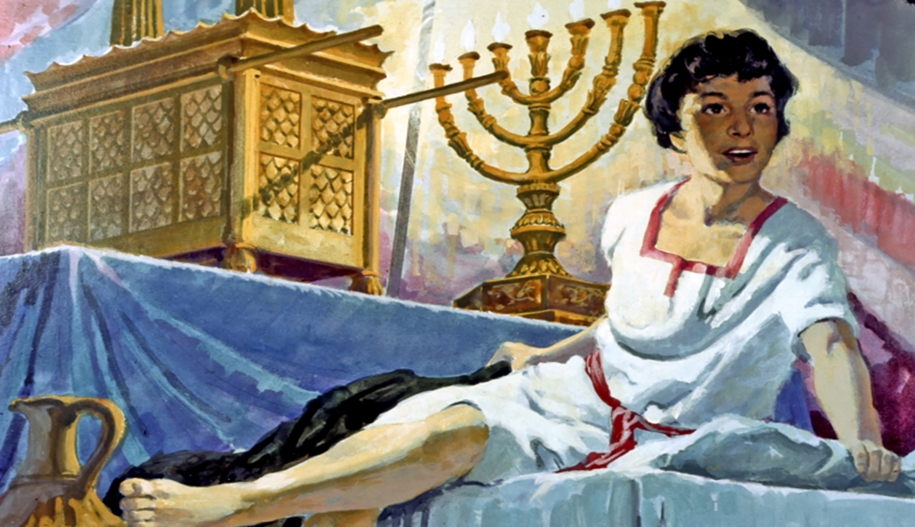
Ranger Church of Christ
Mesquite and Rusk
Welcome to Worship
Notes:
1. I heard an elder say the other day, it is amazing what you can get for an ice cream cone!
2. We have all watched with joy in our hearts as our young boys and girls teach each other the books of the Bible; for an ice cream cone paid for by the Elder.
3. We note also the young man Caden’s and his desire to read the Sunday morning scripture.
4. And again on Wednesday nights, the young men that help their dad with song leading, it all brings joy to our hearts.
5. But, Is all of this in keeping with scripture?
6. Lets look at what the scripture has to say about children and training.

Slide 2
Samuel, And His Life of Service
1 Samuel 7:15
Notes:
1. The importance message of this lesson is to show that God can use servants from their youth through old age.
>>>>>>>>>>>>>>>>
And Samuel judged Israel all the days of his life. (1 Samuel 7:15)

Slide 3
1. God would that all his children to serve him regardless of age.
a. We are all children of God through creation by Him.
b. Some are faithful, and some are not so faithful.
2. Perhaps no Bible character better illustrates this truth than Samuel who served God from his youth through old age.
Notes:
1. God would that all his children to serve him regardless of age.
>>>>>>>>>>>>>
a. We are all children of God through creation by Him.
>>>>>>>>>>>>>
b. Some faithful and some not so faithful.
>>>>>>>>>>>>>>
2. Perhaps no Bible character better illustrates this truth than Samuel who served God from his youth through old age.

Slide 4
I. The potential for a godly and useful life began for Samuel with his parents even before he was born.
A. While parents are not directly responsible for the spiritual deportment of their children, they nevertheless indirectly play an instrumental role in their early development.
1. Children do not inherit sin from their parents or forefathers, and neither are they automatically saved because of who their parents are, Ezek. 18:20.
Notes:
The potential for a godly and useful life began for Samuel with his parents even before he was born.
>>>>>>>>>>>>>>>>>
A. While parents are not directly responsible for the spiritual deportment of their children, they nevertheless indirectly play an instrumental role in their early development.
>>>>>>>>>>>>>>>>>
1. Children do not inherit sin from their parents or forefathers, and neither are they automatically saved because of who their parents are, Ezek. 18:20.
The soul who sins shall die. The son shall not bear the guilt of the father, nor the father bear the guilt of the son. The righteousness of the righteous shall be upon himself, and the wickedness of the wicked shall be upon himself. (Ezekiel 18:20).

Slide 5
2. Parents, and the environment that they provide for their offspring, however, can affect their children favorably or unfavorably.
3. Contemporary parents need to ensure that they have a positive and good affect upon their children, similarly as Elkanah and Hannah favorably affected young Samuel.
Notes:
2. Parents, and the environment that they provide for their offspring, however, can affect their children favorably or unfavorably.
>>>>>>>>>>>>>>>>>>>>
3. Contemporary parents need to ensure that they have a positive and good affect upon their children, similarly as Elkanah and Hannah favorably affected young Samuel.

Slide 6
B. Samuel’s parents contributed greatly to the setting in which Samuel began to serve God from his early years.
Hannah, Samuel’s mother, was barren and prayed for a child, 1 Sam. 1:9-11
a. Hannah was a religious woman.
2. Keeping a promise she made to God, Hannah dedicated young Samuel to the Lord, 1 Sam. 1:24-26
Notes:
B. Samuel’s parents contributed greatly to the setting in which Samuel began to serve God from his early years.
>>>>>>>>>>>>>>>>>>>
1. Hannah, Samuel’s mother, was barren and prayed for a child, 1 Sam. 1:9-11; Hannah was a religious woman.
>>>>>>>>>>>>>>>>>>>
2. Keeping a promise she made to God, Hannah dedicated young Samuel to the Lord, 1 Sam. 1:24-26
Now when she had weaned him, she took him up with her, with three bulls, one ephah of flour, and a skin of wine, and brought him to the house of the LORD in Shiloh. And the child was young. Then they slaughtered a bull, and brought the child to Eli. And she said, "O my lord! As your soul lives, my lord, I am the woman who stood by you here, praying to the LORD. (1 Samuel 1:24-26).

Slide 7
3. After Samuel was weaned, he was taken to Eli to live in the Temple where he received religious instruction and was trained to serve God.
4. Samuel also enjoyed Hannah’s love for him, which was exhibited by the coats she brought him each year, as he outgrew the old ones. 1 Sam. 2:19.
Notes:
3. After Samuel was weaned, he was taken to Eli to live in the Temple where he received religious instruction and was trained to serve God.
>>>>>>>>>>>>>>>>>>>>
4. Samuel also enjoyed Hannah’s love for him, which was exhibited by the coats she brought him each year, as he outgrew the old ones. 1 Sam. 2:19.
Moreover his mother used to make him a little robe, and bring it to him year by year when she came up with her husband to offer the yearly sacrifice. (1 Samuel 2:19)

Slide 8
II. Samuel began serving the Lord while yet a child.
A. He began his life of service by ministering to God in the Temple under the direction of Eli, the priest, 1 Sam. 2:11, 18.
1. As Samuel grew, he gained favor with both God and man, as Christ also did. 1 Sam. 2:26; cf. Luke 2:52.
2. Still a youth, Samuel was called by God, from which time prophecies and revelations from God were renewed in Israel through Samuel, 1 Sam. 3:1-21.
Notes:
II. Samuel began serving the Lord while yet a child.
>>>>>>>>>>>>>>>>>
A. He began his life of service by ministering to God in the Temple under the direction of Eli, the priest, 1 Sam. 2:11, 18.
Then Elkanah went to his house at Ramah. But the child ministered to the LORD before Eli the priest. (1 Samuel 2:11)
----------------------------
But Samuel ministered before the LORD, even as a child, wearing a linen ephod. (1 Samuel 2:18)
>>>>>>>>>>>>>>>>>
1. As Samuel grew, he gained favor with both God and man, as Christ also did. 1 Sam. 2:26; cf. Luke 2:52.
And the child Samuel grew in stature, and in favor both with the LORD and men. (1 Samuel 2:26)
------------------------
And Jesus increased in wisdom and stature, and in favor with God and men. (Luke 2:52)
>>>>>>>>>>>>>>>>>
2. Still a youth, Samuel was called by God, from which time prophecies and revelations from God were renewed in Israel through Samuel, 1 Sam. 3:1-21.
Now the LORD came and stood and called as at other times, "Samuel! Samuel!" And Samuel answered, "Speak, for Your servant hears." (1 Samuel 3:10)

Slide 9
B. Samuel continued to serve God as a prophet from his youth into manhood, 1 Sam. 4:1.
1. After the death of Eli, Samuel replaced him as Judge over Israel, 1 Sam. 4:18; 7:6, 15.
2. Additionally, Samuel served as a priest in Israel, 1 Sam. 7:9.
Notes:
B. Samuel continued to serve God as a prophet from his youth into manhood, 1 Sam. 4:1.
And the word of Samuel came to all Israel. Now Israel went out to battle against the Philistines, and encamped beside Ebenezer; and the Philistines encamped in Aphek. (1 Samuel 4:1)
>>>>>>>>>>>>>>>>>>>
1. After the death of Eli, Samuel replaced him as Judge over Israel, 1 Sam. 4:18; 7:6, 15.
Then it happened, when he made mention of the ark of God, that Eli fell off the seat backward by the side of the gate; and his neck was broken and he died, for the man was old and heavy. And he had judged Israel forty years. (1 Samuel 4:18)
>>>>>>>>>>>>>>>>>>>
2. Additionally, Samuel served as a priest in Israel, 1 Sam. 7:9.
And Samuel took a suckling lamb and offered it as a whole burnt offering to the LORD. Then Samuel cried out to the LORD for Israel, and the LORD answered him. (1 Samuel 7:9)

Slide 10
III. Samuel continued to serve God through his senior years.
A. Though a great servant of God, even Samuel had his failings.
1. Samuel appointed his sons’ judges in Israel, 1 Sam. 8:1.
2. However, for whatever reason, Samuel’s sons did not learn the righteous and the godly ways of their father, but took bribes to pervert judgment, 1 Sam. 8:3.
3. Consequently, Israel rejected God from being their King and clamored for a king like the nations around them, (1 Sam. 8:5-7).
Notes:
III. Samuel continued to serve God through his senior years.
>>>>>>>>>>>>>>>>>
A. Though a great servant of God, even Samuel had his failings.
>>>>>>>>>>>>>>>>>
1. Samuel appointed his sons’ judges in Israel, 1 Sam. 8:1.
Now it came to pass when Samuel was old that he made his sons judges over Israel. (1 Samuel 8:1)
>>>>>>>>>>>>>>>>>
2. However, for whatever reason, Samuel’s sons did not learn the righteous and godly ways of their father, but took bribes to pervert judgment, 1 Sam. 8:3.
But his sons did not walk in his ways; they turned aside after dishonest gain, took bribes, and perverted justice. (1 Samuel 8:3)
>>>>>>>>>>>>>>>>>
3. Consequently, Israel rejected God from being their King and clamored for a king like the nations around them, (1 Sam. 8:5-7).
and said to him, "Look, you are old, and your sons do not walk in your ways. Now make us a king to judge us like all the nations." But the thing displeased Samuel when they said, "Give us a king to judge us." So Samuel prayed to the LORD. And the LORD said to Samuel, "Heed the voice of the people in all that they say to you; for they have not rejected you, but they have rejected Me, that I should not reign over them. (1 Samuel 8:5-7)

Slide 11
B. Samuel continued to serve God for a number of years until his death.
1. In his later years, Samuel appointed kings Saul and David and reproved the people and their kings, 1 Sam. Chapters 9-16.
2. During these years, Samuel also encouraged others to become prophets, 1 Sam. 19:20, even as the apostle Paul prepared young men to follow him in his labors, 2 Tim. 1:13; 3:14-4:8.
Notes:
B. Samuel continued to serve God for a number of years until his death.
>>>>>>>>>>>>>>>>>>
1. In his later years, Samuel appointed kings Saul and David and reproved the people and their kings, 1 Sam. Chapters 9-16.
>>>>>>>>>>>>>>>>>>
2. During these years, Samuel also encouraged others to become prophets, 1 Sam. 19:20, even as the apostle Paul prepared young men to follow him in his labors, 2 Tim. 1:13; 3:14-4:8.
Hold fast the pattern of sound words which you have heard from me, in faith and love which are in Christ Jesus. (2 Timothy 1:13)
--------------------------------
I charge you therefore before God and the Lord Jesus Christ, who will judge the living and the dead at His appearing and His kingdom: Preach the word! Be ready in season and out of season. Convince, rebuke, exhort, with all longsuffering and teaching.
(2 Timothy 4:1-2)

Slide 12
3. As appointed to everyone, Samuel died, for which the people were greatly saddened, 1 Sam. 25:1.
4. In a sense, one might say that Samuel served after death, too, 1 Sam. 28:7-19.
5. It is here that Saul learns that David will be King after him.
Notes:
3. As appointed to everyone, Samuel died, for which the people were greatly saddened, 1 Sam. 25:1.
Then Samuel died; and the Israelites gathered together and lamented for him, and buried him at his home in Ramah. And David arose and went down to the Wilderness of Paran. (1 Samuel 25:1)
>>>>>>>>>>>>>>>>>>>
4. In a sense, one might say that Samuel served after death, too, 1 Sam. 28:7-19.
Then Saul said to his servants, "Find me a woman who is a medium, that I may go to her and inquire of her." And his servants said to him, "In fact, there is a woman who is a medium at En Dor." (1 Samuel 28:7)
>>>>>>>>>>>>>>>>>>>>
5. It is here that Saul learns that David will be King after him.
Then Samuel said: "So why do you ask me, seeing the LORD has departed from you and has become your enemy? And the LORD has done for Himself as He spoke by me. For the LORD has torn the kingdom out of your hand and given it to your neighbor, David. Because you did not obey the voice of the LORD nor execute His fierce wrath upon Amalek, therefore the LORD has done this thing to you this day. Moreover the LORD will also deliver Israel with you into the hand of the Philistines. And tomorrow you and your sons will be with me. The LORD will also deliver the army of Israel into the hand of the Philistines." (1 Samuel 28:16-19)

Slide 13
Conclusion:
1. Samuel’s parents were pious and worshipped God; this was the type of family into which Samuel was born and which contributed to his later greatness as a servant of God.
2. At an early age, Samuel received religious instruction and was trained to serve God.
3. Parental love expressed by Hannah also contributed to Samuel’s well being and fruitful development as a servant of God.
Notes:
Conclusion:
>>>>>>>>>>>>>>>>>
1. Samuel’s parents were pious and worshipped God; this was the type of family into which Samuel was born and which contributed to his later greatness as a servant of God.
>>>>>>>>>>>>>>>
2. At an early age, Samuel received religious instruction and was trained to serve God.
>>>>>>>>>>>>>>>
3. Parental love expressed by Hannah also contributed to Samuel’s well being and fruitful development as a servant of God.

Slide 14
4. Samuel began serving God at a very early age and continued to serve faithfully throughout his life without any interruption unto his death.
5. Those who would serve God today must serve him unto death with the same diligence and faithfulness exhibited by Samuel, 2 Tim. 4:7-8; Rev. 2:10.
Notes:
4. Samuel began serving God at a very early age and continued to serve faithfully throughout his life without any interruption unto his death.
>>>>>>>>>>>>>>>>>
5. Those who would serve God today must serve him unto death with the same diligence and faithfulness exhibited by Samuel, 2 Tim. 4:7-8; Rev. 2:10.
I have fought the good fight, I have finished the race, I have kept the faith. Finally, there is laid up for me the crown of righteousness, which the Lord, the righteous Judge, will give to me on that Day, and not to me only but also to all who have loved His appearing.
(2 Timothy 4:7-8)

Slide 15
Invitation:
1. There is no better time to begin serving God than from the early years of one’s accountability; there is a place in the church and its labors for all Christians, young and old.
2. Faithful and fruitful service, of course, must be preceded by primary obedience to the Gospel, Heb. 5:8-9; Mark 16:16.
3. Continued usefulness as a servant of the Lord is predicated upon continued faithfulness and obedience to the Gospel of Christ, Rom. 1:5; 16:26; 2 Thess. 1:8.
Notes:
Invitation:
>>>>>>>>>>>>>>>>>>>>>>
1. There is no better time to begin serving God than from the early years of one’s accountability; there is a place in the church and its labors for all Christians, young and old.
>>>>>>>>>>>>>>>>>>>>>>>
2. Faithful and fruitful service, of course, must be preceded by primary obedience to the Gospel, Heb. 5:8-9; Mark 16:16.
though He was a Son, yet He learned obedience by the things which He suffered. And having been perfected, He became the author of eternal salvation to all who obey Him, (Hebrews 5:8-9)
-----------------------------
He who believes and is baptized will be saved; but he who does not believe will be condemned. (Mark 16:16)
>>>>>>>>>>>>>>>>>>>>>>>
3. Continued usefulness as a servant of the Lord is predicated upon continued faithfulness and obedience to the Gospel of Christ, Rom. 1:5; 16:26; 2 Thess. 1:8.
but now made manifest, and by the prophetic Scriptures made known to all nations, according to the commandment of the everlasting God, for obedience to the faith— (Romans 16:26)

