Slide 1
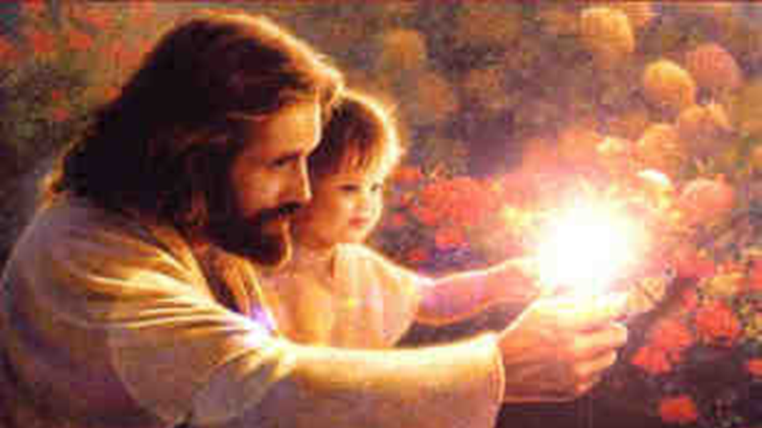
O Worship the King
Ranger Chruch of Christ
Mesquite and Rusk St.

Slide 2
Announcements | Songs | Title
1st Song | 166 | O Worship the King
2nd Song | 248 | Take Time to Be Holy
Opening Prayer
3rd Song | 48 | Fairest Lord Jesus
4th Song | 279 | Why Did My Savior Come To Earth?
Lords Supper
Offering
5th Song | 5 | All The Way My Savior Leads Me
Sermon
Invitation Song | 313 | Bring Christ Your Broken Life
Closing Song | 131 | Love Lifted Me
Closing Prayer

Slide 3
Jesus, the Way to a “Better Life”
John 14:6
Notes:
Today, many will attend worship services who have not attended since Christmas or last Easter.
They do so to celebrate the resurrection of Christ as the rest of the pagan world does.
The Bible instructs us to worship God and remember the death, burial and resurrection on the first day of the week, every week of the year.
Now on the first day of the week, when the disciples came together to break bread, Paul, ready to depart the next day, spoke to them and continued his message until midnight. (Acts 20:7)
1. Jesus, the Way to a Better Life
2. Jesus said to him, "I am the way, the truth, and the life. No one comes to the Father except through Me. John 14:6

Slide 4
The Popular Goal Is: “The Good Life”
Desire of Every Age and Every Walk of Life
But to the Truly Good Life, Jesus Is the Way!
Notes:
1. When you think about todays world, and their desires, The Popular Goal Is: “The Good Life”
>>>>>>>>>>>>>>>>>
2. It is the Desire of Every Age and Every Walk of Life to “Live The Good Life”
>>>>>>>>>>>>>>>>>
3. But to live the Truly Good Life, Jesus Is the only Way!

Slide 5
1. Jesus Corrects our Misconception
Good Life to Many: Material Prosperity, Pleasure, Security, Popularity
Why? – Assume These Things Bring Happiness, Peace, and Comfort
Yet We See and They Do Not.
Jesus The Way
Notes:
1. Jesus Corrects our Misconception about what a good life is and should be for all mankind.
>>>>>>>>>>>>>>>>
2. The Good Life to Many: Is all about the Material Prosperity, Pleasure, Security, Popularity that he obtains in this life.
>>>>>>>>>>>>>>>>
3. Why? – Because it is all he knows; and he Assume These Things Bring Happiness, Peace, and Comfort.
>>>>>>>>>>>>>>>>
4. Yet, as we look at the unhappy world around us We See They Do Not bring that desired Pleasure, Prosperity, Popularity or Security.

Slide 6
1. Jesus Corrects our Misconception
More to Life (Luke 12:15)
He Offers Exceptional Peace, Joy, Contentment (John. 14:27; 15:11; Heb. 13:5-6; Psalm 84:11)
He Gives What The World Cannot
Notes:
1. According to Jesus, there is much more to Life than what we understand as material possessions. (Luke 12:15)
And He said to them, "Take heed and beware of covetousness, for one's life does not consist in the abundance of the things he possesses." (Luke 12:15)
>>>>>>>>>>>>>>>>>>>>>>>
2. Christ Offers Us Exceptional Peace, Joy, Contentment (John. 14:27; 15:11; Heb. 13:5-6; Psalm 84:11)
Peace I leave with you, My peace I give to you; not as the world gives do I give to you. Let not your heart be troubled, neither let it be afraid. (John 14:27)
------------------------
"These things I have spoken to you, that My joy may remain in you, and that your joy may be full. (John 15:11)
------------------------
So we may boldly say: "THE LORD IS MY HELPER; I WILL NOT FEAR. WHAT CAN MAN DO TO ME?" Remember those who rule over you, who have spoken the word of God to you, whose faith follow, considering the outcome of their conduct. (Hebrews 13:6-7)
------------------------
For the LORD God is a sun and shield; The LORD will give grace and glory; No good thing will He withhold From those who walk uprightly.
(Psalms 84:11)
>>>>>>>>>>>>>>>>>
3. He Gives What The World Cannot

Slide 7
2. Jesus Leads the Way to a Better Life
By Identifying the Real Problems.
Jesus The Way
What Is the Cause of So Much Unhappiness? SIN
Source of This Is an Evil Heart (Mark 7:21-23)
Notes:
1. Jesus Leads the Way to a Better Life By Identifying the Real Problems.
>>>>>>>>>>>>>>>>>
2. We all have asked the question “What Is the Cause of So Much Unhappiness”? * * * It is nothing short of SIN
>>>>>>>>>>>>>>>>>
3. Source of This SIN Is an Evil Heart (Mark 7:21-23)
For from within, out of the heart of men, proceed evil thoughts, adulteries, fornications, murders, thefts, covetousness, wickedness, deceit, lewdness, an evil eye, blasphemy, pride, foolishness. All these evil things come from within and defile a man." (Mark 7:21-23)

Slide 8
2. Jesus Leads the Way to a Better Life
By Removing the Real Problem.
His Death Enables Us to Be Redeemed from Aimless Conduct (1 Pet. 1:18; Tit.3:3-7)
“Washing of Regeneration” (v. 5; Jn. 3:5; Prov. 3:7-8)
Jesus The Way
Notes:
1. Jesus Leads the Way to a Better Life By Removing the Real Problem.
>>>>>>>>>>>>>>>>>>
3. His Death Enables Us to Be Redeemed from our own Aimless Conduct (1 Pet. 1:18; Tit.3:3-7)
knowing that you were not redeemed with corruptible things, like silver or gold, from your aimless conduct received by tradition from your fathers, (1 Peter 1:18)
--------------------------------
For we ourselves were also once foolish, disobedient, deceived, serving various lusts and pleasures, living in malice and envy, hateful and hating one another. But when the kindness and the love of God our Savior toward man appeared, not by works of righteousness which we have done, but according to His mercy He saved us, through the washing of regeneration and renewing of the Holy Spirit, whom He poured out on us abundantly through Jesus Christ our Savior, that having been justified by His grace we should become heirs according to the hope of eternal life. (Titus 3:3-7)
>>>>>>>>>>>>>>>>>>
4. “Washing of Regeneration” (v. Titus 3:5; Jn. 3:5; Prov. 3:7-8)
Jesus answered, "Most assuredly, I say to you, unless one is born of water and the Spirit, he cannot enter the kingdom of God. (John 3:5)
------------------------------
5. It is in following the word of God, that we find salvation, men need not be wise in their own eyes, respect God and fear Him.
a. In man’s wisdom, he says that baptism is not necessary, Why? because your faith saves you, not baptism.
Do not be wise in your own eyes; Fear the LORD and depart from evil. It will be health to your flesh, And strength to your bones. (Proverbs 3:7-8)

Slide 9
2. Jesus Leads the Way to a Better Life
By Teaching Us How to Live
Ceases to Make This Life the Ultimate Concern (Col.3:1)
Seeking God’s Will first Is Always Rewarding
Even Restraints (Gen. 2:16-17; Dt. 4:5-8; 1 Tim. 4:8)
Jesus The Way
Notes:
1. Jesus Leads the Way to a Better Life By Teaching Us How to Live.
>>>>>>>>>>>>>>>
3. We can start when we Cease to Make This Life the Ultimate Concern of our life. (Col.3:1)
If then you were raised with Christ, seek those things which are above, where Christ is, sitting at the right hand of God. (Colossians 3:1)
a. Do we not realize that “This World is not Our Home” and we will live after this life?
>>>>>>>>>>>>>>>
4. If You Are Seeking God’s Will First; It Is Always Rewarding.
But seek first the kingdom of God and His righteousness, and all these things shall be added to you. (Matthew 6:33)
>>>>>>>>>>>>>>
5. Even Restraints for Christians are taught by God and must be obeyed. (Gen. 2:16-17; Dt. 4:5-8; 1 Tim. 4:8)
And the LORD God commanded the man, saying, "Of every tree of the garden you may freely eat; but of the tree of the knowledge of good and evil you shall not eat, for in the day that you eat of it you shall surely die." (Genesis 2:16-17)
------------------------------------
"Surely I have taught you statutes and judgments, just as the LORD my God commanded me, that you should act according to them in the land which you go to possess. Therefore be careful to observe them; for this is your wisdom and your understanding in the sight of the peoples who will hear all these statutes, and say, 'Surely this great nation is a wise and understanding people.' "For what great nation is there that has God so near to it, as the LORD our God is to us, for whatever reason we may call upon Him? And what great nation is there that has such statutes and righteous judgments as are in all this law which I set before you this day? (Deuteronomy 4:5-8)
----------------------------------
For bodily exercise profits a little, but godliness is profitable for all things, having promise of the life that now is and of that which is to come.
(1 Timothy 4:8)

Slide 10
“Grace to You…Peace”
“Grace” – God’s Favor
“Peace” – Welfare, Health, Well Being
Notes:
1. “Grace to You…Peace”
>>>>>>>>>>>>>>
2. “Grace” – Is God’s Part of our Salvation, it is God’s Favor Freely Given to Us.
>>>>>>>>>>>>>>
3. “Peace” – Is Added to our Welfare, Health, and Well Being by being in Christ!

Slide 11
2. Jesus Leads the Way to a Better Life
By Teaching Us How to Live
Give, Rather Than Receive
Acts 20:35 – “Blessed”
Helping, Not Hoarding (Heb. 13:16; 2 Cor. 9:6-8; Ps. 41:1-3)
Jesus The Way
Notes:
1. Jesus Leads the Way to a Better Life By Teaching Us How to Live
>>>>>>>>>>>>>>>
2. You have heard the Axiom that came from Paul, “Better to Give, Rather to Than Receive
>>>>>>>>>>>>>>>
3. Acts 20:35 – “Blessed” is the word that Jesus used.
I have shown you in every way, by laboring like this, that you must support the weak. And remember the words of the Lord Jesus, that He said, 'It is more blessed to give than to receive.' " (Acts 20:35)
>>>>>>>>>>>>>>>
4. Helping, Not Hoarding (Heb. 13:16; 2 Cor. 9:6-8; Ps. 41:1-3)
But do not forget to do good and to share, for with such sacrifices God is well pleased. (Hebrews 13:16)
--------------------------
But this I say: He who sows sparingly will also reap sparingly, and he who sows bountifully will also reap bountifully. So let each one give as he purposes in his heart, not grudgingly or of necessity; for God loves a cheerful giver. And God is able to make all grace abound toward you, that you, always having all sufficiency in all things, may have an abundance for every good work. (2 Corinthians 9:6-8)
---------------------------
To the Chief Musician. A Psalm of David. Blessed is he who considers the poor; The LORD will deliver him in time of trouble. The LORD will preserve him and keep him alive, And he will be blessed on the earth; You will not deliver him to the will of his enemies. The LORD will strengthen him on his bed of illness; You will sustain him on his sickbed. (Psalms 41:1-3)

Slide 12
2. Jesus Leads the Way to a Better Life
By Teaching Us How to Live
Compassion for the Lost
Jesus The Way
3 Jn. 3-4 – No Greater Joy
1 Th. 2:19-20 – Glory & Joy
Js. 5:19-20 – Save a Soul from Death
Notes:
1. Jesus Leads the Way to a Better Life By Teaching Us How to Live, and Compassion for the Lost is developed
>>>>>>>>>>>>>>>>>>
2. 3 Jn. 3-4 – No Greater Joy
For I rejoiced greatly when brethren came and testified of the truth that is in you, just as you walk in the truth. I have no greater joy than to hear that my children walk in truth. (3 John 1:3-4)
-----------------------------
3. 1 Th. 2:19-20 – Glory and Joy
For what is our hope, or joy, or crown of rejoicing? Is it not even you in the presence of our Lord Jesus Christ at His coming? For you are our glory and joy. (1 Thessalonians 2:19-20)
----------------------------
4. James. 5:19-20 – Save a Soul from Death
Brethren, if anyone among you wanders from the truth, and someone turns him back, let him know that he who turns a sinner from the error of his way will save a soul from death and cover a multitude of sins. (James 5:19-20)

Slide 13
2. Jesus Leads the Way to a Better Life
By Giving Us What We Do Not Deserve
Jesus The Way
Provides for Our Needs (Mt. 6:33)
Full Joy (Jn. 15:11)
Eternal Distinction (Col. 3:4)
Notes:
1. Jesus Leads the Way to a Better Life By Giving Us What We Do Not Deserve
>>>>>>>>>>>>>>>>>>
2. He Provides for All Our Needs (Mt. 6:33)
But seek first the kingdom of God and His righteousness, and all these things shall be added to you. (Matthew 6:33)
>>>>>>>>>>>>>>>>>>
3. Jesus would have you full of joy (Jn. 15:11)
"These things I have spoken to you, that My joy may remain in you, and that your joy may be full. (John 15:11)
>>>>>>>>>>>>>>>>>
4. You will have the Eternal Distinction that you belong to Christ. (Col. 3:4)
When Christ who is our life appears, then you also will appear with Him in glory. (Colossians 3:4)

Slide 14
World Sets Goals Many Cannot Achieve
Jesus Presents Goals Which Can Be Achieved
Treasure in Heaven
Live for Christ
Notes:
The World Sets Goals That Are Unobtainable and Undesirable For Christians, Therefore, The Lord’s Many Cannot Achieve These worldly goals.
But, our Lord Jesus Presents Goals Which Can Be Achieved
A Great Treasure in Heaven
The Opportunity Live for Christ

Slide 15
Hear and Believe - Mark 1:15
Believe and Act - James 2:26
Good Confession - 1 John 4:15
Sorrowful Repentance - Luke 13:3
Baptized for Remission of Sins- Romans 6:4
Invitation Song | 313 | Bring Christ Your Broken Life
Closing Song | 131 | Love Lifted Me
Closing Prayer
Notes:
1. Jesus requires us to believe that He is the Son of God, He died for our Sins and Was resurrected from death to overcome eternal death for all who believe in Him.
>>>>>>>>>>>>>>>>>>
and saying, "The time is fulfilled, and the kingdom of God is at hand. Repent, and believe in the gospel." (Mark 1:15)
a. He requires your obedience to His commands.
>>>>>>>>>>>>>>>>>>
For as the body without the spirit is dead, so faith without works is dead also. (James 2:26)
b. Confession is Commanded:
>>>>>>>>>>>>>>>>>>
Whoever confesses that Jesus is the Son of God, God abides in him, and he in God. (1 John 4:15)
2. Realizing that He is who He says He is should compel you to repent of your sins in obedience to His command.
>>>>>>>>>>>>>>>>>
I tell you, no; but unless you repent you will all likewise perish. (Luke 13:3)
3. Baptism is the putting to death the old man of sin as a requirement of the Gospel.
>>>>>>>>>>>>>>>>>
Therefore we were buried with Him through baptism into death, that just as Christ was raised from the dead by the glory of the Father, even so we also should walk in newness of life. (Romans 6:4)

