Slide 1
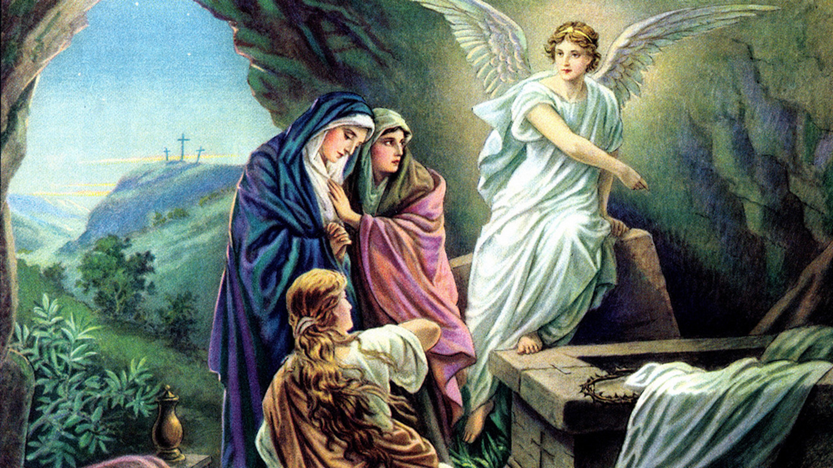
Worship In
Spirit and Truth
Ranger
Church of Christ

Slide 2
Jesus
Christ
Son of
Seven
Notes:
1. Jesus Christ
>>>>>>>>>>>>>>>
2. Biblically He is the “Son of Seven”
While the Pharisees were gathered together, Jesus asked them, (42) saying, "What do you think about the Christ? Whose Son is He?" They said to Him, "The Son of David." (43) He said to them, "How then does David in the Spirit call Him 'LORD,' saying: (44) 'THE LORD SAID TO MY LORD, "SIT AT MY RIGHT HAND, TILL I MAKE YOUR ENEMIES YOUR FOOTSTOOL" '? (45) If David then calls Him 'LORD,' how is He his Son?" (46) And no one was able to answer Him a word, nor from that day on did anyone dare question Him anymore. Matthew 22:41-46

Slide 3
Matt. 22:41-46 – whose son is he?
In response to many questions, Jesus asked His question
According to Law: son of David
Jesus responded, “How then does David in the Spirit call Him ‘Lord’?”
  Answer: Jesus was God in the flesh (cf. Matt. 1:21; Phil. 2:5-8)
Notes:
1. Matt. 22:41-46 – whose son is he?
>>>>>>>>>>>>>>
2. In response to many Sadducees and Pharisees questions, because they wanted to trouble Jesus, Jesus asked His question
>>>>>>>>>>>>>>
3. According to Law: son of David
>>>>>>>>>>>>>>
4. Jesus responded, “How then does David in the Spirit call Him ‘Lord’?”
>>>>>>>>>>>>>>
5. Answer: Jesus was God in the flesh (cf. Matt. 1:21; Phil. 2:5-8)
And she will bring forth a Son, and you shall call His name JESUS, for He will save His people from their sins." (Matthew 1:21)

Slide 4
Other passages speak of Jesus’ sonship:
Son of Adam
Son of Abraham
Son of David
Son of Joseph
Son of Mary
Son of Man
Son of God
This lesson: study the meaning of Jesus as the son of these seven
Notes:
1. Other passages speak of Jesus’ sonship:
>>>>>>>>>>>>>>
2. Son of Adam
>>>>>>>>>>>>>>
3. Son of Abraham
>>>>>>>>>>>>>>
4. Son of David
>>>>>>>>>>>>>>
5. Son of Joseph
>>>>>>>>>>>>>>
6. Son of Mary
>>>>>>>>>>>>>>
7. Son of Man
>>>>>>>>>>>>>>
8. Son of God
>>>>>>>>>>>>>>
9. Today let’s look and study the meaning of Jesus as the son of these seven

Slide 5
Jesus Christ
Son of Seven
Son of David
Notes:
1. Jesus Christ Son of Seven
>>>>>>>>>>>>>
2. Carries the title “Son of David”

Slide 6
Matt 1:1 – genealogy of Jesus from Abraham
Several occasions (Matt. 9:27; 12:23; 15:22)
Applied to the expected Messiah
  Thus, term charged with special significance
Notes:
1. Matt 1:1 – We have Matthew’s accounting in which he gives us the genealogy of Christ starting with Abraham.
>>>>>>>>>>>>>>>>
2. On several occasions, we see the title “Son of David applied by the people, to Jesus Christ. (Matt. 9:27; 12:23; 15:22)
>>>>>>>>>>>>>>>>
3. The term “Son of David” was applied to the expected “Messiah of Israel” by the Jewish people.
>>>>>>>>>>>>>>>>
4. Thus, we can see that the term “Son of David” is charged with a very special significance for the Jewish people.

Slide 7
David’s Victory Over Goliath ~ Jesus’ Victory Over Sin & Death
Sent by father with food and a message (1 Sam. 17:17-18)
  Jesus (John 6:35; Heb. 1:1-2; John 8:31-32; 6:68)
Brothers rejected Him (1 Sam. 17:28)
  Jesus (John 1:11; Acts 4:10-11)
Notes:
1. David’s Victory Over Goliath can be contrasted with Jesus’ Victory Over Sin & Death
>>>>>>>>>>>>>>>>
2. Both men were sent by father with food and a message to be delivered to their hearers. (1 Sam. 17:17-18)
Then Jesse said to his son David, "Take now for your brothers an ephah of this dried grain and these ten loaves, and run to your brothers at the camp. And carry these ten cheeses to the captain of their thousand, and see how your brothers fare, and bring back news of them." (1 Samuel 17:17-18)
>>>>>>>>>>>>>>>>>
3. Jesus came as the bread of life for everyone. (John 6:35; Heb. 1:1-2; John 8:31-32; 6:68)
And Jesus said to them, "I am the bread of life. He who comes to Me shall never hunger, and he who believes in Me shall never thirst. (John 6:35)
>>>>>>>>>>>>>>>>>
4. David’s brothers rejected Him as prideful and insolent. (1 Sam. 17:28)
Now Eliab his oldest brother heard when he spoke to the men; and Eliab's anger was aroused against David, and he said, "Why did you come down here? And with whom have you left those few sheep in the wilderness? I know your pride and the insolence of your heart, for you have come down to see the battle." (1 Samuel 17:28)
>>>>>>>>>>>>>>>>>
5. Jesus (John 1:11; Acts 4:10-11 rejected chief corner stone)
He came to His own, and His own did not receive Him. (John 1:11)

Slide 8
David’s Victory Over Goliath ~ Jesus’ Victory Over Sin & Death
Represented his people
  Jesus only mediator (1 Tim. 2:5; 1 John 2:1)
Rejected Saul’s armor (1 Sam. 17:38-39)
  Jesus tells Peter “Put away sword” (Matt. 26:52-53)
Notes:
1. Each man represented his people before critical eyes of the world.
>>>>>>>>>>>>
2. Jesus is our only mediator with our Father. (1 Tim. 2:5; 1 John 2:1)
>>>>>>>>>>>>
3. David rejected Saul’s armor and weapons of war. (1 Sam. 17:38-39)
>>>>>>>>>>>>
4. Jesus also tells Peter “Put away sword” or perish by it. (Matt. 26:52-53)

Slide 9
David’s Victory Over Goliath ~ Jesus’ Victory Over Sin & Death
Cut off Goliath’s head with giant’s sword (1 Sam. 17:51)
  Jesus defeated Satan with devil’s principal weapon – death (Heb. 2:14)
Notes:
1. David killed and cut off Goliath’s head with the giant’s own sword (1 Sam. 17:51)
>>>>>>>>>>>>>>>>>>
2. Jesus defeated Satan with devil’s principal weapon – death (Heb. 2:14)
Inasmuch then as the children have partaken of flesh and blood, He Himself likewise shared in the same, that through death He might destroy him who had the power of death, that is, the devil, (Hebrews 2:14)

Slide 10
Descendant of David to Sit on Throne of David
Acts 2:22-33
Throne
Death
Resurrection
Descendant and Promised Messiah
Notes:
1. The descendant of David is to Sit on Throne of David in Heaven.
"Men of Israel, hear these words: Jesus of Nazareth, a Man attested by God to you by miracles, wonders, and signs which God did through Him in your midst, as you yourselves also know-Him, being delivered by the determined purpose and foreknowledge of God, you have taken by lawless hands, have crucified, and put to death; (Acts 2:22-23)
>>>>>>>>>>>>>>>>>>
2. From His own death He arose a victor over death and Satan.
>>>>>>>>>>>>>>>>>>
3. He ascended in to Heaven to sit on the “throne of David”.
"For David did not ascend into the heavens, but he says himself: 'THE LORD SAID TO MY LORD, "SIT AT MY RIGHT HAND, TILL I MAKE YOUR ENEMIES YOUR FOOTSTOOL." ‘ (Acts 2:34-35)
4. He now reigns with His Father from the throne room of Heave.

Slide 11
Jesus Christ
Son of Seven
Son of Abraham
Notes:
1. Jesus Christ Son of Seven
>>>>>>>>>>>>>>>>
2. As a descendant of Abraham, he is a Son of Abraham

Slide 12
Through his seed all nations blessed (Gen. 26:3-4)
  Gal. 3:16 – “seed” singular
  Gal. 3:26-29 – If Christ’s then heirs according to promise
Jesus was of legal descent through Isaac; unlike those of Ishmael (Matt. 1; Luke 3)
Notes:
1. Through Abraham’s seed, God promised that all nations of the earth would be blessed. (Gen. 26:3-4)
2. Gal. 3:16 – “seed” singular
Now to Abraham and his Seed were the promises made. He does not say, "And to seeds," as of many, but as of one, "AND TO YOUR SEED," who is Christ. (Galatians 3:16)
3. Paul further tells us in Gal. 3:26-29 – If we belong to Christ’s then we are heirs of God according to this promise.
4. Jesus was of legal descent through Isaac; unlike those of descent from Ishmael. (Matt. 1:2; Luke 3:34)

Slide 13
Similarities Between Jesus and Isaac
Offered as a sacrifice
Submitted willingly
Bore wood up the hill
Notes:
1. Similarities Between Jesus and Isaac
>>>>>>>>>>>>
2. Both were offered as a sacrifice by their Fathers.
>>>>>>>>>>>>
3. Both men submitted willingly to their Father’s command.
>>>>>>>>>>>>
4. Both men bore their own sacrificial wood to the place of sacrifice.

Slide 14
Jesus Christ
Son of Seven
Son of Adam
Notes:
1. Jesus Christ Son of Seven
>>>>>>>>>>>
2. Appears as the Son of Adam

Slide 15
Physically all are sons of Adam
Christ’s sonship special (1 Cor. 15:45)
Both placed on Earth by miracle (Gen. 2:7; Matt. 1:23)
Bride of both came from their sleep (Gen. 2:21-24; Eph. 5:25-27)
  From their blood (Acts 20:28)
Notes:
1. If you think about it, physically all are sons of Adam, even Eve came from Adam and became the mother of all nations.
2. But with our Lord, Christ’s sonship is something special to our world. (1 Cor. 15:45)
And so it is written, "THE FIRST MAN ADAM BECAME A LIVING BEING." The last Adam became a life-giving spirit. (1 Corinthians 15:45)
3. Both men were placed on Earth by miracle from heaven. (Gen. 2:7; Matt. 1:23)
And the LORD God formed man of the dust of the ground, and breathed into his nostrils the breath of life; and man became a living soul. (Genesis 2:7)
4. Bride of both men came from their sleep (Gen. 2:21-24 God caused a deep sleep for Adam; Eph. 5:25-27 He gave Himself for her)
5. From their blood (Acts 20:28)
a. All men are from the bloodline of Adam.
b. All men in Christ have been purchased by the blood of Christ.

Slide 16
Jesus Christ
Son of Seven
Son of Joseph
Notes:
1. Jesus Christ Son of Seven,
>>>>>>>>>>>>>>>
2. He was also the Son of Joseph

Slide 17
His foster son (Matt. 13:55; Luke 3:23)
The child Jesus was subject to His parents (Luke 2:51)
Notes:
1. His foster son (Matt. 13:55; Luke 3:23)
Is this not the carpenter's son? Is not His mother called Mary? And His brothers James, Joses, Simon, and Judas? (Matthew 13:55)
Now Jesus Himself began His ministry at about thirty years of age, being (as was supposed) the son of Joseph, the son of Heli, (Luke 3:23)
2. The child Jesus was subject to His parents (Luke 2:51)
Then He went down with them and came to Nazareth, and was subject to them, but His mother kept all these things in her heart. (Luke 2:51)

Slide 18
Jesus Christ
Son of Seven
Son of Mary
Notes:
1. Jesus Christ Son of Seven
>>>>>>>>>>
2. was also the Son of Mary

Slide 19
By virgin birth (Matt. 1:20-23)
Jesus was her first born (Matt. 13:55-56)
  Four brothers named (55b)
  Undetermined number of sisters (56a)
She was NOT the “mother of God,” but the Mother of Jesus [Eternal God incarnated in the body to which Mary gave birth]
Notes:
1. By virgin birth (Matt. 1:20-23)
>>>>>>>>>>>>>>>>>
2. Jesus was her first born (Matt. 13:55-56)
>>>>>>>>>>>>>>>>>
3. Four brothers named - And His brothers James, Joses, Simon, and Judas? (Matthew 13:55b)
>>>>>>>>>>>>>>>>>
4. Undetermined number of sisters - And His sisters, are they not all with us? (Matthew 13:56a)
>>>>>>>>>>>>>>>>>
5. She was NOT the “mother of God,” but the Mother of Jesus, the “Son of Man” [He was the Eternal God incarnated in the body to which Mary gave birth]
a. God was not created in the body of Mary, He has existed forever, a physical man’s body was created for Jesus and God was incarnated in that Body.
b. To incarnate is to: to clothe with flesh; to embody in flesh. From Webster’s dictionary.

Slide 20
Jesus Christ
Son of Seven
Son of Man
Notes:
1. Jesus Christ Son of Seven
>>>>>>>>>>>
2. He is also the “Son of Man”.

Slide 21
Most frequent way Jesus referred to Himself
  Matthew (32), Mark (15), Luke (27), John (12) – 85 total
  Only twice used by others Emphasized uniqueness of His humanity – man and God in one (Col. 2:9)
Made in man’s likeness (Phil. 2:7)
Notes:
1. The “Son of Man” is the most frequent way Jesus has referred to Himself.
>>>>>>>>>>>>>>>>>>>
2. We find it in Matthew (32), Mark (15), Luke (27), John (12) – 85 total
>>>>>>>>>>>>>>>>>>>
3. Only twice is it used by others “as being Son of man”. (Acts 7:56; Heb 2:6)
4. The Bible emphasized the uniqueness of His humanity and man did not recognize Him as God – man and God in one (Col. 2:8)
For in Him dwells all the fullness of the Godhead bodily; (Colossians 2:9)
5. Jesus was made in man’s likeness (Phil. 2:7)
but made Himself of no reputation, taking the form of a bondservant, and coming in the likeness of men. (Philippians 2:7)

Slide 22
Being “Son of man” qualified Jesus as:
  Mediator (1 Tim. 2:5)
  Compassionate High Priest (Heb. 4:15)
  Perfect Savior (Heb. 5:8-9)
  Destroyer of the power of death (Heb. 2:14)
Notes:
1. Being a “Son of man”, as we are sons of men, qualified Jesus as:
>>>>>>>>>>>>>>>
2. Our mediator, because he gave himself as a ransom for our sins. (1 Tim. 2:5)
>>>>>>>>>>>>>>>
3. He is a compassionate High Priest for us before His Father, having been tempted by Satan himself in all the manners that we are, yet without sin. (Heb. 4:15)
>>>>>>>>>>>>>>>
4. He is the perfect Savior because He is without sin and He disobeyed any of His Father’s commands. (Heb. 5:8-9)
>>>>>>>>>>>>>>>
5. Through His own death, Jesus became the destroyer of death, and the power of death that Satan holds over us as human beings. (Heb. 2:14)

Slide 23
Jesus Christ
Son of Seven
Son of God
Notes:
1. Jesus Christ the Son of Seven
>>>>>>>>>>
2. He is also the Son of God.

Slide 24
“Only begotten of the Father (John 1:14)
  Matt. 3:17 – “My beloved Son”
  Matt. 17:5 – “My beloved Son”
Belief in essential (John 20:30-31)
Confession of essential (Rom. 10:9-10)
Salvation in no other (Acts 4:12)
Church established on this fact (Matt. 16:16-18)
Notes:
1. “Only begotten of the Father (John 1:14)
>>>>>>>>>>>>>>>>>>
2. Matt. 3:16 – God spoke from haven “My beloved Son” at Jesus’s baptism
>>>>>>>>>>>>>>>>>>
3. Matt. 17:5 – Again God said “My beloved Son” on the Mount of Transfiguration, with an admonition for us to “hear Him”.
>>>>>>>>>>>>>>>>>>
4. Belief in Jesus as the son of God is essential for your salvation (John 20:30-31)
>>>>>>>>>>>>>>>>>>
5. Confession with the mouth is also essential for eternal life. (Rom. 10:9-10)
>>>>>>>>>>>>>>>>>>
6. There is salvation in “no other” name than that of Jesus Christ. (Acts 4:12)
>>>>>>>>>>>>>>>>>>
7. Church established on this fact that Jesus is the Son of God. (Matt. 16:16-18)

Slide 25
“What do you think about the Christ?”
Do YOU have faith in Him?
He is coming again – will you be ready?
Notes:
1. “What do you think about the Christ?”
>>>>>>>>>>>>>>>
2. Do YOU have faith in Him?
>>>>>>>>>>>>>>>
3. He is coming again – will you be ready?

