Slide 1
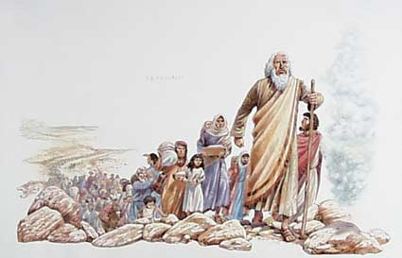
Welcome to Worship at the Ranger Church of Christ.

Slide 2
Israel – an Example Not to Follow
1 Cor. 10:1-13
Notes:
1. Israel – an Example Not to Follow
1 Corinthians 10:1-13 Moreover, brethren, I do not want you to be unaware that all our fathers were under the cloud, all passed through the sea, (2) all were baptized into Moses in the cloud and in the sea, (3) all ate the same spiritual food, (4) and all drank the same spiritual drink. For they drank of that spiritual Rock that followed them, and that Rock was Christ. (5) But with most of them God was not well pleased, for their bodies were scattered in the wilderness. (6) Now these things became our examples, to the intent that we should not lust after evil things as they also lusted. (7) And do not become idolaters as were some of them. As it is written, "THE PEOPLE SAT DOWN TO EAT AND DRINK, AND ROSE UP TO PLAY." (8) Nor let us commit sexual immorality, as some of them did, and in one day twenty-three thousand fell; (9) nor let us tempt Christ, as some of them also tempted, and were destroyed by serpents; (10) nor complain, as some of them also complained, and were destroyed by the destroyer. (11) Now all these things happened to them as examples, and they were written for our admonition, upon whom the ends of the ages have come. (12) Therefore let him who thinks he stands take heed lest he fall. (13) No temptation has overtaken you except such as is common to man; but God is faithful, who will not allow you to be tempted beyond what you are able, but with the temptation will also make the way of escape, that you may be able to bear it.

Slide 3
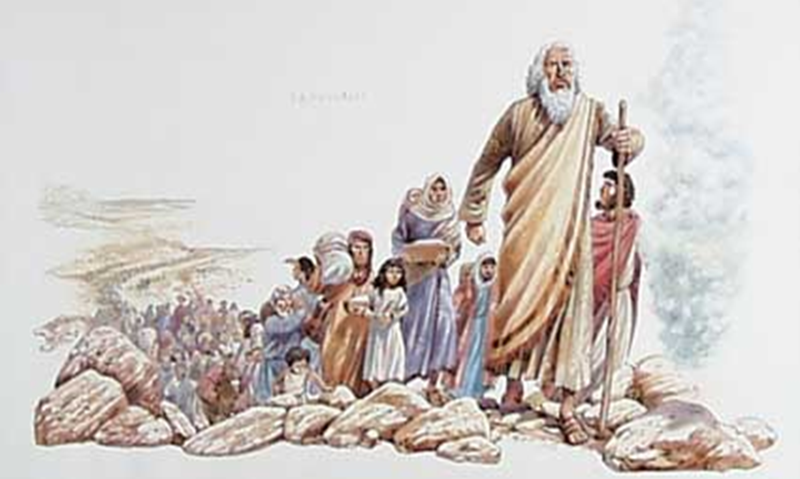
1 Cor. 10:1-13
Israel’s history pictures a danger to Christians – falling from grace
Moses sent to save Israel and lead them to Canaan
“Now these things became our examples” (vs. 6, 11)
Notes:
>>>>>>>>>>>>>>>>>>
1. Israel’s history pictures a danger to Christians – something some teach as doctrine and say cannot happen - falling from grace.
>>>>>>>>>>>>>>>>>>
2. Moses sent to save Israel from slavery and paganism, and he was to lead them to Canaan
>>>>>>>>>>>>>>>>>>
3. “Now these things became our examples” (vs. 6, 11)
Now these things became our examples, to the intent that we should not lust after evil things as they also lusted. (1 Corinthians 10:6)
Now all these things happened to them as examples, and they were written for our admonition, upon whom the ends of the ages have come. (1 Corinthians 10:11)

Slide 4
Israel Compared With Christians
Saved when baptized (1 Pet. 3:21)
God’s care after baptism (Gal. 3:26-27; Eph. 1:3)
Most did not enter promise land (Heb. 2:1-3)
Sins: lust, idolatry, sexual sins, tested God, murmured
Notes:
1. Israel Compared With Christians
>>>>>>>>>>>>>>>>>
2. Saved when baptized (1 Pet. 3:21)
There is also an antitype which now saves us-baptism (not the removal of the filth of the flesh, but the answer of a good conscience toward God), through the resurrection of Jesus Christ, (1 Peter 3:21)
>>>>>>>>>>>>>>>>>
3. God’s care after baptism (Gal. 3:26-27; Eph. 1:3)
For you are all sons of God through faith in Christ Jesus. For as many of you as were baptized into Christ have put on Christ. (Galatians 3:26-27)
Blessed be the God and Father of our Lord Jesus Christ, who has blessed us with every spiritual blessing in the heavenly places in Christ, (Ephesians 1:3)
>>>>>>>>>>>>>>>>>
4. Most did not enter promise land (Heb. 2:1-3)
Therefore we must give the more earnest heed to the things we have heard, lest we drift away. For if the word spoken through angels proved steadfast, and every transgression and disobedience received a just reward, how shall we escape if we neglect so great a salvation, which at the first began to be spoken by the Lord, and was confirmed to us by those who heard Him, (Hebrews 2:1-3)
>>>>>>>>>>>>>>>>
5. Sins: lust, idolatry, sexual sins, tested God, murmured

Slide 5
Israel – an Example to Not Follow
1. They Lusted After Evil Things
Notes:
1. Israel – an Example to Not Follow
2. 1. They Lusted After Evil Things

Slide 6
Lust After Evil Things
Lust – strong compelling desire
Lust for evil things – obsessive desire for that from which God has separated you
Num. 11:4-6 – tired of manna, lust after meats and pleasures in Egypt
Notes:
1. Lust – strong compelling desire
>>>>>>>>>>>>>>>>
2. Lust for evil things – obsessive desire for that from which God has separated you
>>>>>>>>>>>>>>>>
3. Num. 11:4-6 – tired of manna, lust after meats and pleasures in Egypt
Now the mixed multitude who were among them yielded to intense craving; so the children of Israel also wept again and said: "Who will give us meat to eat? We remember the fish which we ate freely in Egypt, the cucumbers, the melons, the leeks, the onions, and the garlic; but now our whole being is dried up; there is nothing at all except this manna before our eyes!" (Numbers 11:4-6)

Slide 7
Lust After Evil Things
They wanted salvation from slavery, God’s blessings, and the promised land
But, also wanted things they could only enjoy if they were not God’s people
They lost sight of their blessings
Notes:
>>>>>>>>>>>>>>>>>>>>>>
1. They wanted salvation from slavery, God’s blessings, and the promised land
>>>>>>>>>>>>>>>>>>>>>>
2. But, also wanted things they could only enjoy if they were not God’s people
>>>>>>>>>>>>>>>>>>>>>>
3. They lost sight of their blessings

Slide 8
Lust After Evil Things
Christians can also long for things from which Christ has separated us – pleasures of unrestrained life (1 Cor. 6:9ff)
Become blinded to blessings, privileges, values and hope
Lust for evil things deadens spiritual awareness
1 Jn. 2:15-17
Jms. 1:14-15
Notes:
1. Christians can also long for things from which Christ has separated us – pleasures of unrestrained life (1 Cor. 6:9)
Do you not know that the unrighteous will not inherit the kingdom of God? Do not be deceived. Neither fornicators, nor idolaters, nor adulterers, nor homosexuals, nor sodomites, (1 Corinthians 6:9)
>>>>>>>>>>>>>>>>>>>>>>>
2. Become blinded to blessings, privileges, values and hope
>>>>>>>>>>>>>>>>>>>>>>>
3. Lust for evil things deadens spiritual awareness
>>>>>>>>>>>>>>>>>>>>>>>
4. 1 Jn. 2:15-17
Do not love the world or the things in the world. If anyone loves the world, the love of the Father is not in him. For all that is in the world-the lust of the flesh, the lust of the eyes, and the pride of life-is not of the Father but is of the world. And the world is passing away, and the lust of it; but he who does the will of God abides forever. (1 John 2:15-17)
>>>>>>>>>>>>>>>>>>>>>>>
5. Jms. 1:14-15
But each one is tempted when he is drawn away by his own desires and enticed. Then, when desire has conceived, it gives birth to sin; and sin, when it is full-grown, brings forth death. (James 1:14-15)

Slide 9
Lust After Evil Things
Religion is of the heart
We become Christians when we are obedient from the heart (Rom. 6:17-18)
By the heart we live faithfully unto God (Matt. 12:35; 15:19)
The treasures of life are what we treasure the most
Notes:
1. Religion is of the heart
>>>>>>>>>>>>>>>>>>>>>>
2. We become Christians when we are obedient from the heart (Rom. 6:17-18)
But God be thanked that though you were slaves of sin, yet you obeyed from the heart that form of doctrine to which you were delivered. And having been set free from sin, you became slaves of righteousness. (Romans 6:17-18)
>>>>>>>>>>>>>>>>>>>>>>
3. By the heart we live faithfully unto God (Matt. 12:35; 15:19)
A good man out of the good treasure of his heart brings forth good things, and an evil man out of the evil treasure brings forth evil things. (Matthew 12:35)
But those things which proceed out of the mouth come from the heart, and they defile a man. For out of the heart proceed evil thoughts, murders, adulteries, fornications, thefts, false witness, blasphemies. (Matthew 15:18-19)
>>>>>>>>>>>>>>>>>>>>>>
4. The treasures of life are what we treasure the most

Slide 10
Israel – an Example to Not Follow
1. They Lusted After Evil Things
2. They committed Idolatry
Notes:
2. They committed Idolatry

Slide 11
Idolatry
Golden calf at Mt. Sinai – 3000 perished (Ex. 32:1-29)
Some religious groups claiming Christianity bow before images – idolatry
Any false religion is equal to idolatry (1 Sam. 15:3, 15, 22-23)
Notes:
1. Idolatry
>>>>>>>>>>>>>>>>>>
2. Golden calf at Mt. Sinai – 3000 perished, by the sword of the Levites (v28). (Ex. 32:1-29)
a. And there is more:
And the LORD said to Moses, "Whoever has sinned against Me, I will blot him out of My book. Now therefore, go, lead the people to the place of which I have spoken to you. Behold, My Angel shall go before you. Nevertheless, in the day when I visit for punishment, I will visit punishment upon them for their sin." (Exodus 32:33-34)
>>>>>>>>>>>>>>>>>>
3. Some religious groups claiming Christianity bow before images – idolatry
>>>>>>>>>>>>>>>>>>
4. Any false religion is equal to idolatry (1 Sam. 15:3, 15, 22-23)
Now go and attack Amalek, and utterly destroy all that they have, and do not spare them. But kill both man and woman, infant and nursing child, ox and sheep, camel and donkey.' " (1 Samuel 15:3)
------------------------------
And Saul said, "They have brought them from the Amalekites; for the people spared the best of the sheep and the oxen, to sacrifice to the LORD your God; and the rest we have utterly destroyed." (1 Samuel 15:15)
------------------------------
So Samuel said: "Has the LORD as great delight in burnt offerings and sacrifices, As in obeying the voice of the LORD? Behold, to obey is better than sacrifice, And to heed than the fat of rams. For rebellion is as the sin of witchcraft, And stubbornness is as iniquity and idolatry. Because you have rejected the word of the LORD, He also has rejected you from being king." (1 Samuel 15:22-23)

Slide 12
Saul could not have been more displeasing to God if he had bowed before an idol
Saul displeased God because he rejected God’s word and worshiped unacceptably
Not abiding by God’s will is false religion - equal to idolatry
Notes:
1. Saul could not have been more displeasing to God if he had bowed before an idol
>>>>>>>>>>>>>>>>>>>
2. Saul displeased God because he rejected God’s word and worshiped unacceptably
>>>>>>>>>>>>>>>>>>>
3. Not abiding by God’s will is false religion – and that is equal to idolatry.

Slide 13
Denominations are false religions (Gal. 1:6-9)
“Denomination” – one of a variety, distinguished by different creeds
Bible teachings not in the creed are not practiced
Teachings foreign to Bible in the creed are practiced
Notes:
1. All Denominations and their worship are false religions (Gal. 1:6-9)
I marvel that you are turning away so soon from Him who called you in the grace of Christ, to a different gospel, which is not another; but there are some who trouble you and want to pervert the gospel of Christ. But even if we, or an angel from heaven, preach any other gospel to you than what we have preached to you, let him be accursed. As we have said before, so now I say again, if anyone preaches any other gospel to you than what you have received, let him be accursed. (Galatians 1:6-9)
>>>>>>>>>>>>>>>>>
2. What is a “Denomination” – it is one of a variety, that distinguished itself by different creeds
>>>>>>>>>>>>>>>>>
3. Bible teachings that are found in these creeds are not to be practiced
>>>>>>>>>>>>>>>>>
4. Teachings things that are foreign to the Bible, and those taught in the creeds, are practiced as false religion.

Slide 14
Bible Warnings
Matt. 15:9 – Doctrine of Men
2 John 9-10 – Doctrine of Christ
Matt. 7:21-23 – Not Everyone
Matt. 15:13-14 – Blind leads the Blind
Notes:
We have many Biblical warnings about false doctrine.
1. Matt. 15:9
AND IN VAIN THEY WORSHIP ME, TEACHING AS DOCTRINES THE COMMANDMENTS OF MEN.' " (Matthew 15:9)
>>>>>>>>>>>>>>>>>>>
2. 2 John 9-10
Whoever transgresses and does not abide in the doctrine of Christ does not have God. He who abides in the doctrine of Christ has both the Father and the Son. If anyone comes to you and does not bring this doctrine, do not receive him into your house nor greet him; (2 John 1:9-10)
>>>>>>>>>>>>>>>>>>>
3. Matt. 7:21-23
"Not everyone who says to Me, 'Lord, Lord,' shall enter the kingdom of heaven, but he who does the will of My Father in heaven. Many will say to Me in that day, 'Lord, Lord, have we not prophesied in Your name, cast out demons in Your name, and done many wonders in Your name?' And then I will declare to them, 'I never knew you; depart from Me, you who practice lawlessness!' (Matthew 7:21-23)
>>>>>>>>>>>>>>>>>>>
4. Matt. 15:13-14
But He answered and said, "Every plant which My heavenly Father has not planted will be uprooted. Let them alone. They are blind leaders of the blind. And if the blind leads the blind, both will fall into a ditch."
(Matthew 15:13-14)

Slide 15
Idolatry
Anything put before God is an idol (Col. 3:5)
Possessions (Matt. 19:16-22)
Work – pride – recreation – friends – popularity – sports
Christian must constantly guard against erecting an idol in his heart (Eccl. 12:13-14)
Notes:
1. Anything you put before God in your life, is an idol (Col. 3:5)
Therefore put to death your members which are on the earth: fornication, uncleanness, passion, evil desire, and covetousness, which is idolatry. (Colossians 3:5)
>>>>>>>>>>>>>>>>>>>
2. Even your love for your possessions (Matt. 19:16-22)
a. Remember the Rich Young Ruler who had kept all of the commandments.
Jesus said to him, "If you want to be perfect, go, sell what you have and give to the poor, and you will have treasure in heaven; and come, follow Me." (Matthew 19:21)
>>>>>>>>>>>>>>>>>>>
3. Anything, whether it be - Work – pride – recreation – friends – popularity – sports - money
>>>>>>>>>>>>>>>>>>>
4. Christian must constantly guard against erecting a personal idol in his heart (Eccl. 12:13-14)
Let us hear the conclusion of the whole matter: Fear God and keep His commandments, For this is man's all. For God will bring every work into judgment, Including every secret thing, Whether good or evil. (Ecclesiastes 12:13-14)

Slide 16
Conclusion
“Now all these things happened to them as examples, and they were written for our admonition, upon whom the ends of the ages have come. Therefore let him who thinks he stands take heed lest he fall” (1 Cor. 10:11-12)
We have examined two of the five causes for falling away
Notes:
In Conclusion
1. We have examined two of the five causes for falling away
>>>>>>>>>>>>>>>>>>>>>>>>>
Now all these things happened to them as examples, and they were written for our admonition, upon whom the ends of the ages have come. Therefore let him who thinks he stands take heed lest he fall. (1 Corinthians 10:11-12)

Slide 17
Conclusion
We have examined two of the five causes for falling away
Most of the Israelites allowed Satan to overthrow them in the wilderness
Though we have been baptized into Christ, we are danger of not entering into Heaven
Notes:
2. Most of the Israelites allowed Satan to overthrow them in the wilderness, even in the face of all of God’s miracles.
>>>>>>>>>>>>>>>>
3. Even though we have been baptized into Christ, we are always danger of not entering into Heaven if we erect idols in our lives and hearts.

Slide 18
Hearing and faith, Rom. 10:17
Repentance, Luke 13:5
Confessing Christ, 1 John 4:15
Immersion in water, Col 2:12
Faithfulness, Rev. 3:11
Jesus extends His Invitation to all Men
Notes:
1. Hearing and faith, Rom. 10:17
So then faith comes by hearing, and hearing by the word of God. (Romans 10:17)
>>>>>>>>>>>>>>>>>>>>>>>>>>>
2. Repentance, Luke 13:5
I tell you, no; but unless you repent you will all likewise perish." (Luke 13:5)
>>>>>>>>>>>>>>>>>>>>>>>>>>>>
3. Confessing Christ, 1 John 4:15
Whoever confesses that Jesus is the Son of God, God abides in him, and he in God. (1 John 4:15)
>>>>>>>>>>>>>>>>>>>>>>>>>>>>>
4. Immersion in water, Col 2:12
buried with Him in baptism, in which you also were raised with Him through faith in the working of God, who raised Him from the dead. (Colossians 2:12)
>>>>>>>>>>>>>>>>>>>>>>>>>>>>>
5. Faithfulness, Rev. 3:11
Behold, I am coming quickly! Hold fast what you have, that no one may take your crown. (Revelation 3:11)
>>>>>>>>>>>>>>>>>>>>>>>>>>>>
6. Jesus extends His Invitation to all Men

