Slide 1
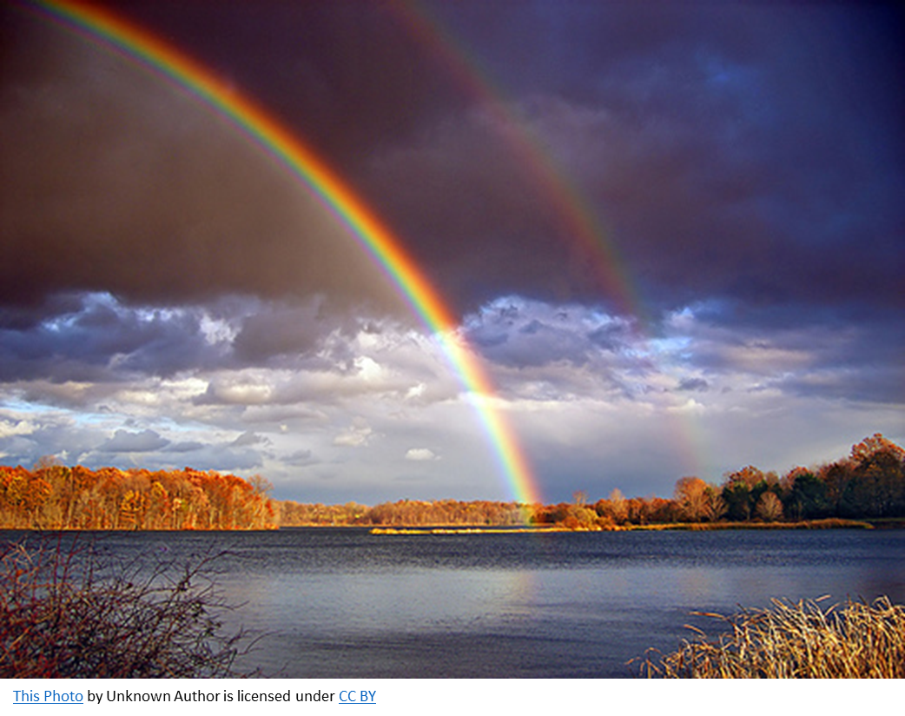
All Are Welcome
To Worship
Ranger Church of Christ
Mesquite and Rusk St.

Slide 2
Announcements | Songs | Title
1st Song | 273 | Wonderful Love
2nd Song | 177 | Purer in Heart, O God
Opening Prayer
3rd Song | 231 | ‘Tis So Sweet to Trust in Jesus
4th Song | 23 | By Christ Redeemed
Lords Supper
Offering
5th Song | 53s | Glory! Glory! Hallelujah!
Sermon
Invitation Song | 6s | He Died For You And Me
Closing Song | 30s | A Common Love
Closing Prayer

Slide 3
Herod the Horrible
Matthew 2:1-23
Notes:
Now after Jesus was born in Bethlehem of Judea in the days of Herod the king, behold, wise men from the East came to Jerusalem, saying, "Where is He who has been born King of the Jews? For we have seen His star in the East and have come to worship Him." When Herod the king heard this, he was troubled, and all Jerusalem with him. (Matthew 2:1-3)

Slide 4
A Troubled Heart Means a Troubled Soul
“he was troubled” – But Why?
  Not because foreigners knew something he didn’t
  Not because he might miss out on worshipping Jesus
  But rather because his throne was threatened
  Troubled with Christ because he was troubled with God
Notes:
1. A Troubled Heart in anyone Means a Troubled Soul seeking answers, vindication, and justice.
>>>>>>>>>>>>>>>>>>>>>
2. The scripture says that “he was troubled” – But Why?
a. In order to answer the “Why?” we must know the cause of his trouble.
>>>>>>>>>>>>>>>>>>>>>
3. It was Not because foreigners knew something he didn’t know.
4. It was Not because he might miss out on worshipping Jesus
5. But rather his fear and trouble came because his throne was threatened by the birth of a child king.
6. His soul was troubled with the birth of Christ because he was troubled with the superior power of the eternal God.

Slide 5
A Troubled Heart Means a Troubled Soul
King Saul’s soul was troubled
  Tried his “own thing” and lost his throne
  Notice 1 Samuel 18:12, “Saul was afraid of David”
    Not afraid of David because he had killed Goliath
    Afraid of David because the Lord was with David
Felix was troubled
  Acts 24:25
Notes:
1. Herod was not the only king to be troubled, King Saul was also troubled.
2. Tried his “own thing” and lost his throne
3. Notice 1 Samuel 18:12, “Saul was afraid of David”
Now Saul was afraid of David, because the LORD was with him, but had departed from Saul. (1 Samuel 18:12)
4. Saul was Not afraid of David because he had killed Goliath
5. But he was afraid of David because the Lord was with David
6. Felix was also troubled by the Apostle Paul
7. Acts 24:25
Now as he reasoned about righteousness, self-control, and the judgment to come, Felix was afraid and answered, "Go away for now; when I have a convenient time I will call for you." (Acts 24:25)

Slide 6
A Troubled Heart Means a Troubled Soul
Do spiritually active people make you nervous or uncomfortable?
  Is it possible that it is God, that we are afraid of?
  Examine yourself, and submit to God and there will be no fear!
What could Herod have done to help Christ?
What can we do when we submit to God?
Notes:
1. Do spiritually active people make you nervous or uncomfortable?
>>>>>>>>>>>>>>>>>>>>
2. Is it possible that it’s God that we are afraid of?
>>>>>>>>>>>>>>>>>>>>
3. Examine yourself and submit to God and there will be no fear!
>>>>>>>>>>>>>>>>>>>>
4. What could Herod have done to help Christ establish His kingdom?
>>>>>>>>>>>>>>>>>>>>
5. What can we do when we submit to God?

Slide 7
Our Troubles Affect Others, Especially If We Are Leaders
“he was troubled, and all Jerusalem with him”
  When fear is at the top, it trickles down!
  The Israelite Army was troubled when King Saul was (2 Samuel 4).
  Israel was troubled when Achan sinned (Joshua 7).
  The church was troubled when the Grecian widows were troubled (Acts 6).
“A little leaven leavens the whole lump” (1 Cor 5:6)
Notes:
Our troubles can and do, affect others around us, especially If we are one of the leaders
1. “he [Herod] was troubled, and all Jerusalem with him”
a. When fear is at the top, it trickles down!
b. The Israelite Army was troubled when King Saul was troubled. (2 Samuel 4).
When Saul's son heard that Abner had died in Hebron, he lost heart, and all Israel was troubled. (2 Samuel 4:1)
c. All Israel was troubled when Achan sinned (Joshua 7).
And Joshua said, "Why have you troubled us? The LORD will trouble you this day." So all Israel stoned him with stones; and they burned them with fire after they had stoned them with stones. (Joshua 7:25)
d. The church was troubled when the Grecian widows were troubled (Acts 6).
Now in those days, when the number of the disciples was multiplying, there arose a complaint against the Hebrews by the Hellenists, because their widows were neglected in the daily distribution. (Acts 6:1)
2. “A little leaven leaveneth the whole lump” (1 Cor 5:6)
Your glorying is not good. Do you not know that a little leaven leavens the whole lump? (1 Corinthians 5:6)
a. Sin is referred to as leaven and leaven which is yeast grows in bread dough, so does trouble spread as it grows to affect others.

Slide 8
Knowing the Facts Does Not Necessarily Make One Wise
2:7,8 – “Then Herod, when he had secretly called the wise men, determined from them what time the star had appeared.”
  It wasn’t much of a secret!
Felix had the facts, but rejected them
  Acts 24:25 – “Go away for now…”
Wise men sought Christ then and wise men still seek Him today!
Notes:
Knowing the Facts that cause the fear, does not necessarily make one wise
1. 2:7,8 – “Then Herod, when he had secretly called the wise men, determined from them what time the star had appeared.”
Then Herod, when he had secretly called the wise men, determined from them what time the star appeared. And he sent them to Bethlehem and said, "Go and search carefully for the young Child, and when you have found Him, bring back word to me, that I may come and worship Him also." (Matthew 2:7-8)
2. It wasn’t much of a secret was it!
3. Felix had all the facts that he needed, but rejected the facts and the truth “our of hand”.
4. Remember that in Acts 24:25 – “Go away for now…”
5. Wise men sought Christ then and all wise men still seek Him today!

Slide 9
You Can’t Stop God
2:16, “Herod…sent forth and put to death all the male children”
  Joseph, Mary, and Jesus were out of town (13-15)!
We may be for, OR against God, but His plan will happen!
  2:15, “…that it might be fulfilled which was spoken by the Lord through the prophet saying, ‘Out of Egypt I called my Son.’”
Notes:
1. Try as you may, You Can’t Stop God, He is omnipotent.
2. 2:16, “Herod…sent forth and put to death all the male children”
Then Herod, when he saw that he was deceived by the wise men, was exceedingly angry; and he sent forth and put to death all the male children who were in Bethlehem and in all its districts, from two years old and under, according to the time which he had determined from the wise men. (Matthew 2:16)
3. Joseph, Mary, and Jesus were out of town (13-15)!
Now when they had departed, behold, an angel of the Lord appeared to Joseph in a dream, saying, "Arise, take the young Child and His mother, flee to Egypt, and stay there until I bring you word; for Herod will seek the young Child to destroy Him." When he arose, he took the young Child and His mother by night and departed for Egypt, and was there until the death of Herod, that it might be fulfilled which was spoken by the Lord through the prophet, saying, "OUT OF EGYPT I CALLED MY SON." (Matthew 2:13-15)
4. We may be for God, if that is acceptable to us, OR against God, but whatever our position may be, His plan will happen!
a. In verse 15, “…that it might be fulfilled which was spoken by the Lord through the prophet saying, ‘Out of Egypt I called my Son.’”

Slide 10
You Can’t Stop God
Some would say, “Well, they got Him later when they crucified Him!”
  Acts 2:23,24
  It was God’s plan all along!
    Luke 2:14 – seek peace between mankind and God
    Luke 19:10 – seek and save the lost
    Luke 24:46,47 – bring peace through death, burial, and resurrection
Notes:
1. Some would say, “Well, they got Him later when they crucified Him!”
2. Acts 2:23,24
Him, being delivered by the determined purpose and foreknowledge of God, you have taken by lawless hands, have crucified, and put to death; whom God raised up, having loosed the pains of death, because it was not possible that He should be held by it. (Acts 2:23-24)
3. What does this verse tell us? “It was God’s plan all along!”
4. Luke 2:14 – He came to seek peace between mankind and God
"Glory to God in the highest, And on earth peace, goodwill toward men!" (Luke 2:14)
5. Luke 19:10 – He came seek and save the lost
for the Son of Man has come to seek and to save that which was lost." (Luke 19:10)
6. Luke 24:46,47 – His plan was to bring peace through death, burial, and resurrection of His Son
Then He said to them, "Thus it is written, and thus it was necessary for the Christ to suffer and to rise from the dead the third day, and that repentance and remission of sins should be preached in His name to all nations, beginning at Jerusalem. (Luke 24:46-47)

Slide 11
God Is Eternal and We Are Not
2:19, “Now when Herod was dead…”
If God cannot use you, He can wait for you to get out of the way!
  God would rather that we help!
  2 Pet 3:9
Notes:
1. God Is Eternal and We Are Not
2. 2:19, “Now when Herod was dead…”
Now when Herod was dead, behold, an angel of the Lord appeared in a dream to Joseph in Egypt, (Matthew 2:19)
3. If God cannot use you, He can wait for you to get out of the way!
4. God would rather that we help!
5. 2 Pet 3:9
The Lord is not slack concerning His promise, as some count slackness, but is longsuffering toward us, not willing that any should perish but that all should come to repentance. (2 Peter 3:9)

Slide 12
From Herod We Can Learn
A troubled heart means a troubled soul
We can’t stop God
Our troubles affect others, especially if we are leaders
God is eternal, we are not
Knowing the facts does not necessarily make us wise
Notes:
1. From Herod We Can Learn
2. A troubled heart means a troubled soul
3. We can’t stop God
4. Our troubles affect others, especially if we are leaders
5. God is eternal, we are not
6. Knowing the facts does not necessarily make us wise

Slide 13
Invitation:
1. Hearing and faith, Rom. 10:17; Mark 16:16
2. Repentance, Acts 2:38
3. Professing Christ, Rom. 10:9-10
4. Immersion in water, Rom. 6:3-5; Acts 22:16
5. Faithfulness, Rev. 2:10
Invitation Song | 6s | He Died For You And Me
Closing Song | 30s | A Common Love
Closing Prayer
Notes:
Invitation:
1. Hearing and faith, Rom. 10:17; Mark 16:16
2. Repentance, Acts 2:38
3. Professing Christ, Rom. 10:9-10
4. Immersion in water, Rom. 6:3-5; Acts 22:16
5. Faithfulness, Rev. 2:10
Prayerful penitence for the erring child of God, Acts 8:22
Repent therefore of this your wickedness, and pray God if perhaps the thought of your heart may be forgiven you. (Acts 8:22)

