Slide 1
Join Us In Worship
This Evening
Ranger Church of Christ
Mesquite And Rusk St.

Slide 2
Seven Thieves of Inner Peace

Slide 3
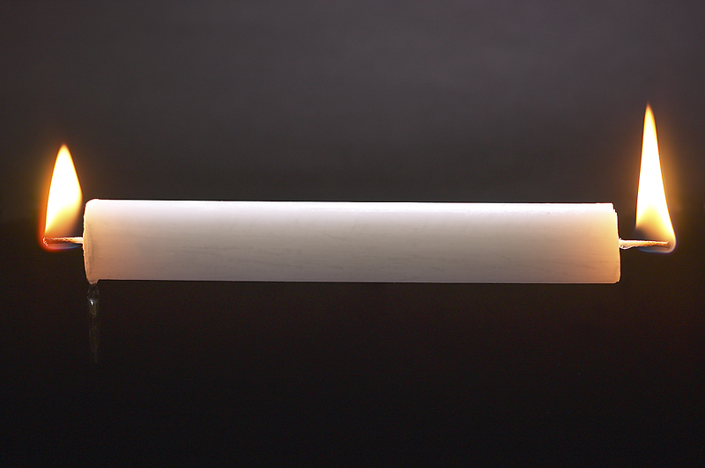
Burning The Candle
At Both Ends
Notes:
1. Inner peace cannot be had if you are working both day and night.
2. The is called “Burning the Candle at both ends.”
3. Peace is not all rest, but a certain amount of rest is helpful in achieving inner peace.

Slide 4
What’s Robbing Us Of Our Inner Peace?
Notes:
1. What’s Robbing Us Of Our Inner Peace?
2. All of us are a little different, but there are things we have in common that can steal our inner peace.
3. My uncle Frank tells me I can take his money, his house, his land, his vehicle, and his pets, but don’t steal his time, everything else he can replace.

Slide 5
Seven Thieves of Inner Peace

Slide 6
Materialism
Notes:
1. Materialism!
2. Would you say that the acquisition of material things to make your life easier is the most important thing in your life?
3. Do you have to have one of everything, in every color?

Slide 7
But those who desire to be rich fall into temptation and a snare, and into many foolish and harmful lusts which drown men in destruction and perdition.
For the love of money is a root of all kinds of evil, for which some have strayed from the faith in their greediness, and pierced themselves through with many sorrows. 1 Tim. 6:9-10
Notes:
But those who desire to be rich fall into temptation and a snare, and into many foolish and harmful lusts which drown men in destruction and perdition.
For the love of money is a root of all kinds of evil, for which some have strayed from the faith in their greediness, and pierced themselves through with many sorrows. (1 Tim. 6:9-10)

Slide 8
He who loves silver will not be satisfied with silver; nor he who loves abundance, with increase. This also is vanity. Ecclesiastes 5:10
Notes:
He who loves silver will not be satisfied with silver; nor he who loves abundance, with increase. This also is vanity. Ecclesiastes 5:10

Slide 9
One of the significant causes of depression today is indebtedness. It is so easy to pile up debts, and so difficult to get out from beneath this burden, that many feel almost hopeless.
Wayne Jackson, Debt Depression, www.christiancourier.com
Notes:
1. One of the significant causes of depression today is indebtedness.
2. It is so easy to pile up debts, and so difficult to get out from beneath this burden, that many feel almost hopeless.
Wayne Jackson, Debt Depression, www.christiancourier.com

Slide 10
But godliness with contentment is great gain. For we brought nothing into this world, and it is certain we can carry nothing out. And having food and clothing, with these we shall be content 1 Tim. 6:6-8
Notes:
But godliness with contentment is great gain. For we brought nothing into this world, and it is certain we can carry nothing out. And having food and clothing, with these we shall be content (1 Tim. 6:6-8)
1. Inner peace and contentment is found in being content with what you have, God will provide for the rest of your needs.
-------------------------------
Therefore, since all these things will be dissolved, what manner of persons ought you to be in holy conduct and godliness, (2 Peter 3:11)

Slide 11
Double-Mindedness
Notes:
1. Double-Mindedness
2. A double minded person cannot make up his mind and settle on a course for his life.
3. He is blown away by new ideas, flashing lights, new gadgets, and has no stability in his life.
4. He has one foot in the church, but the other foot is more firmly grounded in the world with it’s glitter.

Slide 12
Calls for the Impossible.
Two Masters Cannot be served (Mat. 6:24; Jas. 4:4)
Leads to Instability (Jas. 1:8)
Notes:
1. Double-mindness calls for the Impossible.
>>>>>>>>>>>>>>>>>>>>>>>
2. Two Masters Cannot be served at the same time (Mat. 6:24; Jas. 4:4)
"No one can serve two masters; for either he will hate the one and love the other, or else he will be loyal to the one and despise the other. You cannot serve God and mammon. (Matthew 6:24)
Adulterers and adulteresses! Do you not know that friendship with the world is enmity with God? Whoever therefore wants to be a friend of the world makes himself an enemy of God. (James 4:4)
>>>>>>>>>>>>>>>>>>>>>>>
3. Leads to Instability with no inner peace (Jas. 1:8)
he is a double-minded man, unstable in all his ways. (James 1:8)

Slide 13
The Answer to Double-Mindedness...
Serving God with the Whole Heart (Mark 12:30-31)
Notes:
1. The Answer to Double-Mindedness is found in the Word of God ...
2. Serving God with the Whole Heart (Mark 12:30-31)
AND YOU SHALL LOVE THE LORD YOUR GOD WITH ALL YOUR HEART, WITH ALL YOUR SOUL, WITH ALL YOUR MIND, AND WITH ALL YOUR STRENGTH.' This is the first commandment. And the second, like it, is this: 'YOU SHALL LOVE YOUR NEIGHBOR AS YOURSELF.' There is no other commandment greater than these." (Mark 12:30-31)

Slide 14
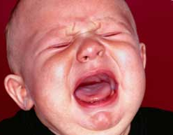
Childishness
Notes:
1. Childishness, as witnessed at the Supreme Court Nomination Hearings this past week.

Slide 15
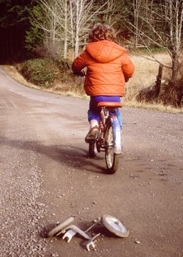
Must put away childish things (1 Cor. 13:11)
Must grow up and mature (2 Pet. 3:18)
Notes:
1. Must put away childish things, take off your training wheels, know what the Word of God says. (1 Cor. 13:11)
When I was a child, I spoke as a child, I understood as a child, I thought as a child; but when I became a man, I put away childish things. (1 Corinthians 13:11)
>>>>>>>>>>>>>>>>
2. Must grow up and mature (2 Pet. 3:18)
but grow in the grace and knowledge of our Lord and Savior Jesus Christ. To Him be the glory both now and forever. Amen. (2 Peter 3:18)

Slide 16
PRIDE
Notes:
1. PRIDE, are you too worldly proud to need the help of God?
2. Is your favorite song ”I Did it My Way”?
3. Rest assured you are not the first to do it your way, look at where it landed them doing it their way instead of God’s way.

Slide 17
Pride goes before destruction, and a haughty spirit before a fall. Proverbs 16:18
Notes:
Pride goes before destruction, and a haughty spirit before a fall. Proverbs 16:18

Slide 18
Pride...
Brings contention (Pro. 13:10)
Brings low (Pro. 29:23)
Not of God (1 John 2:16)
Never Satisfied
Notes:
1. Pride...
>>>>>>>>>>>>>>
2. Brings contention (Pro. 13:10)
By pride comes nothing but strife, But with the well-advised is wisdom. (Proverbs 13:10)
>>>>>>>>>>>>>>
3. Brings low (Pro. 29:23)
A man's pride will bring him low, But the humble in spirit will retain honor. (Proverbs 29:23)
>>>>>>>>>>>>>>
4. Not of God (1 John 2:16)
For all that is in the world—the lust of the flesh, the lust of the eyes, and the pride of life—is not of the Father but is of the world. (1 John 2:16)
>>>>>>>>>>>>>>
5. Your pride can never be satisfied, it is a game of “one-up-man-ship”, each tale has to be bigger then the one just told by someone else, or you pride is damaged.

Slide 19
Humble yourselves in the sight of the Lord, and He will lift you up. James 4:10
Notes:
Humble yourselves in the sight of the Lord, and He will lift you up. James 4:10

Slide 20
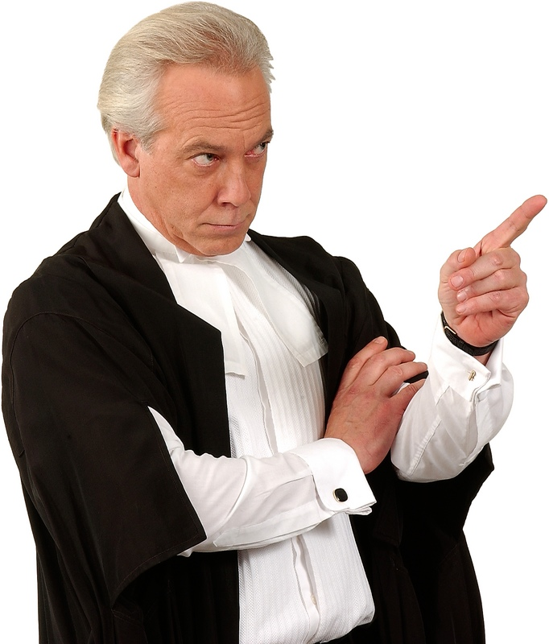
Judgmentalism
Notes:
1. Judgmentalism
2. You Know The Look!

Slide 21
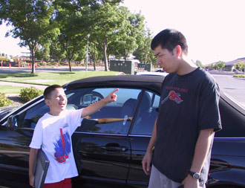
“I’m Better than You!”
Condemned by Jesus (Mat. 7:1-2; Luke 18:9-14)
Warned Against by James (Jas. 2:12-13)
Fault Finders Never Find Peace!
Notes:
1. You can hear this childish cry on almost any school ground in America; “I’m Better than You!”
>>>>>>>>>>>>>>>>>>>>>
2. This is condemned by Jesus (Mat. 7:1-2; Luke 18:9-14)
"Judge not, that you be not judged. For with what judgment you judge, you will be judged; and with the measure you use, it will be measured back to you. (Mat 7:1-2)
>>>>>>>>>>>>>>>>>>>
3. It is warned Against by James (Jas. 2:12-13)
So speak and so do as those who will be judged by the law of liberty. For judgment is without mercy to the one who has shown no mercy. Mercy triumphs over judgment. (James 2:12-13)
>>>>>>>>>>>>>>>>>>>
4. Fault Finders Never Find Inner Peace!

Slide 22
Fear
Notes:
1. Fear

Slide 23
Fear...
Is not a gift from God (2 Tim. 1:7)
Stifles Faith (Heb. 11:6)
Displeases God (Rev 21:8)
Overcome through Christ (Mark 6:50)
Notes:
1. Fear...
>>>>>>>>>>>>>>>>>
2. Is not a gift from God (2 Tim. 1:7)
For God has not given us a spirit of fear, but of power and of love and of a sound mind. (2 Timothy 1:7)
>>>>>>>>>>>>>>>>>
3. Fear will stifle your Faith therefore, God did not give us a spirit of fear. (Heb. 11:6)
But without faith it is impossible to please Him, for he who comes to God must believe that He is, and that He is a rewarder of those who diligently seek Him. (Hebrews 11:6)
>>>>>>>>>>>>>>>>>
4. God demands reverence, but fear displeases God (Rev. 21:8)
But the cowardly (KJV, ASV - fearful), unbelieving, abominable, murderers, sexually immoral, sorcerers, idolaters, and all liars shall have their part in the lake which burns with fire and brimstone, which is the second death." (Revelation 21:8)
>>>>>>>>>>>>>>>>>
5. Overcome through Christ (Mark 6:50)
for they all saw Him and were troubled (ESV, ISV - terrified). But immediately He talked with them and said to them, "Be of good cheer! It is I; do not be afraid." (Mark 6:50)

Slide 24
Doubt
Notes:
Being in constant Doubt will disturb your inner peace.

Slide 25
Doubt is...
A Failure to trust God (Pro. 3:5-6)
Eliminated through God’s Promises (2 Tim. 2:11-13)
Overcome by faith (1 John 5:4)
Notes:
1. A Failure to trust God (Pro. 3:5-6)
Trust in the LORD with all your heart, And lean not on your own understanding; In all your ways acknowledge Him, And He shall direct your paths. (Proverbs 3:5-6)
>>>>>>>>>>>>>>>>>>>
2. Eliminated through God’s Promises (2 Tim. 2:11-13)
This is a faithful saying: For if we died with Him, We shall also live with Him. If we endure, We shall also reign with Him. If we deny Him, He also will deny us. If we are faithless, He remains faithful; He cannot deny Himself. (2 Timothy 2:11-13)
>>>>>>>>>>>>>>>>>>>
3. Overcome by faith (1 John 5:4)
For whatever is born of God overcomes the world. And this is the victory that has overcome the world—our faith. (1 John 5:4)

Slide 26
Seven Thieves of Inner Peace
Notes:
Seven Thieves of Inner Peace

Slide 27
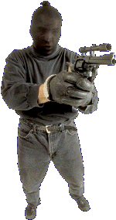
Materialism
Double-mindedness
Childishness
Pride
Judgmentalism
Fear
Doubt
Notes:
1. Materialism
>>>>>>>>>>>>>>>>>>>>>>
2. Double-mindedness
>>>>>>>>>>>>>>>>>>>>>>
3. Childishness
>>>>>>>>>>>>>>>>>>>>>
4. Pride
>>>>>>>>>>>>>>>>>>>>>
5. Judgmentalism
>>>>>>>>>>>>>>>>>>>>>
6. Fear
>>>>>>>>>>>>>>>>>>>>>
7. Doubt

Slide 28
Peace I leave with you, My peace I give to you; not as the world gives do I give to you. Let not your heart be troubled, neither let it be afraid. John 14:27
Notes:
Peace I leave with you, My peace I give to you; not as the world gives do I give to you. Let not your heart be troubled, neither let it be afraid. John 14:27

Slide 29
Inner Peace Is From Obedience To God’s Will
Then Peter said to them, "Repent, and let every one of you be baptized in the name of Jesus Christ for the remission of sins; and you shall receive the gift of the Holy Spirit. (Acts 2:38)
And a cloud came and overshadowed them; and a voice came out of the cloud, saying, "This is My beloved Son. Hear Him!" (Mark 9:7)
Notes:
1. Inner Peace Is From Obedience To God’s Will
>>>>>>>>>>>>>>
2. Repent and be Baptized
Then Peter said to them, "Repent, and let every one of you be baptized in the name of Jesus Christ for the remission of sins; and you shall receive the gift of the Holy Spirit. (Acts 2:38)
>>>>>>>>>>>>>>
3. Mark 9:7
And a cloud came and overshadowed them; and a voice came out of the cloud, saying, "This is My beloved Son. Hear Him!" (Mark 9:7)

