Slide 1
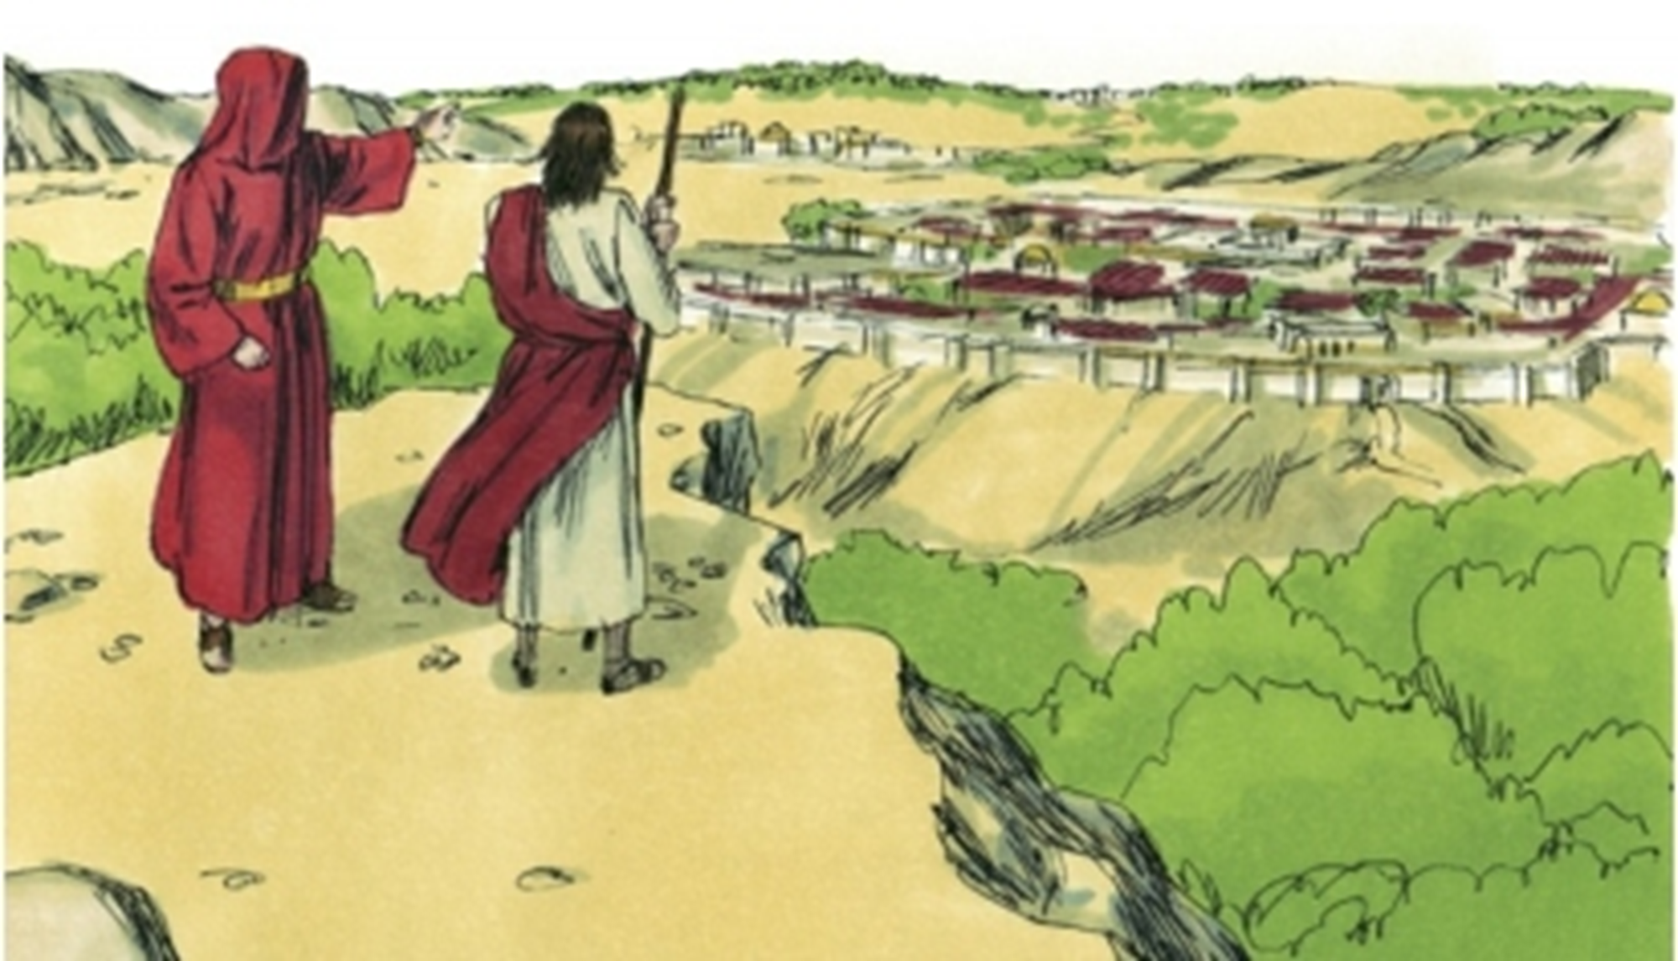
Welcome to Worship
Ranger Church of Christ
Mesquite & Rusk St.

Slide 2
Announcements | Songs | Title
1st Song | 672 | Our God, He Is Alive
2nd Song | 677 | Because He Lives
Opening Prayer
3rd Song | 646 | What A Day That Will Be
4th Song | 504 | The Breaking of Bread
Lords Supper
Offering
5th Song | 616 | Mansions Over the Hilltop
Sermon
Invitation Song | 223 | There is Power in the Blood
Closing Song | 109 | I Have Decided to Follow Jesus
Closing Prayer

Slide 3
Three Questions with One Answer
Romans 8:31-37

Slide 4

The first question, who can oppose us?
(Rom. 8:31, 32)
Gen. 15:1 - Abram
Gen. 26:24-26 - Isaac
Gen. 46:3 - Joseph
Ex. 14:13 - Moses
Ps. 23:4 - David
Isa. 41:10 - Remnant
Isa. 51:12-13 - Exiles
Heb. 13:6 - Christians
Notes:
1. The first question, who can oppose us? (Rom 8:31,32)
a. The sub-question is who is us?
b. The who is us is “we who believe in the Son of God”.
What then shall we say to these things? If God is for us, who can be against us? He who did not spare His own Son, but delivered Him up for us all, how shall He not with Him also freely give us all things? (Romans 8:31-32)
>>>>>>>>>>>>>>>>>>>>
2. Genesis 15:1 – The Lord speaking to Abram
After these things the word of the LORD came to Abram in a vision, saying, "Do not be afraid, Abram. I am your shield, your exceedingly great reward." (Genesis 15:1)
a. True faith in God and His word, moved Abram to follow God directions, believing that God would provide an heir to make him a great nation.
b. Why was it hard for Abram to believe? Gen 17:17 Because He would be 100 years old. Gen 21:5
>>>>>>>>>>>>>>>>>>>>
3. Genesis 26:24 –That same protection was extended to his son Isaac
And the LORD appeared to him the same night and said, "I am the God of your father Abraham; do not fear, for I am with you. I will bless you and multiply your descendants for My servant Abraham's sake." (Genesis 26:24)
a. True faith in God protection moved Isaac to follow God directions and move out of Gerar and go down to Egypt because of the famine following Abraham’s death.
b. This is not the great famine recorded in Joseph’s time, but an earlier famine.
>>>>>>>>>>>>>>>>>>>>
4. Genesis 46:3 – To Joseph the Lord spoke
So He said, "I am God, the God of your father; do not fear to go down to Egypt, for I will make of you a great nation there. (Genesis 46:3)
a. As the promise of God moved down through Abraham’s descendants, God provided the protection He had promised to Abraham.
b. We know that Joseph maintained that same faith in the Lord
>>>>>>>>>>>>>>>>>>>>>
5. Exodus 14:13 – Moses
And Moses said to the people, "Do not be afraid. Stand still, and see the salvation of the LORD, which He will accomplish for you today. For the Egyptians whom you see today, you shall see again no more forever. (Exodus 14:13)
a. God spoke to Moses who was from the blood line of Abraham to extend that same promise to him. (Exodus 3:6)
b. God told Moses to extend His calming word to the people because that were being pursued.
The LORD will fight for you, and you shall hold your peace." (Exodus 14:14)
>>>>>>>>>>>>>>>>>>>>
6. Psalms 23:4 – David
Yea, though I walk through the valley of the shadow of death, I will fear no evil; For You are with me; Your rod and Your staff, they comfort me. (Psalms 23:4)
a. In this scripture we can readily see David’s Love, Trust, and Faith in the Lord God.
b. As a descendant in the blood line of Christ, David had the protection of God’s promise to the faithful followers of His commandments.
>>>>>>>>>>>>>>>>>>>>
7. Isaiah 41:10 – The Remnant in captivity
Fear not, for I am with you; Be not dismayed, for I am your God. I will strengthen you, Yes, I will help you, I will uphold you with My righteous right hand.' (Isaiah 41:10)
a. The remnant in captivity knew and believed God and they held his word close their hearts.
You whom I have taken from the ends of the earth, And called from its farthest regions, And said to you, 'You are My servant, I have chosen you and have not cast you away: (Isaiah 41:9)
b. It may have not been in their lifetime, so they endeavored to insure their children were taught to love God.
>>>>>>>>>>>>>>>>>>>>
8. Isaiah 51: 12-13 – the exiles
"I, even I, am He who comforts you. Who are you that you should be afraid Of a man who will die, And of the son of a man who will be made like grass? And you forget the LORD your Maker, Who stretched out the heavens And laid the foundations of the earth; You have feared continually every day Because of the fury of the oppressor, When he has prepared to destroy. And where is the fury of the oppressor? (Isaiah 51:12-13)
a. Isaiah wanted to comfort those in exile and remind them of who they were to place their faith in, and that was in the promises from the Lord.
>>>>>>>>>>>>>>>>>>>>
9. Heb 13:6 – As Christians
So we may boldly say: "THE LORD IS MY HELPER; I WILL NOT FEAR. WHAT CAN MAN DO TO ME?" (Hebrews 13:6)
a. As sons in the New Israel, we are also afforded the same protection so long as we obey his will.
>>>>>>>>>>>>>>>>>>>>
10. We need to Focus on Jesus
looking unto Jesus, the author and finisher of our faith, who for the joy that was set before Him endured the cross, despising the shame, and has sat down at the right hand of the throne of God. (Hebrews 12:2)
a. God kept His promise to His Son and He will keep His promise to us through our coming to Him.
b. God is with us and no one can oppose us.

Slide 5
The second question, who can accuse us? (Rom. 8:33,34)
Can Satan accuse us? Rev. 12:10; Job 1:6; Zec. 3:1
Can our enemies accuse us? Acts 19
Can God accuse us? Romans 8:33-34; Micah 7:19; Heb 8:12 and 10:17
Can Christ accuse us? Acts 17:31; Rom. 8:34; Mt. 25:31-32, 41; and 2 Cor. 5:10
Notes:
1. The second question, who can accuse us? (Rom. 8:33,34)
Who shall bring a charge against God's elect? It is God who justifies. Who is he who condemns? It is Christ who died, and furthermore is also risen, who is even at the right hand of God, who also makes intercession for us. (Romans 8:33-34)
>>>>>>>>>>>>>>>>>>>>>>
2. Can Satan accuse us?
Then I heard a loud voice saying in heaven, "Now salvation, and strength, and the kingdom of our God, and the power of His Christ have come, for the accuser of our brethren, who accused them before our God day and night, has been cast down. (Revelation 12:10)
a. Everyday, Satan has accusations to bring to God about all of us.
b. But the power of Christ is there and the truth of His power to save us is shown in 1 John 1:7, if we ask for forgiveness and repent of our sins.
But if we walk in the light as He is in the light, we have fellowship with one another, and the blood of Jesus Christ His Son cleanses us from all sin. (1 John 1:7)
Now there was a day when the sons of God came to present themselves before the LORD, and Satan also came among them. (Job 1:6)
a. It is true that we will be accused; because we have free will - Satan will be testing us - just as he tested Job.
b. But God has provided a way for us to avoid temptation.
No temptation has overtaken you except such as is common to man; but God is faithful, who will not allow you to be tempted beyond what you are able, but with the temptation will also make the way of escape, that you may be able to bear it. (1 Corinthians 10:13)
c. Tempted yes! But not without a way to escape the snare of the devil.
d. If you fall for Satan’s snare, it is by your choice and truly repentance and prayer are needed.
Repent therefore of this your wickedness, and pray God if perhaps the thought of your heart may be forgiven you. (Acts 8:22)
Then he showed me Joshua the high priest standing before the Angel of the LORD, and Satan standing at his right hand to oppose him. (Zechariah 3:1)
a. Yes, Satan will be there to prosecute you before God.
b. As a child of God, Christ will be there to make intercession for you and to tell of your atonement by His blood.
>>>>>>>>>>>>>>>>>>>>>>>>>
3. Can our enemies accuse us?
Now when they heard this, they were full of wrath and cried out, saying, "Great is Diana of the Ephesians!" So the whole city was filled with confusion, and rushed into the theater with one accord, having seized Gaius and Aristarchus, Macedonians, Paul's travel companions. (Acts 19:28-29)
a. All of the idol craftsmen of Ephesus accused Paul and his brethren who were with him in Ephesus and caused a riot around him.
b. It reminds me of the Kavanaugh hearings that are going on in our Senate this week.
c. Yes, your enemies can accuse you.
>>>>>>>>>>>>>>>>>>>>>>>>>
4. Can God accuse us?
Who shall bring a charge against God's elect? It is God who justifies. Who is he who condemns? It is Christ who died, and furthermore is also risen, who is even at the right hand of God, who also makes intercession for us. (Romans 8:33-34)
a. God is the judge, God is the justifier, not the accuser.
b. We have a defender in His Son who has shed His blood for our sins, He will defend God’s elect against all charges.
He will again have compassion on us, And will subdue our iniquities. You will cast all our sins Into the depths of the sea. (Micah 7:19)
c. Yes, that is under the old law, but God’s word never changes.
FOR I WILL BE MERCIFUL TO THEIR UNRIGHTEOUSNESS, AND THEIR SINS AND THEIR LAWLESS DEEDS I WILL REMEMBER NO MORE." (Hebrews 8:12)
d. That forgiveness is repeated for our understanding.
then He adds, "THEIR SINS AND THEIR LAWLESS DEEDS I WILL REMEMBER NO MORE." (Hebrews 10:17)
>>>>>>>>>>>>>>>>>>>>>>>>>>
5. Can Christ accuse us?
because He has appointed a day on which He will judge the world in righteousness by the Man whom He has ordained. He has given assurance of this to all by raising Him from the dead." (Acts 17:31)
a. No He can’t! But woe unto those that He can accuses, and blessed are those that he defends.
Who is he who condemns? It is Christ who died, and furthermore is also risen, who is even at the right hand of God, who also makes intercession for us. (Romans 8:34)
b. Have no doubt that Jesus will judge all mankind, none are excepted from that Judgment Day.
"When the Son of Man comes in His glory, and all the holy angels with Him, then He will sit on the throne of His glory. All the nations will be gathered before Him, and He will separate them one from another, as a shepherd divides his sheep from the goats. (Matthew 25:31-32)
c. What about the doctrine that he is all merciful, and all forgiving, and would not condemn anyone to Hell?
"Then He will also say to those on the left hand, 'Depart from Me, you cursed, into the everlasting fire prepared for the devil and his angels: (Matthew 25:41)
d. They that teach such false doctrine will find themselves in with the goats on that day.
For we must all appear before the judgment seat of Christ, that each one may receive the things done in the body, according to what he has done, whether good or bad. (2 Corinthians 5:10)

Slide 6
The third question, who can separate us? (Rom. 8:35-37)
1. Can trouble?
2. Can distress?
3. Can persecution?
4. Can hunger?
5. Can nakedness?
6. Can danger?
7. Can death?
Notes:
1. The third question, who can separate us? (Rom. 8:35-37)
Who shall separate us from the love of Christ? Shall tribulation, or distress, or persecution, or famine, or nakedness, or peril, or sword? As it is written: "FOR YOUR SAKE WE ARE KILLED ALL DAY LONG; WE ARE ACCOUNTED AS SHEEP FOR THE SLAUGHTER." Yet in all these things we are more than conquerors through Him who loved us. (Romans 8:35-37)
>>>>>>>>>>>>>>>>>>>>>>
1. Can trouble? - No
>>>>>>>>>>>>>>>>>>>>>
2. Can distress? - No
>>>>>>>>>>>>>>>>>>>>>
3. Can persecution? - No
>>>>>>>>>>>>>>>>>>>>>
4. Can hunger? -No
>>>>>>>>>>>>>>>>>>>>>
5. Can nakedness? - No
>>>>>>>>>>>>>>>>>>>>>
6. Can danger? - No
>>>>>>>>>>>>>>>>>>>>>
7. Can death? - No

Slide 7
Three questions one answer!
Who can oppose us?
Who can accuse us?
Who can separate us?
NO ONE!
Notes:
1. Three questions one answer!
>>>>>>>>>>>>
2. Who can oppose us? – No one if we are in Christ Jesus, He paid the debt for our sins
>>>>>>>>>>>>
3. Who can accuse us? - No one if we are the bride of Christ
>>>>>>>>>>>>
4. Who can separate us? – We are the only one that can cause us to loose our eternal salvation.
>>>>>>>>>>>>
5. NO ONE!

Slide 8
Invitation Song | 223 | There is Power in the Blood
Closing Song | 109 | I Have Decided to Follow Jesus
Closing Prayer
Notes:
Invitation:
1. The Bible’s way to Salvation!
>>>>>>>>>>>>>>
2. Hear the word – Romans 10: 17
So then faith comes by hearing, and hearing by the word of God. (Romans 10:17)
>>>>>>>>>>>>>>
3. Believe it – John 8:24
Therefore I said to you that you will die in your sins; for if you do not believe that I am He, you will die in your sins." (John 8:24)
>>>>>>>>>>>>>>
4. Repent of Sins – Acts 2:38 & Acts 17:30
Truly, these times of ignorance God overlooked, but now commands all men everywhere to repent, (Acts 17:30)
>>>>>>>>>>>>>>
5. Confess Jesus – Romans 10: 9,10
that if you confess with your mouth the Lord Jesus and believe in your heart that God has raised Him from the dead, you will be saved. For with the heart one believes unto righteousness, and with the mouth confession is made unto salvation. (Romans 10:9-10)
>>>>>>>>>>>>>>
6. Baptized for Forgiveness of sins – Acts 2:38 & Acts 22:16
And now why are you waiting? Arise and be baptized, and wash away your sins, calling on the name of the Lord.' (Acts 22:16)
>>>>>>>>>>>>>>
7. THERE IS NO OTHER WAY FOR YOU TO NOT BE SEPERATABLE FROM CHRIST!

