Slide 1
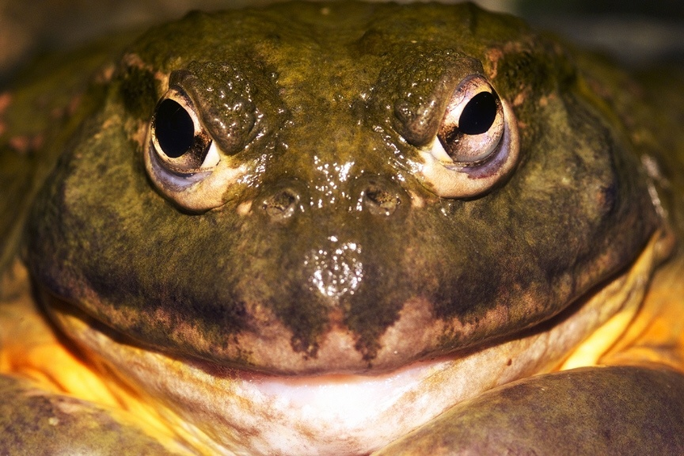
Another Night with the Frogs

Slide 2
Pharaoh refused to obey God and rejected His will
Earlier Pharaoh had claimed ignorance of just who God was –
God warned Pharaoh of the consequences of disobeying –
Exodus 8: 2 - “If you refuse to let them go, I will send a plague of frogs on your whole country. The Nile will teem with frogs. They will come up into your palace and your bedroom and onto your bed, into the houses of your officials and on your people, and into your ovens and kneading troughs. The frogs will come up on you and your people and all your officials.”
Pharaoh said, "Who is the LORD that I should obey His voice to let Israel go? I do not know the LORD…” Exodus 5:2

Slide 3
This is the second plague from God
God gave Pharaoh time to think about things.
Moses and Aaron had already turned the water to blood.
“Thus says the LORD, "By this you shall know that I am the LORD: behold, I will strike the water that is in the Nile with the staff that is in my hand, and it will be turned to blood. The fish that are in the Nile will die, and the Nile will become foul, and the Egyptians will find difficulty in drinking water from the Nile."” - Exodus 7:17-18

Slide 4
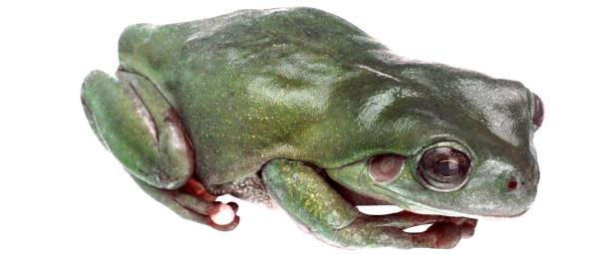
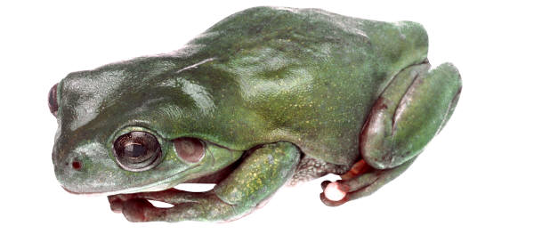
So the river shall bring forth frogs abundantly, which shall go up and come into your house, into your bedroom, on your bed, into the houses of your servants, on your people, into your ovens, and into your kneading bowls. And the frogs shall come up on you, on your people, and on all your servants. Ex. 8:3-4

Slide 5
Then the LORD said to Moses, “Tell Aaron, ‘Stretch out your hand with your staff over the streams and canals and ponds, and make frogs come up on the land of Egypt.’” So Aaron stretched out his hand over the waters of Egypt, and the frogs came up and covered the land.
- Exodus 8:5-6

Slide 6
Pharaoh was in control of his own destiny!
He knew that he had messed up!
“… Pray to the LORD to take the frogs away from me and my people, and I will let your people go …” - Exodus 8:8
Exodus 8:9 - “Moses said to Pharaoh, “I leave to you the honor of setting the time for me to pray for you and your officials and your people that you and your houses may be rid of the frogs, except for those that remain in the Nile.”
If you were asked to answer the question, “WHEN?”
What would your answer be?

Slide 7
Pharaoh said,
“Tomorrow”
- Exodus 8:10
He was willing to spend one more night with the frogs!!

Slide 8
Pharaoh's rebellion is not uncommon
He was separated from God by sin - Isaiah 59:1-2
His heart was not tender toward God – Exodus 8:15, 19
Others hardened Pharaoh's heart – Exodus 7:8-13, 22
Pharaoh hardened his own heart – Exodus 8:32; 9:7, 34
It is the same today!

Slide 9
Pharaoh refused to obey God and rejected His will –
Pharaoh personifies all the sinners in the world today:
1) God has revealed Himself to all men -
“For since the creation of the world His invisible attri-butes, His eternal power and divine nature, have been clearly seen, being understood through what has been made, so that they are without excuse.” - Romans 1:20
“For who among men knows the thoughts of a man except the spirit of the man which is in him? Even so the thoughts of God no one knows except the Spirit of God.” - 1 Corinthians 2:11

Slide 10
God warns about the consequences
“Now I make known to you, brethren, the gospel which I preached to you, which also you received, in which also you stand, by which also you are saved, if you hold fast the word which I preached to you.” 1 Corinthians 15:1-2
“But even if we, or an angel from heaven, should preach
to you a gospel contrary to what we have preached to you,
he is to be accursed! - Galatians 1:8
“Beloved, do not believe every spirit, but test the spirits to
see whether they are from God…” - 1 John 4:1
“which things we also speak, not in words taught by human
wisdom, but in those taught by the Spirit, combining
spiritual thoughts with spiritual words.” 1 Corinthians 2:13

Slide 11
Every man has the honor of saying "WHEN"
Hebrews 8:8-12 reads:
"BEHOLD, DAYS ARE COMING, SAYS THE LORD, WHEN I WILL EFFECT A NEW COVENANT WITH THE HOUSE OF ISRAEL AND WITH THE HOUSE OF JUDAH; NOT LIKE THE COVENANT WHICH I MADE WITH THEIR FATHERS ON THE DAY WHEN I TOOK THEM BY THE HAND TO LEAD THEM OUT OF THE LAND OF EGYPT; FOR THEY DID NOT CONTINUE IN MY COVENANT, AND I DID NOT CARE FOR THEM, SAYS THE LORD. FOR THIS IS THE COVENANT THAT I WILL MAKE
WITH THE HOUSE OF ISRAEL AFTER THOSE DAYS, SAYS THE LORD: I WILL PUT MY LAWS INTO THEIR MINDS, AND I WILL WRITE THEM ON THEIR HEARTS. AND I WILL BE THEIR GOD, AND THEY SHALL BE MY PEOPLE. AND THEY SHALL NOT TEACH EVERYONE HIS FELLOW CITIZEN, AND EVERYONE HIS BROTHER, SAYING, 'KNOW THE LORD,' FOR ALL WILL KNOW ME, FROM THE LEAST TO THE GREATEST OF THEM. FOR I WILL BE MERCIFUL TO THEIR INIQUITIES, AND I WILL REMEMBER THEIR SINS NO MORE.“
It is not a matter of being born to the right family –
but of being BORN AGAIN (John 3:1-5)
Deut. 5:1-15

Slide 12
Salvation comes at the point of obedience
Not by prayer, nor by “faith only” – but when we obey
The conversion of Saul is the perfect picture:
(Acts 9:1-19; Acts 22:4-16; Acts 26:9-20)
He was blinded on the road - Acts 9:3; 22:6, 11
Paul didn’t know he was saved! -3 days fasting – Acts 9:9
Jesus didn’t know it! - preacher to him – Acts 9:10-17; 22:12-15
Ananias didn’t know it! He commanded Saul – Acts 22:16
“Calling on the name of the Lord” is done by obedience –
“Corresponding to that, baptism now saves you--not the removal of dirt from the flesh, but an appeal to God for a good conscience…” 1 Peter 3:21

Slide 13
Like Pharaoh many quickly forget
“Now the parable is this: the seed is the word of God. Those beside the road are those who have heard; then the devil comes and takes away the word from their heart, so that they will not believe and be saved. “ Luke 8:12
“Elymas the magician… was opposing them, seeking to turn the proconsul away from the faith.” - Acts 13:8
“…those who perish, because they did not receive the love of the truth so as to be saved. For this reason God will send upon them a deluding influence so that they will believe what is false, in order that they all may be judged who did not believe the truth, but took pleasure in wickedness.”
- 2 Thessalonians 2:10 - 12

Slide 14
Many learn to live with frogs (of sin)
“But encourage one another day after day, as long as it is still called "Today," so that none of you will be hardened by the deceitfulness of sin.” - Hebrews 3:13
“But the Spirit explicitly says that in later times some will fall away from the faith, paying attention to deceitful spirits and doctrines of demons, by means of the hypocrisy of liars seared
in their own conscience as with a branding iron” - Timothy 4:1-2
“darkened in their understanding, excluded from the life of God because of the ignorance that is in them, because of the hardness of their heart” - Ephesians 4:18

Slide 15
If you are not a Christian - and were asked to decide when you’d obey God - what would your answer be??
RIGHT NOW?
or

Slide 16
Will it be another night with the
It’s your call? Why not now?

Slide 17
What must I do to be saved?
What must I do to be Saved ?
Hear Romans 10:14, 17
Believe John 8:24; Mark 16:16
Repent Luke 13:3; Acts 2:38
Confess Matthew10:32
Be baptized in water Acts 2:38; 22:16
Remain faithful Revelation 2:10 b, Matthew 25:21

Slide 18
Contact me if you need help.
If you have questions, you may contact us at the following addresses or by phone:
Charlie Gant
P. O. Box 837
Leakey, Texas 78873-0837
E-mail: charliegant@hotmail.com

