Slide 1
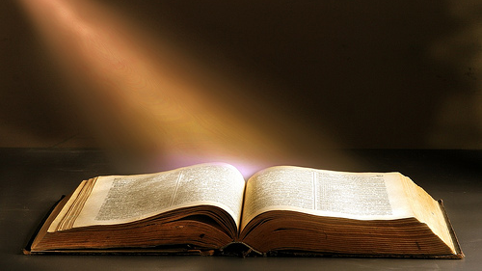
Welcome to Worship
Ranger Church of Christ
Mesquite and Rusk St.

Slide 2
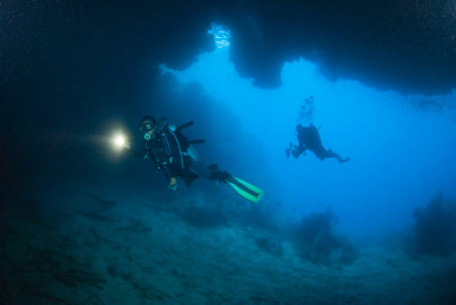
Proving the Inspiration of the Bible
Astronomy
Oceanography
Medicine
Biology
Notes:
1. Proving the Inspiration of the Bible Is possible even though the atheist do not believe that you can.
2. Even Using Astronomy, Oceanography, Medicine, Biology it can be seen to be the inspired “Word of God”.

Slide 3
Available Prothrombin
Taken from None of These Diseases pg. 83
110%
Notes:
Under the topic of medicine, we discussed proof of the Biblical inspiration by looking at the:
1. Available Prothrombin in the blood stream of babies, this is an extremely important factor in preventing the child from bleeding to death following circumcision.
>>>>>>>>>>>
2. Day one is only about 95%,
>>>>>>>>>>>
3. But on the eighth day it is 110%
>>>>>>>>>>>
4. A good Bible study would have revealed this to the atheist and the Doctors because God revealed it to mankind during their days of ignorance on the subject..

Slide 4
The Bible said: You Cannot Count the Stars
Scientists kept counting only about a 1000 stars
until they invented the telescope
Jer 33:22 NKJV See also Gen 15:5
Notes:
Inspiration from the view of astronomy shows us the progress in counting stars, that God had already told us, was innumerable.
1. Scientists kept counting only about a 1000 stars until they invented the telescope
As the host of heaven cannot be numbered, nor the sand of the sea measured, so will I multiply the descendants of David My servant and the Levites who minister to Me.' " (Jeremiah 33:22)
----------------------------
Then He brought him outside and said, "Look now toward heaven, and count the stars if you are able to number them." And He said to him, "So shall your descendants be." (Genesis 15:5)

Slide 5
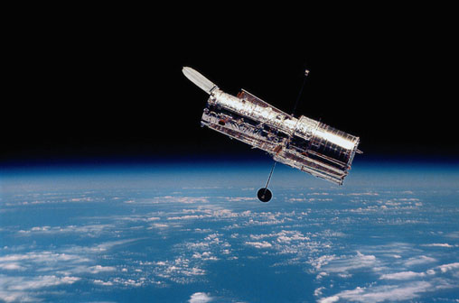
The Hubble Telescope
Notes:
1. Ever wanted to wish upon a star?
2. Well, you have 70,000 million, million, million to choose from.
3. That's the total number of stars in the known universe, according to a study by Australian astronomers.
4. It's also about 10 times as many stars as grains of sand on all the world's beaches and deserts according to some scientist and we know from the word of God that this is also innumerable. .
5. Star survey reaches 70 sextillion July 23, 2003 - CNN - TECH (7 + 21 zeros) and still counting and verifying.

Slide 6
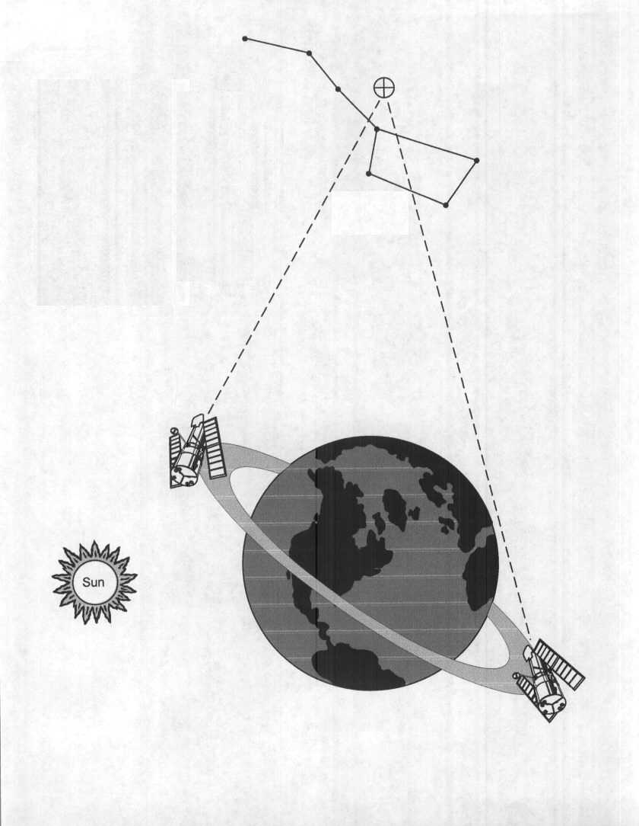
Hubble looking at grain of sand size area
Continuous Viewing Zone
An area 1/30th the size of the full moon, or about the size of a grain of sand held at arms length, was stared at for ten straight days.
Notes:
How can this counting be done?
1. The area chosen for counting the stars was totally black, with no visible light, according to ground based telescope operators.
2. The area covered by the focus of the telescope was an area about 1/30th the size of a grain of sand held at arms length,
3. The focus was maintained for ten straight days in order for even the faintest of stars to be photographed and counted.
4. Through multiplication of the area covered by that not covered, a determination of the number of stars was determined for factual science.

Slide 7
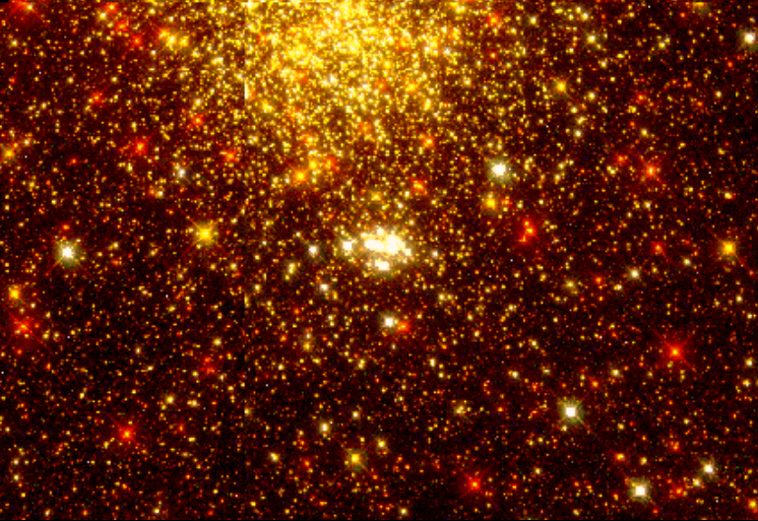
Saw
Bible was Right Man’s Science was Wrong!
A grain of sand hides more stars than can be counted.
Notes:
1. The stars are innumerable according to God!
>>>>>>>>>>>>>>>
2. Bible was Right, Man’s Science was still Wrong!

Slide 8
Estimated each person has 2 Trillion
It has been estimated that there are enough stars for every person on earth to own 2,000,000,000,000 (2 trillion) of them. Astronomy and the Bible, Donald DeYoung p. 57
Notes:
1. It has been estimated that there are enough stars for every person on earth to own 2,000,000,000,000 (2 trillion) of them personally.
a. I wonder how the Jehovah Witness saints are going to determine which of the 2 trillion stars they and their families will rule over.
>>>>>>>>>>>>>>>>>>>.
2. Astronomy and the Bible, Donald DeYoung p. 57

Slide 9
The Bible & Astronomy
Job 38:24 - How light is parted?
The only logical conclusion is that these verses were given by inspiration of God!
Notes:
1. In considering the Bible & Astronomy, consider God’s question to Job about the light He sends us daily.
>>>>>>>>>>>>>>>>>>>>>>>>>>>>>
By what way is light diffused, Or the east wind scattered over the earth? (Job 38:24)
>>>>>>>>>>>>>>>>>>>>>>>>>>>>>
2. The only logical conclusion is that God knew the answers to these questions and Job did not.
3. Now that we know these things, it is proof that these verses were given by inspiration of God!

Slide 10
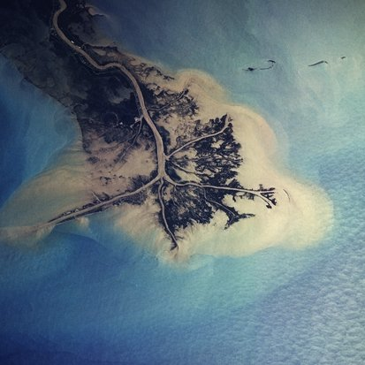
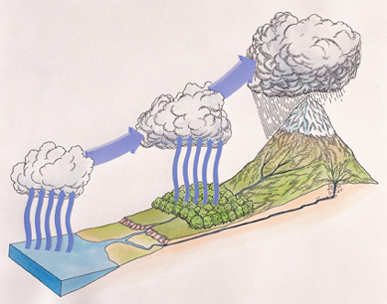
The Bible & Oceanography
Ecclesiastes 1:7 - All rivers run to the sea, yet it is not full
Combined with Ecclesiastes11:3 & Amos 9:6 describes the water cycle
Notes:
1. Moving along using the Bible & Oceanography as proof of God’s inspiration He ask a question. All the rivers run into the sea, Yet the sea is not full; To the place from which the rivers come, There they return again. (Ecclesiastes 1:7)
>>>>>>>>>>>>>>>>>>>>
2. The water goes to the sea, but how does it return?
If the clouds are full of rain, They empty themselves upon the earth; And if a tree falls to the south or the north, In the place where the tree falls, there it shall lie. (Ecclesiastes 11:3)
-------------------------------------
3. If we study the word of God, we can recognize the answers to God’s questions to us.
He who builds His layers in the sky, And has founded His strata in the earth; Who calls for the waters of the sea, And pours them out on the face of the earth-- The LORD is His name. (Amos 9:6)

Slide 11
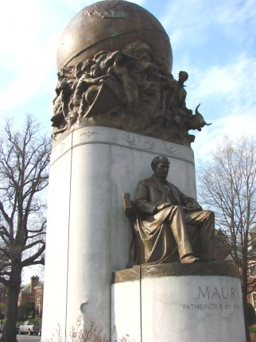
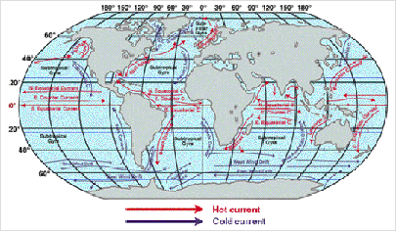
Psalm 8:8
Matthew Maury was described as “Pathfinder of the Sea.” His book on physical geography of the sea is still considered one of the best, and is used in many universities.
Notes:
The birds of the air, And the fish of the sea That pass through the paths of the seas. (Psalms 8:8)
>>>>>>>>>>>>>>>>>>>>>
1. The universities, atheist, and agonist give Matthew Maury the credit for what King David, of Israel knew, about 1040 to 970 BC.
>>>>>>>>>>>>>>>>>>>>
2. Matthew Maury was described as “Pathfinder of the Sea.”
>>>>>>>>>>>>>>>>>>>>>
3. His book on physical geography of the sea is still considered to be one of the best, and is used in many universities.

Slide 12
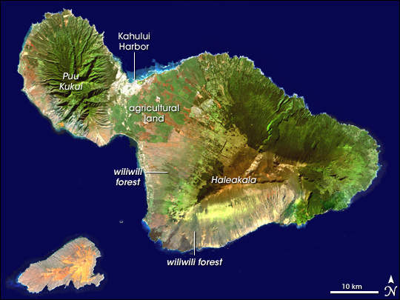
The Bible & Oceanography
Job 38:16 - Springs of the Sea
The Recesses of the Deep
Notes:
1. Let us look at more concerning the Bible & Oceanography from the point of inspiration.
"Have you entered the springs of the sea? Or have you walked in search of the depths? (Job 38:16)
>>>>>>>>>>>>>>>>>>>>>>
2. Scientists discover fresh water beneath ocean floor July/15/2010, 07:37:35 AM (VietNamNet Bridge)
3. They report that Scientists from the Division for Water Resources Planning for southern Viet Nam have discovered an underwater source of fresh water in the midst of the salt water of the ocean.
4. The fresh water was discovered at a depth ranging from 48-106 meters ranging from 150’ to 350’ in depth below the surface, 3 kilometres (approximately 2 miles off the coast of Bac Lieu.
>>>>>>>>>>>>>>>>>>>>>>>
5. It is only during the history of this country that mankind has been able to explore and search the depths of the sea by the invention of submersibles that can withstand the pressures of the deep.
6. How great of a pressure are we talking about?
a. Every depth of 100 feet, results in 44 pounds of pressure on every square inch of your body equally.
b. A 12” ball will have a surface area of 1810 square inches that subjects it to 44 x 427 sq in= 18,788 pounds of pressure for every 100 feet below the surface of the ocean.
c. At 300 feet below the surface of the water, 44 x 3= 132 pounds per square inch that is 56,364 pounds of pressure on the ball.
d. Crush depth will depend on the strength of the ball material.

Slide 13
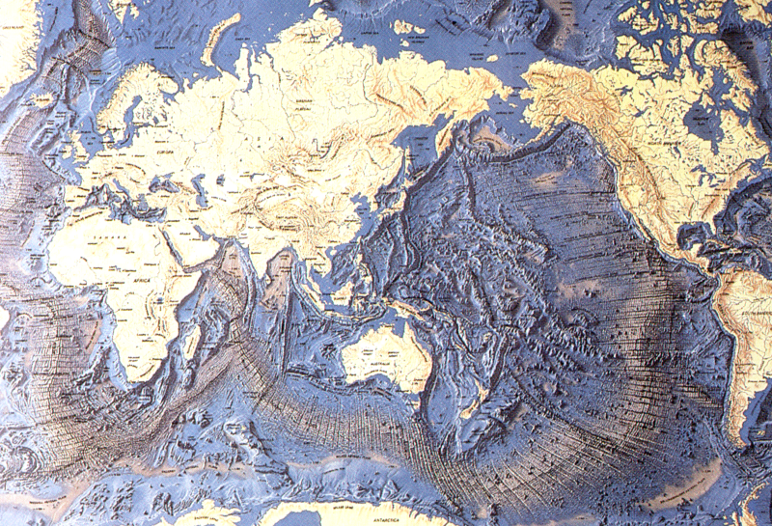
35,800’ trench, 1972
East off the Marianas is the famous Mariana Trench. This trench has a deepest recorded point of 11,035 meters. It is called the Challenger Deep. Many times, people have marked a 'largest seadepth' in the Mariana Trench. The Challenger Expedition (The Challenger was a British navy vessel on a 3-year ocean research expedition; 1872-75) found a depth of 8,183 meter in 1875. After them, the Nero-depth followed, which was recorded at 9,640 meter. The Challenger II recorded 10,870 meters and 10,899 meters in 1951. Finally in 1959, the Russian vessel Vitjaz marked a depth of 11,035 meters. With 11,524 meters, the record seadepth is located in the Philippine trench. It was discovered in 1972. No person has ever reached the deepest point on the ocean bed, or rather the deepest pont n earth yet.
Merrill Earth Science 1993 p. 313
Notes:
1. East off the Mariana islands is the famous Mariana Trench.
2. This trench has a deepest recorded point of 11,035 meters (36,204 ft.)…. Or 6.86 miles straight down.
3. With 11,035 meters, as the record sea depth is located in the Philippine trench, the pressure per square inch is 4855 pounds, about 2.5 tons per square inch.
4. the depth of these trenches was discovered in 1972.
5. No person has ever reached the deepest point on the ocean bed, or rather the deepest point on earth yet.

Slide 14
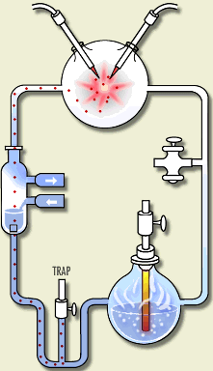
The Bible & Biology
Acts 17:25 - God is described as the “giver of life.” Try as we will, man has yet to create life.
The Products of the Miller Experiment
Tar 85%
Carboxylic acids not important to life 13.0%
Glycine 1.05%
Alanine 0.85%
Glutamic acid trace
Aspartic acid trace
Valine trace
Notes:
1. We can prove inspiration of the Bible by looking at Biology
Nor is He worshiped with men's hands, as though He needed anything, since He gives to all life, breath, and all things. (Acts 17:25)
>>>>>>>>>>>>>>>>>>>>>>>>>>>>>>>>>
2. Man has always tried to reproduce life because he would like to be like God in his own eyes.
3. Man believes that there is nothing that God can do that he cant duplicate.
4. This includes producing life in the labratory from premortal soup.
The Products of the Miller Experiment
Tar 85%
Carboxylic acids not important to life 13.0%
Glycine 1.05%
Alanine 0.85%
Glutamic acid trace
Aspartic acid trace
Valine trace
5. The end result was “No life, not even a single cell.

Slide 15
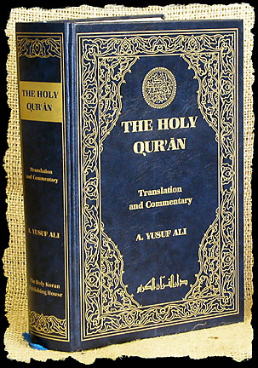
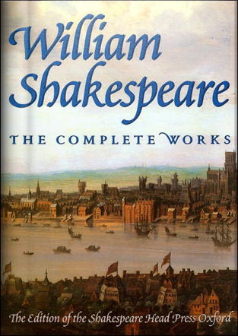
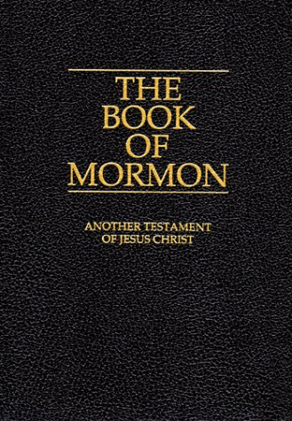
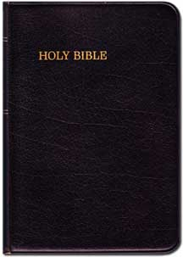
We can know the Bible is inspired.
Notes:
We can know the Bible is inspired.
1. We do not need the Book of Mormon to know the Bible is True
>>>>>>>>>>>>>>>>>>
2. We do not need the Koran to know the Bible is True
>>>>>>>>>>>>>>>>>>
3. We do not need William Shakespeare to know the Bible is True
>>>>>>>>>>>>>>>>>>
4. We need only the inspired word “Word of God” to know the truth about all things pertaining to life and godliness.
as His divine power has given to us all things that pertain to life and godliness, through the knowledge of Him who called us by glory and virtue, (2 Peter 1:3)
>>>>>>>>>>>>>>>>>>
5. The Holy Bible.
6. It should be clear to even the scientist, that from the scientific point of view, we can know that the Bible is true and inspired.

Slide 16
Challenges To The Bible
How Do We
Know We Have
The Bible?
Notes:
1. There have always been, and always will be, challenges to the Bible.
2. As long as Satan and Man exist, there will be challenges to the “Word of God”

Slide 17
PROPHECY ABOUT THE CITY OF TYRE
In Ezekiel 26:1-21 the prophet foretold with miraculous precision 7 things about the fall of the city of Tyre.
1.
King Nebuchadnezzar of Babylon would destroy the mainland portion of the city of Tyre (26:7-8).
2.
“Other nations” would participate in the fulfillment of the prophecy (3).
3.
The city would be flattened, like the top of a rock (4,14).
4.
Tyre eventually would become a place for the spreading of fishing nets (5,14).
5.
Its stones and timbers would be laid in the sea (12).
6.
Other cities would tremble at the fall of Tyre (15-18).
7.
The city would never be rebuilt to its former glory (20-21).
Notes:
1. PROPHECY ABOUT THE CITY OF TYRE
2. In Ezekiel 26:1-21 the prophet foretold with miraculous precision 7 things about the fall of the city of Tyre.
>>>>>>>>>>>>>>>>>>>>
3. King Nebuchadnezzar of Babylon would destroy the mainland portion of the city of Tyre (26:7-8).
>>>>>>>>>>>>>>>>>>>>
4. “Other nations” would participate in the fulfillment of the prophecy (3).
>>>>>>>>>>>>>>>>>>>>
5. The city would be flattened, like the top of a rock (4,14).
>>>>>>>>>>>>>>>>>>>>
6. Tyre eventually would become a place for the spreading of fishing nets (5,14).
>>>>>>>>>>>>>>>>>>>>
7. Its stones and timbers would be laid in the sea (12).
>>>>>>>>>>>>>>>>>>>>
8. Other cities would tremble at the fall of Tyre (15-18).
>>>>>>>>>>>>>>>>>>>>
9. The city would never be rebuilt to its former glory (20-21).

Slide 18
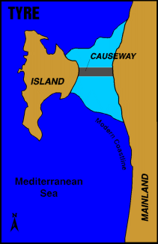
PROPHECY ABOUT THE CITY OF TYRE
King Nebuchadnezzar of Babylon would destroy the mainland portion of the city of Tyre.
1.
Tyre was a coastal city that had a somewhat unusual arrangement. In addition to the inland city, there was an island city roughly 3/4’s of a mile offshore. In 586 B.C., Nebuchadnezzar’s army besieged the city on the mainland, but when the king finally was able to take the city in about 573 B.C., his victory was hollow. He did not know that the inhabitants had left the city and moved to the island—a situation that remained virtually unchanged for the next 241 years.
Notes:
1. PROPHECY ABOUT THE CITY OF TYRE
2. King Nebuchadnezzar of Babylon would destroy the mainland portion of the city of Tyre. ( Ezekiel 26:7-8)
3. Tyre was a coastal city that had a somewhat unusual arrangement with sister cities on the shore.
4. In addition to the inland city, there was an island city roughly 3/4’s of a mile offshore.
5. In 586 B.C., Nebuchadnezzar’s army besieged the city on the mainland, but when the king finally was able to take the city in about 573 B.C., his victory was hollow.
6. He did not know that the inhabitants had left the city and moved to the island—a situation that remained virtually unchanged for the next 241 years.

Slide 19
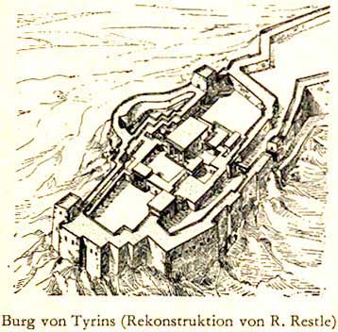
Nebuchadnezzar II laid siege to Tyre for a period of 13 years, beginning in 585-586 B.C. However, during this time, the inhabitants transferred most of their valuables to the island city. The king seized Tyre’s mainland territories, but returned to Babylon, finding himself unable to militarily subdue the island fortress (cf. 29:18). Tyre, weakened by the longstanding conflict, soon recognized Babylonian authority, which effectively put an end to the city’s autonomy and any aspirations for a greater Phoenicia.
FULFILLMENT OF THE 1ST PROPHECY
Notes:
1. FULFILLMENT OF THE 1ST PROPHECY
2. Nebuchadnezzar II laid siege to Tyre for a period of 13 years, beginning in 585-586 B.C.
3. However, during this time, the inhabitants transferred most of their valuables to the island city.
4. The king seized Tyre’s mainland territories, but returned to Babylon, finding himself unable to militarily subdue the island fortress (cf. 29:18).
"Son of man, Nebuchadnezzar king of Babylon caused his army to labor strenuously against Tyre; every head was made bald, and every shoulder rubbed raw; yet neither he nor his army received wages from Tyre, for the labor which they expended on it. (Ezekiel 29:18)
5. Tyre, weakened by the longstanding conflict, soon recognized Babylonian authority, which effectively put an end to the city’s autonomy and any aspirations for A Greater Phoenicia.

Slide 20
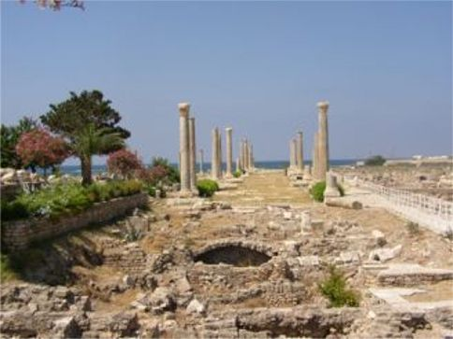
FULFILLMENT OF THE 2nd PROPHECY
2. Other nations would participate in the fulfillment of the prophecy (vs. 3).
Following the Babylonian period, Tyre remained in subjection to Persia from 538-332 B.C. Alexander the Great besieged and captured the port in 332 B.C., and ultimately, Ptolemies, Seleucids, Romans, and Muslim Arabs all had their turn at rule. After passing briefly into the hands of the Crusaders, the city was completely destroyed by a group known as the Mamluks (former Muslim soldier-slaves) in A.D. 1291.
Notes:
1. PROPHECY ABOUT THE CITY OF TYRE
2. FULFILLMENT OF THE 2nd PROPHECY
3. Following the Babylonian period, Tyre remained in subjection to Persia from 538-332 B.C.
4. Alexander the Great besieged and captured the port in 332 B.C., and ultimately, Ptolemies, Seleucids, Romans, and Muslim Arabs all had their turn at rule.
5. After passing briefly into the hands of the Crusaders, the city was completely destroyed by a group known as the Mamluks (former Muslim soldier-slaves) in A.D. 1291.
6. 586 bc to 332bc = 254 years the city withstood occupation and a total of 1877 years before it’s destruction in 1291 AD.

Slide 21
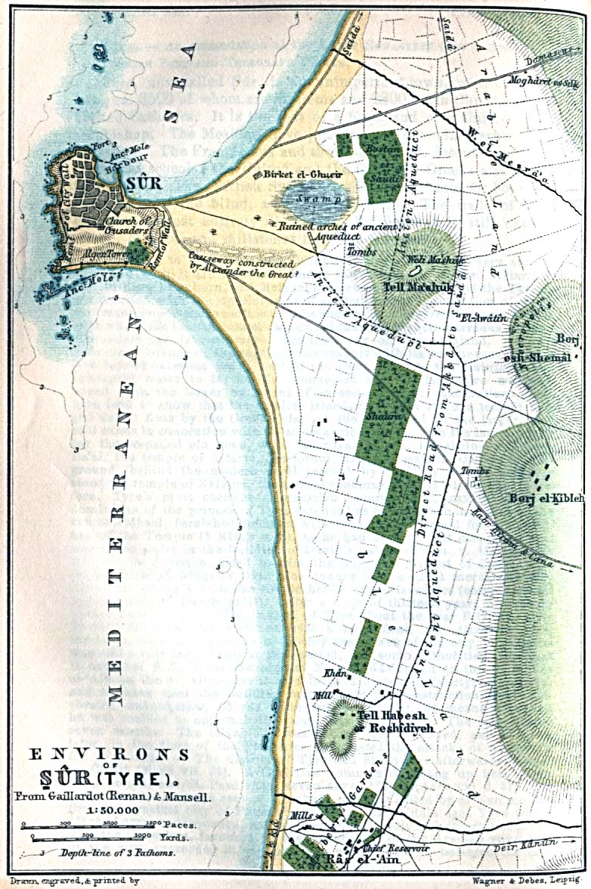
PROPHECY ABOUT THE CITY OF TYRE
3. The city was to be flattened, like the top of a rock (vss. 4,14).
FULFILLMENT OF THE 3rd PROPHECY
Like Nebuchadnezzar before him, Alexander was stymied by Tyre’s natural moat. The brilliant general was not so quick to give up, however. He used the building materials of the mainland city to build a causeway to the island, which allowed his troops to enter and conquer the city. His complete conquest of Tyre took only seven months.
Notes:
1. PROPHECY ABOUT THE CITY OF TYRE
2. The city was to be flattened, like the top of a rock (vss. 4,14).
And they shall destroy the walls of Tyre and break down her towers; I will also scrape her dust from her, and make her like the top of a rock. (Ezekiel 26:4)
3. FULFILLMENT OF THE 3rd PROPHECY
4. Like Nebuchadnezzar before him, Alexander the Great was stymied by Tyre’s natural moat.
5. The brilliant general was not so quick to give up, however.
6. He used the building materials of the mainland city to build a causeway to the island, which allowed his troops to enter and conquer the city.
7. His complete conquest of Tyre took only seven months.

Slide 22
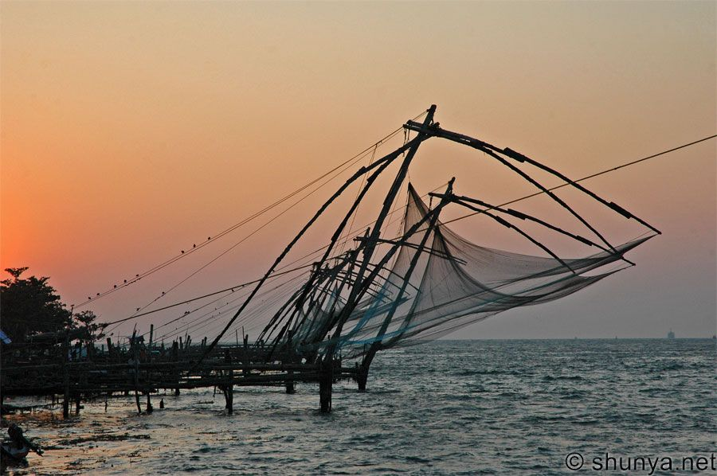
4th PROPHECY ABOUT THE CITY OF TYRE
4. It would become a spot for the spreading of nets (vss. 5,14).
FULFILLMENT OF THE 4th PROPHECY
The waters around Tyre were renowned in ancient times for their excellent fishing prospects. And after its complete decimation by Alexander, this was the only claim to fame the city had left. Modern-day travelers who visit the site of ancient Tyre will find only a small colony of people existing there. What do those people do for a living? They fish with nets.
Notes:
1. PROPHECY ABOUT THE CITY OF TYRE
I will make you like the top of a rock; you shall be a place for spreading nets, and you shall never be rebuilt, for I the LORD have spoken,' says the Lord GOD. (Ezekiel 26:14)
2 It would become a spot for the spreading of nets (vss. 5,14).
3. Where Tyre use to be is now a fishing ground.

Slide 23
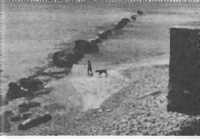
PROPHECY ABOUT THE CITY OF TYRE
5. Its stones and timbers were to be laid in the sea (vs. 12).
FULFILLMENT OF THE 5th PROPHECY
As noted earlier, the building of the causeway came from the remains of the mainland city. Sands carried by currents have built up a spit (or “tombolo”) around the causeway, producing a permanent connection between the island and the mainland.
Notes:
1. PROPHECY ABOUT THE CITY OF TYRE
2. Its stones and timbers were to be laid in the sea (vs. 12).
They will plunder your riches and pillage your merchandise; they will break down your walls and destroy your pleasant houses; they will lay your stones, your timber, and your soil in the midst of the water. (Ezekiel 26:12)
3. FULFILLMENT OF THE 5th PROPHECY
4. As noted earlier, the building of the causeway came from the remains of the mainland city.
5. Sands carried by currents have built up a spit (or “tombolo”) around the causeway, producing a permanent connection between the island and the mainland.

Slide 24
PROPHECY ABOUT THE CITY OF TYRE
6. Other cities were to fear greatly at the fall of Tyre (vss. 15-18).
FULFILLMENT OF THE 6th PROPHECY
History records that a number of fortified cities in the area around Tyre capitulated to Alexander after they saw the relative ease with which he captured the island city.
Notes:
1. PROPHECY ABOUT THE CITY OF TYRE 2. Other cities were to fear greatly at the fall of Tyre (vss. 15-18).
Now the coastlands tremble on the day of your fall; Yes, the coastlands by the sea are troubled at your departure." ' (Ezekiel 26:18)
3. FULFILLMENT OF THE 6th PROPHECY
4. History records that a number of fortified cities in the area around Tyre capitulated to Alexander after they saw the relative ease with which he captured the island city.

Slide 25
PROPHECY ABOUT THE CITY OF TYRE
7. The city would not be rebuilt nor inhabited (vss. 20-21).
FULFILLMENT OF THE 7th PROPHECY
Alexander sold practically all of Tyre’s inhabitants into slavery, and the city forever lost its importance on the world stage. It now remains underwater. Although a new Tyre has been built, the original city has not been rebuilt or inhabited.
Notes:
1. PROPHECY ABOUT THE CITY OF TYRE
2. The city would not be rebuilt nor inhabited (vss. 20-21)
I will make you a terror, and you shall be no more; though you are sought for, you will never be found again,' says the Lord GOD." (Ezekiel 26:21)
3. FULFILLMENT OF THE 7th PROPHECY
4. Alexander sold practically all of Tyre’s inhabitants into slavery, and the city forever lost its importance on the world stage.
5. It now remains underwater.
6. Although a new Tyre has been built, the original city has not been rebuilt or inhabited.

Slide 26
Faith Comes by Hearing
Belief and Obedience are required
Forgiveness depends on Repentance
True belief requires confession before men
You must be baptized to wash away your sins
Live Faithfully until He Returns
Invitation Song | 214 | Trust and Obey
Closing Song | 674 | O Praise the Lord
Closing Prayer
Notes:
Invitation:
1. Hearing and faith, Rom. 10:17; Mark 16:16
>>>>>>>>>>>
2. Repentance, Acts 2:38
>>>>>>>>>>>
3. Professing Christ, Rom. 10:9-10
>>>>>>>>>>>
4. Immersion in water, Rom. 6:3-5; Acts 22:16
>>>>>>>>>>>
5. Faithfulness, Rev. 2:10
>>>>>>>>>>>
6. Prayerful penitence for the erring child of God, Acts 8:22
Repent therefore of this your wickedness, and pray God if perhaps the thought of your heart may be forgiven you. (Acts 8:22)

Slide 28
Welcome to Worship
Ranger Church of Christ
Mesquite and Rusk St.

Slide 29
Challenges To The Bible
Has God’s Word
Been Lost
In Transmission?
Notes:
1. Has God’s Word Been Lost In Transmission?
2. That is a good and valid question and in light of what the Koran teaches, it must be answered in the affirmative.
3. The inspired scripture tells us that we have had everything delivered to us and that we have all scripture pertaining to life and Godliness.

Slide 30
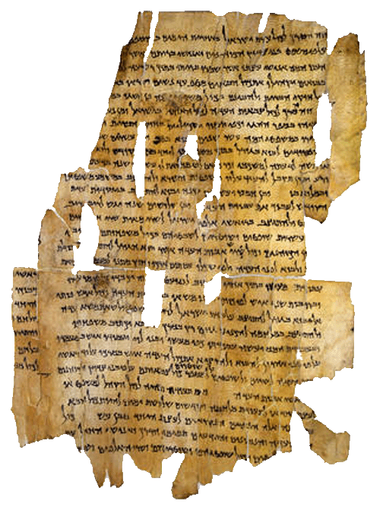
Our Bible is old, but it is not the oldest book in the world.
Notes:
1. It may come as a surprise to you, your Bible is old, but it is not the oldest book in the world.

Slide 31
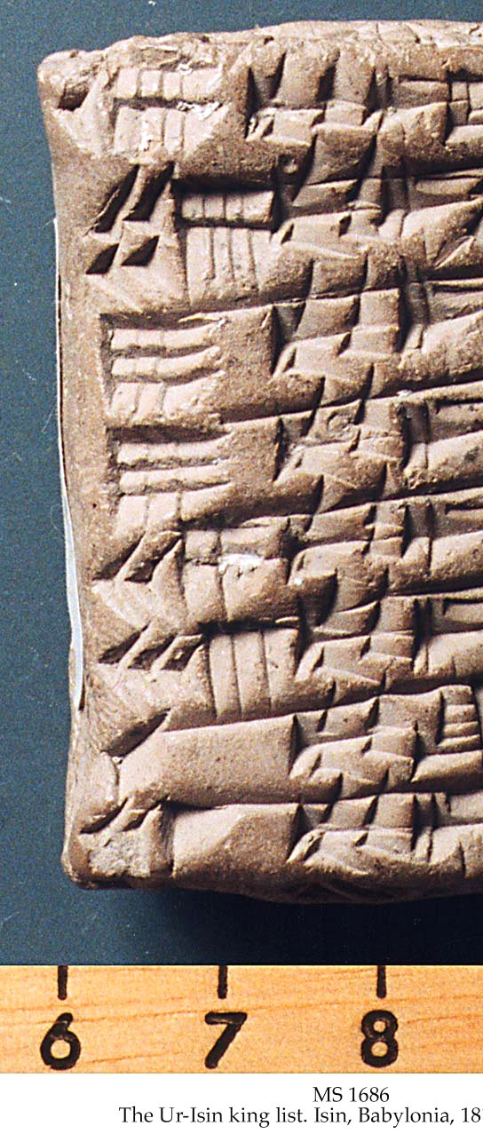
Writing was well-established long before the beginning of the Hebrew nation.
In fact, inscriptions found in ancient Babylon date back to as early as 3750 BC.
The importance of this should not be overlooked. Skeptics like to claim writing was not around when Moses lived in 1500 B.C.
Notes:
1. Writing was well-established long before the beginning of the Hebrew nation.
>>>>>>>>>>>>>>>>>>>
2. In fact, inscriptions found in ancient Babylon date back to as early as 3750 BC.
>>>>>>>>>>>>>>>>>>>
3. The importance of this should not be overlooked.
4. Skeptics like to claim writing was not around when Moses lived in 1500 B.C.
5. Not to embarrass them, but that would be 1250 years before Moses lived.

Slide 32
Ancient people used many kinds of material for writing purposes—the Bible actually makes mention of a number of these materials:
Stone
Clay
Leather
Papyrus
Vellum or Parchment
Flesh
Notes:
1. Ancient people used many kinds of material for writing purposes—the Bible actually makes mention of a number of these materials:
>>>>>>>>>>>>>>>>>>>>
a. Stone
And when He had made an end of speaking with him on Mount Sinai, He gave Moses two tablets of the Testimony, tablets of stone, written with the finger of God. (Exodus 31:18)
>>>>>>>>>>>>>>>>>>>>
b. Clay
"You also, son of man, take a clay tablet and lay it before you, and portray on it a city, Jerusalem. (Ezekiel 4:1)
>>>>>>>>>>>>>>>>>>>>
c. Leather – Jer 36:23
>>>>>>>>>>>>>>>>>>>
d. Papyrus
"Can the papyrus grow up without a marsh? Can the reeds flourish without water? (Job 8:11)
>>>>>>>>>>>>>>
e. Vellum or Parchment
Bring the cloak that I left with Carpus at Troas when you come—and the books, especially the parchments. (2 Timothy 4:13)
>>>>>>>>>>>>>>
f. Flesh
clearly you are an epistle of Christ, ministered by us, written not with ink but by the Spirit of the living God, not on tablets of stone but on tablets of flesh, that is, of the heart. (2 Corinthians 3:3)

Slide 33
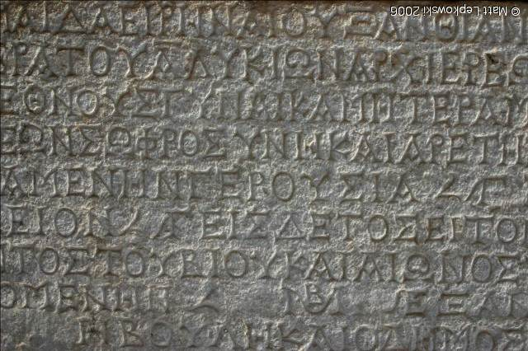
This is the substance upon which the earliest writing in the Bible is found.
Biblical examples of writing on stone can be found in Exodus 31:18; 34:1,28; Deuteronomy 27:2-3; Josh. 8:30-32.
Greek writing in stone
Notes:
1. This is the substance upon which the earliest writing in the Bible is found.
2. Biblical examples of writing on stone can be found in Exodus 31:18; 34:1,28; Deuteronomy 27:2-3; Josh. 8:30-32
And it shall be, on the day when you cross over the Jordan to the land which the LORD your God is giving you, that you shall set up for yourselves large stones, and whitewash them with lime. You shall write on them all the words of this law, when you have crossed over, that you may enter the land which the LORD your God is giving you, 'a land flowing with milk and honey,' just as the LORD God of your fathers promised you. (Deuteronomy 27:2-3)

Slide 34
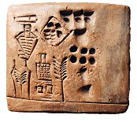
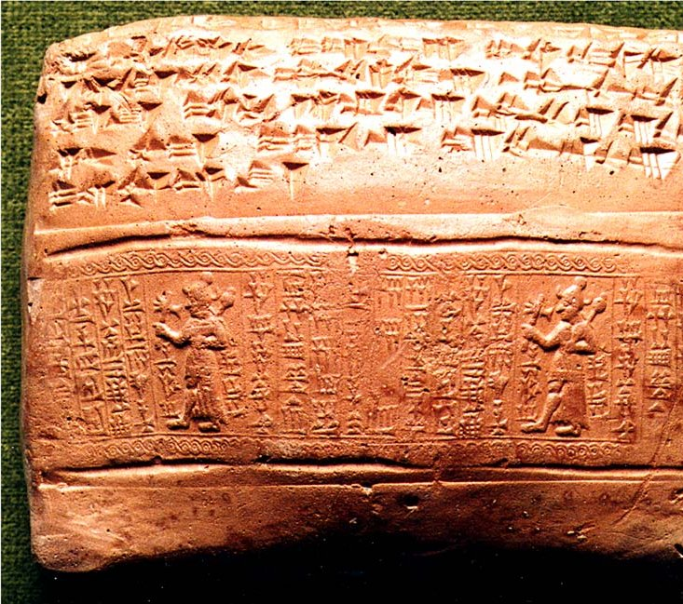
Clay was the predominate material for writing in Assyria and Babylonia
This type of preservation of writing is what is referred to in Ezekiel 4:1
“You also, son of man, take a clay tablet and lay it before you, and portray on it a city, Jerusalem.”
Notes:
1. Clay was the predominate material for writing in Assyria and Babylonia
2. This type of preservation of writing is what is referred to in Ezekiel 4:1
“You also, son of man, take a clay tablet and lay it before you, and portray on it a city, Jerusalem.” Ezekiel 4:1

Slide 35
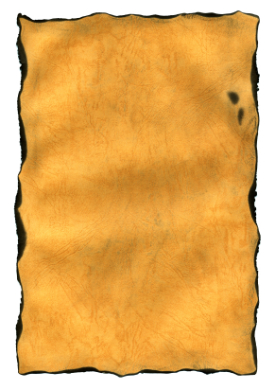
Leather: Though it is not mentioned specifically in the Bible, it was undoubtedly the material used for writing by the Hebrews.
A scribe’s knife, used for the purpose of erasures, is mentioned in Jer. 36:23
The Jewish Talmud, a code of traditional laws, explicitly called for the Scriptures to be copied on animal skins.
Notes:
1. Leather: Though it is not mentioned specifically in the Bible, it was undoubtedly the material used for writing by the Hebrews.
>>>>>>>>>>>>>>>>>
And it happened, when Jehudi had read three or four columns, that the king cut it with the scribe's knife and cast it into the fire that was on the hearth, until all the scroll was consumed in the fire that was on the hearth. (Jeremiah 36:23) (King Jehoiakim)
2. We know of others who have used tearing or cutting of scriptures from the Bible because they did not agree with them.
>>>>>>>>>>>>>>>>>>
3. The Jewish Talmud, a code of traditional laws, explicitly called for the Scriptures to be copied on animal skins.

Slide 36
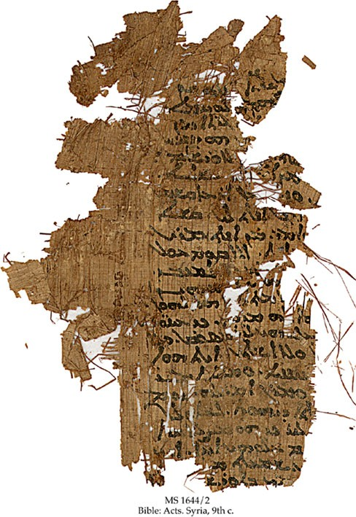
Papyrus was the most widely used material for writing in the Grecian/Roman culture, though the Egyptians used it as far back as 2,500 B.C.
Part of the New Testament on papyrus: Acts: 8:40-9:14; 9:16–27
Dated 9th Century A.D.
(from the Schoyen Collection)
Notes:
1. Papyrus was the most widely used material for writing in the Grecian/Roman culture, though the Egyptians used it as far back as 2,500 B.C.
>>>>>>>>>>>>>>>>>
2. Part of the New Testament on papyrus: Acts: 8:40-9:14; 9:16–27
>>>>>>>>>>>>>>>>>
3. Dated 9th Century A.D. (from the Schoyen Collection)

Slide 37
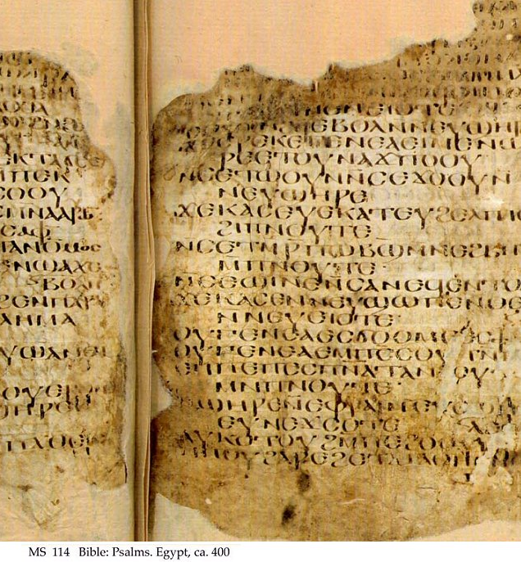
Vellum or Parchment came into prominence as a writing material due to the desire to build a world-wide library.
No doubt, this was the material Paul requested Timothy to bring him in 2 Timothy 4:13.
This material—made from the skins of animals, but not “tanned” into leather—became the material upon which copies of the New Testament were made for about 1000 years.
Part of the Psalms
Notes:
1. Vellum or Parchment came into prominence as a writing material due to the desire to build a world-wide library.
Bring the cloak that I left with Carpus at Troas when you come--and the books, especially the parchments. (2 Timothy 4:13)
>>>>>>>>>>>>>>>>>>
2. No doubt, this was the material Paul requested Timothy to bring him in 2 Timothy 4:13.
>>>>>>>>>>>>>>>>>>
3. This material—made from the skins of animals, but not “tanned” into leather—became the material upon which copies of the New Testament were made for about 1000 years.
>>>>>>>>>>>>>>>>>>>>>>
Vellum VEL'LUM, n. [L. vello.] A finer kind of parchment or skin, rendered clear and or white for writing.
Parchment P`ARCHMENT, [L. pergamena; purgo] The skin of a sheep or goat dressed or prepared and rendered fit for writing on.
This is done by separating all the flesh and hair, rubbing the skin with pumice stone, and reducing its thickness with a sharp instrument.
Vellum is made of the skins of abortive or very young calves.

Slide 38
Quick Summary…
The history of writing goes back hundreds of years before the days of Moses.
People wrote on almost all kinds of materials depending on their locale and situation in history.
For the O.T. the most important writing material was leather or skins, and sometimes on clay tablets.
When the N.T. was penned papyrus was generally used.
Notes:
1. The history of writing goes back hundreds of years before the days of Moses.
>>>>>>>>>>>>>>>>>>>
2. People wrote on almost all kinds of materials depending on their locale and situation in history.
>>>>>>>>>>>>>>>>>>>
3. For the O.T. the most important writing material was leather or skins, and sometimes on clay tablets.
>>>>>>>>>>>>>>>>>>>
4. When the N.T. was penned papyrus was generally used.

Slide 39
The Bible Surpasses—
Hindu Vedas
Quran of Islam
Buddhist Pitakas
Zoroastrian Avesta
Notes:
1. The Bible Surpasses all books written for mankind by mankind.
a. None of these come close to the truth contained in the Bible.
>>>>>>>>>>>>>>>
2. Hindu Vedas
3. Quran of Islam
4. Buddhist Pitakas
5. Zoroastrian Avesta

Slide 40
Can We Know We Have God’s Word?
We know how the original New Testament documents read because we have three surviving classes of evidence by which to reconstruct the original New Testament.
Notes:
1. Can We Know We Have God’s Word?
>>>>>>>>>>>>>>>>>>>>>
2. We know how the original New Testament documents read, because we have three surviving classes of evidence by which to reconstruct the original New Testament.

Slide 41
Can We Know We Have God’s Word?
Original New Testament Documents
Greek Manuscripts
Ancient Versions
Patristic Citations
Notes:
1. Can We Know We Have God’s Word?
2. Yes, we have some Original New Testament Documents
>>>>>>>>>>>>>>>>>>>
a. Greek Manuscripts
b. Ancient Versions
c. Patristic Citations

Slide 42
Can We Know We Have God’s Word?
Original
New Testament Documents
Greek Manuscripts
Ancient Versions
Patristic Citations
Notes:
1. What do you mean by Greek Manuscripts?

Slide 43
Can We Know We Have God’s Word?
The current number of Greek manuscript copies containing all or part of the New Testament is 5,735.
Notes:
1. The current number of Greek manuscript copies containing all or part of the New Testament is 5,735.
>>>>>>>>>>>>>>>>>

Slide 44
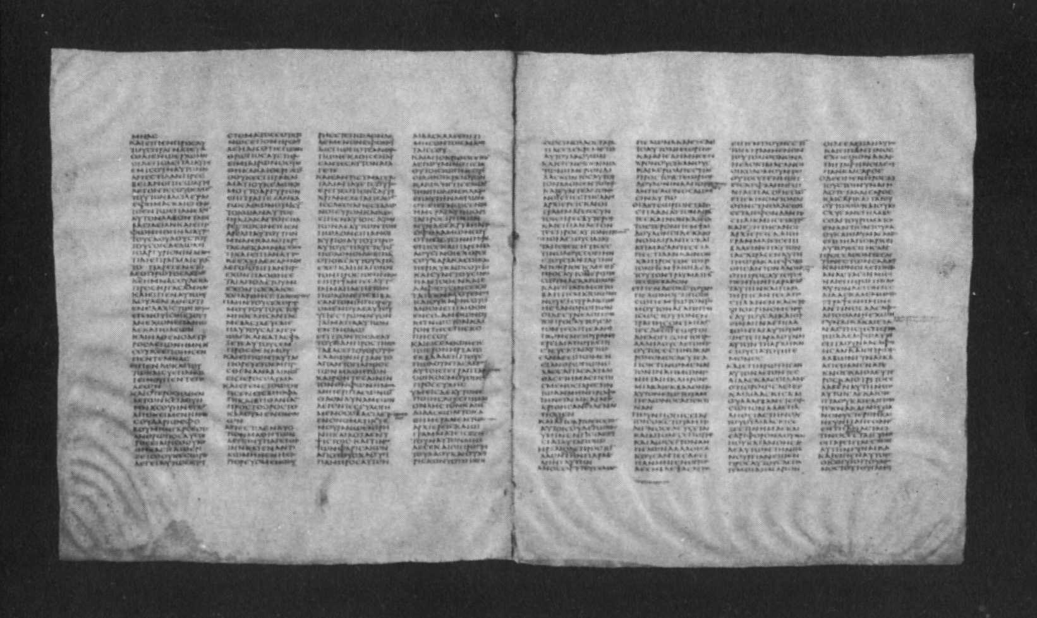
Discovered by Constantine Tischendorf in 1859 at a monastery at the base of Mt. Sinai. 4th Century Uncial Parchment Virtually complete Old and New Testaments Located in the British Museum
Codex Sinaiticus
Notes:
1. Discovered by Constantine Tischendorf in 1859 at a monastery at the base of Mt. Sinai. 4th Century Uncial Parchment Virtually complete Old and New Testaments They are now Located in the British Museum
a. Codex Sinaiticus -
>>>>>>>>>>>>>>>>>>>>>
Tis’ chen’ dorf’
{Un’ cial’ means text in large letters}

Slide 45
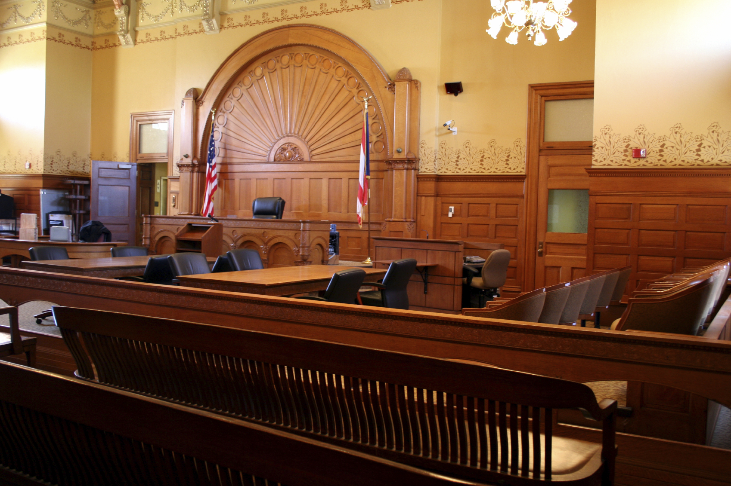
HOW DOES THE NT MEASURE UP TO OTHER ANCIENT BOOKS?
Title of Book | Date it was Written | Earliest Manuscript | Number of Manuscripts
Homer’s Illiad | 700 B.C. | Unknown | 643
History of Herodotus | 425 B.C. | A.D. 900 | 8
Josephus’ Jewish Wars | A.D. 70 | A.D. 400 | 9
Histories of Tacitus | A.D. 100 | A.D. 900 | 2
New Testament | A.D. 50-100 | A.D. 125 | 5,735
Notes:
1. HOW DOES THE NEW TESTAMENT MEASURE UP TO OTHER ANCIENT BOOKS?
>>>>>>>>>>>>>>>>>>>>>>>>>
2. Homer’s Illiad - 643
3. History of Herodotus - 8
4. Josephus’ Jewish Wars - 9
5. Histories of Tacitus - 2
6. New Testament – 5,735

Slide 46
Can We Know We Have God’s Word?
Original
New Testament Documents
Greek Manuscripts
Ancient Versions
Patristic Citations
Notes:
1. What do you mean by Ancient Manuscripts?

Slide 47
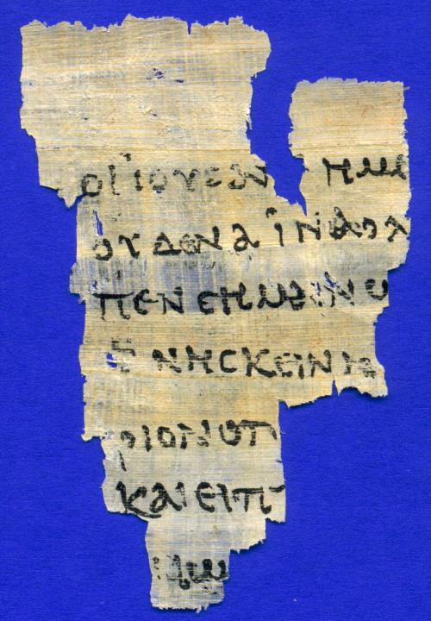
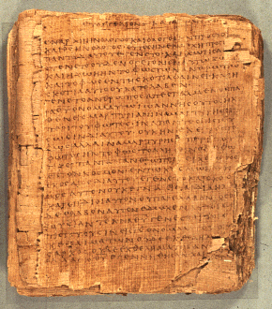
P52—Fragment of John 18
A.D. 125
Papyrus Bodmer II (P66)
A.D. 150-200
Notes:
1. Time does take a toll on any manmade books, even the Divine Scriptures is ignored.
>>>>>>>>>>>>>
2. Here is an example of Scripture from John, P^{52,} from A.D, 125
>>>>>>>>>>>>>
3. Another ancient Scripture found in Egypt in 1952 is the Pyparus Bodmer II, another copy of the Gospel of John scribed from 150 to 200 A.D.

Slide 48
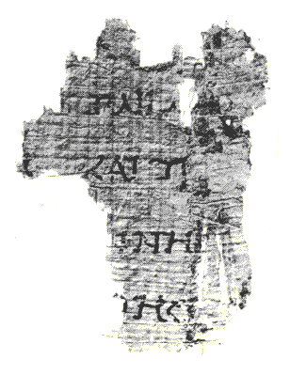
Perhaps the earliest N.T. fragment.
Found at Qumran.
Written before
A.D. 68.
Notes:
1. Perhaps the earliest N.T. fragment that we have was written about 30 years before the Apostle John died.
2. It was found at Qumran and written in 68 A.D.

Slide 49
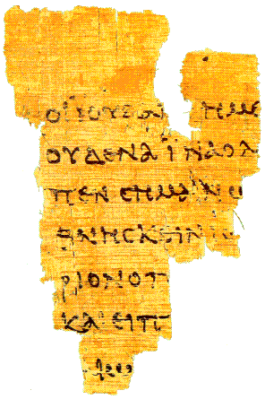
p⁵²
A papyrus fragment from Egypt.
Contains Portions of
John 18:31-33,37-38
Dated from A.D. 80-130.
Located at John Rylands Library
Manchester, England
Notes:
1. On this papyrus fragment from Egypt, it is a scrap identified as P⁵²
2. It contains portions of John 18:31-33,37-38 – The trial of Jesus before Pilate, and you rightly say I am a King.
3. Scribed about A.D. 80 – 130, another possiblw written in the lifetime of the Apostle John

Slide 50
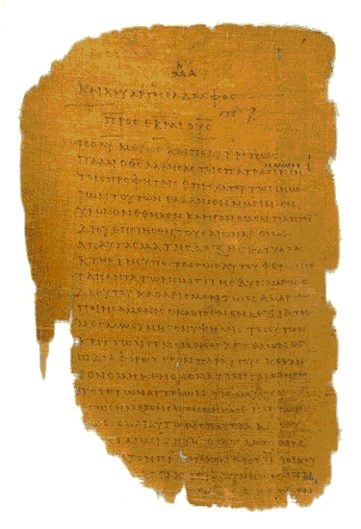
A portion of one of the most valuable papyri (p⁴⁶)— a substantially complete collection of Paul’s letters— dated around A.D. 250.
The first page of Hebrews
Part of the Chester Beatty collection.
Located in Dublin and Ann Arbor.
Notes:
1. A portion of one of the most valuable papyri (p⁴⁶)— a substantially complete collection of Paul’s letters— dated around A.D. 250.
2. The first page of the book of Hebrews

Slide 51
Can We Know We Have God’s Word?
Original
New Testament Documents
Greek Manuscripts
Ancient Versions
Patristic Citations
Notes:
1. PATRIS'TIC - Pertaining to the ancient fathers of the Christian church.

Slide 52
WRITINGS FROM EARLY NON-INSPIRED PREACHERS WHO RECOGNIZED CHRIST AS DIETY
Clement of Rome (c. A.D. 30-100)
Ignatius (A.D. 70-110)
Polycarp (A.D. 70-156)
Justin Martyr (A.D. 100-165)
Irenaeus (A.D. 130-202)
Tertullian (A.D. 200),
Origen (A.D. 225),
Novatian (A.D. 235),
Cyprian (A.D. 250),
Methodius (A.D. 290),
Notes:
1. WRITINGS FROM EARLY NON-INSPIRED PREACHERS WHO RECOGNIZED CHRIST AS DIETY
2. These were writers in the first 300 years of the Church’s birth.
a. Clement of Rome (c. A.D. 30-100)
b. Ignatius (A.D. 70-110)
c. Polycarp (A.D. 70-156)
d. Justin Martyr (A.D. 100-165)
e. Irenaeus (A.D. 130-202)
f. Tertullian (A.D. 200),
g. Origen (A.D. 225),
h. Novatian (A.D. 235),
i. Cyprian (A.D. 250),
j. Methodius (A.D. 290),

Slide 53
1. We Have The truth!
2. It Is The Inspired Word of God!
3. All It Requires Is Our Knowledge
and Obedience To His Word!
Now is the Time!!!
Notes:
1. We Have The truth!
>>>>>>>>>>>
2. Yes, we can know that we have the Word of God, complete and documented.
3. Ready for our instruction and commitment.
4. If you need to commit your life to Christ or if you need to study more, we will help you in any way that we can.
>>>>>>>>>>>>
5. It Is The Inspired Word of God!
>>>>>>>>>>>>
6. All It Requires Is Your Knowledge and Obedience To His Word!
>>>>>>>>>>>>
7. Now is the Time!

