Slide 1
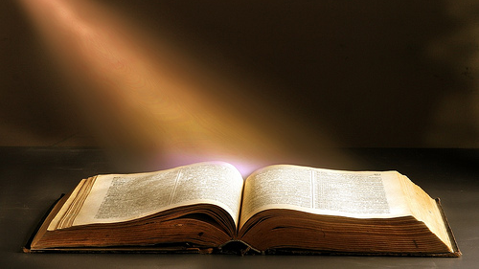
Welcome to Worship
Ranger Church of Christ
Mesquite and Rusk St.

Slide 2
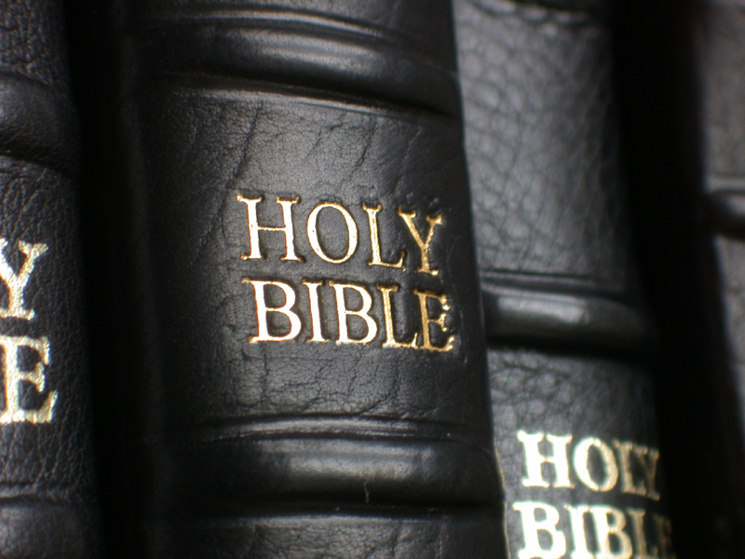
This Bible Is Not A Bag Of Trail Mix
You can’t Just Pick Out The Pieces You Like And Ignore The Rest!
Notes:
1. The Holy Bible is not like a bag of trail mix,
>>>>>>>>>>>>>>>>>>
2. You can’t just pick out the pieces you like and ignore the rest.

Slide 3
Welcome
Ranger Church of Christ
Science and religion focus on different aspects of reality.
Science tends to try to explain “how” the universe works.
Religion focuses on “why”.
Science points to God’s handiwork, and is concerned with the exploration and discovery of the world around us.
Religion points to God and focuses on our relationship with God.
Conflict occurs when we mistakenly ask one to attempt do the task of the other.
GDM
Notes:
1. Science and religion focus on different aspects of reality.
>>>>>>>>>>>>
2. Science tends to try to explain “how” the universe works.
>>>>>>>>>>>>
3. Religion focuses on “why”.
>>>>>>>>>>>>
4. Science points to God’s handiwork, and is concerned with the exploration and discovery of the world around us.
>>>>>>>>>>>>
5. Religion points to God and focuses on our relationship with God.
>>>>>>>>>>>>
6. Conflict occurs when we mistakenly ask one to attempt do the task of the other.

Slide 4
The only real way to defeat Evolution is to Prove the Bible is the “Word of God”
“Can We Prove The Bible”
Adapted from a Power Point
by Brad Harrub, Ph.D.
GDM
Notes:
1. The only real way to defeat Evolution is to Prove the Bible is the “Word of God”
>>>>>>>>>>>>>>>>>>>>>>>>>
2. “Can We Prove The Bible”
>>>>>>>>>>>>>>>>>>>>>>>>>
3. The question is can we look at things today, and then look at the Bible, and show the atheist that God revealed these things long before man had any idea that they existed.
4. Yes!
5. And we can also point out to the atheist, that if they had studied the Bible, then they would have known all these facts long ago.
6. As it is now, they rely daily on Evil Bible.com.

Slide 5


It may be the person to your left who stumbles across an atheistic Web site…
Notes:
1. Evil Bible.com
>>>>>>>>>>>
2. It may be the person to your left who stumbles across an atheistic Web site
>>>>>>>>>>>
This is a web-site which preaches Atheism by exposing, the so called, many evil crimes in the Bible committed by God and his followers.

Slide 6
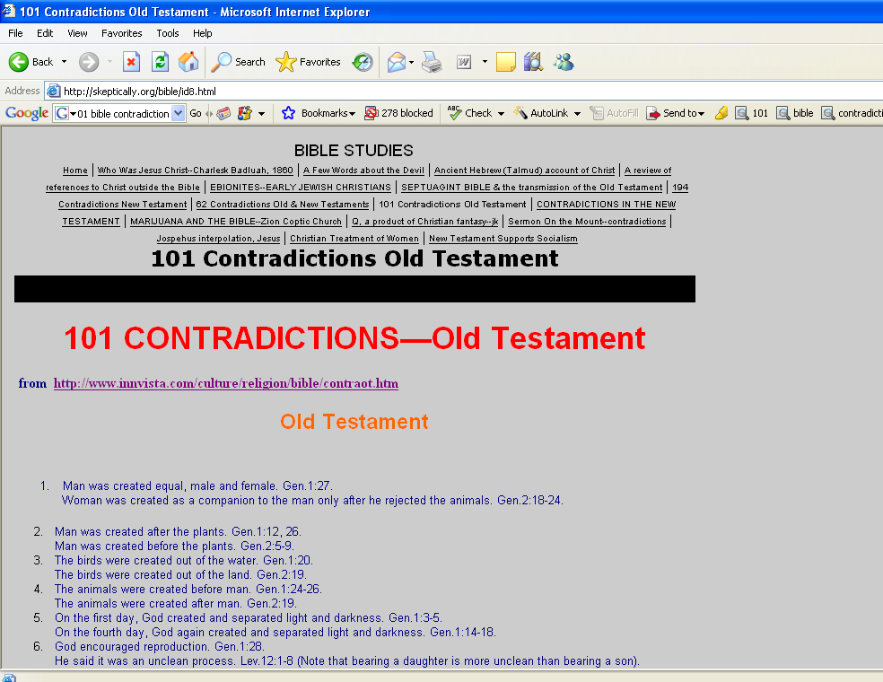
Notes:
1. Any hateful thing that can be said about the word of God can be found on evilbible.com’s website.
2. On their old website they listed, under Bible studies, 101 contradictions in the Old Testament.

Slide 7
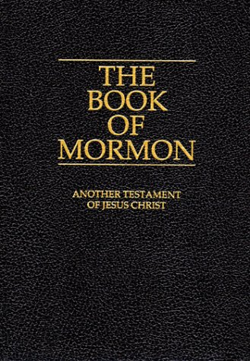
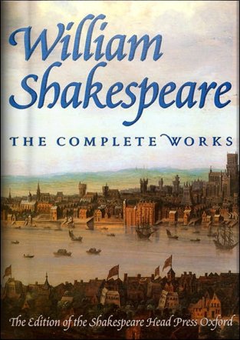
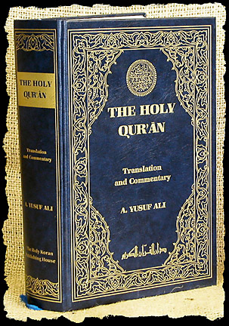
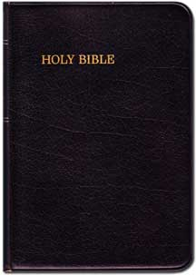
Do your children know the difference?
Notes:
1. Do you know about different religions and what they teach and what they say about Christianity?
>>>>>>>>>>>>>>>>>
2. Do you know these books?
>>>>>>>>>>>>>>>>>
3. Many people believe in the things written within their pages.
>>>>>>>>>>>>>>>>>
4. There are many false teachers in the world today.

Slide 8
Steve Wells, author of The Skeptic’s Annotated Bible, claims that the Bible is “unworthy of belief” because of its numerous contradictions and false prophecies.
Steve Wells (2001), The Skeptic’s Annotated Bible, [On-line], URL: http://www.Skepticsannotatedbible.com.
Notes:
1. Steve Wells, author of The Skeptic’s Annotated Bible, claims that the Bible is “unworthy of belief” because of its numerous contradictions and false prophecies.
2. I wonder if he has even studied it.

Slide 9
A FLAWED BOOK?
“People who are free of theological bias notice that the bible contains hundreds of discrepancies…. The bible is a flawed book.”
Dan Barker (1992), Losing Faith In Faith—From Preacher to Atheist (Madison, WI: Freedom from Religion Foundation), pp.164, 177.
Notes:
1. Dan Barker is a pastor turned atheist.
2. He served as associate pastor at a Friend’s (Quaker) Church, an Assembly of God.
2. He said “People who are free of theological bias notice that the bible contains hundreds of discrepancies…. The bible is a flawed book.”

Slide 10
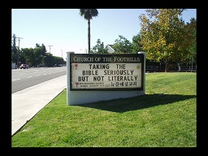
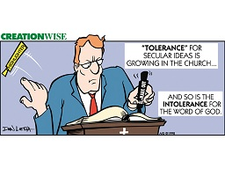
Notes:
1. “Taking the Bible Seriously, But not Literally.”
2. This is on a Church billboard?
3. Can you believe it?
4. The Church of the Foothills
5. The Church of the Foothills is a successfully aligned congregation of three denominations, the United Church of Christ, united with the Christian Church, and the Disciples of Christ.
>>>>>>>>>>>>>>>>>>>>>>>>>>
6. Tolerance for secular ideas is growing in these churches.
7. And so is the intolerance for the “Word of God.”
8. Tolerance only for the world, and no tolerance for God and His Son.

Slide 11
“Every analyst of the Bible should realize that the Book is a veritable miasma of contradictions, inconsistencies, inaccuracies, poor science, bad math, inaccurate geography, immoralities, degenerate heroes, false prophecies, boring repetitions, childish superstitions, silly miracles, and dry-as-dust discourse. But contradictions remain the most obvious, the most potent, the most easily proven, and the most common problem to plague the Book.”
McKinsey, Dennis (1995), The Encyclopedia of Biblical Errancy, p. 71.
Notes:
1. Every analyst of the Bible should realize that the Book is a veritable mi’as’ma of contradictions, inconsistencies, inaccuracies, poor science, bad math, inaccurate geography, immoralities, degenerate heroes, false prophecies, boring repetitions, childish superstitions, silly miracles, and dry-as-dust discourse.
2. But contradictions remain the most obvious, the most potent, the most easily proven, and the most common problem to plague the Book.”
Dennis McKinsey

Slide 12
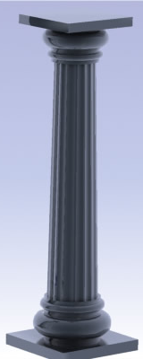
The Pillars of Christianity That All
Christians Must Be Able to Prove.
CHRISTIANITY
EXISTENCE
OF
GOD
INSPIRATION
OF
BIBLE
DEITY
OF
CHRIST
Notes:
1. These are the Pillars of Christianity That All Christians Must Be Able to Prove.
a. INSPIRATION OF BIBLE
b. EXISTENCE OF GOD
c. DEITY OF CHRIST

Slide 13
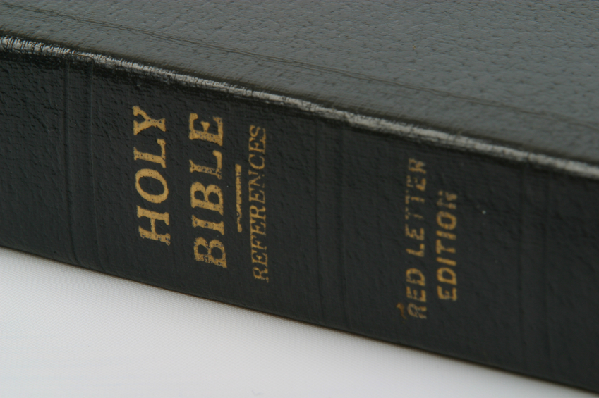
“Sanctify them by Your truth. Your word is truth” (John 17:17).
“The entirety of Your word is truth” (Psalm 119:160).
Notes:
1. Sanctify them by Your truth. Your word is truth” (John 17:17).
>>>>>>>>>>>>>>>>>>>>>
2. “The entirety of Your word is truth” (Psalm 119:160).

Slide 14
Messianic Prophecies
Genesis 22:18—Descend From Abraham—Luke 3:34
Genesis 49:10—Through Tribe of Judah—Hebrews 7:14
2 Samuel 7:12—Through Family of David—Luke 1:32
Isaiah 7:14—Through Virgin Mary—Matthew 1:22
Micah 5:2—Born in Bethlehem Ephrathah—Luke 2:4
Daniel 2:44; 9:26—During Roman Empire—Luke 2:1
Genesis 49:10—Judah Still Had King—Matthew 2:22
Psalm 41:9—Betrayed By Friend—John 13:18
Zechariah 11:12—Betrayed For 30 Pieces—Matthew 26:15
Isaiah 50:6—Spit On/Beaten—Matthew 27:30
Psalm 22:16—Hands/Feet Pierced—Luke 24:39
Psalm 16:10—Body Would Not Decay—Acts 2:22ff.
Notes:
1. Messianic Prophecies
2. We have many messianic prophecies listed in the Old Testament and we can see their fulfillment in the New Testament.
3. Not only of His birth and lineage But;
>>>>>>>>>>>>>>>>>
4. When and how he would be betrayed, and what would happen to His body.

Slide 15

First we want to look at the reliability of Bible. For instance THE TWELVE?
“He was seen by Cephas, then by the twelve” (1 Cor. 15:5).
But what about…
“He [Judas] threw down the pieces of silver in the temple and departed, and went and hanged himself”
(Matthew 27:5—before Jesus’ resurrection).
“He [Matthias] was numbered with the eleven apostles” (Acts 1:26—after Jesus’ ascension into heaven).
Notes:
1. First we want to look at the reliability of Bible.
a. For instance THE TWELVE? Or was it eleven?
2. “He was seen by Cephas, then by the twelve” (1 Cor. 15:5).
a. Peter saw Him first: and then Peter and the eleven, that is with Matthias, saw Him on another and later occasion.
>>>>>>>>>>>>>>>>>>>>
3. But what about…Judas being dead?
4. “He [Judas] threw down the pieces of silver in the temple and departed, and went and hanged himself”
5. (Matthew 27:5—before Jesus’ resurrection and that was before Jesus stood before Pilate).
6. “He [Matthias] was numbered with the eleven apostles” (Acts 1:26—after Jesus’ ascension into heaven).

Slide 16
NUMBERS USED AS NAMES
BIG 10
2 x 4
Notes:
1. Despite the conference's name, the Big 10, since Penn State joined in 1990, there have been 11 schools in the Big Ten.
2. The University of Nebraska-Lincoln will join the conference as its 12th member effective July 1, 2011.
>>>>>>>>>>>>>>>>>
3. So what size is a 2” x 4” piece of lumber?
4. Everyone that uses this lumber knows that it is 1-1/2 x 3-1/2 inches.

Slide 17
Prolepsis
“The assignment of something, such as an event or name, to a time that precedes it.”
Notes:
1. Prolepsis
>>>>>>>>>>>>>>>>>
2. “The assignment of something, such as an event or name, to a time that precedes it.”

Slide 18
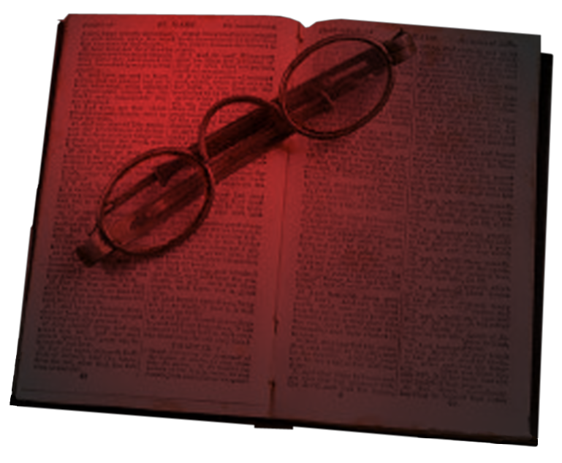
HOW DID JUDAS DIE?
“He [Judas] threw down the pieces of silver in the temple and departed, and went and hanged himself” (Matthew 27:5).
But what about…
“Now this man purchased a field with the wages of iniquity; an falling headlong, he burst open in the middle and all his entrails gushed out” (Acts 1:18).
Notes:
1. HOW DID JUDAS DIE?
2. “He [Judas] threw down the pieces of silver in the temple and departed, and went and hanged himself” (Matthew 27:5).
a. How could he throw the money in the temple and also purchase land with it?
b. How could he hang himself and also fall headlong and burst?
3. But what about…
4. “Now this man purchased a field with the wages of iniquity; an falling headlong, he burst open in the middle and all his entrails gushed out” (Acts 1:18).
5. A Prolepsis! - “The assignment of something, such as an event or name, to a time that precedes it.”

Slide 19
SUPPLEMENTATION DOES NOT EQUAL CONTRADICTION
Matthew 14:21; Mark 6:44
Matthew 27:57-60; John 19:38-40
Notes:
1. SUPPLEMENTATION DOES NOT EQUAL CONTRADICTION
Now those who had eaten were about five thousand men, besides women and children. (Matthew 14:21)
Now those who had eaten the loaves were about five thousand men. (Mark 6:44)
a. Only men were counted in Old Israel
>>>>>>>>>>>>>>>>>>>>
When Joseph had taken the body, he wrapped it in a clean linen cloth, and laid it in his new tomb which he had hewn out of the rock; and he rolled a large stone against the door of the tomb, and departed. (Mat 27:59 -60)
--------------------------
After this, Joseph of Arimathea, being a disciple of Jesus, but secretly, for fear of the Jews, asked Pilate that he might take away the body of Jesus; and Pilate gave him permission. So he came and took the body of Jesus. And Nicodemus, who at first came to Jesus by night, also came, bringing a mixture of myrrh and aloes, about a hundred pounds. Then they took the body of Jesus, and bound it in strips of linen with the spices, as the custom of the Jews is to bury. (John 19:38-40)

Slide 20
WHAT HAPPENED ON RESURRECTION SUNDAY?
“Now after the Sabbath, as the first day of the week began to dawn, Mary Magdalene and the other Mary came to the tomb” (Matthew 28:1).
But what about…
“Now when the Sabbath was past, Mary Magdalene, Mary the mother of James, and Salome bought spices, that they might come and anoint Him” (Mark 16:1).
“On the first day of the week Mary Magdalene came to the tomb early...” (John 20:1).
Notes:
1. WHAT HAPPENED ON RESURRECTION SUNDAY?
2. “Now after the Sabbath, as the first day of the week began to dawn, Mary Magdalene and the other Mary came to the tomb” (Matthew 28:1).
>>>>>>>>>>>>>>>>>>>>>
3. But what about…
4. “Now when the Sabbath was past, Mary Magdalene, Mary the mother of James, and Salome bought spices, that they might come and anoint Him” (Mark 16:1).
5. “On the first day of the week Mary Magdalene came to the tomb early...” (John 20:1).
6. How many came to the tomb?
7. John says one,
8. Matthew says two and Mark says three, looks like two out of three did not get it right!
9. Supplemental Information is not a contradiction.

Slide 21
WHO BOUGHT THE FIELD?
“But the chief priests took the silver pieces …consulted together and bought with them the potter’s field, to bury strangers in” (Matthew 27:6-7).
But what about…
“Now this man [Judas] purchased a field with the wages of iniquity” (Acts 1:18).
Notes:
1. WHO BOUGHT THE FIELD?
But the chief priests took the silver pieces and said, "It is not lawful to put them into the treasury, because they are the price of blood." And they consulted together and bought with them the potter's field, to bury strangers in. (Matthew 27:6-7)
2. But what about…
Now this man purchased a field with the wages of iniquity; and falling headlong, he burst open in the middle and all his entrails gushed out. (Acts 1:18)
3. Once again, we have a prolepsis, where Judas’ name is attached to the money as his.

Slide 22
JESSE’S MISSING SON
1 Samuel 16:11 and 17:12 indicate that David was the youngest of eight sons.
1 Chronicles 2:13-15: “Jesse begot Eliab his firstborn, Abinadab the second, Shimea the third, Nethanel the fourth, Raddai the fifth, Ozem the sixth, and David the seventh.”
Notes:
1. JESSE’S MISSING SON
>>>>>>>>>>>>>>>>>>>>>>>
2. Samuel 16:11 and 17:12 indicate that David was the youngest of eight sons.
>>>>>>>>>>>>>>>>>>>>>>>
Jesse begot Eliab his firstborn, Abinadab the second, Shimea the third, Nethanel the fourth, Raddai the fifth, Ozem the sixth, and David the seventh. (1 Chronicles 2:13-15)
3. It is probable that a son that has died, and did not leave an heir, therefore he is not on the genealogical rolls.
4. Three of Jesse’s eldest sons were in the battle with King Saul and his army when David slay Goliath.

Slide 23
Principle #1:
The same person, place, or thing must be under consideration.
Ricky Smith is rich.
Ricky Smith is poor.
R.S. in Florida
R.S. in New York
Notes:
1. We need principles to be able to understand almost anything, and the Bible is no exception.
2. The word for this is Hermeneutics.
3. Principle #1: The same person, place, or thing must be under consideration.
a. Ricky Smith is rich.
b. Ricky Smith is poor.
4. R.S. in Florida is Rich
5. R.S. in New York is Homeless

Slide 24
Principle #2:
The same time period must be under consideration
Ricky Smith is rich
Ricky Smith is poor.
Young Rich R.S.
Older Poor R.S.
Notes:
1. Principle #2: The same time period must be under consideration
a. Ricky Smith is rich
b. Ricky Smith is poor.
2. Young Rich R.S.
3. Older Poorer R.S.

Slide 25
Principle #3:
The same sense must be under consideration.
Ricky Smith is poor
Ricky Smith is rich.
Materially Poor R.S.
Spiritually Rich R.S.
Notes:
1. Principle #3: The same sense must be under consideration.
a. Ricky Smith is poor
b. Ricky Smith is rich.
>>>>>>>>>>>
2. Materially Poor R.S.
>>>>>>>>>>>
3. Spiritually Rich R.S.

Slide 26
THE SIZE OF THE ARK
“The length of the ark shall be three hundred cubits, its width fifty cubits, and its height thirty cubits” (Genesis 6:15).
But what about…
“And they shall make an ark of acacia wood; two and a half cubits shall be its length, a cubit and a half its width, and a cubit and a half its height” (Exodus 25:10).
Notes:
1. THE SIZE OF THE ARK
“The length of the ark shall be three hundred cubits, its width fifty cubits, and its height thirty cubits” (Genesis 6:15).
>>>>>>>>>>>>>>>>>>>
2. But what about…
“And they shall make an ark of acacia wood; two and a half cubits shall be its length, a cubit and a half its width, and a cubit and a half its height” (Exodus 25:10).
3. We are not talking about the same thing are we.
4. The ark of Noah is much larger and much earlier that the ark of the temple.

Slide 27
THE CREATION
“Then God saw everything that He had made, and indeed it was very good” (Genesis 1:31).
But what about…
“Then the Lord saw that the wickedness of man was great in the earth, and that every intent of the thoughts of his heart was only evil continually” (Genesis 6:5).
Notes:
1. THE CREATION
“Then God saw everything that He had made, and indeed it was very good” (Genesis 1:31).
>>>>>>>>>>>>>>>>>>
2. But what about…
“Then the Lord saw that the wickedness of man was great in the earth, and that every intent of the thoughts of his heart was only evil continually” (Genesis 6:5).
3. Man alone has the control of his free will.
4. God does not dictate your choices!
5. The wicked are responsible for their own wickedness.

Slide 28
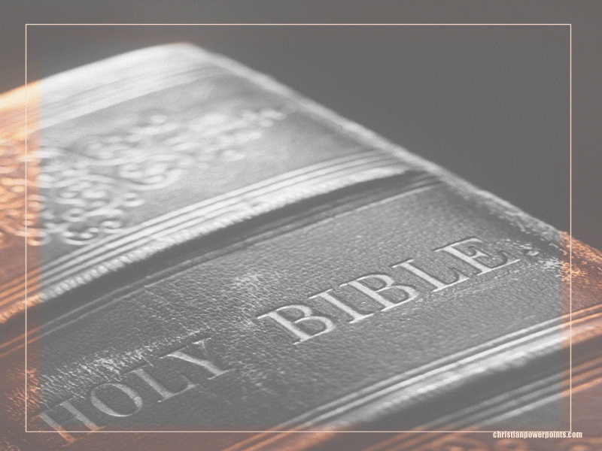
Prove It
Is the Bible inspired of God or is it simply a “good book”?
Is there any evidence?
Notes:
1. The atheist will say “Prove It”
>>>>>>>>>>>>>>>>>>>
2. Is the Bible inspired of God or is it simply a “good book”?
>>>>>>>>>>>>>>>>>>>
3. Is there any evidence?

Slide 29

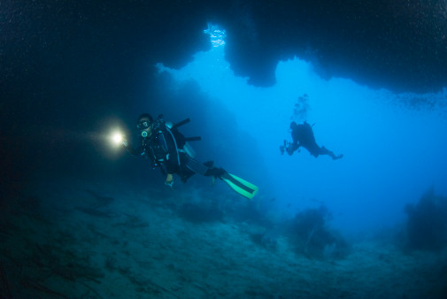
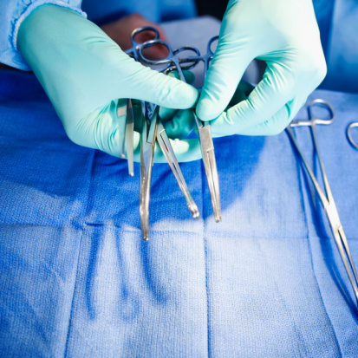

Proving the Inspiration of the Bible
Astronomy
Oceanography
Medicine
Biology
Notes:
1. Proving the Inspiration of the Bible Is possible even though the atheist do not believe that you can.
2. Even Using Astronomy, Oceanography, Medicine, Biology it can be seen to be inspired

Slide 30
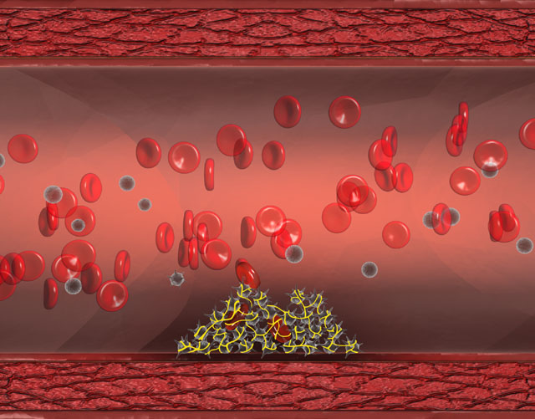
The Bible & Medicine
Genesis 17:12
God commanded Abraham to circumcise newborn males on the eighth day.
Blood clotting is dependent on 3 factors:
Platelets
Prothrombin
Vitamin K – Which is responsible for
prothrombin production
Notes:
1. The Bible & Medicine
He who is eight days old among you shall be circumcised, every male child in your generations, he who is born in your house or bought with money from any foreigner who is not your descendant. (Genesis 17:12)
>>>>>>>>>>>>>>>>>>>>>
2. Blood clotting is dependent on 3 factors:
Platelets
Pro’throm’bin
Vitamin K – Which is responsible for prothrombin production

Slide 31
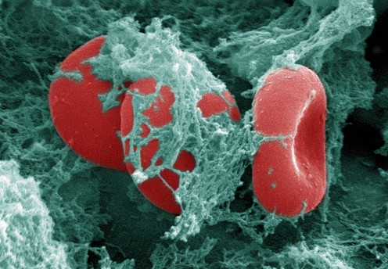
Vitamin K from stomach bacteria aids the infant, and it is produced 5-7 days after birth.
Notes:
1. Vitamin K from stomach bacteria aids the infant, and it is produced 5-7 days after birth.

Slide 32
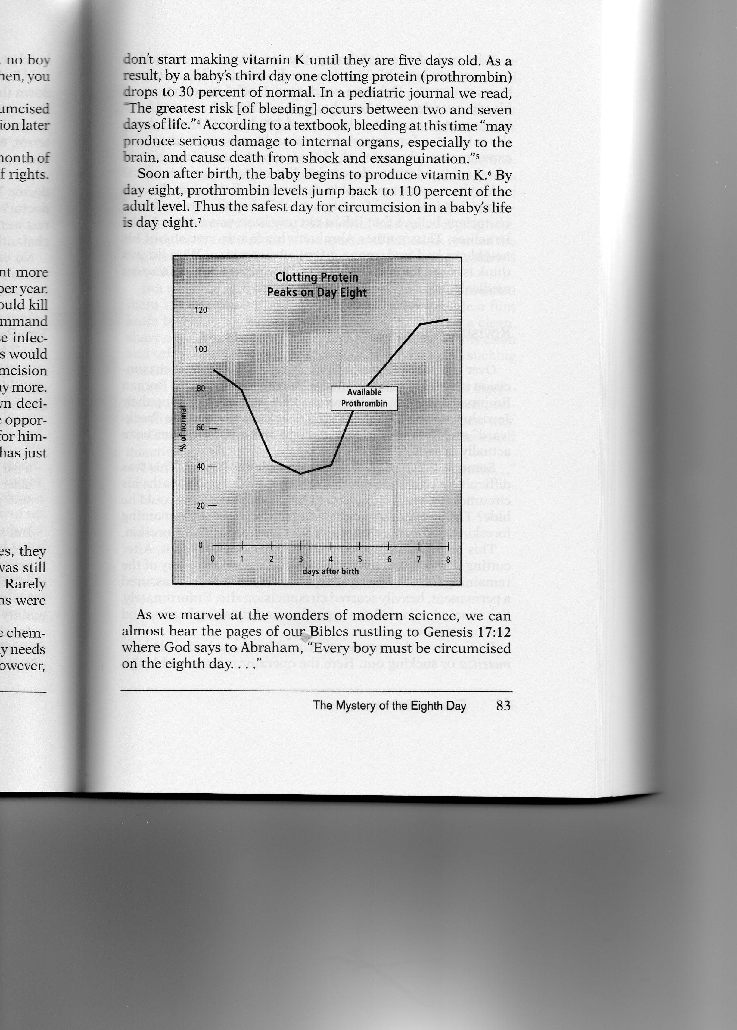

Available Prothrombin
Taken from None of These Diseases pg. 83
110%
Notes:
1. Available Prothrombin
2. Day one is only about 95%,
>>>>>>>>>>>
3. But after day eight it is 110%
>>>>>>>>>>>
4. or more
>>>>>>>>>>>
5. of the normal levels
>>>>>>>>>>>
6. A good Bible study would have revealed this to the atheist and Doctor.

Slide 33
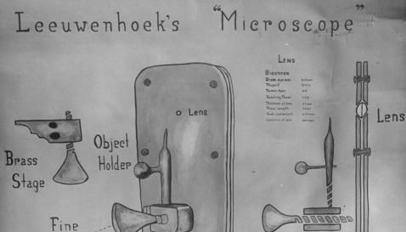
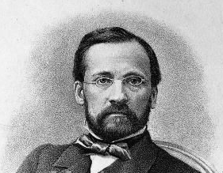
The Bible & Medicine
Lev 13 - Cover Their Lip
In 1677 Anton Von Leeuwenhoek identified what he described as “animalcules”
In the 1860s Louis Pasteur
came up with the
“Germ Theory of Disease”
Notes:
1. The Bible & Medicine
2. Lev 13 - Cover Their Lip
"Now the leper on whom the sore is, his clothes shall be torn and his head bare; and he shall cover his mustache, and cry, 'Unclean! Unclean!' (Leviticus 13:45)
>>>>>>>>>>>>>>>>>>>
3. In 1677 Anton Von Leeuwenhoek identified what he described as “animalcules”
>>>>>>>>>>>>>>>>>>>
4. In the 1860s Louis Pasteur came up with the “Germ Theory of Disease”
>>>>>>>>>>>>>>>>>>>
5. The simple biblical truth is that if you cover your mouth while you talk, shout, sneeze, or cough you won’t spread germs.

Slide 34
… “If you diligently heed the voice of the Lord your God and do what is right in His sight, give ear to His commandments and keep all His statutes, I will put none of the diseases on you which I have brought on the Egyptians. For I am the Lord who heals you.”
Exodus 15:26 NKJ
Notes:
… “If you diligently heed the voice of the Lord your God and do what is right in His sight, give ear to His commandments and keep all His statutes, I will put none of the diseases on you which I have brought on the Egyptians. For I am the Lord who heals you.”
Exodus 15:26 NKJ
1. Old physical Israel did not give ear to this warning nor keep his commandments or statutes and many plagues have come upon them. Amos 7:1
Thus the Lord GOD showed me: Behold, He formed locust swarms at the beginning of the late crop; indeed it was the late crop after the king's mowings. (Amos 7:1)

Slide 35
“And the Lord will take away from you all sickness, and will afflict you with none of the terrible diseases of Egypt which you have known…”
Deut 7:15 NKJV
Notes:
“And the Lord will take away from you all sickness, and will afflict you with none of the terrible diseases of Egypt which you have known…” Deut 7:15 NKJV

Slide 36
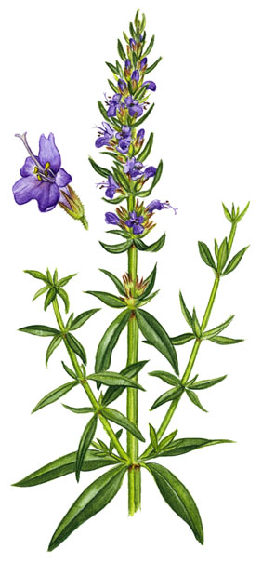
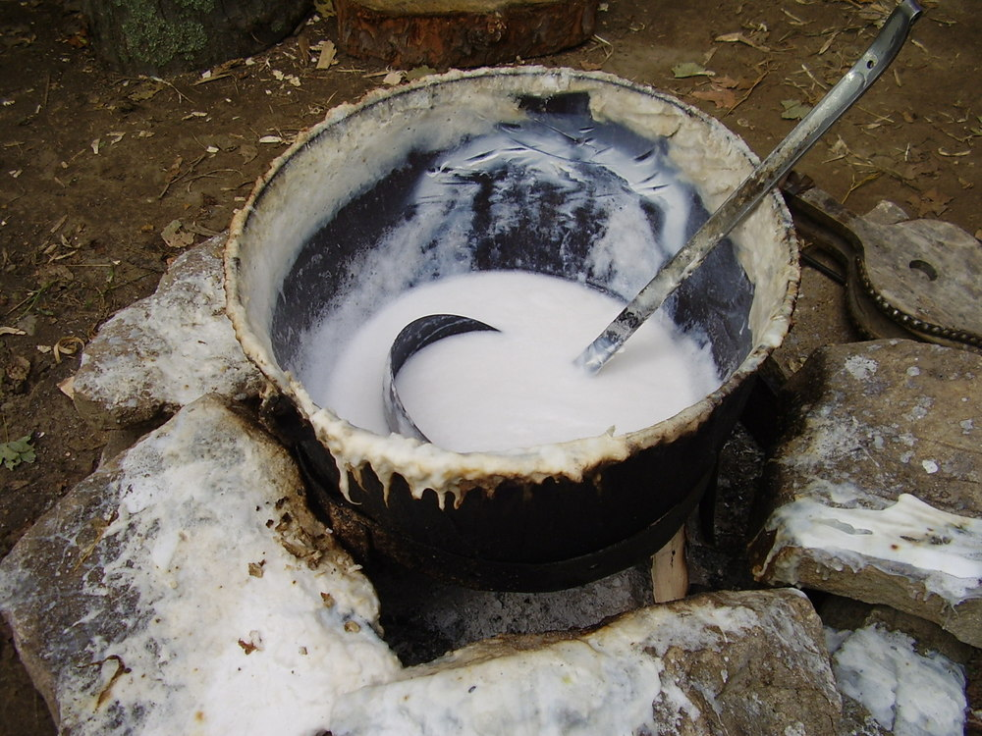
Weird ritual or remarkable recipe?
The Bible & Medicine
Numbers 19:16-18
Notes:
Whoever in the open field touches one who is slain by a sword or who has died, or a bone of a man, or a grave, shall be unclean seven days.
'And for an unclean person they shall take some of the ashes of the heifer burnt for purification from sin, and running water shall be put on them in a vessel. A clean person shall take hyssop and dip it in the water, sprinkle it on the tent, on all the vessels, on the persons who were there, or on the one who touched a bone, the slain, the dead, or a grave. (Numbers 19:16-18)
1. In the ashes of the dead animal, we find the ingredients for lye soap.

Slide 37
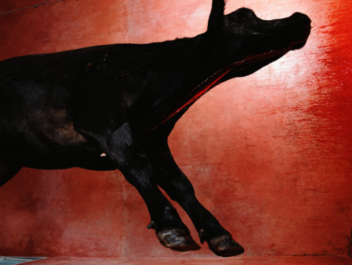
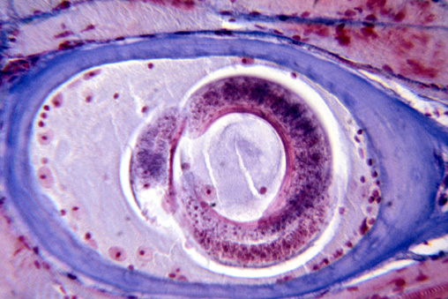
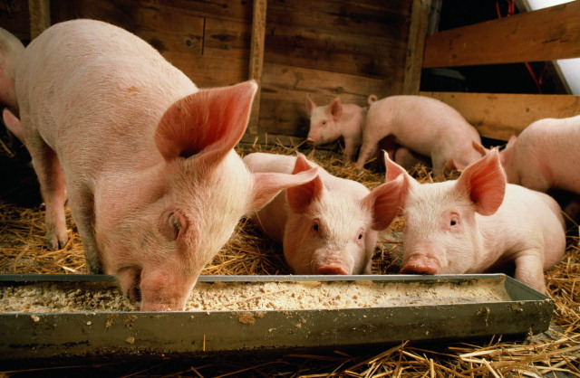

The Bible & Medicine
Leviticus 17:15 Prohibits eating meat from an animal that died “naturally.”
Leviticus 11:7
Prohibited Jews from eating the meat of pigs.
Notes:
1. The Bible & Medicine
2. Leviticus 17:15 Prohibits eating meat from an animal that died “naturally.”
"And every person who eats what died naturally or what was torn by beasts, whether he is a native of your own country or a stranger, he shall both wash his clothes and bathe in water, and be unclean until evening. Then he shall be clean. (Leviticus 17:15)
>>>>>>>>>>>>>>>>>>>
and the swine, though it divides the hoof, having cloven hooves, yet does not chew the cud, is unclean to you. (Leviticus 11:7)
>>>>>>>>>>>>>>>>>>
3. Pig meat can have worms embedded in the flesh and uncooked or undercooked, it can pass the worms to mankind.

Slide 38
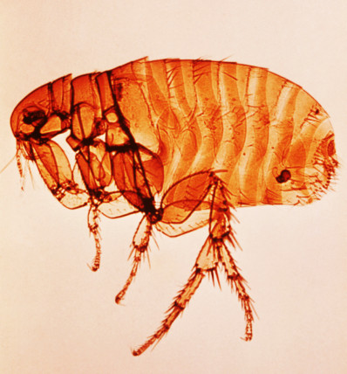
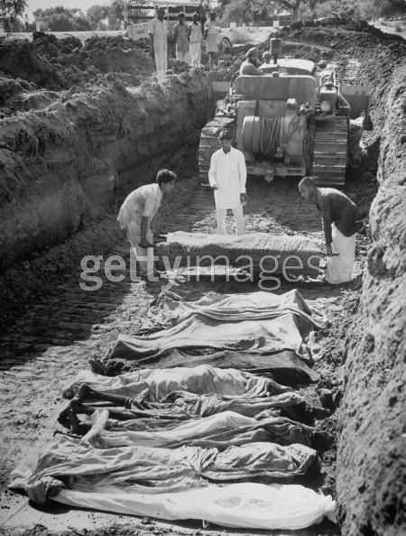
The Bible & Medicine
Deuteronomy 23:12-14
Moses instructed the Israelites to bury their waste.
The Black Plague
Notes:
1. The Bible & Medicine
2. Deuteronomy 23:12-14 - Moses instructed the Israelites to bury their waste.
"Also you shall have a place outside the camp, where you may go out; and you shall have an implement among your equipment, and when you sit down outside, you shall dig with it and turn and cover your refuse. For the LORD your God walks in the midst of your camp, to deliver you and give your enemies over to you; therefore your camp shall be holy, that He may see no unclean thing among you, and turn away from you. (Deuteronomy 23:12-14)
>>>>>>>>>>>>>>>>>>>>>>>>
3. It was the Black Plague spread from filth by the flea of mice and rats in Europe, that took at terrible toll on people.
A reading of the Bible could have prevented the Black Plague if they had washed their hands and clothing after handling waste through burial in the earth.

Slide 39
Life can Change in a Minute
Invitation Song | 226 | There’s A Great Day Coming
Closing Song | 29 | Christ for the World We Sing
Closing Prayer
Notes:
1. I know that it is a long lesson, but we must stop for now, please return this evening if you desire to hear more.
>>>>>>>>>>>>>>>>>>>>
2. The Lord was not want anyone to be lost, your life can change in a minute, if you desire to repent and be baptized, we want to extend to you an invitation while we stand and sing.
>>>>>>>>>>>>>>>>>>>>>

Slide 42
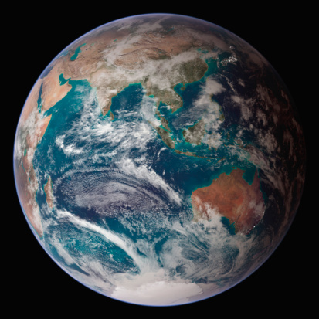
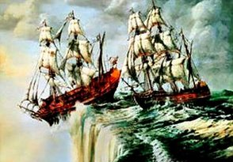


The Bible & Astronomy
Isaiah 40:22 - The Circle of the Earth
Psalm 19:6 - The Orbit of the Sun
Job 38:19 - Light travels in a “way” or path
Notes:
1. The Bible & Astronomy
>>>>>>>>>>>>>>>>>>>>>>
It is He who sits above the circle of the earth, And its inhabitants are like grasshoppers, Who stretches out the heavens like a curtain, And spreads them out like a tent to dwell in. (Isaiah 40:22)
>>>>>>>>>>>>>>>>>>>>
Its rising is from one end of heaven, And its circuit to the other end; And there is nothing hidden from its heat. (Psalms 19:6)
>>>>>>>>>>>>>>>>>>>>
"Where is the way to the dwelling of light? And darkness, where is its place, (Job 38:19)

Slide 43

The Bible said:
You Cannot Count the Stars
Scientists kept counting only about a 1000 stars
until they invented the telescope
Jer 33:22 NKJV See also Gen 15:5
Notes:
1. Scientists kept counting only about a 1000 stars until they invented the telescope
As the host of heaven cannot be numbered, nor the sand of the sea measured, so will I multiply the descendants of David My servant and the Levites who minister to Me.' " (Jeremiah 33:22)
----------------------------
Then He brought him outside and said, "Look now toward heaven, and count the stars if you are able to number them." And He said to him, "So shall your descendants be." (Genesis 15:5)

Slide 44
128 BC – Hippicacus 1026 stars
Bible’s Wrong!
150 AD - Ptolemy 1056 stars
1575 AD - Tycho Brahe 777 stars
1600 AD - Keplar 1005 stars
Bible’s Wrong!
Bible’s Wrong!
Science Books by man
Notes:
1. All science books written by mankind have been wrong on this point, even today.

Slide 45
As the host of heaven cannot be numbered, neither the sand of the sea measured; so will I multiply the seed of David my servant, ...
Jer 33:22 NKJV
See also Gen 15:5
Notes:
1. The seed of David continues to be multiplied in us, as Spiritual Israel!

Slide 46
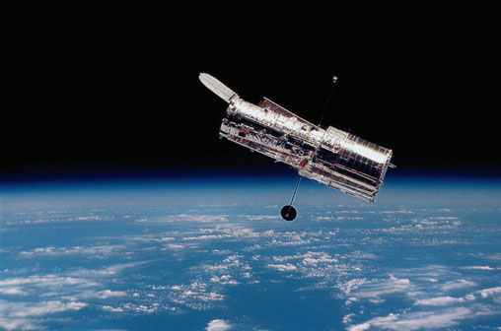
The Hubble Telescope
Notes:
1. Ever wanted to wish upon a star?
2. Well, you have 70,000 million, million, million to choose from.
3. That's the total number of stars in the known universe, according to a study by Australian astronomers.
4. It's also about 10 times as many stars as grains of sand on all the world's beaches and deserts.
5. Star survey reaches 70 sextillion July 23, 2003 - CNN - TECH (7 + 21 zeros)

Slide 47
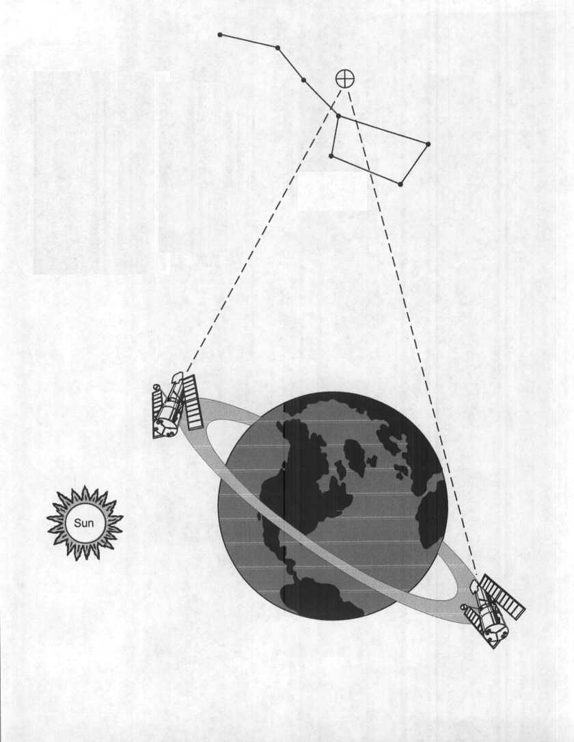
Hubble looking at grain of sand size area
Continuous Viewing Zone
An area 1/30 the size of the full moon, or about the size of a grain of sand held at arms length, was stared at for ten straight days.
Notes:
1. The area chosen was totally black according to ground based telescopes.

Slide 48
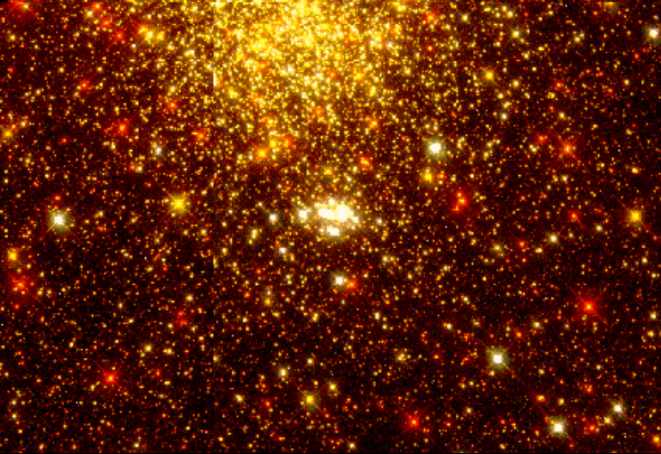
Saw
Bible was Right
Man’s Science was Wrong!
A grain of sand hides more stars than can be counted.
Notes:
1. Bible was Right
Man’s Science was Wrong!

Slide 49

Estimated each person has 2 Trillion
It has been estimated that there are enough stars for every person on earth to own 2,000,000,000,000
(2 trillion) of them.
Astronomy and the Bible, Donald DeYoung p. 57
Notes:
1. It has been estimated that there are enough stars for every person on earth to own 2,000,000,000,000 (2 trillion) of them.
>>>>>>>>>>>>>>>>>>>.
2. Astronomy and the Bible, Donald DeYoung p. 57

Slide 50
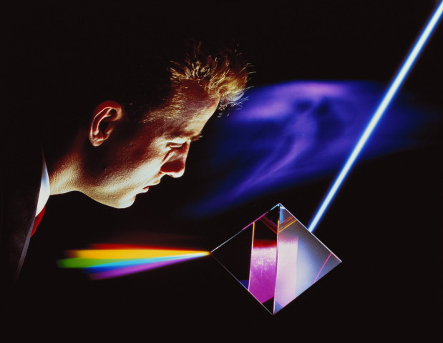
The Bible & Astronomy
Job 38:24 - How light is parted?
The only logical conclusion is that these verses were given by inspiration of God!
Notes:
1. The Bible & Astronomy
>>>>>>>>>>>>>>>>>>>>>>>>>>>>>
By what way is light diffused, Or the east wind scattered over the earth? (Job 38:24)
>>>>>>>>>>>>>>>>>>>>>>>>>>>>>
2. The only logical conclusion is that these verses were given by inspiration of God!

Slide 51
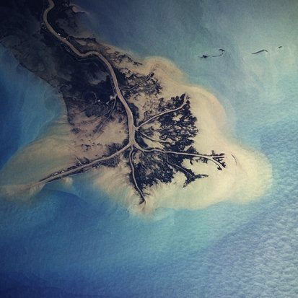
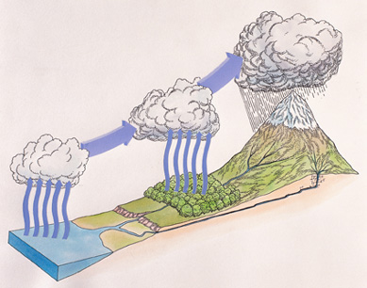
The Bible & Oceanography
Ecclesiastes 1:7 - All rivers run to the sea
Combined with Ecclesiastes11:3 & Amos 9:6 describes the water cycle
Notes:
The Bible & Oceanography
All the rivers run into the sea, Yet the sea is not full; To the place from which the rivers come, There they return again. (Ecclesiastes 1:7)
>>>>>>>>>>>>>>>>>>>>
If the clouds are full of rain, They empty themselves upon the earth; And if a tree falls to the south or the north, In the place where the tree falls, there it shall lie. (Ecclesiastes 11:3)
-------------------------------------
He who builds His layers in the sky, And has founded His strata in the earth; Who calls for the waters of the sea, And pours them out on the face of the earth-- The LORD is His name. (Amos 9:6)

Slide 52
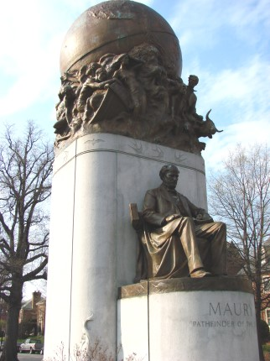
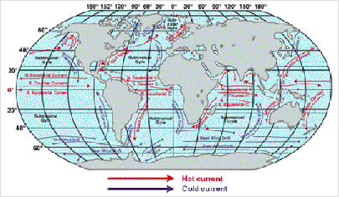
Psalm 8:8
Matthew Maury was described as “Pathfinder of the Sea.” His book on physical geography of the sea is still considered one of the best, and is used in many universities.
Notes:
The birds of the air, And the fish of the sea That pass through the paths of the seas. (Psalms 8:8)
>>>>>>>>>>>>>>>>>>>>>
1. The universities, atheist and agonist give Matthew Maury the credit for what King David, of Israel knew, about 1040 to 970 BC.
>>>>>>>>>>>>>>>>>>>>
2. Matthew Maury was described as “Pathfinder of the Sea.”
>>>>>>>>>>>>>>>>>>>>>
3. His book on physical geography of the sea is still considered one of the best, and is used in many universities.

Slide 53
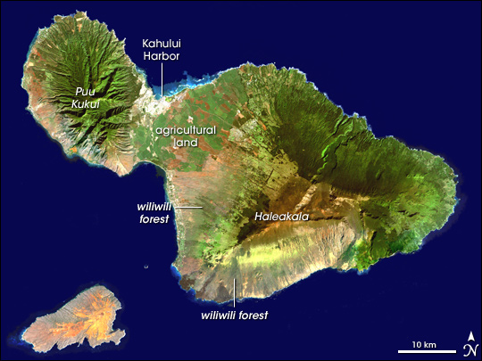
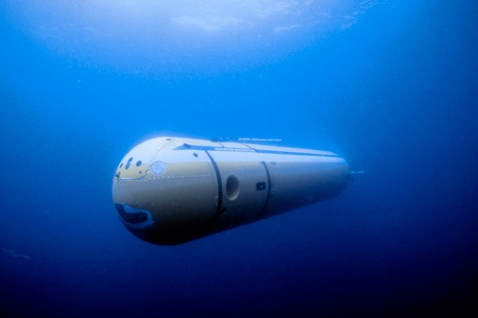
The Bible & Oceanography
Job 38:16 - Springs of the Sea
The Recesses of the Deep
Notes:
1. The Bible & Oceanography
"Have you entered the springs of the sea? Or have you walked in search of the depths? (Job 38:16)
>>>>>>>>>>>>>>>>>>>>>>
2. Scientists discover fresh water beneath ocean floor July/15/2010, 07:37:35 AM
3. (VietNamNet Bridge)-Scientists from the Division for Water Resources Planning for southern Viet Nam have discovered an underwater source of fresh water.
4. The fresh water was discovered at a depth ranging from 48-106 metres, 3kilometres off the coast of Bac Lieu.

Slide 54
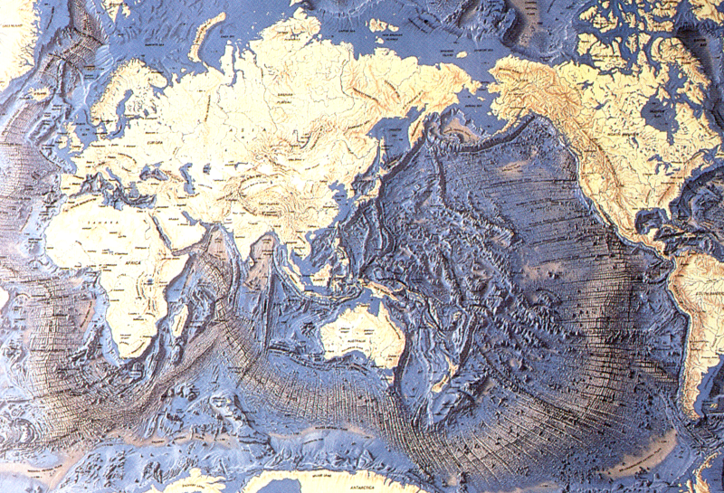
35,800’ trench, 1972
East off the Marianas is the famous Mariana Trench. This trench has a deepest recorded point of 11,035 meters. It is called the Challenger Deep. Many times, people have marked a 'largest seadepth' in the Mariana Trench. The Challenger Expedition (The Challenger was a British navy vessel on a 3-year ocean research expedition; 1872-75) found a depth of 8,183 meter in 1875. After them, the Nero-depth followed, which was recorded at 9,640 meter. The Challenger II recorded 10,870 meters and 10,899 meters in 1951. Finally in 1959, the Russian vessel Vitjaz marked a depth of 11,035 meters. With 11,524 meters, the record seadepth is located in the Philippine trench. It was discovered in 1972. No person has ever reached the deepest point on the ocean bed, or rather the deepest pont n earth yet.
Merrill Earth Science 1993 p. 313
Notes:
1. East off the Marianas is the famous Mariana Trench.
2. This trench has a deepest recorded point of 11,035 meters (36,070 ft.)….
3. With 11,524 meters, the record sea depth is located in the Philippine trench.
4. It was discovered in 1972.
5. No person has ever reached the deepest point on the ocean bed, or rather the deepest point on earth yet.

Slide 55
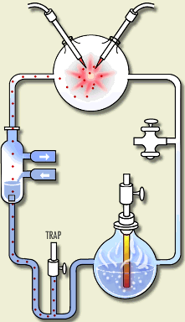
The Bible & Biology
Acts 17:25 - God is described as the “giver of life.” Try as we will, man has yet to create life.
The Products of the Miller Experiment
Tar 85%
Carboxylic acids not important to life 13.0%
Glycine 1.05%
Alanine 0.85%
Glutamic acid trace
Aspartic acid trace
Valine trace
Notes:
Nor is He worshiped with men's hands, as though He needed anything, since He gives to all life, breath, and all things. (Acts 17:25)
>>>>>>>>>>>>>>>>>>>>>>>>>>>>>>>>>
The Products of the Miller Experiment
Tar 85%
Carboxylic acids not important to life 13.0%
Glycine 1.05%
Alanine 0.85%
Glutamic acid trace
Aspartic acid trace
Valine trace

Slide 56

We can know the Bible is inspired.
Notes:
1. We do not need the Book of Mormon to know the Bible is True
>>>>>>>>>>>>>>>>>>
2. We do not need the Koran to know the Bible is True
>>>>>>>>>>>>>>>>>>
3. We do not need William Shakespeare to know the Bible is True
>>>>>>>>>>>>>>>>>>
4. We need only the “Word of God”
>>>>>>>>>>>>>>>>>>
5. The Holy Bible.
6. It should be clear to even the scientist, that from the scientific point of view, we can know that the Bible is true and inspired.

Slide 57
Challenges To The Bible
How Do We
Know We Have
The Bible?
Notes:
1. There have always been, and always will be, challenges to the Bible.
2. As long as Satan and Man exist, there will be challenges to the “Word of God”

Slide 58
PROPHECY ABOUT THE CITY OF TYRE
In Ezekiel 26:1-21 the prophet foretold with miraculous precision 7 things about the fall of the city of Tyre.
King Nebuchadnezzar of Babylon would destroy the mainland portion of the city of Tyre (26:7-8).
1.
2.
“Other nations” would participate in the fulfillment of the prophecy (3).
The city would be flattened, like the top of a rock (4,14).
3.
4.
Tyre eventually would become a place for the spreading of fishing nets (5,14).
5.
Its stones and timbers would be laid in the sea (12).
6.
Other cities would tremble at the fall of Tyre (15-18).
7.
The city would never be rebuilt to its former glory (20-21).
Notes:
1. PROPHECY ABOUT THE CITY OF TYRE
2. In Ezekiel 26:1-21 the prophet foretold with miraculous precision 7 things about the fall of the city of Tyre.
>>>>>>>>>>>>>>>>>>>>
3. King Nebuchadnezzar of Babylon would destroy the mainland portion of the city of Tyre (26:7-8).
>>>>>>>>>>>>>>>>>>>>
4. “Other nations” would participate in the fulfillment of the prophecy (3).
>>>>>>>>>>>>>>>>>>>>
5. The city would be flattened, like the top of a rock (4,14).
>>>>>>>>>>>>>>>>>>>>
6. Tyre eventually would become a place for the spreading of fishing nets (5,14).
>>>>>>>>>>>>>>>>>>>>
7. Its stones and timbers would be laid in the sea (12).
>>>>>>>>>>>>>>>>>>>>
8. Other cities would tremble at the fall of Tyre (15-18).
>>>>>>>>>>>>>>>>>>>>
9. The city would never be rebuilt to its former glory (20-21).

Slide 59
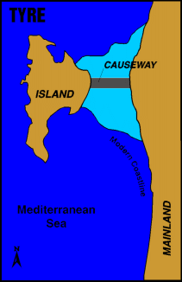
PROPHECY ABOUT THE CITY OF TYRE
King Nebuchadnezzar of Babylon would destroy the mainland portion of the city of Tyre.
1.
Tyre was a coastal city that had a somewhat unusual arrangement. In addition to the inland city, there was an island city roughly 3/4’s of a mile offshore. In 586 B.C., Nebuchadnezzar’s army besieged the city on the mainland, but when the king finally was able to take the city in about 573 B.C., his victory was hollow. He did not know that the inhabitants had left the city and moved to the island—a situation that remained virtually unchanged for the next 241 years.
Notes:
1. PROPHECY ABOUT THE CITY OF TYRE
2. King Nebuchadnezzar of Babylon would destroy the mainland portion of the city of Tyre. ( Ezekiel 26:7-8)
3. Tyre was a coastal city that had a somewhat unusual arrangement.
4. In addition to the inland city, there was an island city roughly 3/4’s of a mile offshore.
5. In 586 B.C., Nebuchadnezzar’s army besieged the city on the mainland, but when the king finally was able to take the city in about 573 B.C., his victory was hollow.
6. He did not know that the inhabitants had left the city and moved to the island—a situation that remained virtually unchanged for the next 241 years.

Slide 60
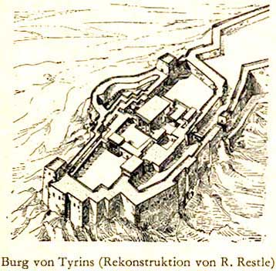
Nebuchadnezzar II laid siege to Tyre for a period of 13 years, beginning in 585-586 B.C. However, during this time, the inhabitants transferred most of their valuables to the island city. The king seized Tyre’s mainland territories, but returned to Babylon, finding himself unable to militarily subdue the island fortress (cf. 29:18). Tyre, weakened by the longstanding conflict, soon recognized Babylonian authority, which effectively put an end to the city’s autonomy and any aspirations for a greater Phoenicia.
FULFILLMENT OF THE 1ST PROPHECY
Notes:
1. FULFILLMENT OF THE 1ST PROPHECY
2. Nebuchadnezzar II laid siege to Tyre for a period of 13 years, beginning in 585-586 B.C.
3. However, during this time, the inhabitants transferred most of their valuables to the island city.
4. The king seized Tyre’s mainland territories, but returned to Babylon, finding himself unable to militarily subdue the island fortress (cf. 29:18).
5. Tyre, weakened by the longstanding conflict, soon recognized Babylonian authority, which effectively put an end to the city’s autonomy and any aspirations for a greater Phoenicia.

Slide 61
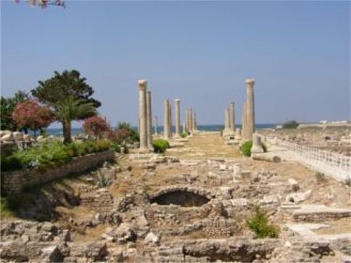
FULFILLMENT OF THE 2nd PROPHECY
2. Other nations would participate in the fulfillment of the prophecy (vs. 3).
Following the Babylonian period, Tyre remained in subjection to Persia from 538-332 B.C. Alexander the Great besieged and captured the port in 332 B.C., and ultimately, Ptolemies, Seleucids, Romans, and Muslim Arabs all had their turn at rule. After passing briefly into the hands of the Crusaders, the city was completely destroyed by a group known as the Mamluks (former Muslim soldier-slaves) in A.D. 1291.
Notes:
1. PROPHECY ABOUT THE CITY OF TYRE
2. FULFILLMENT OF THE 2nd PROPHECY
3. Following the Babylonian period, Tyre remained in subjection to Persia from 538-332 B.C.
4. Alexander the Great besieged and captured the port in 332 B.C., and ultimately, Ptolemies, Seleucids, Romans, and Muslim Arabs all had their turn at rule.
5. After passing briefly into the hands of the Crusaders, the city was completely destroyed by a group known as the Mamluks (former Muslim soldier-slaves) in A.D. 1291.
6. 586 bc to 332bc = 254 years the city withstood occupation and a total of 1877 years before it’s destruction in 1291 AD.

Slide 62
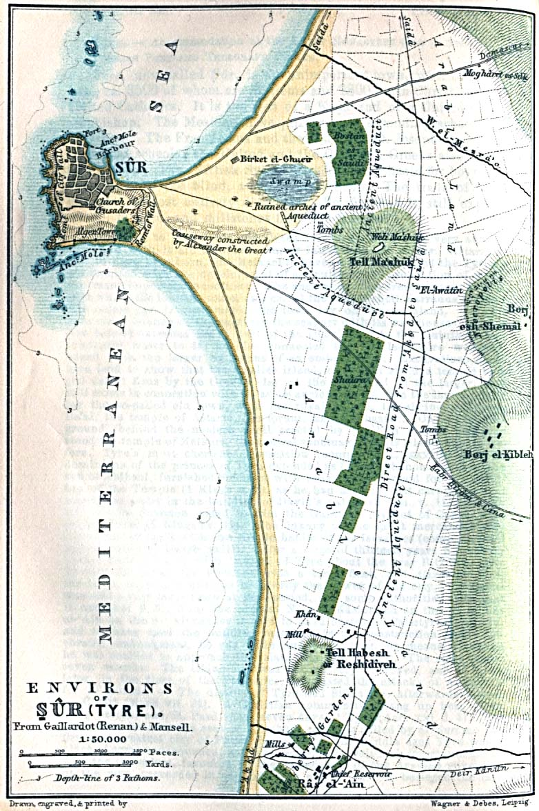
PROPHECY ABOUT THE CITY OF TYRE
3. The city was to be flattened, like the top of a rock (vss. 4,14).
FULFILLMENT OF THE 3rd PROPHECY
Like Nebuchadnezzar before him, Alexander was stymied by Tyre’s natural moat. The brilliant general was not so quick to give up, however. He used the building materials of the mainland city to build a causeway to the island, which allowed his troops to enter and conquer the city. His complete conquest of Tyre took only seven months.
Notes:
1. PROPHECY ABOUT THE CITY OF TYRE
2. The city was to be flattened, like the top of a rock (vss. 4,14).
3. FULFILLMENT OF THE 3rd PROPHECY
4. Like Nebuchadnezzar before him, Alexander was stymied by Tyre’s natural moat.
5. The brilliant general was not so quick to give up, however.
6. He used the building materials of the mainland city to build a causeway to the island, which allowed his troops to enter and conquer the city.
7. His complete conquest of Tyre took only seven months.

Slide 63
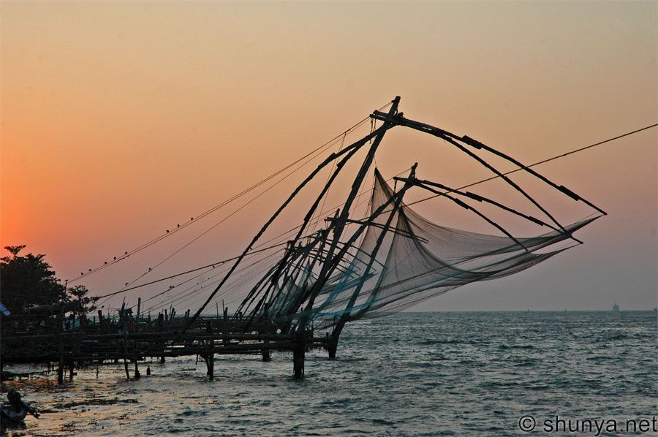
PROPHECY ABOUT THE CITY OF TYRE
4. It would become a spot for the spreading of nets (vss. 5,14).
FULFILLMENT OF THE 4th PROPHECY
The waters around Tyre were renowned in ancient times for their excellent fishing prospects. And after its complete decimation by Alexander, this was the only claim to fame the city had left. Modern-day travelers who visit the site of ancient Tyre will find only a small colony of people existing there. What do those people do for a living? They fish with nets.
Notes:
1. PROPHECY ABOUT THE CITY OF TYRE
I will make you like the top of a rock; you shall be a place for spreading nets, and you shall never be rebuilt, for I the LORD have spoken,' says the Lord GOD. (Ezekiel 26:14)
2 It would become a spot for the spreading of nets (vss. 5,14).
3. Where Tyre use to be is now a fishing ground.

Slide 64
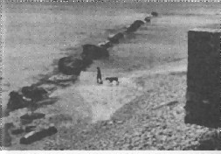
PROPHECY ABOUT THE CITY OF TYRE
5. Its stones and timbers were to be laid in the sea (vs. 12).
FULFILLMENT OF THE 5th PROPHECY
As noted earlier, the building of the causeway came from the remains of the mainland city. Sands carried by currents have built up a spit (or “tombolo”) around the causeway, producing a permanent connection between the island and the mainland.
Notes:
1. PROPHECY ABOUT THE CITY OF TYRE
2. Its stones and timbers were to be laid in the sea (vs. 12).
3. FULFILLMENT OF THE 5th PROPHECY
4. As noted earlier, the building of the causeway came from the remains of the mainland city.
5. Sands carried by currents have built up a spit (or “tombolo”) around the causeway, producing a permanent connection between the island and the mainland.

Slide 65
PROPHECY ABOUT THE CITY OF TYRE
6. Other cities were to fear greatly at the fall of Tyre (vss. 15-18).
FULFILLMENT OF THE 6th PROPHECY
History records that a number of fortified cities in the area around Tyre capitulated to Alexander after they saw the relative ease with which he captured the island city.
Notes:
1. PROPHECY ABOUT THE CITY OF TYRE
2. Other cities were to fear greatly at the fall of Tyre (vss. 15-18).
3. FULFILLMENT OF THE 6th PROPHECY
4. History records that a number of fortified cities in the area around Tyre capitulated to Alexander after they saw the relative ease with which he captured the island city.

Slide 66
PROPHECY ABOUT THE CITY OF TYRE
7. The city would not be rebuilt nor inhabited (vss. 20-21).
FULFILLMENT OF THE 7th PROPHECY
Alexander sold practically all of Tyre’s inhabitants into slavery, and the city forever lost its importance on the world stage. It now remains underwater. Although a new Tyre has been built, the original city has not been rebuilt or inhabited.
Notes:
1. PROPHECY ABOUT THE CITY OF TYRE
2. The city would not be rebuilt nor inhabited (vss. 20-21)
3. FULFILLMENT OF THE 7th PROPHECY
4. Alexander sold practically all of Tyre’s inhabitants into slavery, and the city forever lost its importance on the world stage.
5. It now remains underwater.
6. Although a new Tyre has been built, the original city has not been rebuilt or inhabited.

Slide 67
Challenges To The Bible
Has God’s Word
Been Lost
In Transmission?
Notes:
1. Has God’s Word Been Lost In Transmission?

Slide 68
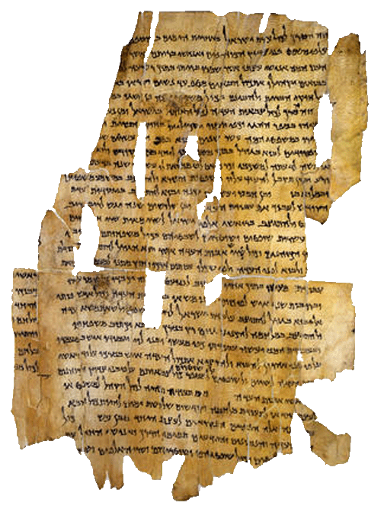
Our Bible is old, but it is not the oldest book in the world.
Notes:
1. Our Bible is old, but it is not the oldest book in the world.

Slide 69
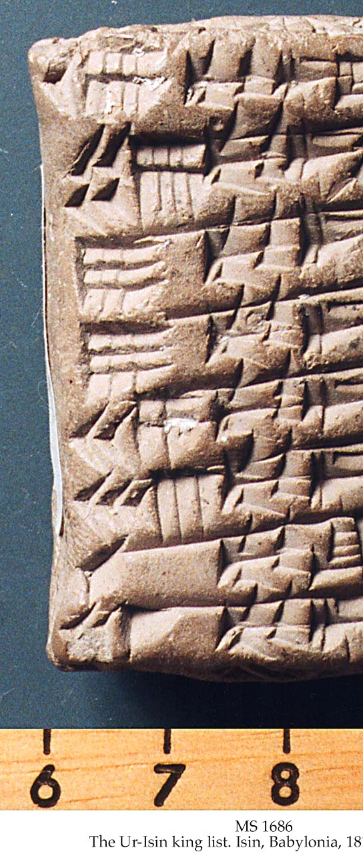
Writing was well-established long before the beginning of the Hebrew nation.
In fact, inscriptions found in ancient Babylon date back to as early as 3750 BC.
The importance of this should not be overlooked. Skeptics like to claim writing was not around when Moses lived in 1500 B.C.

Slide 70
Ancient people used many kinds of material for writing purposes—the Bible actually makes mention of a number of these materials:
Stone
Clay
Leather
Papyrus
Vellum or Parchment

Slide 71
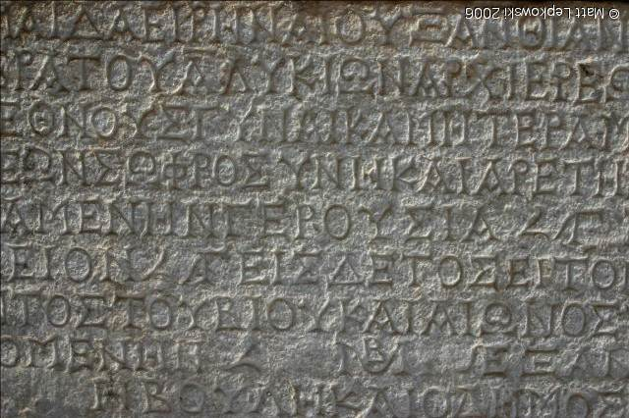
This is the substance upon which the earliest writing in the Bible is found.
Biblical examples of writing on stone can be found in Exodus 31:18; 34:1,28; Deuteronomy 27:2-3; Josh. 8:30-32.
Greek writing in stone
Notes:
And it shall be, on the day when you cross over the Jordan to the land which the LORD your God is giving you, that you shall set up for yourselves large stones, and whitewash them with lime. You shall write on them all the words of this law, when you have crossed over, that you may enter the land which the LORD your God is giving you, 'a land flowing with milk and honey,' just as the LORD God of your fathers promised you.
(Deuteronomy 27:2-3)

Slide 72



Clay was the predominate material for writing in Assyria and Babylonia
This type of preservation of writing is what is referred to in Ezekiel 4:1:
“You also, son of man, take a clay tablet and lay it before you, and portray on it a city, Jerusalem.”

Slide 73


Leather: Though it is not mentioned specifically in the Bible, it was undoubtedly the material used for writing by the Hebrews.
A scribe’s knife, used for the purpose of erasures, is mentioned in Jer. 36:23
The Jewish Talmud, a code of traditional laws, explicitly called for the Scriptures to be copied on animal skins.
Notes:
And it happened, when Jehudi had read three or four columns, that the king cut it with the scribe's knife and cast it into the fire that was on the hearth, until all the scroll was consumed in the fire that was on the hearth. (Jeremiah 36:23) (King Jehoakim)
We know of others who have used tearing or cutting of scriptures from the Bible because they did not agree with them.

Slide 74


Papyrus was the most widely used material for writing in the Grecian/Roman culture, though the Egyptians used it as far back as 2,500 B.C.
Part of the New Testament on papyrus:
Acts: 8:40-9:14; 9:16–27
Dated 9th Century A.D.
(from the Schoyen Collection)

Slide 75


Vellum or Parchment came into prominence as a writing material due to the desire to build a world-wide library.
No doubt, this was the material Paul requested Timothy to bring him in 2 Timothy 4:13.
This material—made from the skins of animals, but not “tanned” into leather—became the material upon which copies of the New Testament were made for about 1000 years.
Part of the Psalms
Notes:
Bring the cloak that I left with Carpus at Troas when you come--and the books, especially the parchments. (2 Timothy 4:13)
Vellum VEL'LUM, n. [L. vello.] A finer kind of parchment or skin, rendered clear and white for writing.
Parchment P`ARCHMENT, [L. pergamena; purgo] The skin of a sheep or goat dressed or prepared and rendered fit for writing on. This is done by separating all the flesh and hair, rubbing the skin with pumice stone, and reducing its thickness with a sharp instrument. Vellum is made of the skins of abortive or very young calves.

Slide 76
Quick Summary…
The history of writing goes back hundreds of years before the days of Moses.
People wrote on almost all kinds of materials depending on their locale and situation in history.
For the O.T. the most important writing material was leather or skins, and sometimes on clay tablets.
When the N.T. was penned papyrus was generally used.

Slide 77







The Bible Surpasses—
Hindu Vedas
Quran of Islam
Buddhist Pitakas
Zoroastrian Avesta
Notes:
None of these come close to the truth contained in the Bible.

Slide 78
Can We Know We Have God’s Word?
We know how the original
New Testament documents
read because we have three
surviving classes of evidence
by which to reconstruct the
original New Testament.

Slide 79
Can We Know We Have God’s Word?
Original
New Testament Documents
Greek Manuscripts
Ancient Versions
Patristic Citations

Slide 80
Can We Know We Have God’s Word?
Original
New Testament Documents
Greek Manuscripts
Ancient Versions
Patristic Citations

Slide 81
Can We Know We Have God’s Word?
The current number of
Greek manuscript
copies containing all or
part of the New
Testament is 5,735.

Slide 82

Discovered by Constantine Tischendorf in 1859
at a monastery at the base of Mt. Sinai.
4th Century Uncial Parchment
Virtually complete Old and New Testaments
Located in the British Museum
Codex Sinaiticus
Notes:
Tis’ chen’ dorf’ {Un’ cial’ means text in large letters}

Slide 83

HOW DOES THE NT MEASURE UP
TO OTHER ANCIENT BOOKS?
Title of Book | Date it was Written | Earliest Manuscript | Number of Manuscripts
Homer’s Illiad | 700 B.C. | Unknown | 643
History of Herodotus | 425 B.C. | A.D. 900 | 8
Josephus’ Jewish Wars | A.D. 70 | A.D. 400 | 9
Histories of Tacitus | A.D. 100 | A.D. 900 | 2
New Testament | A.D. 50-100 | A.D. 125 | 5,735

Slide 84


P52—Fragment of John 18
A.D. 125
Papyrus Bodmer II (P66)
A.D. 150-200

Slide 85

Perhaps the earliest N.T. fragment.
Found at Qumran.
Written before
A.D. 68.
Notes:
Before the Apostle John died.

Slide 86

A papyrus fragment
from Egypt.
p⁵²
Contains Portions of
John 18:31-33,37-38
Dated from A.D. 80-130.
Located at John Rylands Library
Manchester, England

Slide 87

A portion of one of the most valuable papyri (p⁴⁶)—
a substantially complete collection of Paul’s letters— dated around A.D. 250.
The first
page of
Hebrews
Part of the Chester Beatty collection.
Located in Dublin and Ann Arbor.

Slide 88
Can We Know We Have God’s Word?
Original
New Testament Documents
Greek Manuscripts
Ancient Versions
Patristic Citations
Notes:
PATRIS'TIC - Pertaining to the ancient fathers of the christian church.

Slide 89
WRITINGS FROM EARLY
NON-INSPIRED PREACHERS WHO RECOGNIZED CHRIST AS DIETY
Clement of Rome (c. A.D. 30-100)
Ignatius (A.D. 70-110)
Polycarp (A.D. 70-156)
Justin Martyr (A.D. 100-165)
Irenaeus (A.D. 130-202)
Tertullian (A.D. 200),
Origen (A.D. 225),
Novatian (A.D. 235),
Cyprian (A.D. 250),
Methodius (A.D. 290),
Notes:
Yes, we can know that we have the word of God, complete and documented. Ready for our instruction and commitment. If you need to commit your life to Christ or study more we will help you in any way that we can.

