Slide 1
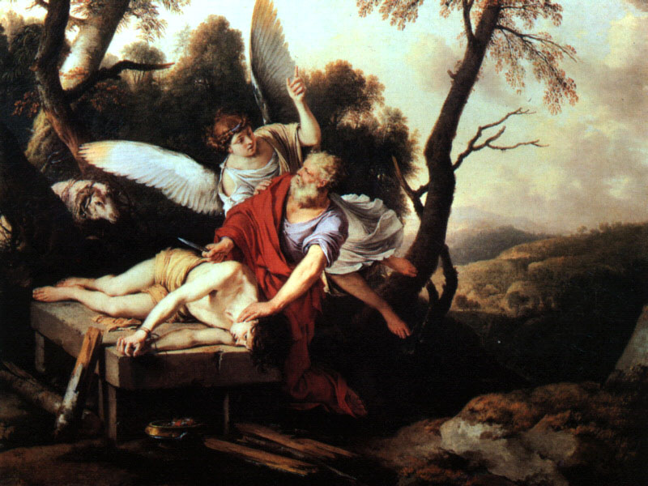
Isaac
The Shadow of Sacrifice
Ranger Church of Christ Mesquite and Rusk St.
Notes:
1. Isaac: The Shadow of Sacrifice
2. Many times you have heard “The Old Testament is the New Testament Concealed.”
3. In the Old Testament we have the ”Shadow of things to come!” in the New Testament.

Slide 2
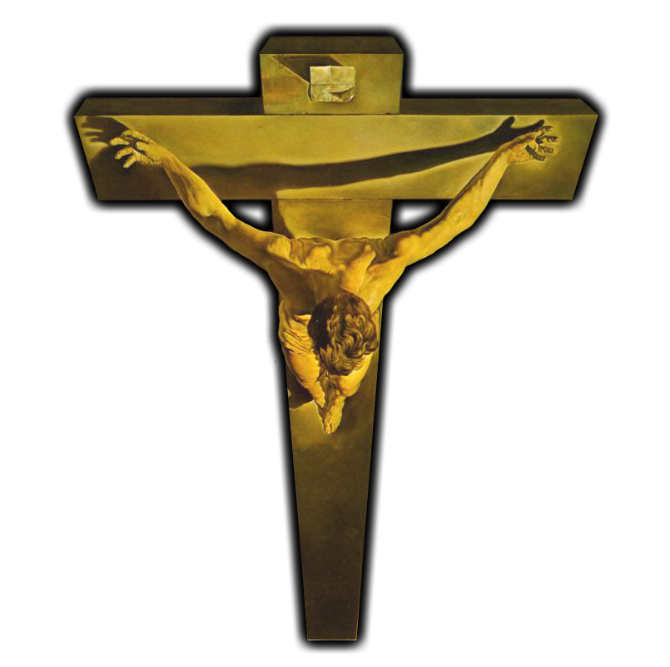
He who had received the promises offered up his only begotten son...
Notes:
1. Without question, these verses refer to the most astounding demonstration of true faith in God to be found in the entire history of faith.
By faith Abraham, when he was tested, offered up Isaac, and he who had received the promises offered up his only begotten son, (Hebrews 11:17)

Slide 3
concluding that God was able to raise him up, even from the dead
Hebrews 11:17-19
Notes:
of whom it was said, "IN ISAAC YOUR SEED SHALL BE CALLED," concluding that God was able to raise him up, even from the dead, from which he also received him in a figurative sense. (Hebrews 11:17-19)

Slide 4
Was not Abraham our father justified by works when he offered Isaac his son on the altar?
(James 2:21)
Notes:
Was not Abraham our father justified by works when he offered Isaac his son on the altar? (James 2:21)
1. He was not justified by works of the law, but by works of obedience, a requirement for everyone who desires to be saved.

Slide 5
Isaac
The Shadow of Sacrifice
Notes:
1. Abraham, being tried is a reference to the remarkable test of his faith recorded in Genesis 22:1.
Now it came to pass after these things that God tested Abraham, and said to him, "Abraham!" And he said, "Here I am." (Genesis 22:1)
2. It is said, in many versions of the Bible that God did “tempt” Abraham, but the word “tired” or “tested” is the true meaning in this verse.
3. Although the word rendered “tested or tried” here is rendered in the New Testament as “tempted” 57 times, such translations here would be erroneous.
4. Why? Because it does not mean here, as it often does, to place inducements before one to lead him to do wrong, but it does mean to subject his faith to a trial in order to test its genuineness.
Let no one say when he is tempted, "I am tempted by God"; for God cannot be tempted by evil, nor does He Himself tempt anyone. (James 1:13)

Slide 6
Obedient Faith
So Abraham arose early in the morning
Saddled his donkey
Gathered the young men
Split the wood
Arose and went to the place God told him
Notes:
So Abraham rose early in the morning and saddled his donkey, and took two of his young men with him, and Isaac his son; and he split the wood for the burnt offering, and arose and went to the place of which God had told him. (Genesis 22:3)
1. Here we see the work of Obedient Faith by Abraham
a. So Abraham arose early in the morning
b. Saddled his donkey
c. Gathered the young men
d. Split the wood
e. Arose and went to the place God told him to go.

Slide 7
Exact Faith
Specified what He wanted … A Burnt Offering
Specified whom He wanted … Isaac
Specified where He wanted it … Mount Moriah
Notes:
1. We see that this is an “Exact Faith”.
a. Specified what He wanted … A Burnt Offering
b. Specified whom He wanted … Isaac
c. Specified where He wanted it … Mount Moriah

Slide 8
Thus Noah did;
according to all that God commanded him, so he did
Genesis 6:22
Notes:
1. We are told that Noah was also a man of faith doing the works of obedience to God’s Commands.
>>>>>>>>>>>>>>>>>>>
Thus Noah did; according to all that God commanded him, so he did. (Genesis 6:22)

Slide 9
Thus Moses did;
according to all that the Lord commanded him, so he did.
Exodus 40:16
Notes:
1. Another prime example of doing the works of obedience is seen in Moses and his keeping of God’s commandments.
>>>>>>>>>>>>>>>>
Thus Moses did; according to all that the LORD had commanded him, so he did. (Exodus 40:16)

Slide 10
Unquestioning Faith
Only heathen nations offer human sacrifices.
But How will the promise be fulfilled?
Do you really mean it Lord?
Notes:
1. The Word of God demonstrated the Unquestioning Faith of Abraham.
>>>>>>>>>>>>>>
2. He did not question God about requiring a human sacrifice.
a. He knew that Only heathen nations offer human sacrifices.
>>>>>>>>>>>>>>
3. He did not question how will the promise be fulfilled?
a. God had promised that all nations would be blessed through Isaac.
b. Isaac is a young man of 33 years old and unmarried in the prime of his life.
c. He did not question how his dead son was going to have children and bless all the nations on earth.
4. He did not ask “Do you really mean it Lord?”
a. Abraham was obedient and made preparations to began the trip to Mt. Moriah.
b. He know it was a three day trip. Remember this 3 day trip.
c. From the time he started this trip, Abraham know his son was a dead man walking with him.

Slide 11
Unquestioning Faith
Can’t you tell someone else to do it?
What about Ishmael?
Can’t I be faithfully yours without doing just this one thing?
Lord this is too much!
Notes:
1. We can see his - Unquestioning Faith
2. Can’t you tell someone else to do it?, this is my only son by my true legitimate wife Sarah.
3. What about Ishmael? He is a stepson is he not, wont he do as a substitute?
4. Can’t I be faithfully yours - without doing just this one thing?
5. Lord this is too much! - Why must I keep all of your commandments?

Slide 12
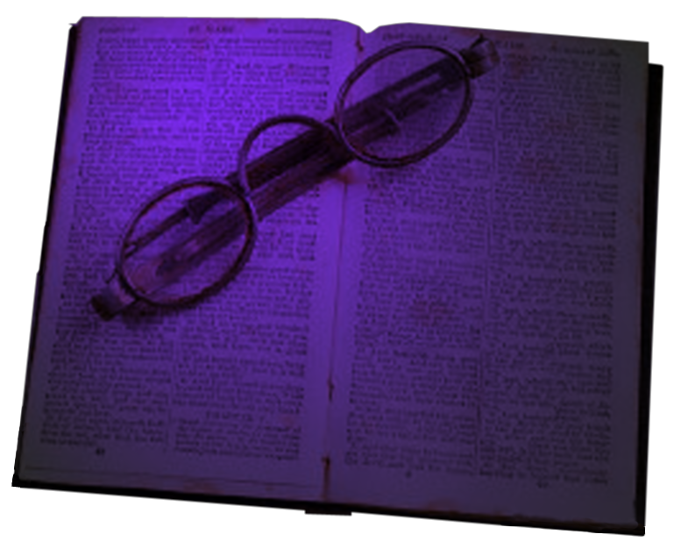
He did not waver at the promise of God through unbelief, but was strengthened in faith, giving glory to God, and being fully convinced that what He had promised He was also able to perform.
(Romans 4:20-21)
Notes:
He did not waver at the promise of God through unbelief, but was strengthened in faith, giving glory to God, and being fully convinced that what He had promised He was also able to perform. (Romans 4:20-21)
1. Why did Abraham not waiver?
2. God’s promise required the survival of Isaac in order to fulfill His promise, a fact that Abraham knew.
3. The astonishing fact is that Abraham seemed to be without a state of turmoil, it just isn’t there.
4. Abraham even promised his servants that both he and Isaac would return after they worshipped God.

Slide 13
"For My thoughts are not your thoughts, Nor are your ways My ways," says the LORD. "For as the heavens are higher than the earth, So are My ways higher than your ways, And My thoughts than your thoughts.
(Isaiah 55:8-9)
Notes:
"For My thoughts are not your thoughts, Nor are your ways My ways," says the LORD. "For as the heavens are higher than the earth, So are My ways higher than your ways, And My thoughts than your thoughts. (Isaiah 55:8-9)
1. The impression we get is that Abraham treated this as God’s problem, not his.
2. So when the command was given, Abraham set about in obedience to do his part of the promise, his duty was clear and commanded.
3. He knew he could safely trust God to discharge His responsibility in the matter of his son’s death.
4. It was, to be sure, Abraham’s faith in God’s power of resurrection that enabled him to reconcile the promise and the command to sacrifice Isaac.
And Abraham said to his young men, "Stay here with the donkey; the lad and I will go yonder and worship, and we will come back to you." (Genesis 22:5)

Slide 14
Sacrificial Faith
Job (Job 1)
Moses (Hebrews 11:24-27)
Daniel (Daniel 6:10-24)
Stephen (Acts 6:10-24; 7)
Notes:
1. Others have exhibited Sacrificial Faith
>>>>>>>>>>>>>>>>>
2. Job (Job 1)
And the LORD said to Satan, "Behold, all that he has is in your power; only do not lay a hand on his person." So Satan went out from the presence of the LORD. (Job 1:12)
>>>>>>>>>>>>>>>>>>
3. Moses (Hebrews 11:24-27)
By faith he forsook Egypt, not fearing the wrath of the king; for he endured as seeing Him who is invisible. (Hebrews 11:27)
>>>>>>>>>>>>>>>>>>
4. Daniel (Daniel 6:10-24)
Then these men assembled and found Daniel praying and making supplication before his God. (Daniel 6:11)
>>>>>>>>>>>>>>>>>>
5. Stephen (Acts 6:10-24; 7)
And they stoned Stephen as he was calling on God and saying, "Lord Jesus, receive my spirit." (Acts 7:59)

Slide 15
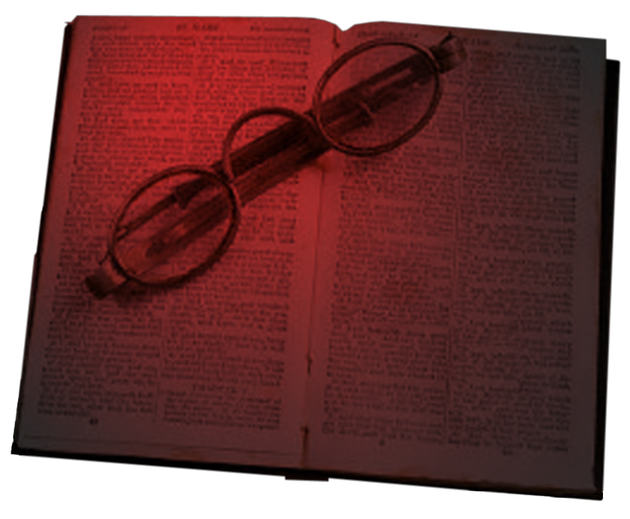
So likewise, whoever of you does not forsake all that he has cannot be My disciple.
(Luke 14:33)
Notes:
So likewise, whoever of you does not forsake all that he has cannot be My disciple. (Luke 14:33)
1. As men of faith, do we forsake all, and do we have full trust in God to fulfill all of the promises that He has made to us, as His children?

Slide 16
Isaac
The Shadow of Sacrifice
Notes:
1. Isaac The Shadow of Sacrifice
2. So, what or who is Isaac the shadow of in the New Teatament?

Slide 17
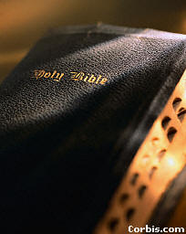
A Father
A Son
Preparation
A Mountain
A Binding
Notes:
1. Here we have A Father -Abraham
>>>>>>>>>>
2. and A Son - Isaac
>>>>>>>>>>
3. Preparations – Getting up, Saddling up, roundup of men, wood cutting and travel
>>>>>>>>>>
4. A Mountain – Mt Moriah was the destination.
>>>>>>>>>>
5. A Binding – binding for the sacrifice.

Slide 18
A Willing Participant
An Altar of Wood
A Substitute
God’s Provision
Notes:
1. A Willing Participant – Isaac did not resist
2. An Altar of Wood – Isaac carried the wood
3. A Substitute – Isaac was bound for the sacrifice
4. God’s Provision – A ram in the thicket

Slide 19
Another Father
Another Son
Another Preparation for Sacrifice
A Mountain
Notes:
Another Father – God himself
Another Son – Jesus Christ
Another Preparation for Sacrifice – Jewish trials
A Mountain – Mt Moriah

Slide 20
Another Binding
Another Willing Participant
Another altar of Wood
Another Substitute
God’s Provision
Notes:
Another Binding – nails to the cross
Another Willing Participant – The Son of God
Another altar of Wood – the Cross that Jesus carried
Another Substitute – Christ for our sins
God’s Provision – Forgiveness by the blood of His Son Jesus.

Slide 21
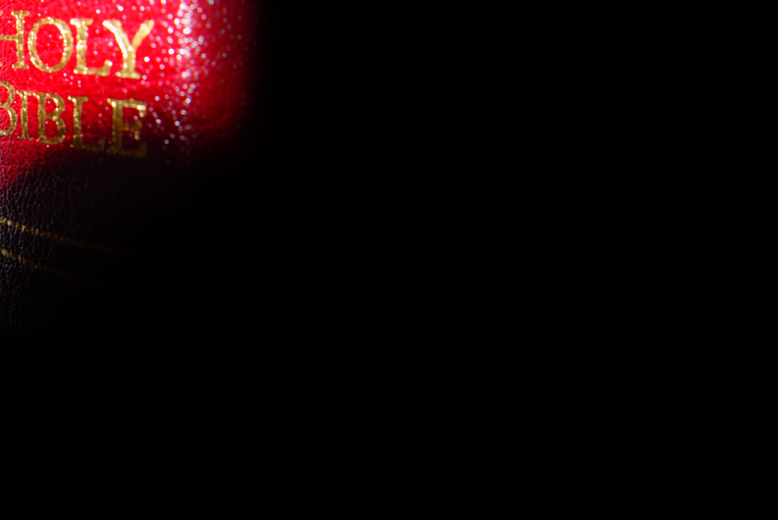
The Sacrifice of Isaac – Abraham’s love For God.
The Sacrifice of Jesus – God’s love for us.
Notes:
The Sacrifice of Isaac – Abraham’s love For God.
>>>>>>>>>>>>>>>>>>
The Sacrifice of Jesus – Shows us God’s love for us.
-------------------------------
Surely, it must have been of that very experience that Abraham received a vision of the day of Christ, as John wrote:
"Your father Abraham rejoiced to see my day; and he saw it and was glad" (John 8:56).
1. God provided in Isaac a type of our Lord, and it was inherently required in such a thing, that the type resemble as nearly as possible him who was the great Antitype, hence the necessity of Isaac's being offered.

Slide 22
1. The invitation never changes:
2. Your obedience, through your faith, is required.
3. In obedience you must be baptized for the remission of your sins.
Then Peter said to them, "Repent, and let every one of you be baptized in the name of Jesus Christ for the remission of sins; and you shall receive the gift of the Holy Spirit. (Acts 2:38)
Notes:
1. The invitation never changes
2. Your obedience, through your faith, is required.
3. In obedience you must be baptized for the remission of your sins
Then Peter said to them, "Repent, and let every one of you be baptized in the name of Jesus Christ for the remission of sins; and you shall receive the gift of the Holy Spirit. (Acts 2:38)
4. If you have not been added to the church by God, now is the time because you never know when He will require your soul.

